Slide 2
CHAPTER 12
MARKETING & MAINTENANCE DEVELOPING THE COMMUNITY
© 2022, 2024 Jeannie Novak All rights reserved.

Slide 3
CHAPTER OBJECTIVES
© 2022, 2024 Jeannie Novak All rights reserved.
After reading this chapter, you should be able to:
Describe the respective functions of the roles associated with marketing—such as advertising, promotion, public relations, and sales.
Explain the functions of game customer support and community management.
Point out the characteristics of player communities—and how they’re created and maintained.

Slide 4
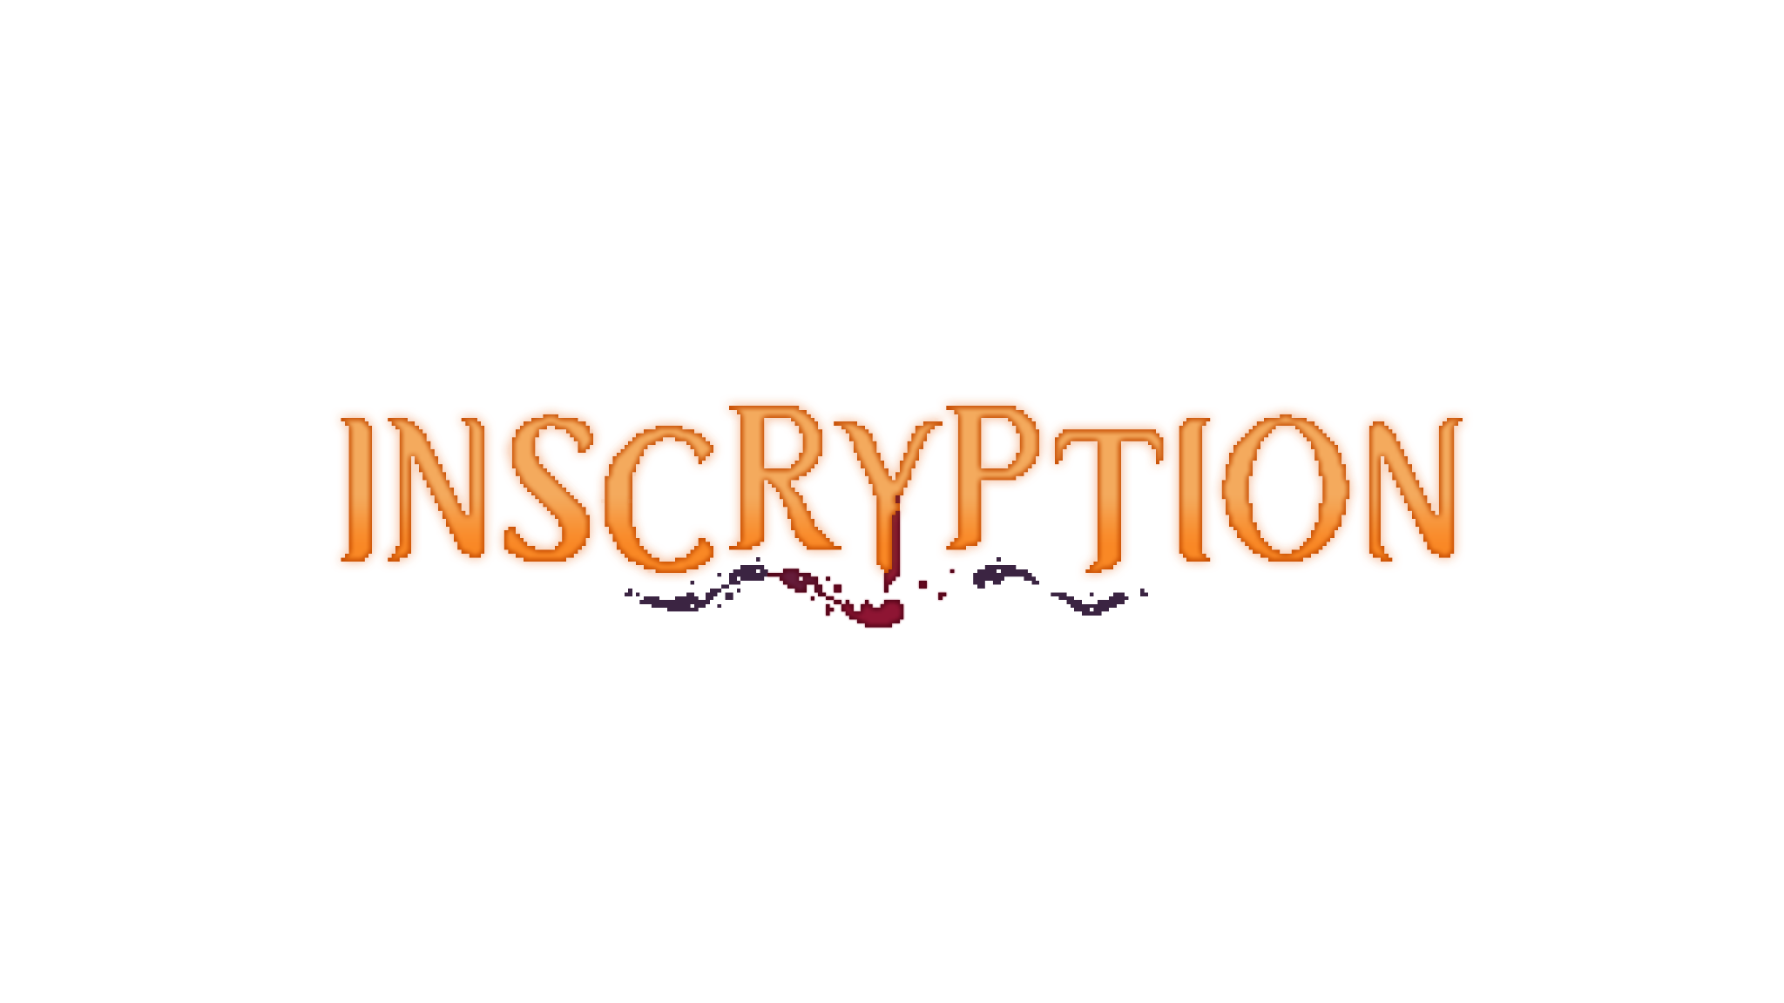
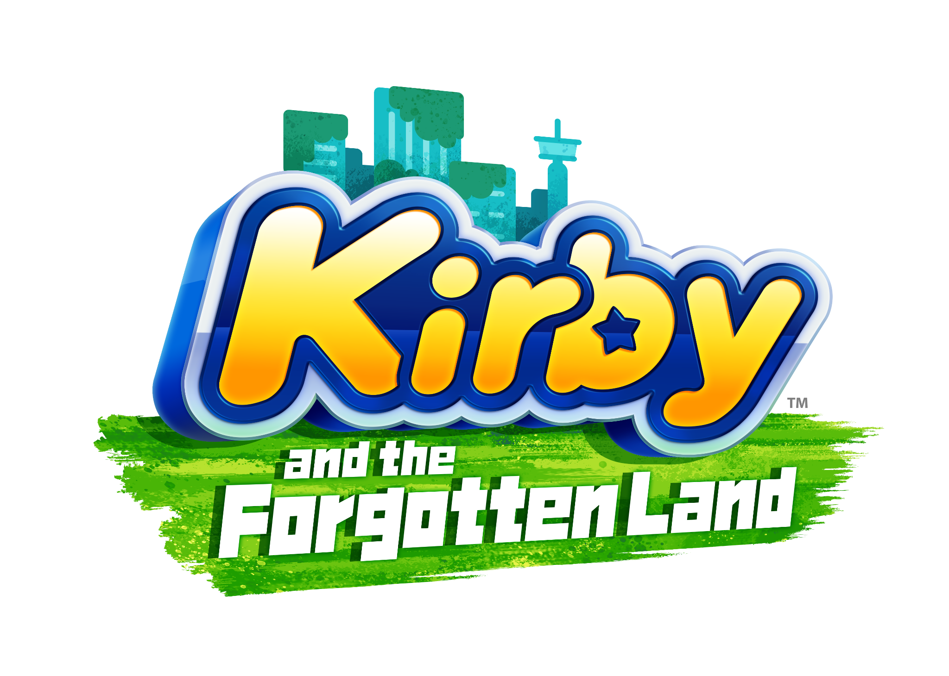
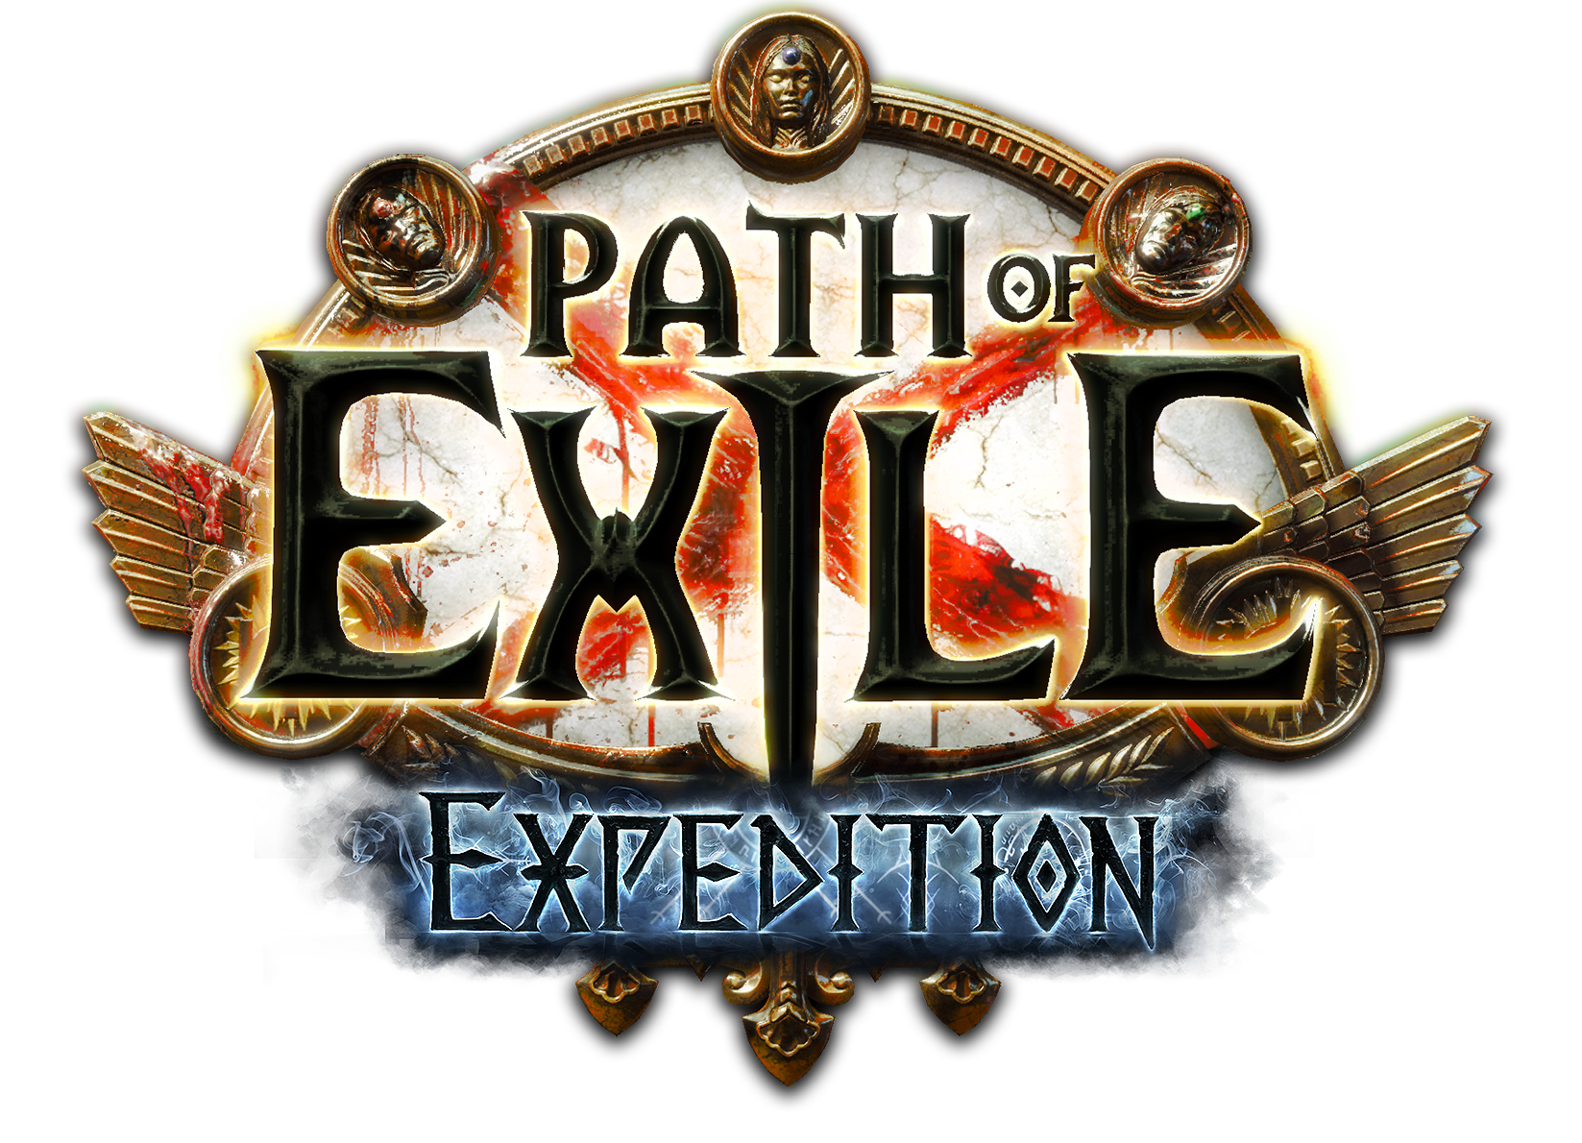
Marketing
Promotion
© 2022, 2024 Jeannie Novak All rights reserved.
Credit: Devolver Digital
Credit: Nintendo
Credit: Grinding Gear Games
Caption: A logo is essential for a game’s branding: Inscryption - left - Kirby and the Forgotten Land - middle - and Path of Exile: Expedition - right.

Slide 5
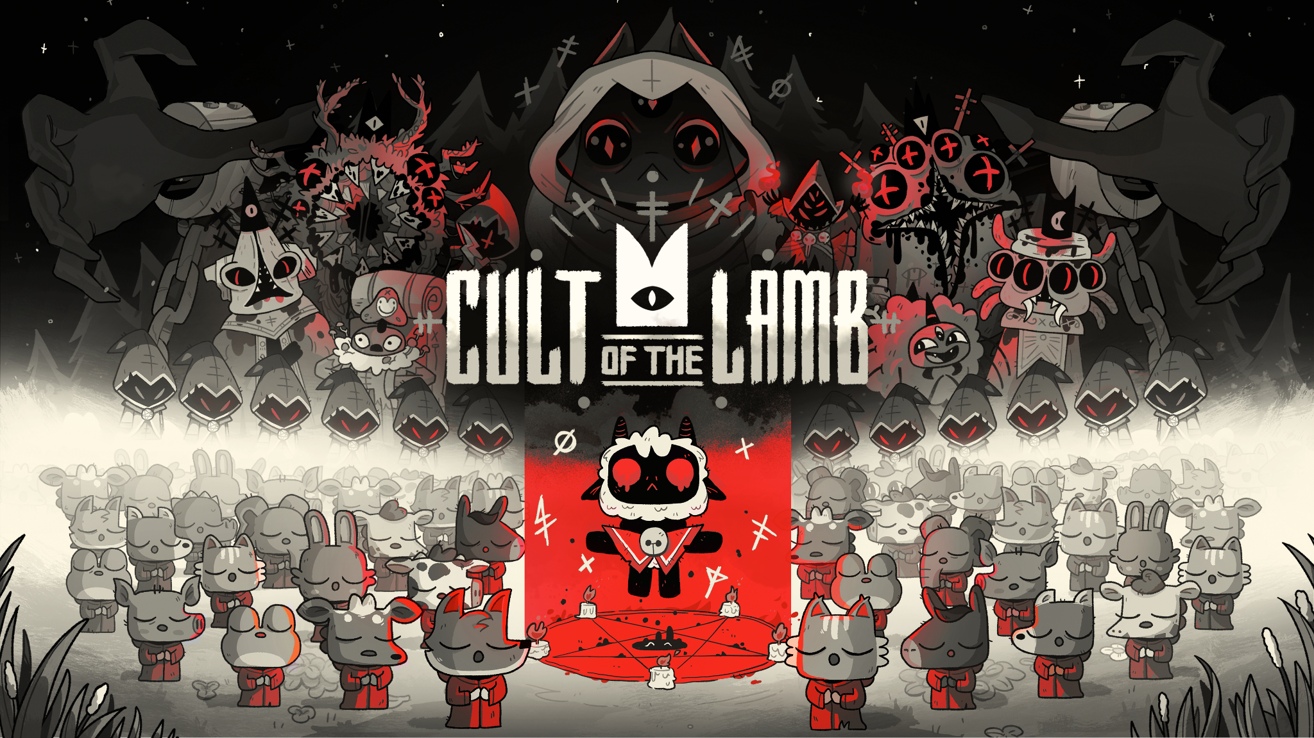
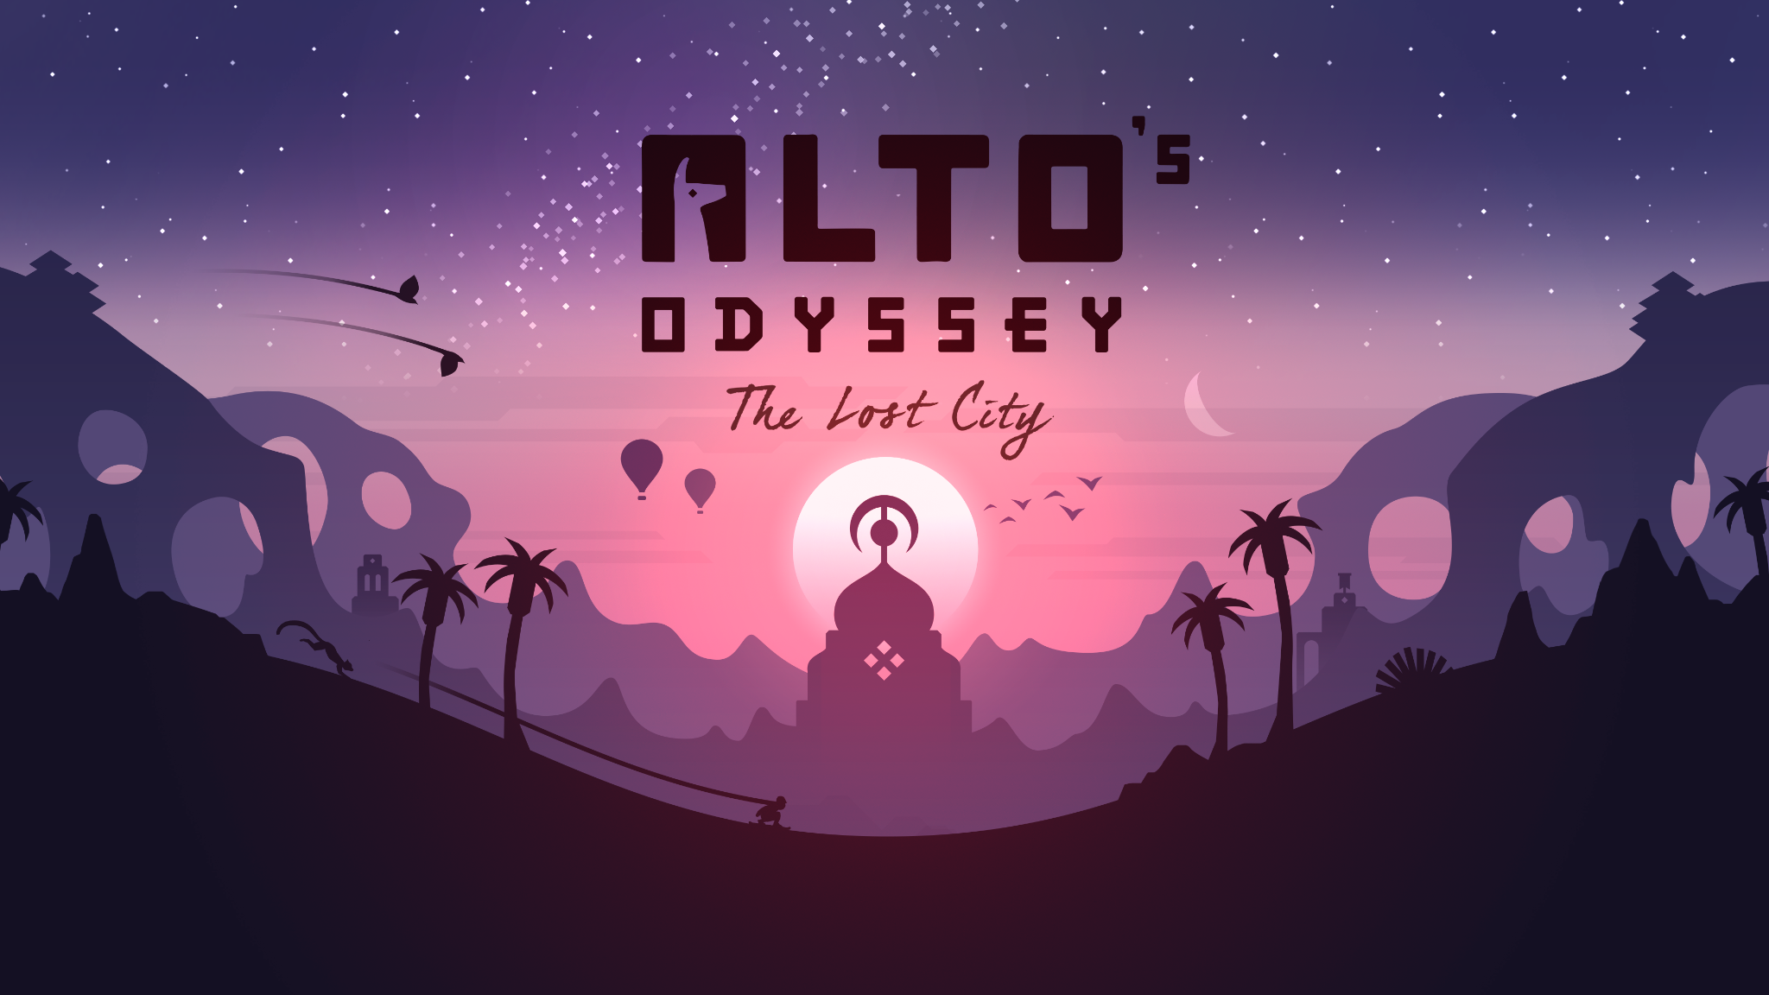
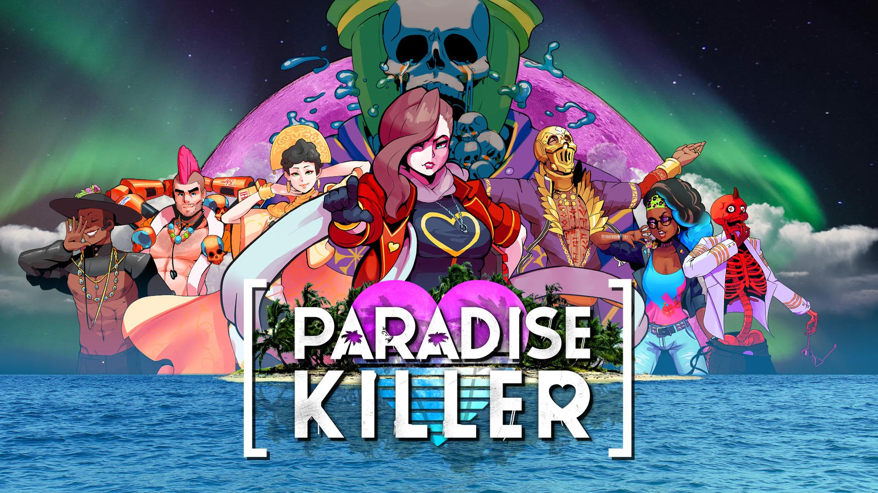
Marketing
Promotion
© 2022, 2024 Jeannie Novak All rights reserved.
Credit: Devolver Digital
Credit: Team Alto
Credit: Kaizen Game Works
Caption: Key art features a background against the logo that incorporates the game’s style: Cult of the Lamb - left - Alto’s Odyssey: The Lost City - middle - and Paradise Killer - right.

Slide 6
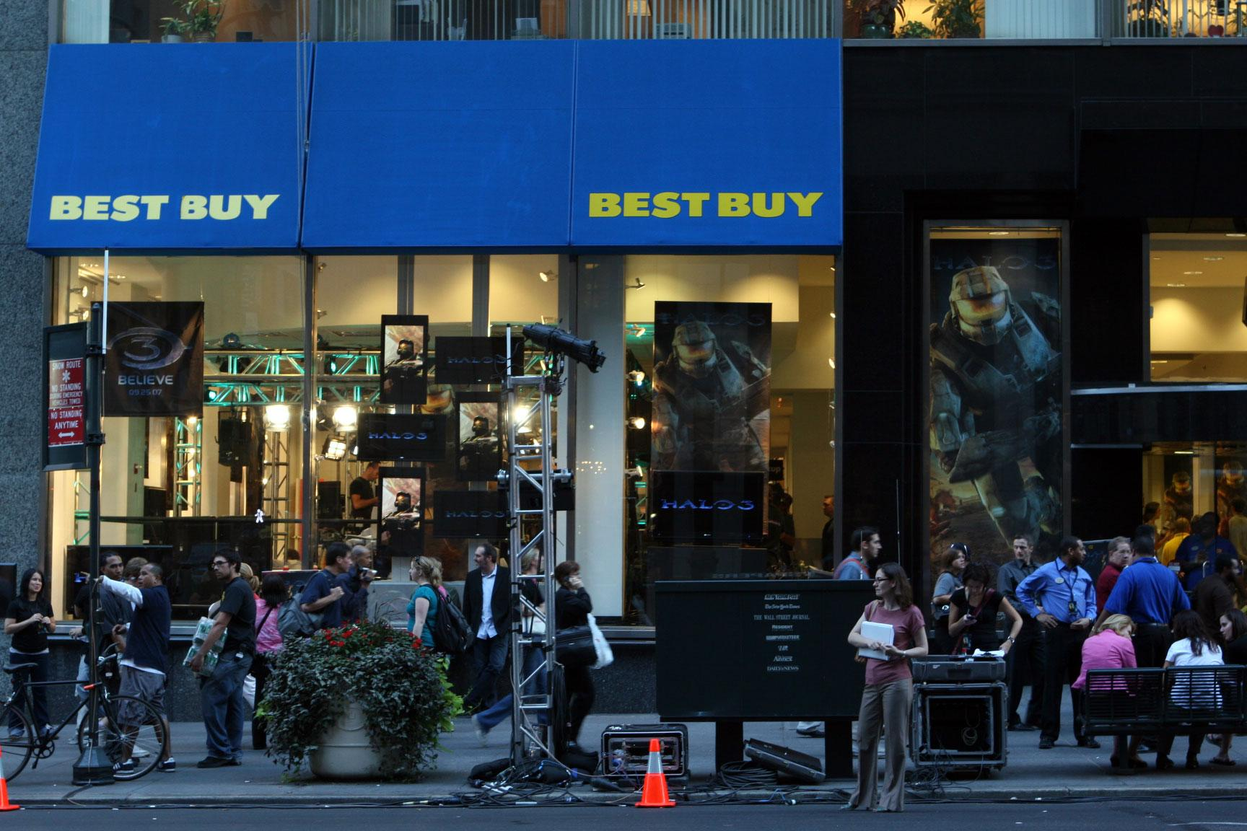
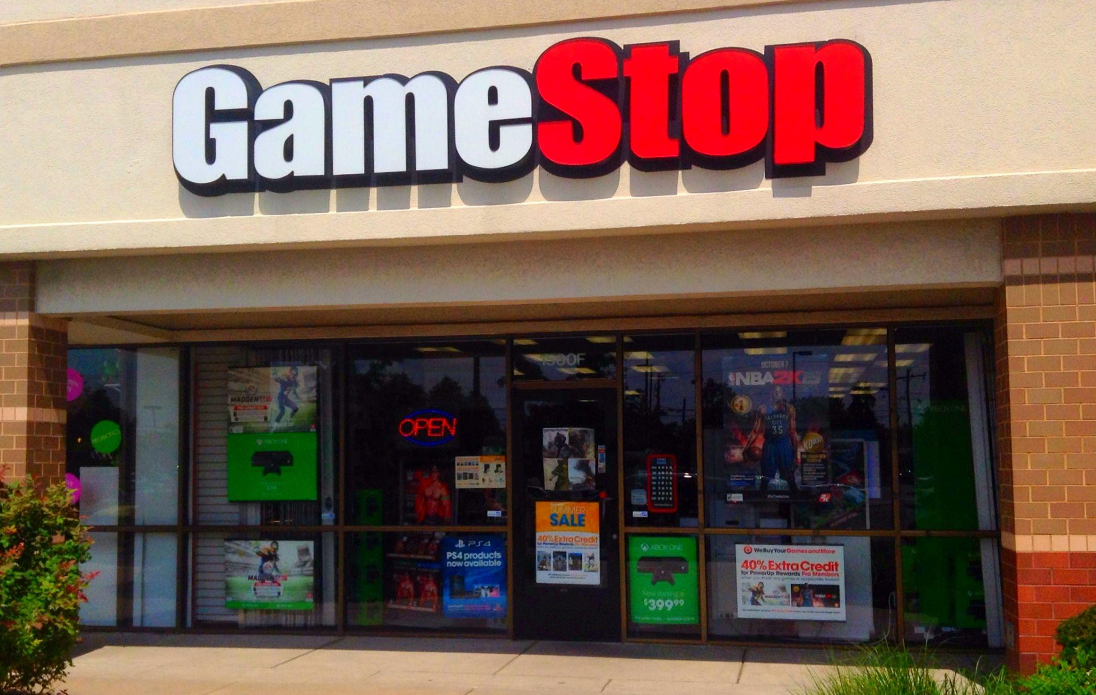
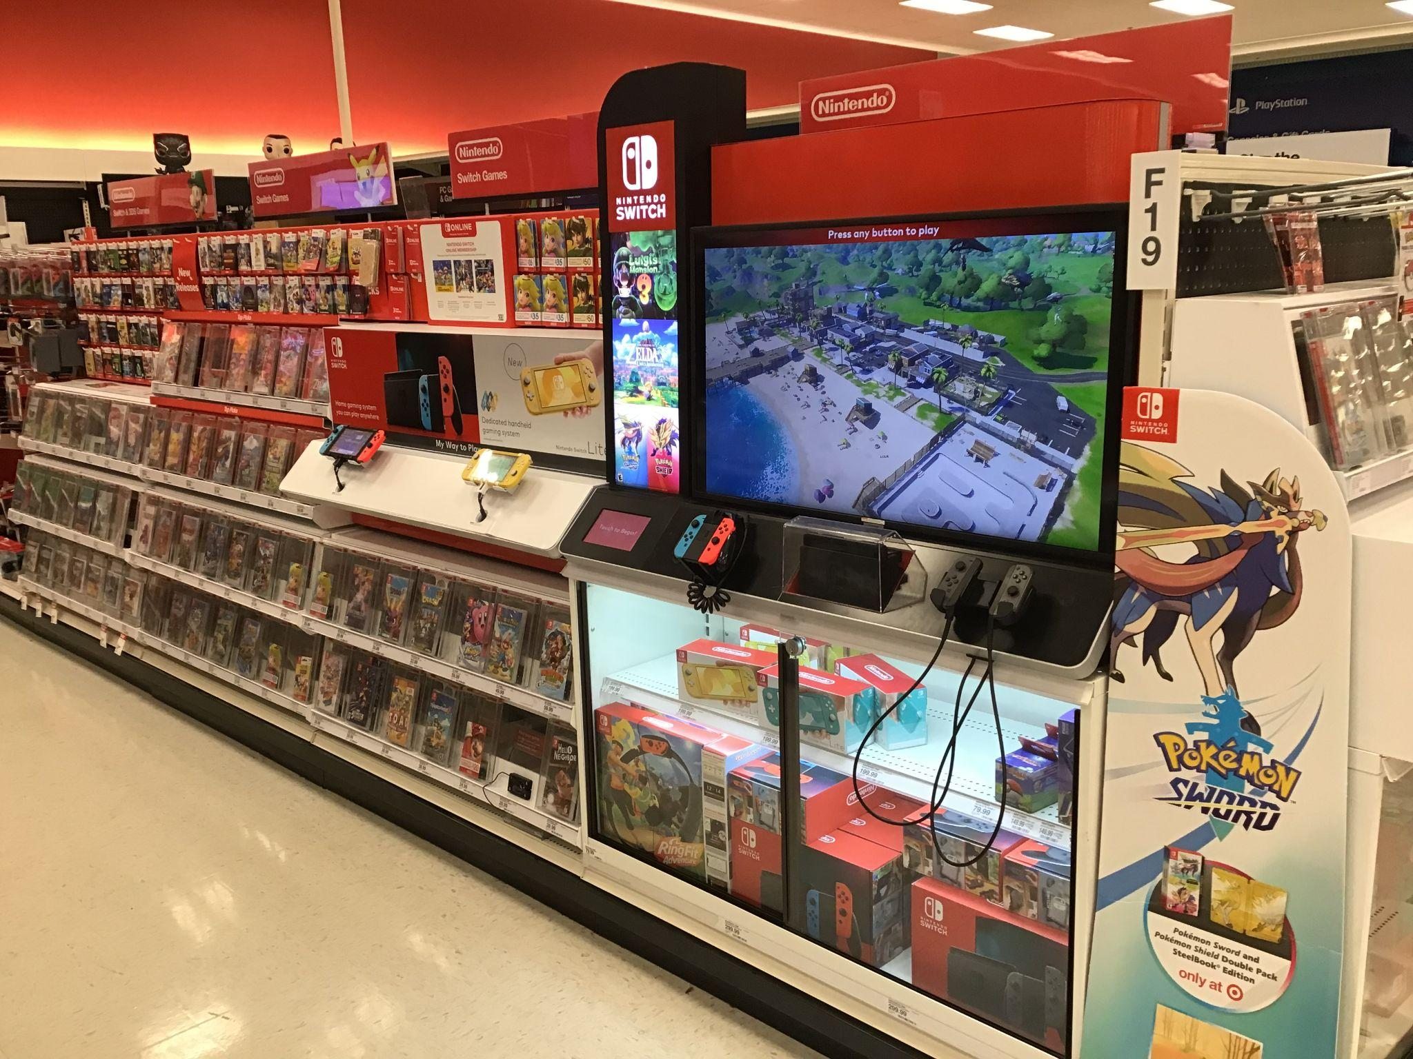
Marketing
Sales
© 2022, 2024 Jeannie Novak All rights reserved.
Credit: Gamerscore Blog (flickr)
Credit: Mike Mozart (flickr)
Credit: Mike Mozart (flickr)
Caption: Brick-and-mortar retailers such as Best Buy - left - GameStop - middle - and Target - right - make use of point-of-purchase (PoP) displays and posters to help sell physical product.

Slide 7
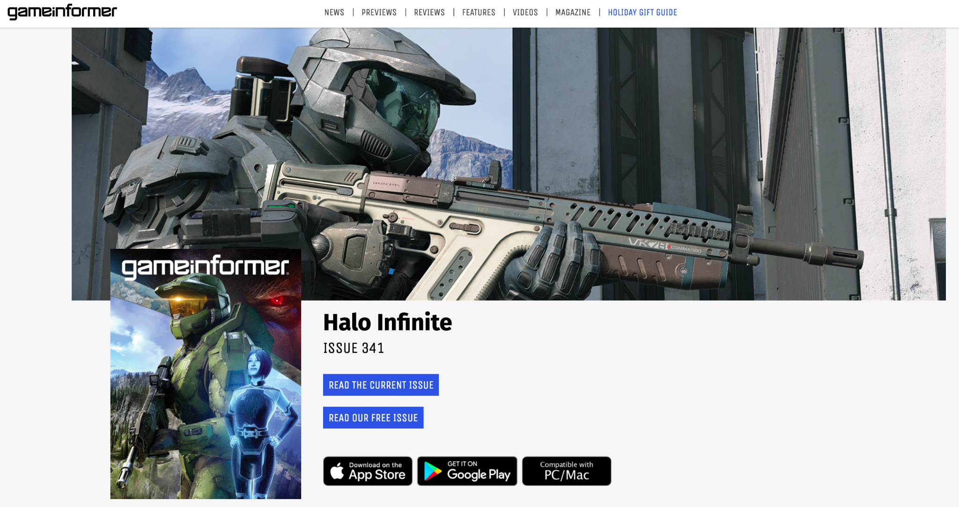
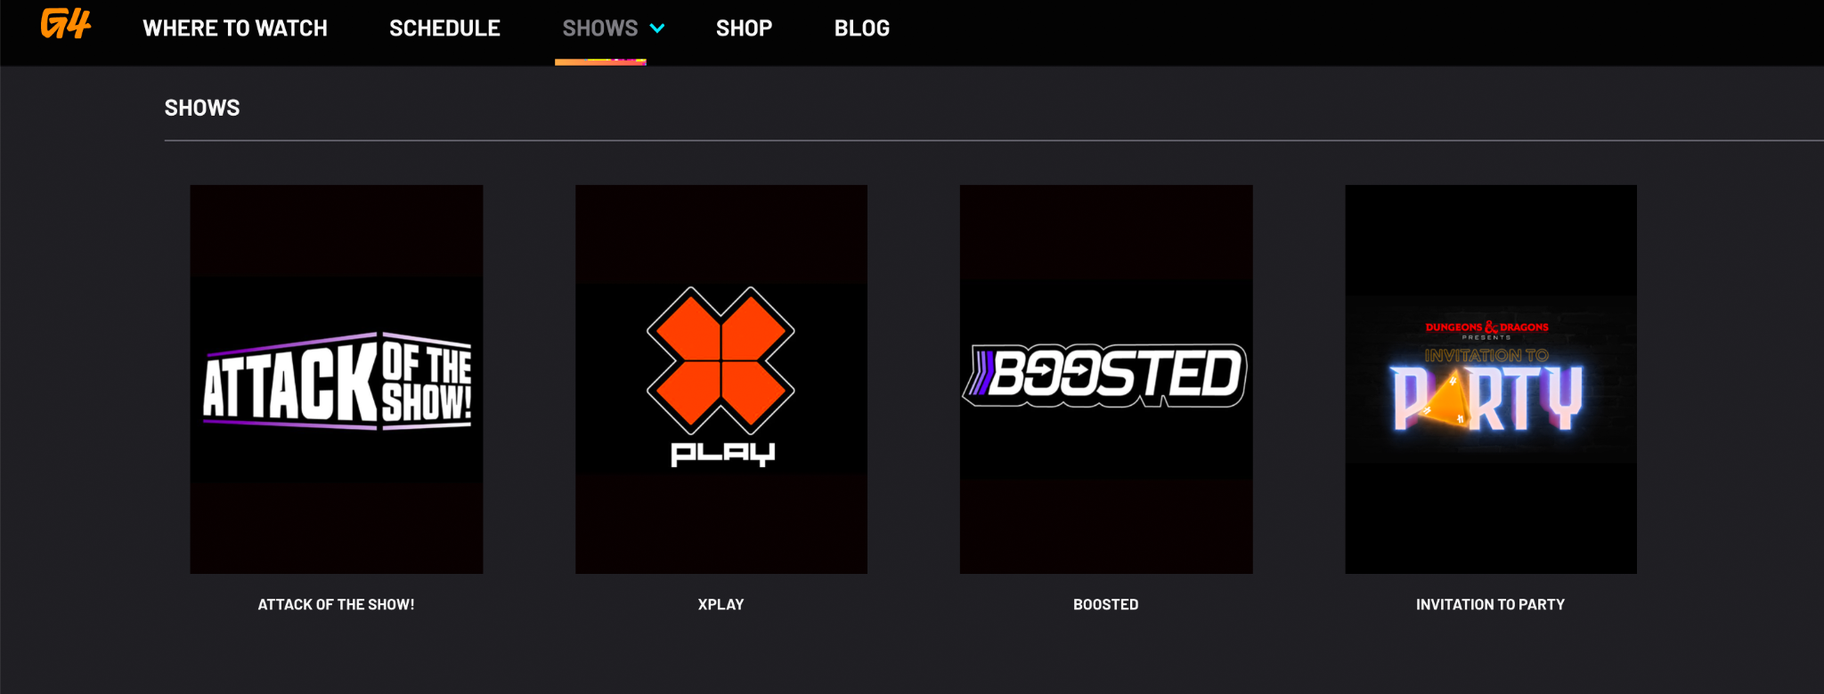
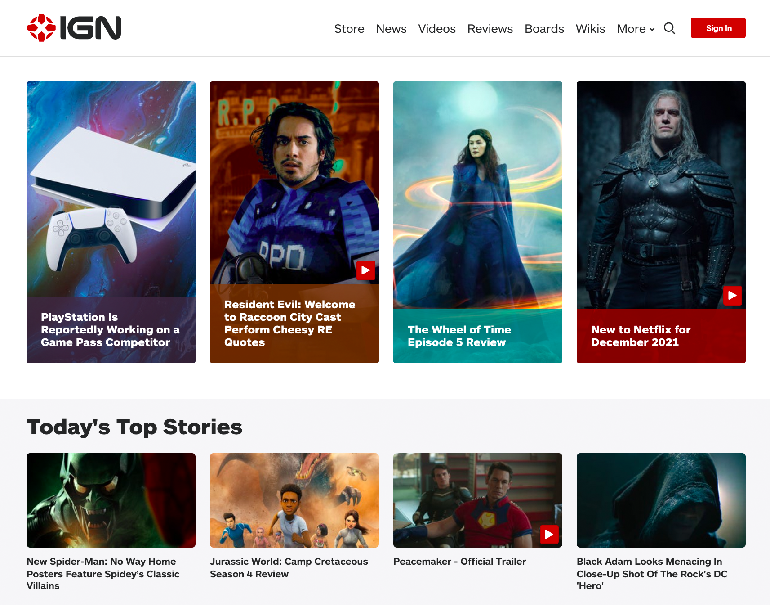
Marketing
Advertising
© 2022, 2024 Jeannie Novak All rights reserved.
Credit: JN
Credit: JN
Credit: JN
Caption: Examples of game-specific outlets include Game Informer - left - G4 - middle - and IGN - right.

Slide 8
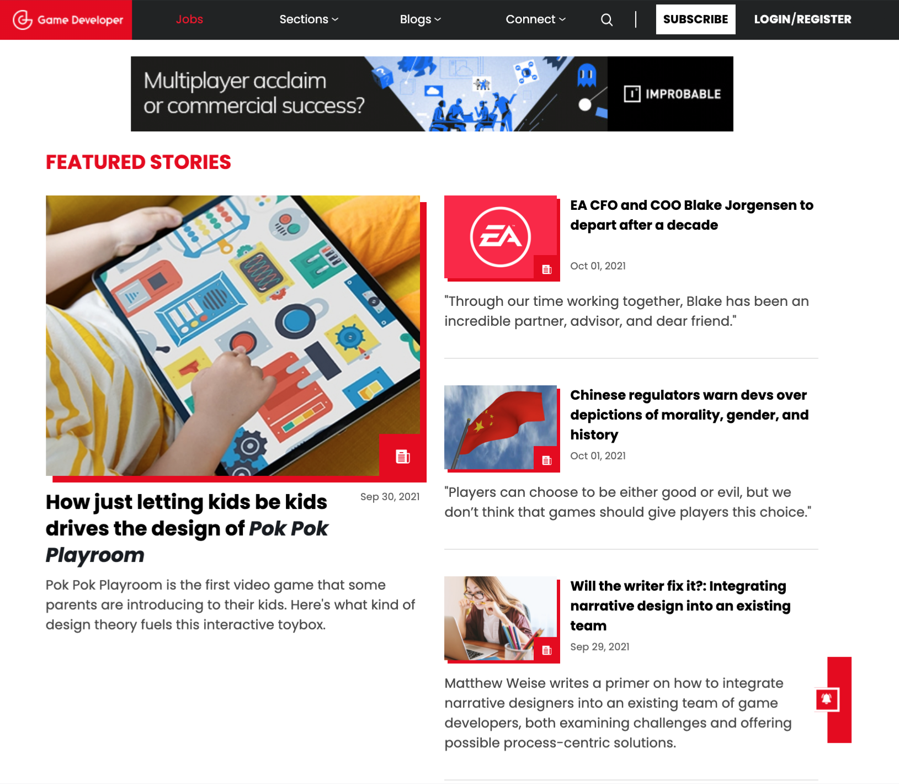
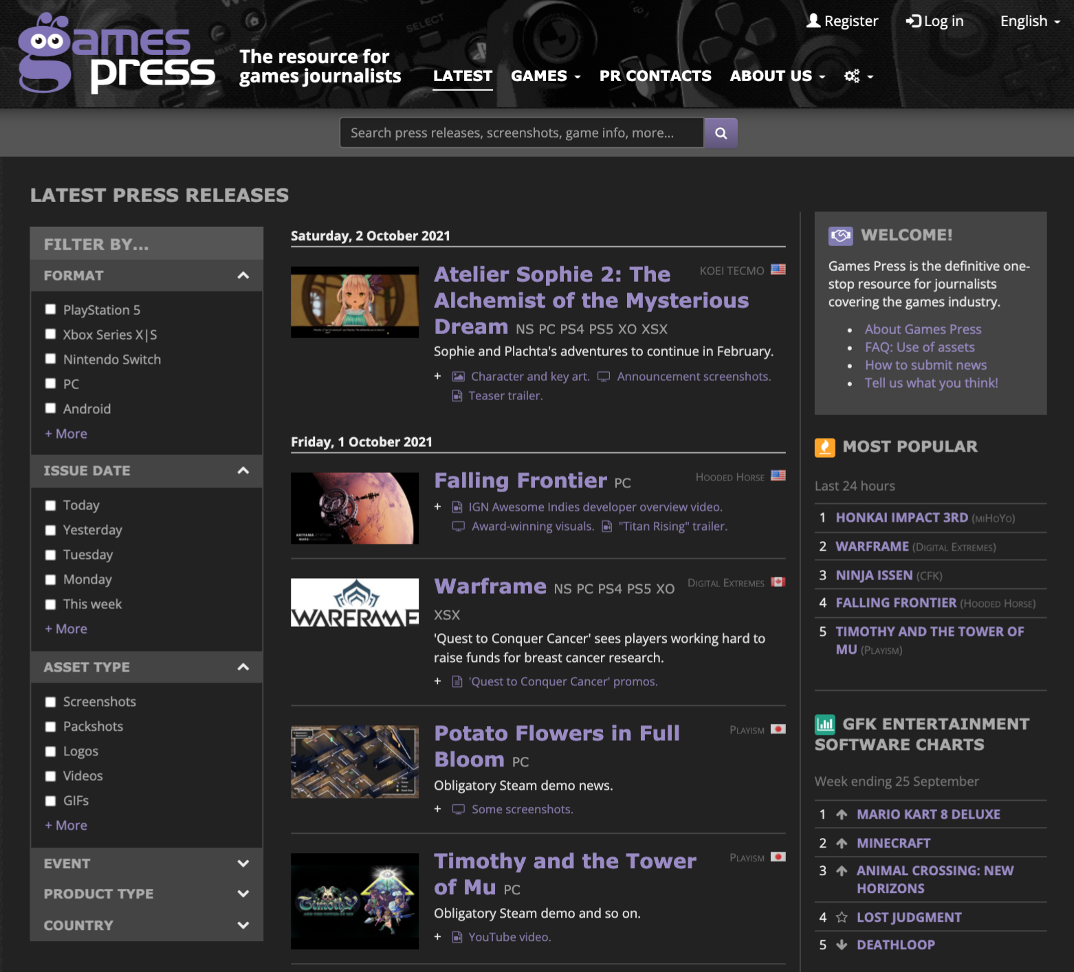
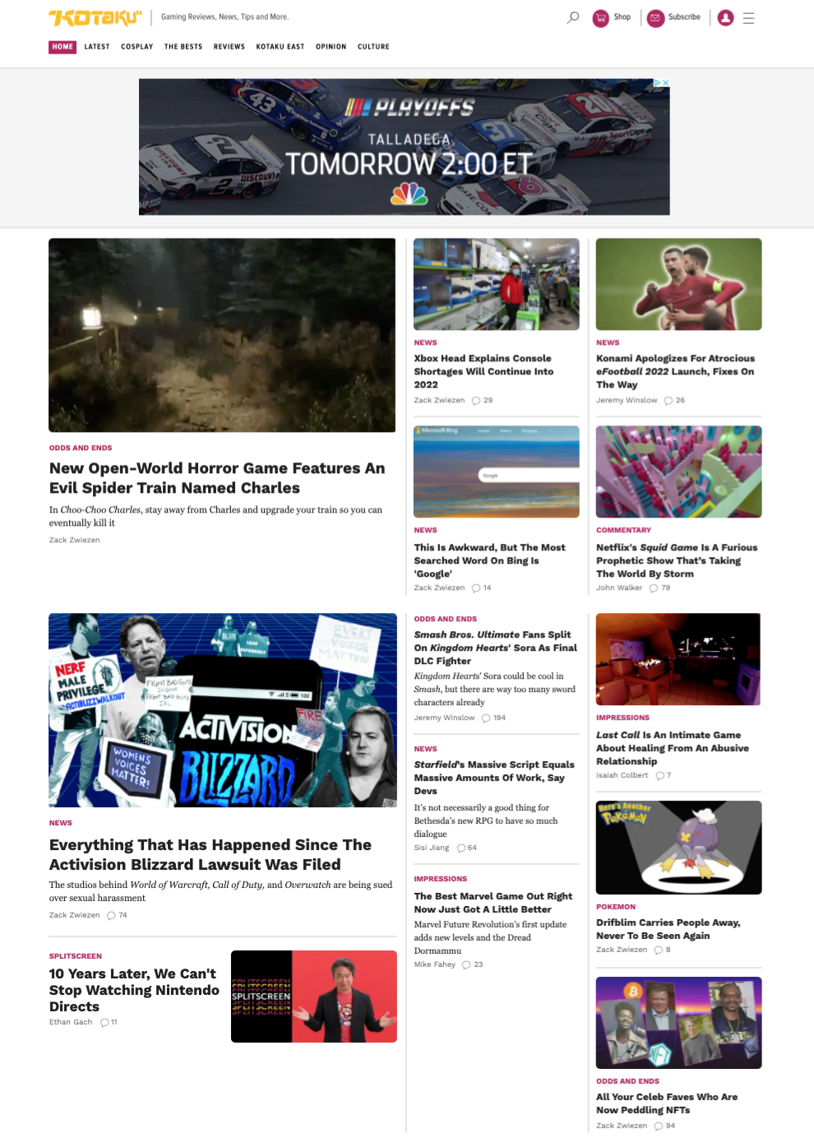
Marketing
Public Relations
© 2022, 2024 Jeannie Novak All rights reserved.
Credit: JN
Credit: JN
Credit: JN
Caption: Game Developer news and information site for game developers - left - Games Press online resource for game journalists - middle - and Kotaku game blog and media site for both player and industry professional markets - right.

Slide 9
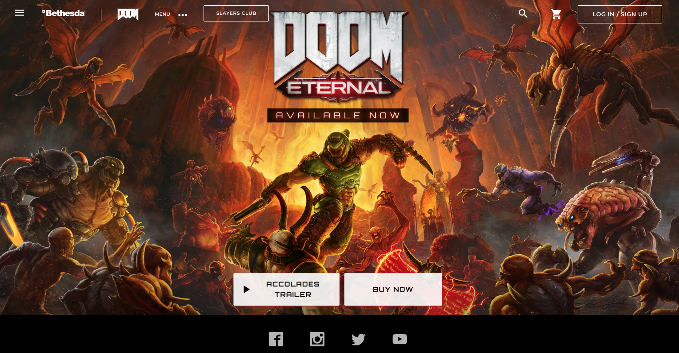
Community Management
Official Website
© 2022, 2024 Jeannie Novak All rights reserved.
Credit: JN
Caption: Bethesda’s official Doom Eternal website provides trailers and previews, tutorials, news, and social media links.

Slide 10
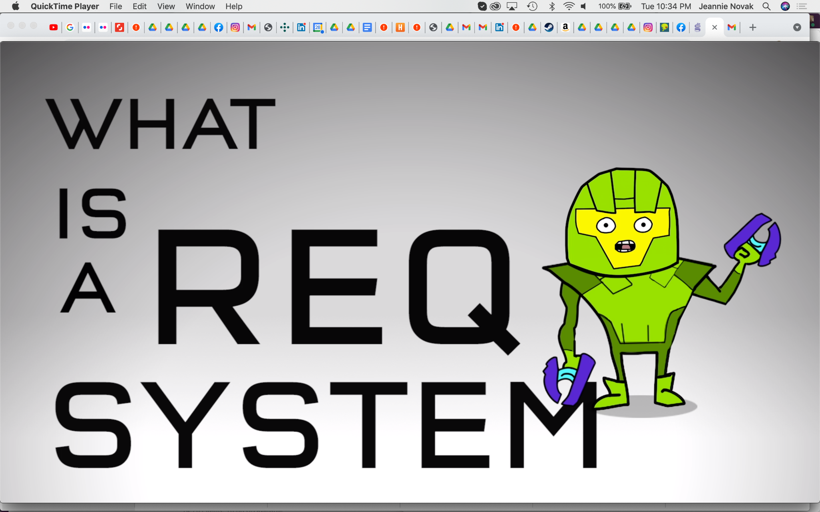
Community Management
Guides
© 2022, 2024 Jeannie Novak All rights reserved.
Credit: Microsoft Corporation
Caption: Tutorials and guides can provide useful support for players (Halo 5: Guardians REQ system tutorial, shown).

Slide 11
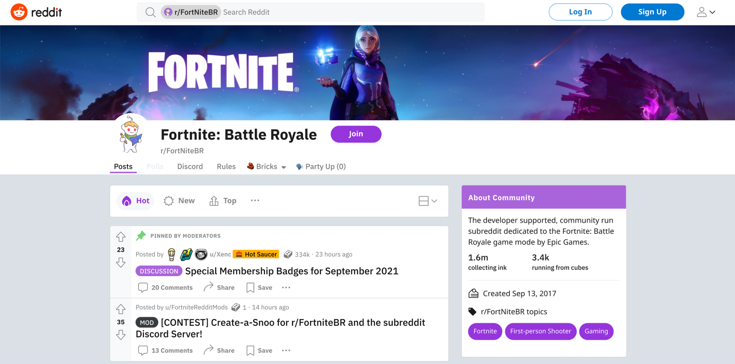
Community Management
Forums
© 2022, 2024 Jeannie Novak All rights reserved.
Credit: JN
Caption: The Fortnite subreddit boasts more than 1.6 million members and allows for direct communication with Epic Games.

Slide 12
Community Management
Newsletter
© 2022, 2024 Jeannie Novak All rights reserved.
Credit: JN
Caption: Subscription prompt for the Sea of Thieves newsletter.

Slide 13
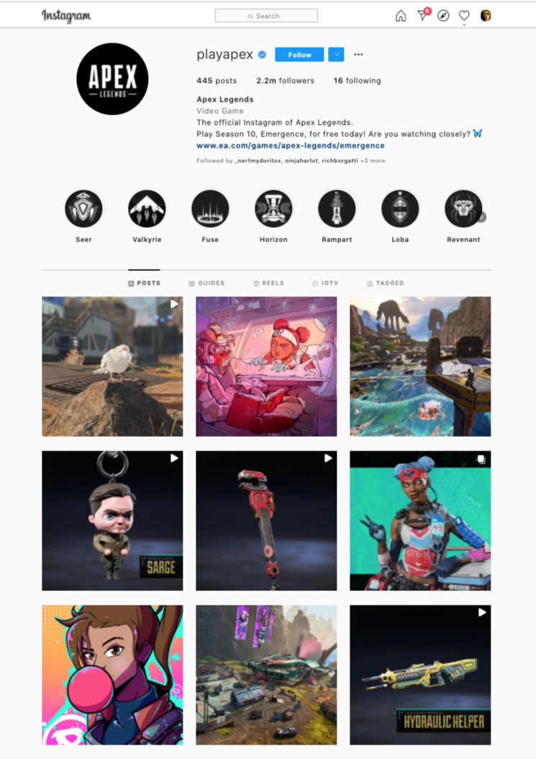
Community Management
Social Media
© 2022, 2024 Jeannie Novak All rights reserved.
Credit: JN
Caption: The Apex Legends Instagram profile features news, IGTV videos, and merch promotions.

Slide 14
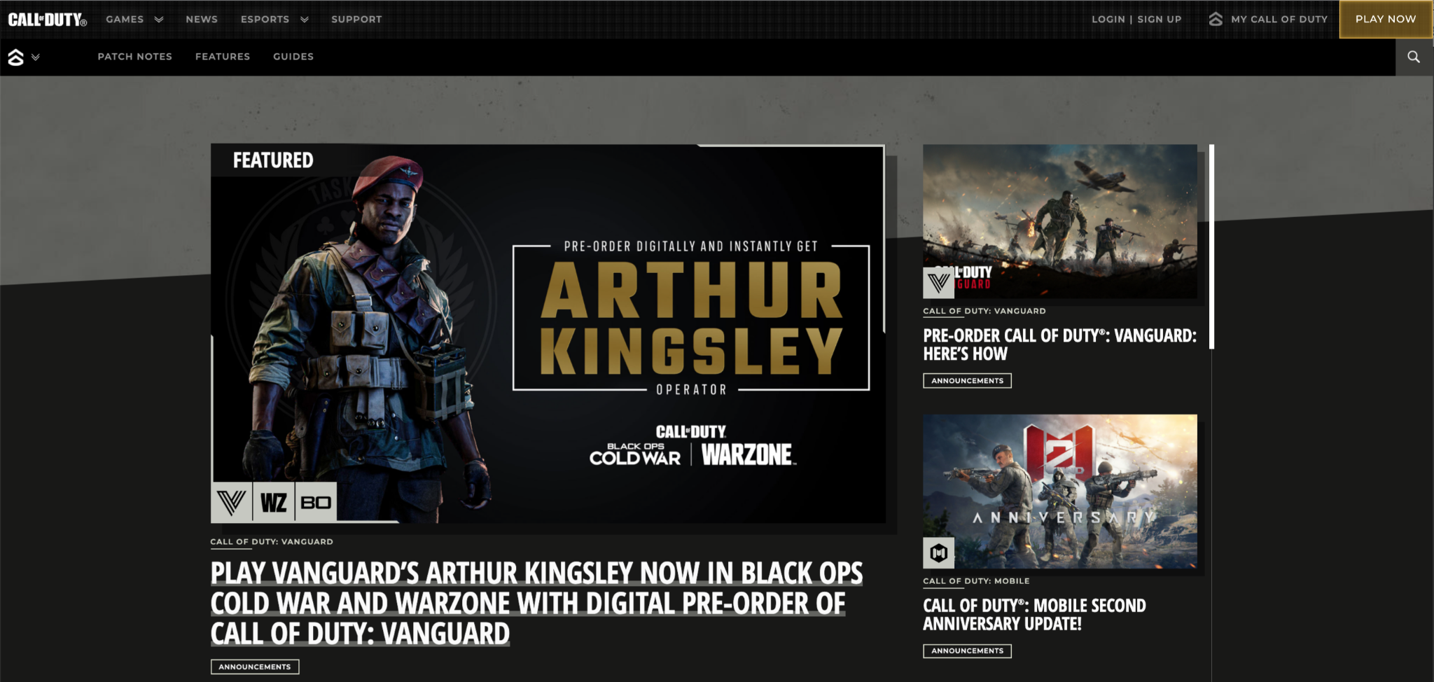
Community Management
Blog
© 2022, 2024 Jeannie Novak All rights reserved.
Credit: JN
Caption: The Call of Duty blog provides news, strategies, patch notes, bundles, and information on open beta tests to the series.

Slide 15
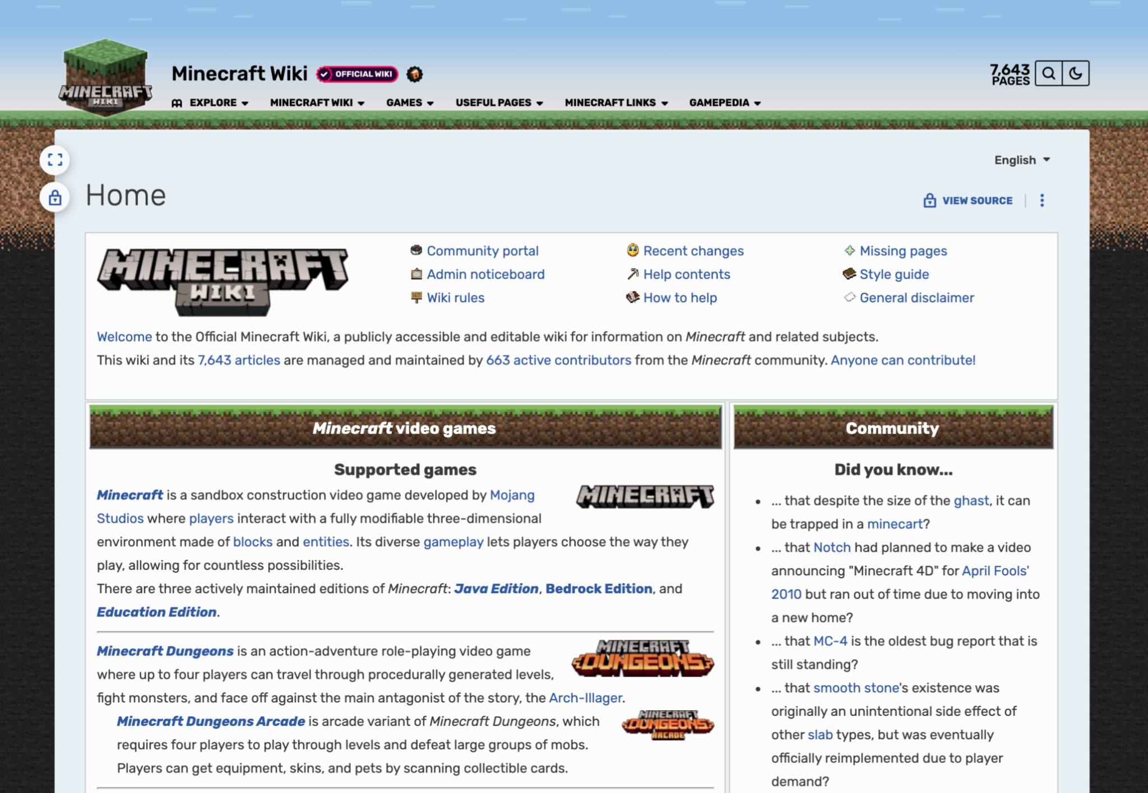
Community Management
Wiki
© 2022, 2024 Jeannie Novak All rights reserved.
Credit: JN
Caption: The Minecraft Wiki features a wealth of information on achievements, blocks, items, effects, recipes, and game modes.

Slide 16
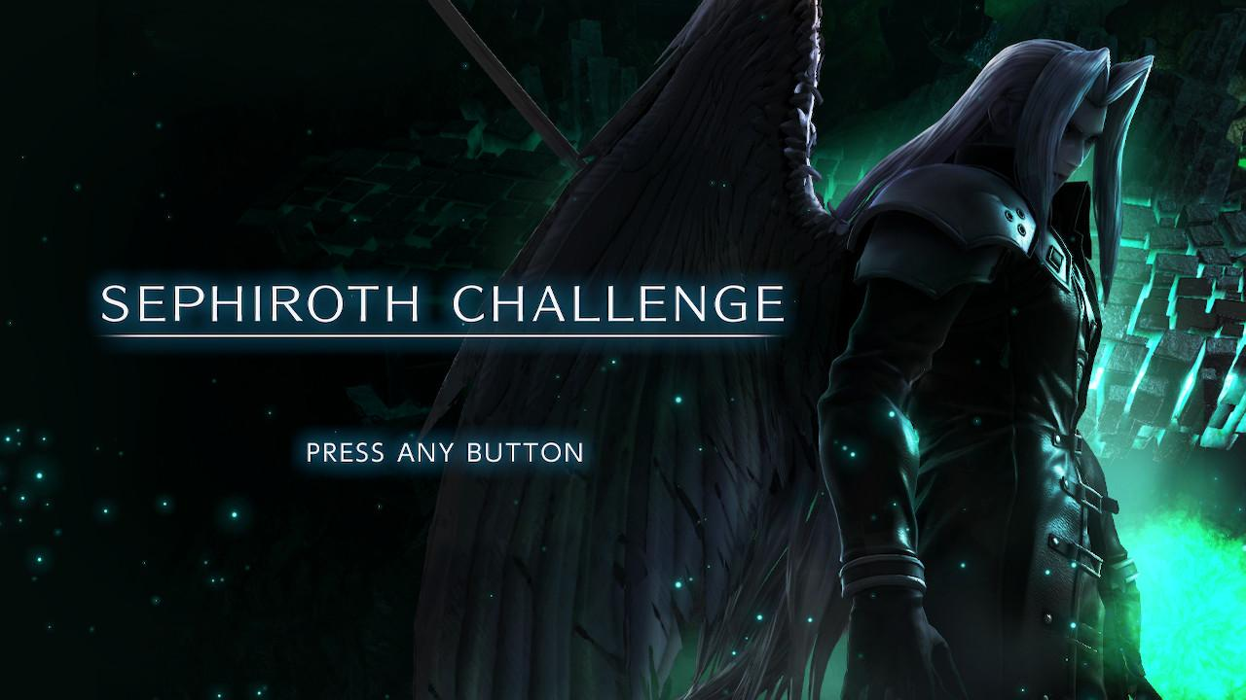
Community Management
In-Game Events
© 2022, 2024 Jeannie Novak All rights reserved.
Credit: Nintendo
Caption: In Super Smash Bros. Ultimate, the Sephiroth Challenge allowed players to battle the notorious Final Fantasy character at three difficulties prior to his official release in the game.

Slide 17
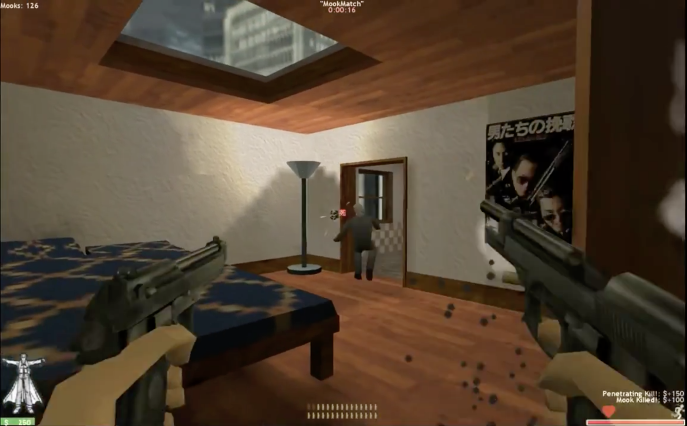
Prosumerism: Player as Developer
Mods
© 2022, 2024 Jeannie Novak All rights reserved.
Credit: JN
Caption: The Opera is one of many popular mods based on the original Half-Life.

Slide 18
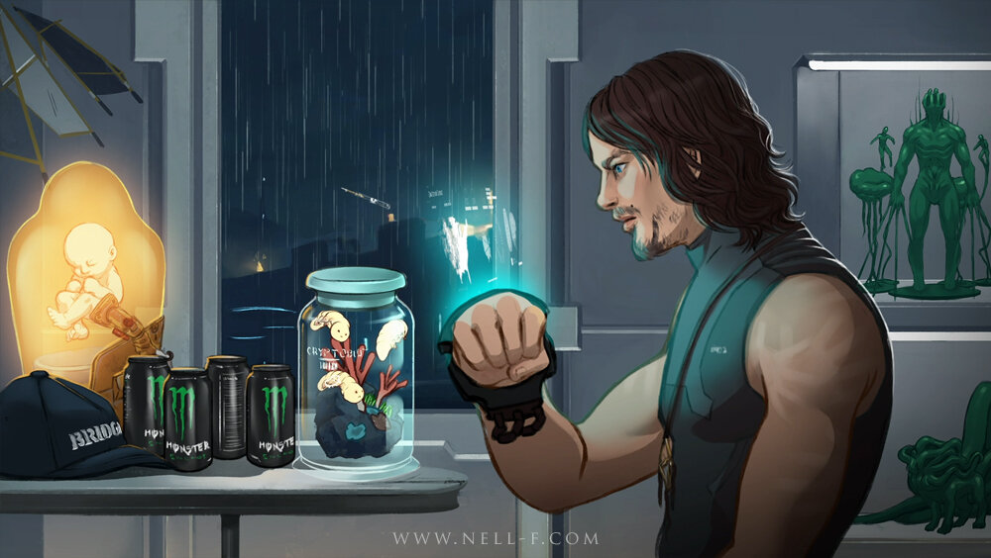
Prosumerism: Player as Developer
Fan Art & Fiction
© 2022, 2024 Jeannie Novak All rights reserved.
Credit: Nell Fallcard | www.nell-f.com
Caption: Fan-created art by Nell Fallcard of Sam Porter Bridges from Death Stranding.

Slide 19
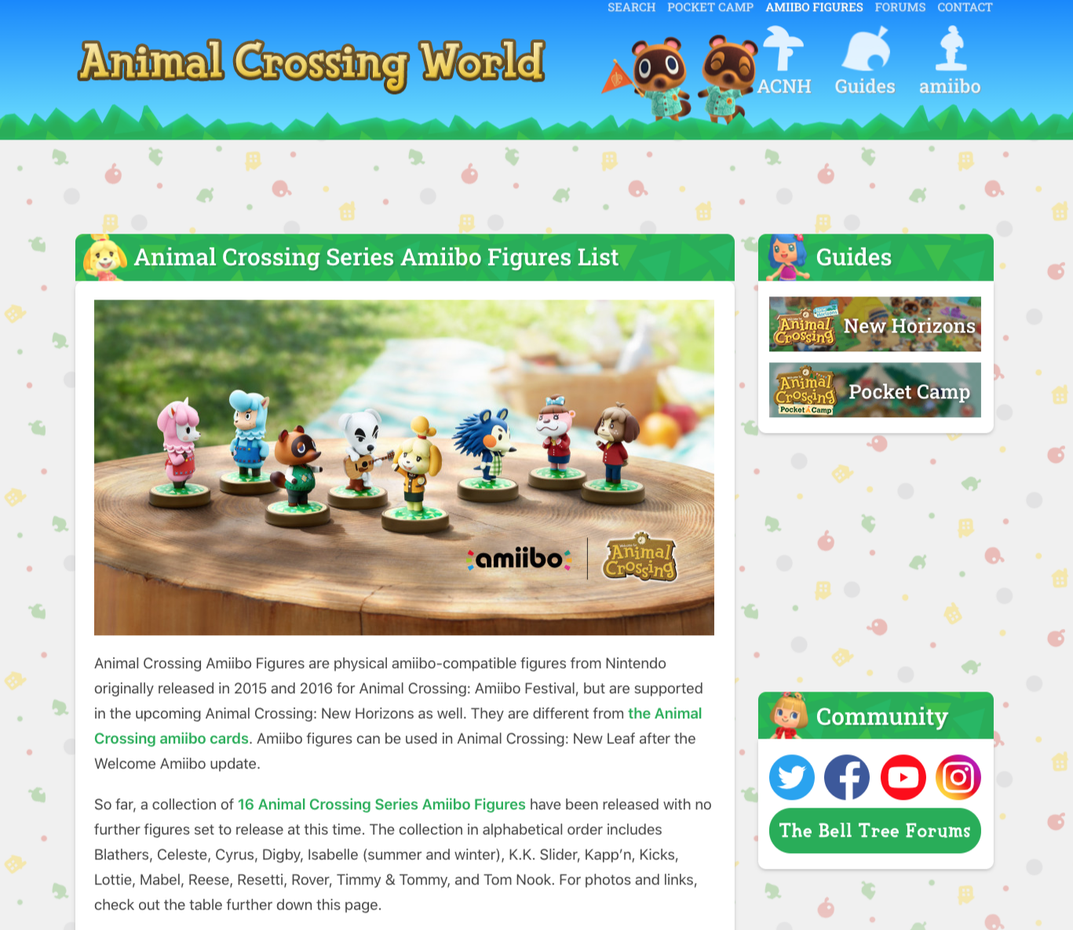
Prosumerism: Player as Developer
Fan Sites
© 2022, 2024 Jeannie Novak All rights reserved.
Credit: JN
Caption: The Animal Crossing World fan site features player forums, guides, and merch.

Slide 20
CHAPTER 12
© 2022, 2024 Jeannie Novak All rights reserved.
REVIEW EXERCISES
1
What are some effective marketing strategies used by game companies? What are some distinctions between the roles associated with marketing—including promotion, advertising, public relations, and sales?
2
How does community management enhance a game’s credibility and extend its life? What are some techniques used by community managers to encourage “prosumerism” in players?
3
Applying what you learned about geographics, demographics, and psychographics earlier in this book, create a player community profile for an original game idea. How would you market the game to this community?

Slide 21
CHAPTER 12
© 2022, 2024 Jeannie Novak All rights reserved.
REVIEW EXERCISES
4
What is the significance of modding and beta-testing communities with regard to the player-developer relationship?
5
Search for player communities centered around one of your favorite games—and participate in
some forums. What sorts of topics are discussed? How do players create a bond with one another?

