Slide 2
CHAPTER 11
Production & management developing the process
© 2022, 2024 Jeannie Novak All rights reserved.

Slide 3
CHAPTER OBJECTIVES
© 2022, 2024 Jeannie Novak All rights reserved.
After reading this chapter, you should be able to:
Describe each phase in the game development cycle.
Point out some effective ways to lead and manage game development teams.
Compare the different types of documentation used in game development.

Slide 4
Developmental Phases
Production
© 2022, 2024 Jeannie Novak All rights reserved.
Credit: Kaizen Game Works
Credit: Kaizen Game Works
Caption: Paradise Killer was developed in English - left - and translated into other languages—including Japanese - right.

Slide 5
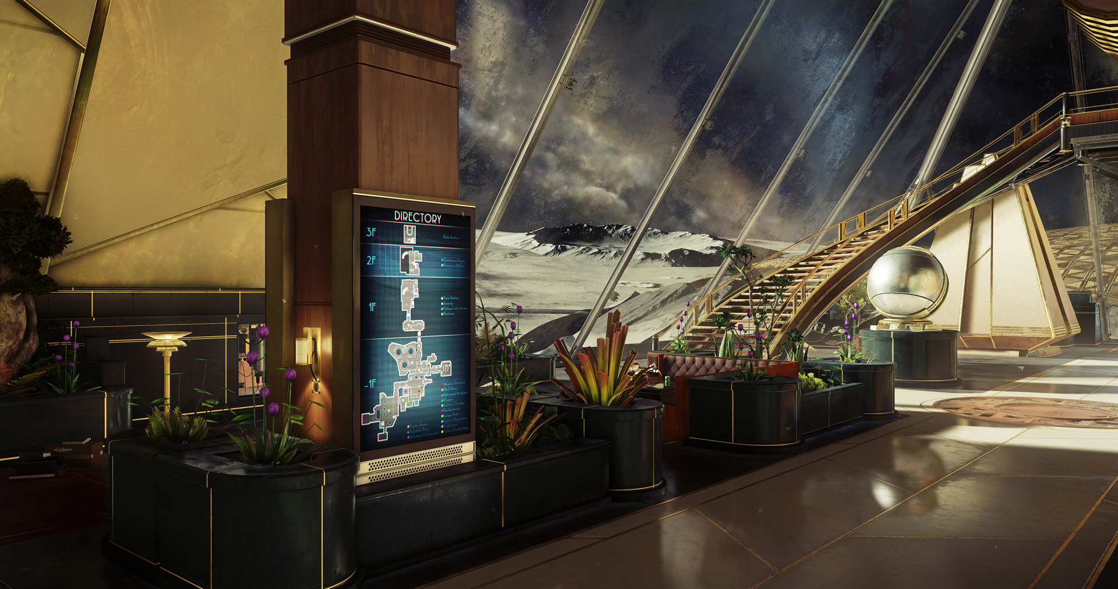
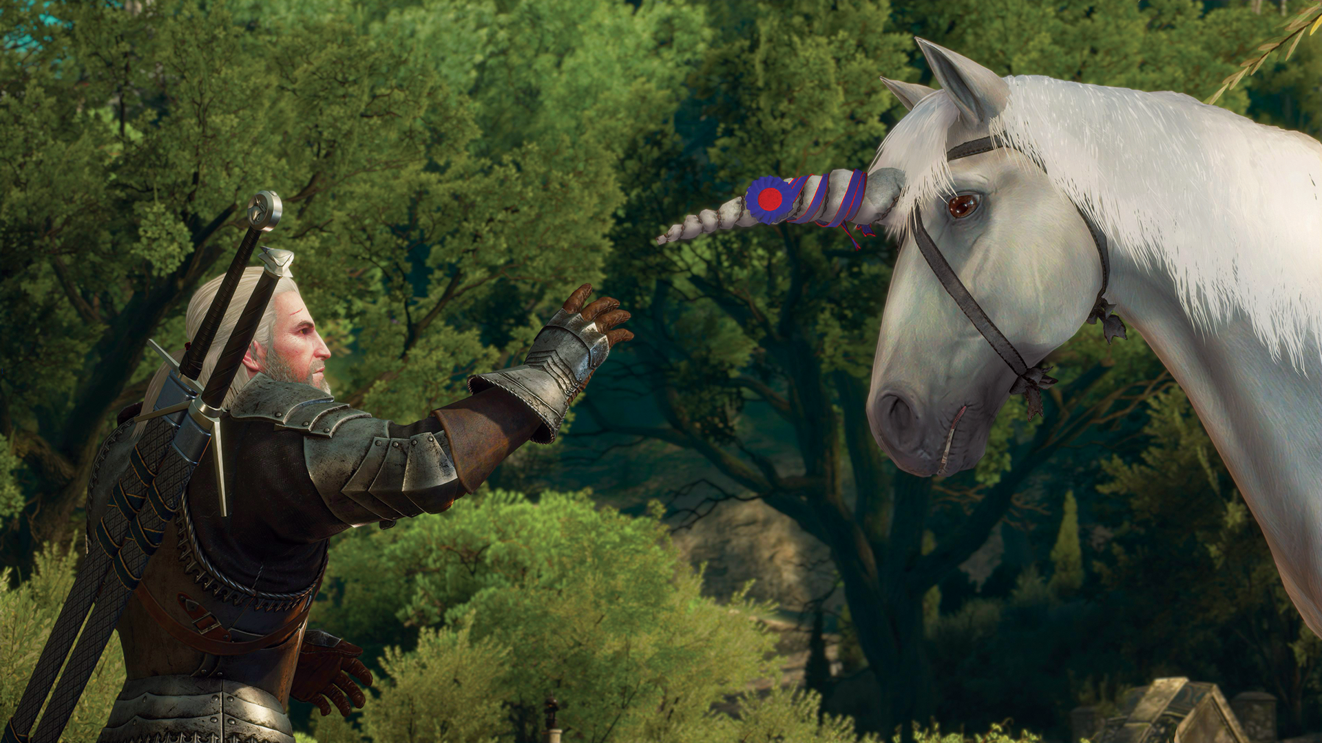
Developmental Phases
Post-Production
© 2022, 2024 Jeannie Novak All rights reserved.
Credit: Bethesda Softworks LLC
Credit: CD Projekt
Caption: The Prey: Mooncrash DLC - left - is a standalone pack that uses the story of Prey as a backdrop, while the Blood & Wine DLC for The Witcher 3: Wild Hunt - right - plays more like an expanded (20+ hours) quest that takes place in the fantasy region of Toussaint.

Slide 6
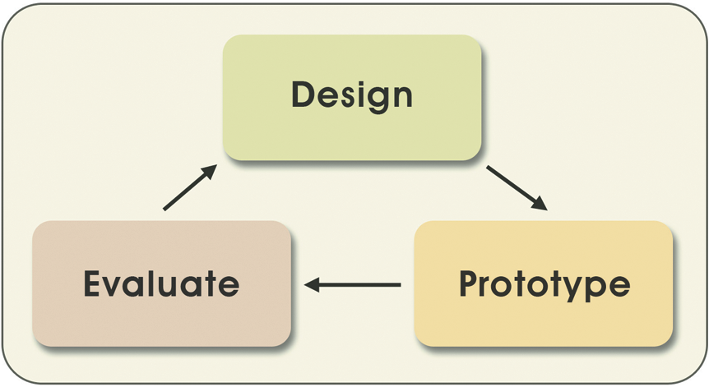
Management
Iterative Development
© 2022, 2024 Jeannie Novak All rights reserved.
Credit: Diagram by Per Olin
Caption: The three-stage iterative development process.

Slide 7
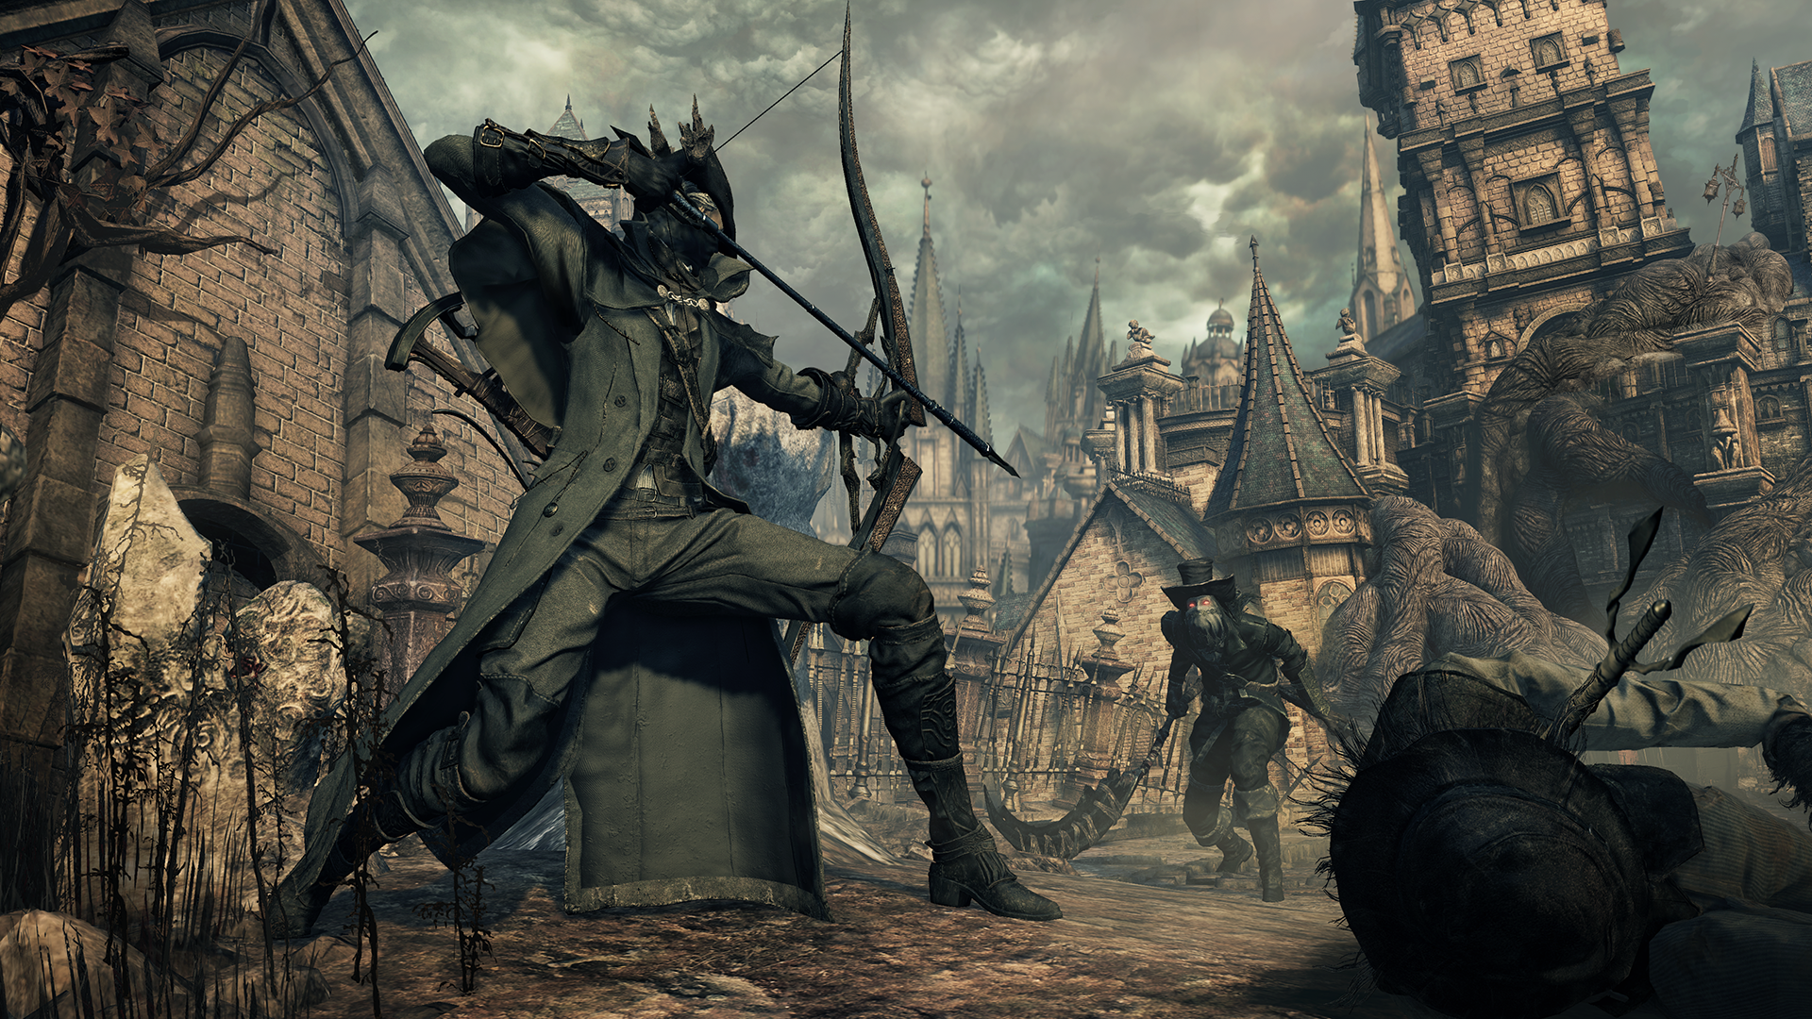
Game Documentation
Concept Document
© 2022, 2024 Jeannie Novak All rights reserved.
Credit: Sony Interactive Entertainment
Caption: Bloodborne’s premise is dark and horrific: “Hunt your nightmares as you search for answers in the ancient city of Yharnam, now cursed with a strange endemic illness spreading through the streets like wildfire.”

Slide 8
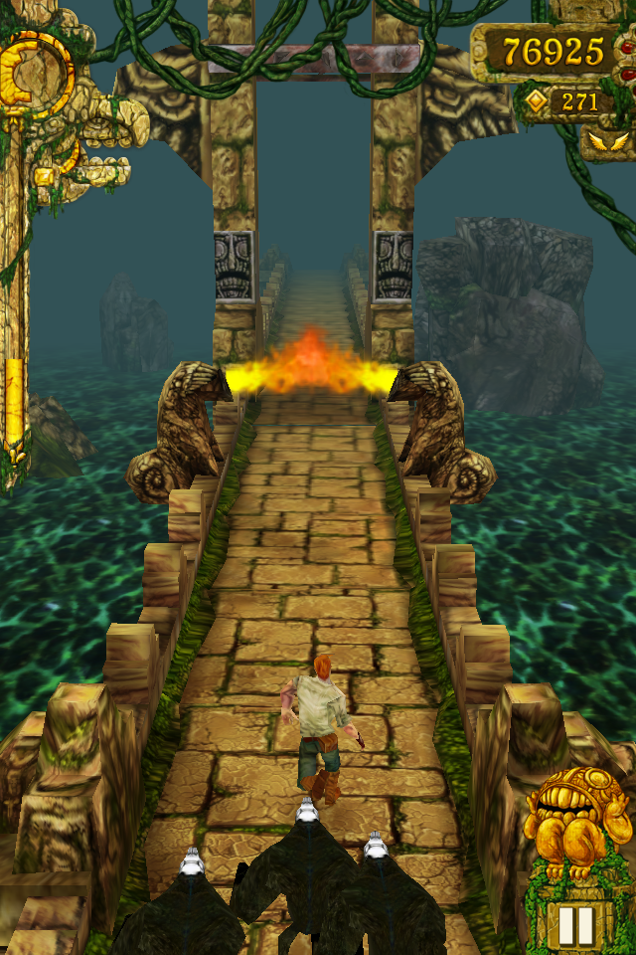
Game Documentation
Concept Document
© 2022, 2024 Jeannie Novak All rights reserved.
Credit: Imangi Studios
Caption: Indie development duo Imangi Studios’ Temple Run spawned a new genre: the endless runner.

Slide 9
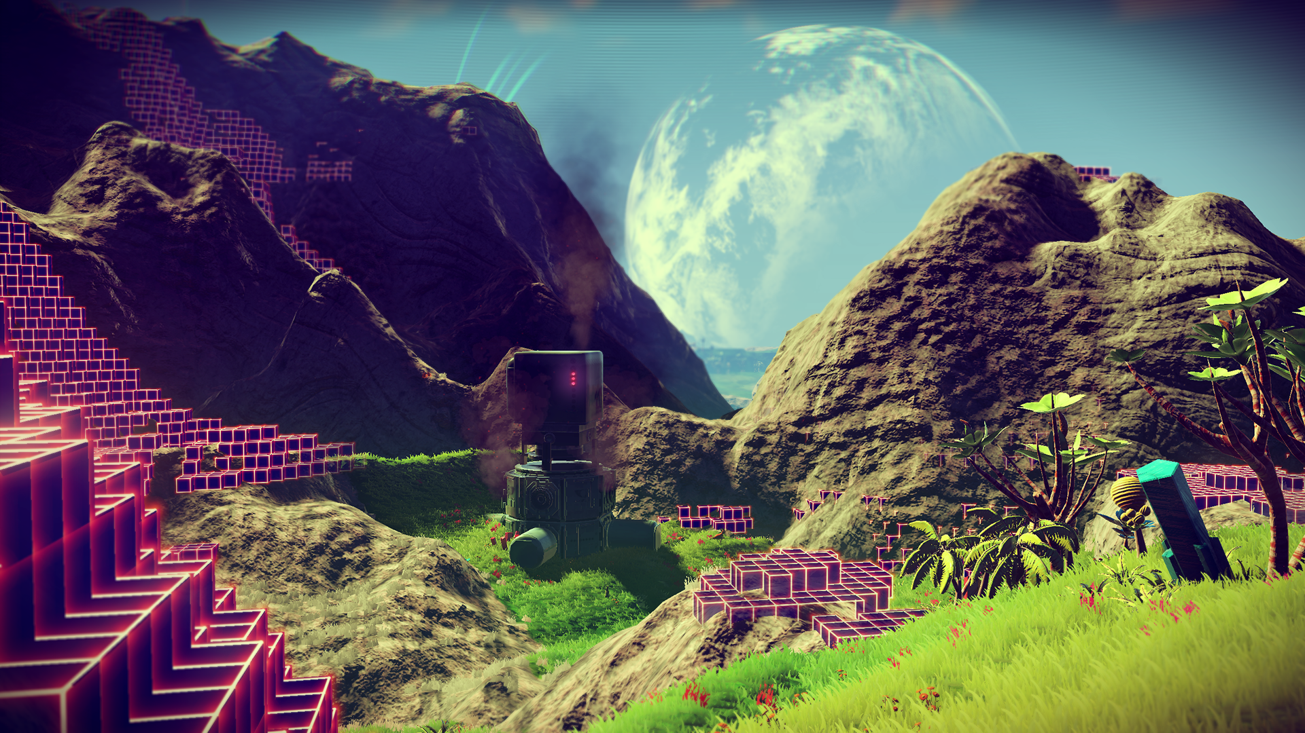
Game Documentation
Game Proposal
© 2022, 2024 Jeannie Novak All rights reserved.
Credit: Sony Interactive Entertainment
Caption: No Man’s Sky features a massive procedurally generated deterministic open-world universe.

Slide 10
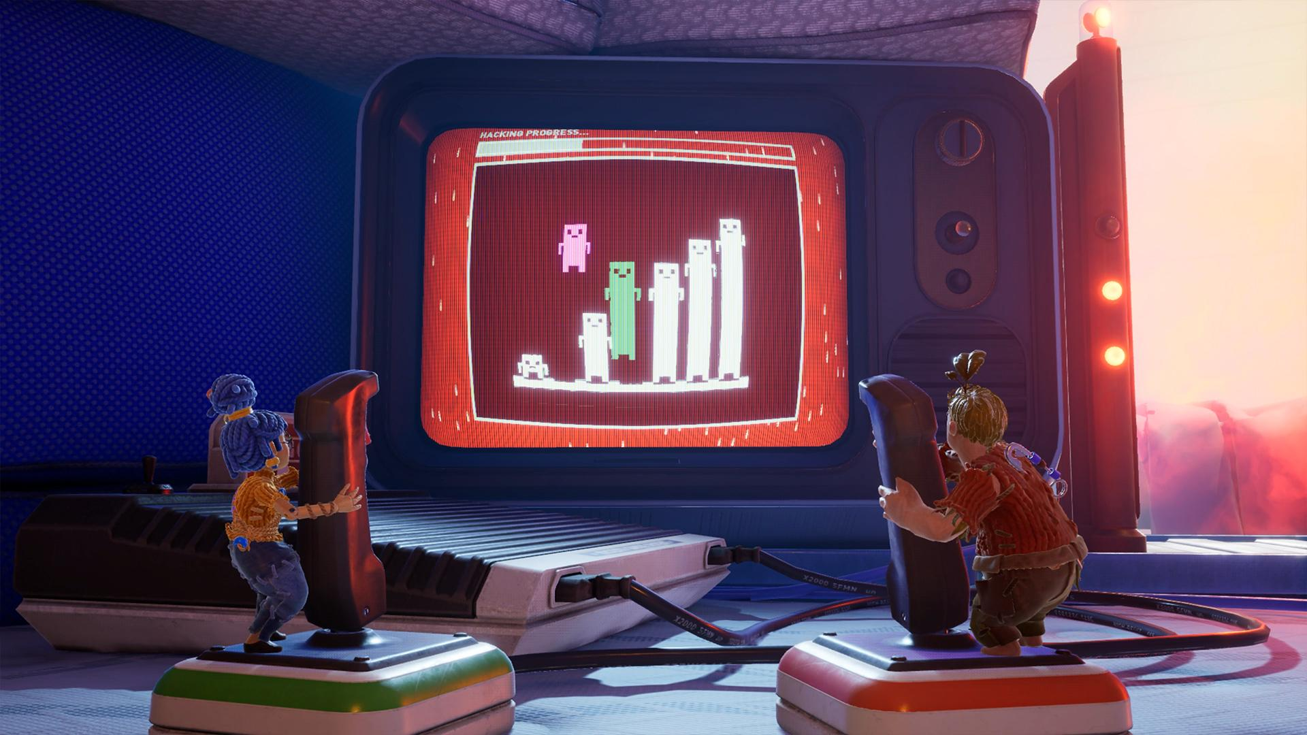
Game Documentation
Game Proposal
© 2022, 2024 Jeannie Novak All rights reserved.
Credit: Electronic Arts
Caption: It Takes Two incorporates two-player co-op and game mechanics tied to a storyline about an estranged couple that must save their relationship after being turned into dolls by a magic spell.

Slide 11
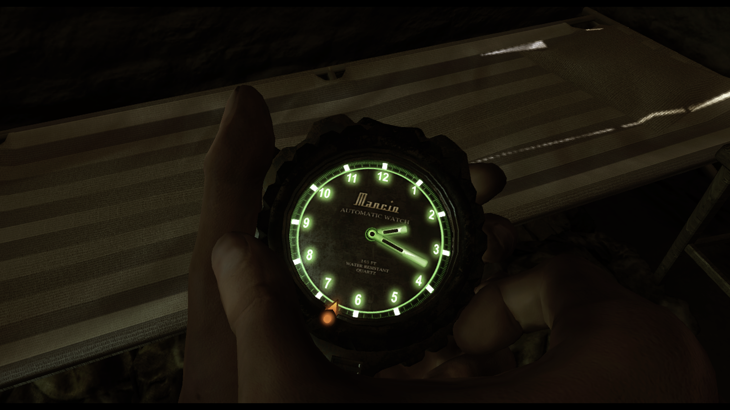
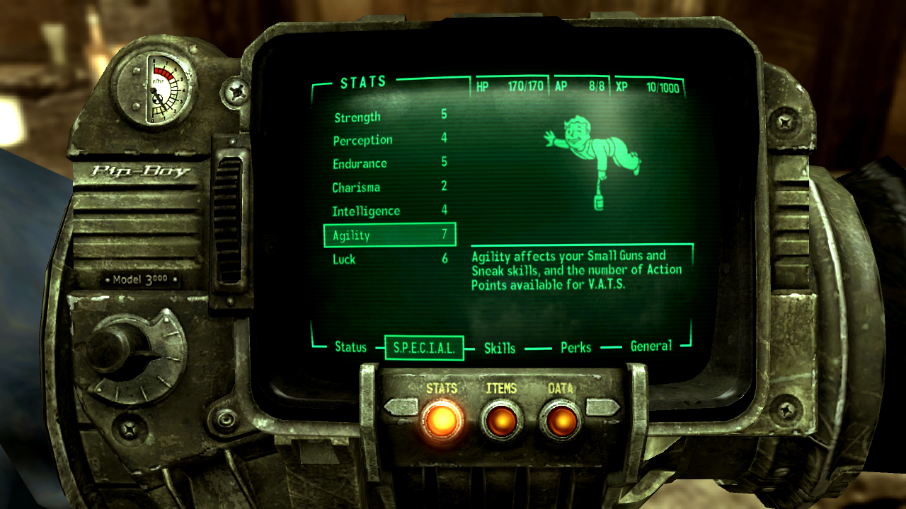
Game Documentation
Game Design Document
© 2022, 2024 Jeannie Novak All rights reserved.
Credit: JN
Credit: Bethesda Softworks LLC
Caption: Will you include diegetic interface elements in your game (Far Cry 2 - left - Fallout 3 - right)?

Slide 12
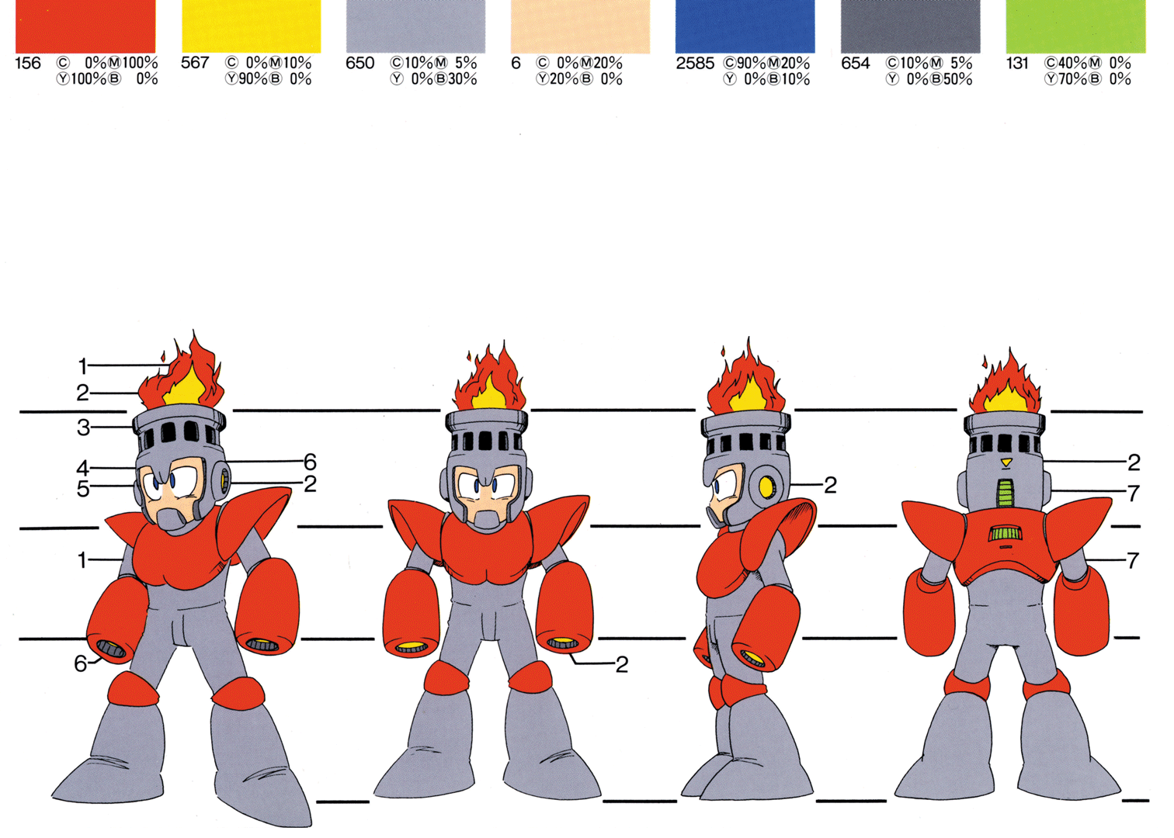
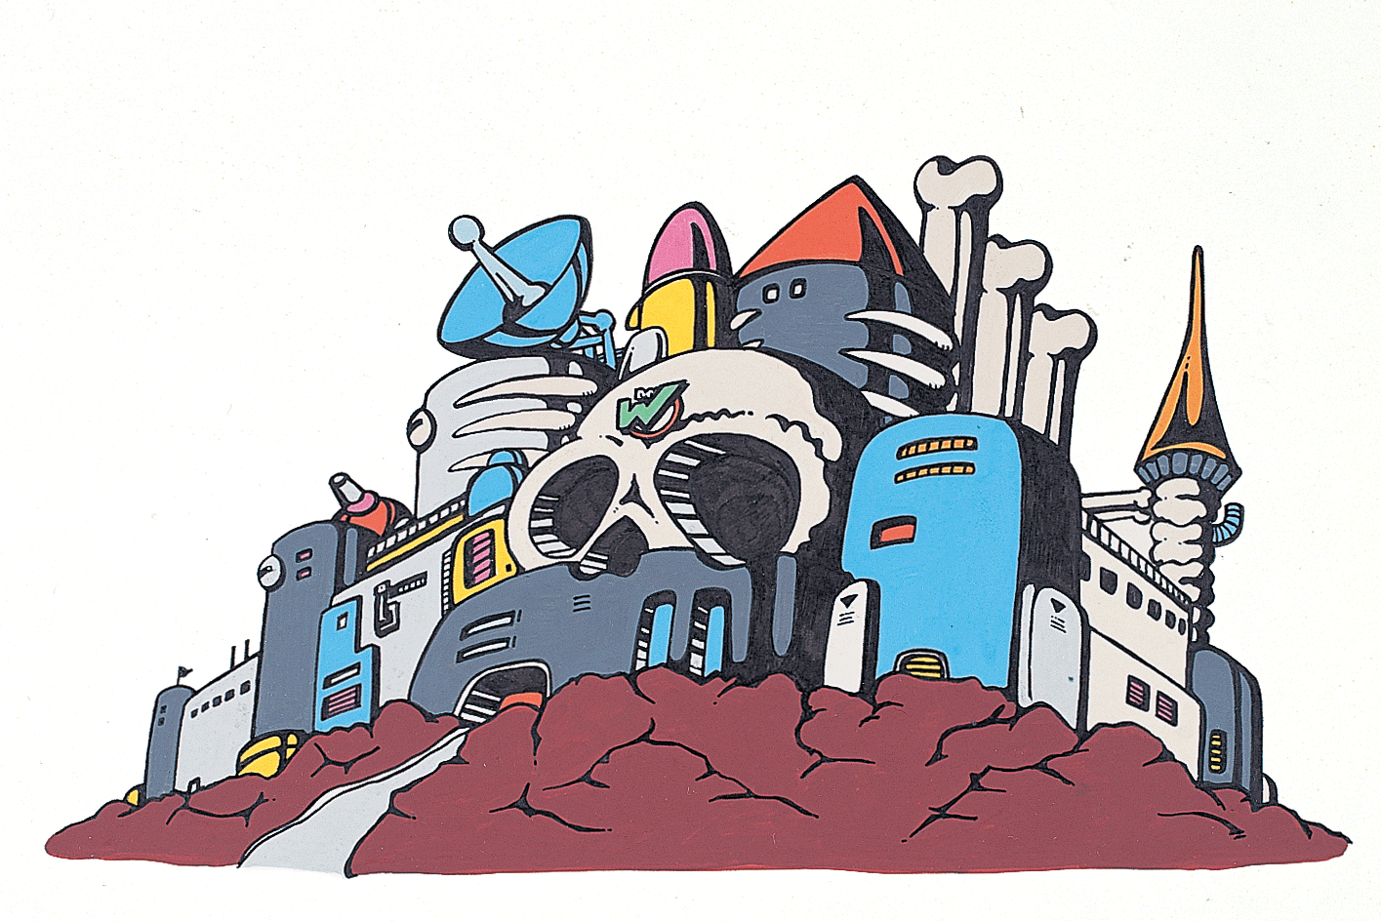
Game Documentation
Art Style Guide
© 2022, 2024 Jeannie Novak All rights reserved.
Credit: Capcom
Credit: Capcom
Caption: Character sheet with color palette - left - and Wily Castle exterior production art incorporating basic colors - right - (from Mega Man Legacy Collection).

Slide 13
Game Documentation
Technical Design Document
© 2022, 2024 Jeannie Novak All rights reserved.
Credit: Ryan Jones (Trusted Reviews)
Caption: The technical design document should account for any hardware purchases—including VR headsets (such as the Vive Pro 2, shown).

Slide 14
Game Documentation
Test Plan
© 2022, 2024 Jeannie Novak All rights reserved.
Credit: Frame Stock Footage (Shutterstock)
Caption: Testing environment using Vive headset and controllers.

Slide 15
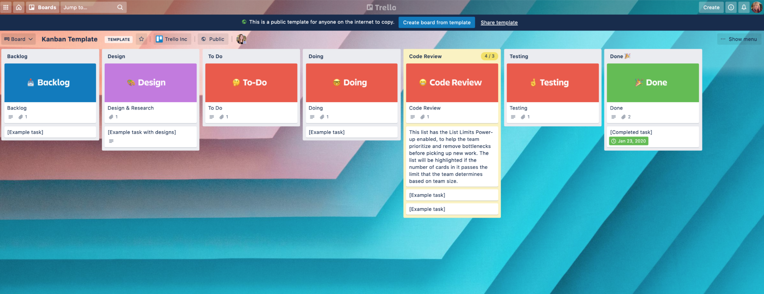
Game Documentation
Project Plan
© 2022, 2024 Jeannie Novak All rights reserved.
Credit: JN
Caption: Trello uses a Kanban board layout to support project plan revisions and allow team members to have a visual representation of the plan.

Slide 16
CHAPTER 11
© 2022, 2024 Jeannie Novak All rights reserved.
REVIEW EXERCISES
1
Distinguish between the different phases of the game development cycle, and discuss the purpose and importance of each phase.
2
Leadership is a significant but often underutilized skill in game development management. Why is this
the case, and what strategies do producers and other managers utilize when leading game development teams?
Select three forms of game documentation and discuss the importance of each in the development process. Discuss three components of each form of documentation. Why do you think these components are necessary to include in the documentation? Now incorporate an original game idea into the game document of your choice. Make sure that your finished document serves its intended purpose.
3

Slide 17
CHAPTER 11
© 2022, 2024 Jeannie Novak All rights reserved.
REVIEW EXERCISES
What is the importance of iterative design? Discuss the three phases of iterative design and what occurs during each phase. How are these phases connected with each other? How is the player market involved in the iterative design process?
4
Develop an analog or digital prototype for your original game. What elements will you include in the prototype? Give reasons you won’t include certain elements at this time. Have a group of people playtest your game and provide comments on elements related to gameplay mechanics, story/character, mood, functionality—and fun factor!
5

