Slide 2
CHAPTER 10
ROLES & RESPONSIBILITIES DEVELOPING THE TEAM
© 2022, 2024 Jeannie Novak All rights reserved.

Slide 3
CHAPTER OBJECTIVES
© 2022, 2024 Jeannie Novak All rights reserved.
After reading this chapter, you should be able to:
List the company roles associated with game development studios, publishers, licensors, and manufacturers.
Describe the team roles and responsibilities associated with management, art, design, programming, audio, and testing.
Identify the specific techniques and tools that are utilized by different team members during game development.

Slide 4
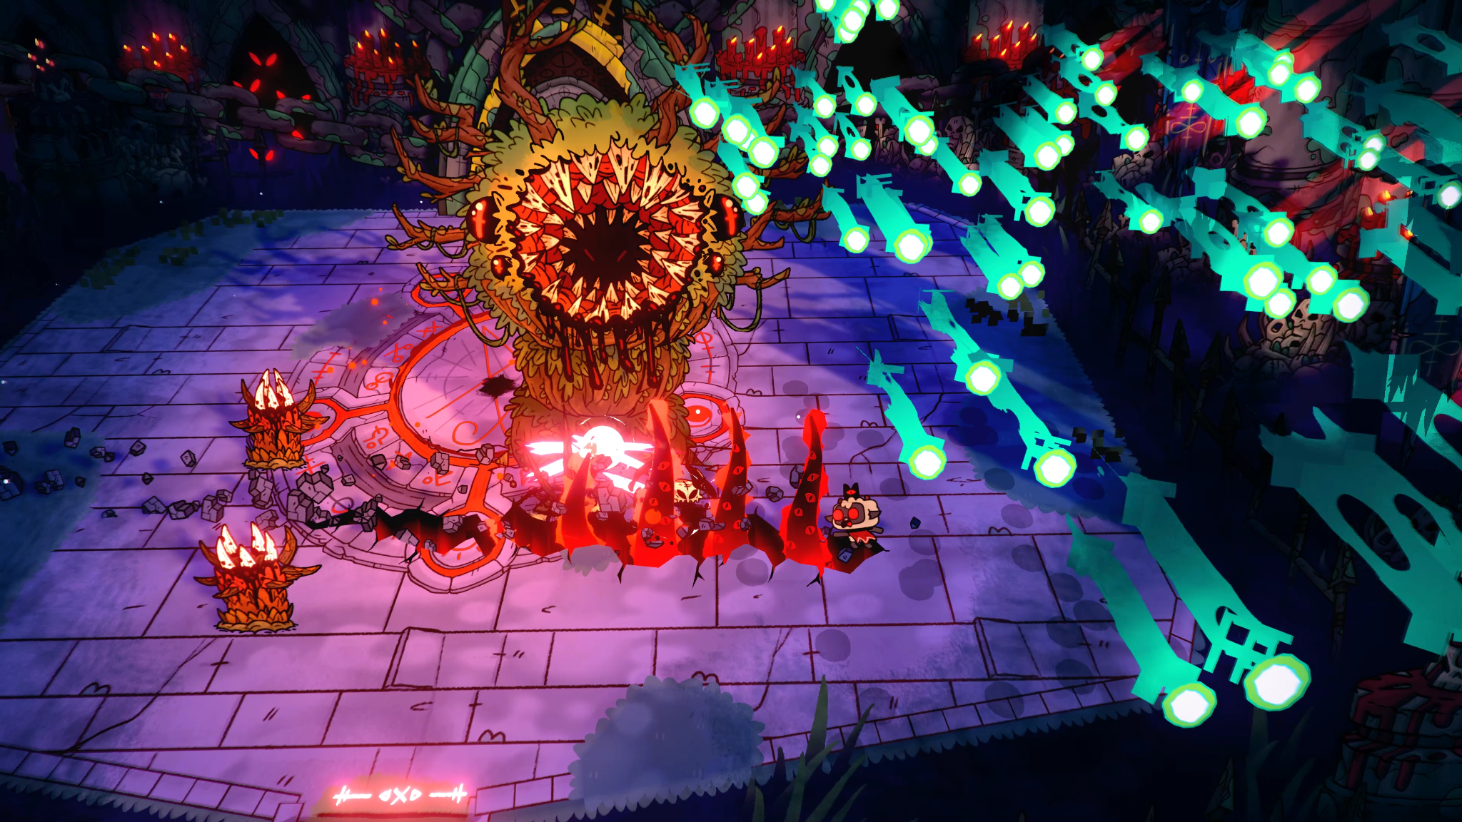
Company Roles
© 2022, 2024 Jeannie Novak All rights reserved.
Credit: Devolver Digital
Caption: Cult of the Lamb, developed by Massive Monster, is published by Developer Digital.

Slide 5
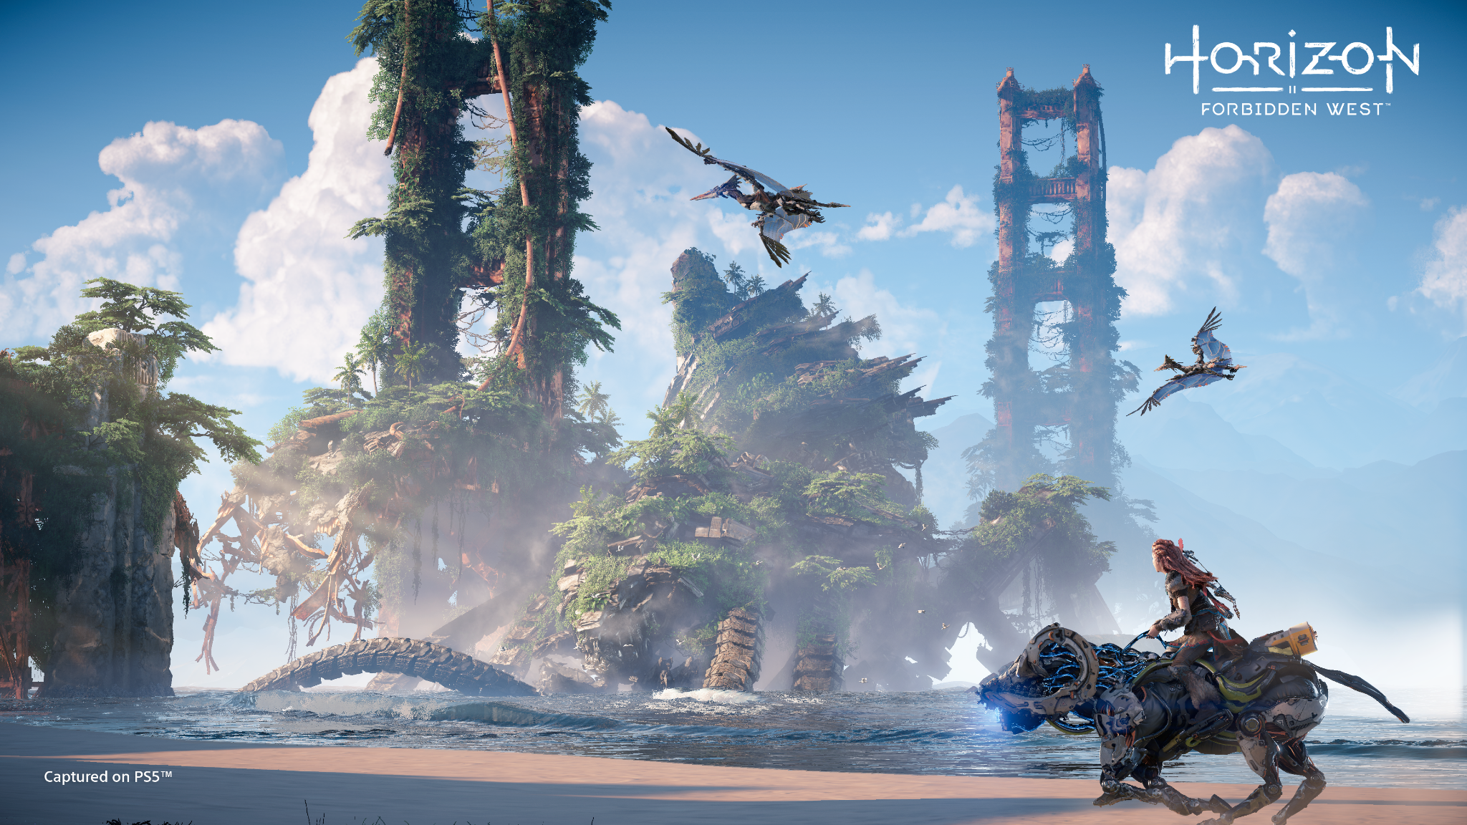
Company Roles
© 2022, 2024 Jeannie Novak All rights reserved.
Credit: Sony Interactive Entertainment
Caption: Horizon Forbidden West is published by Sony Interactive Entertainment and developed by subsidiary Guerilla Games.

Slide 6
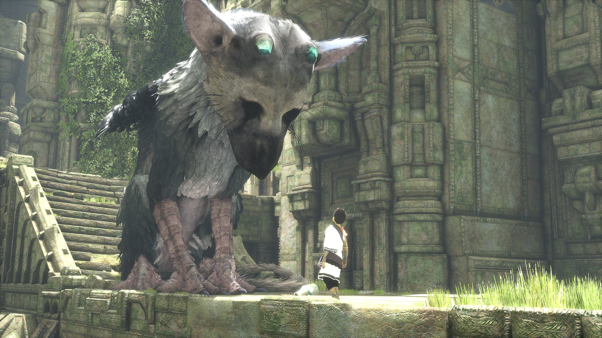
Team Roles
Production
© 2022, 2024 Jeannie Novak All rights reserved.
Credit: Sony Interactive Entertainment
Caption: Mark Cerny was Executive Producer on The Last Guardian.

Slide 7
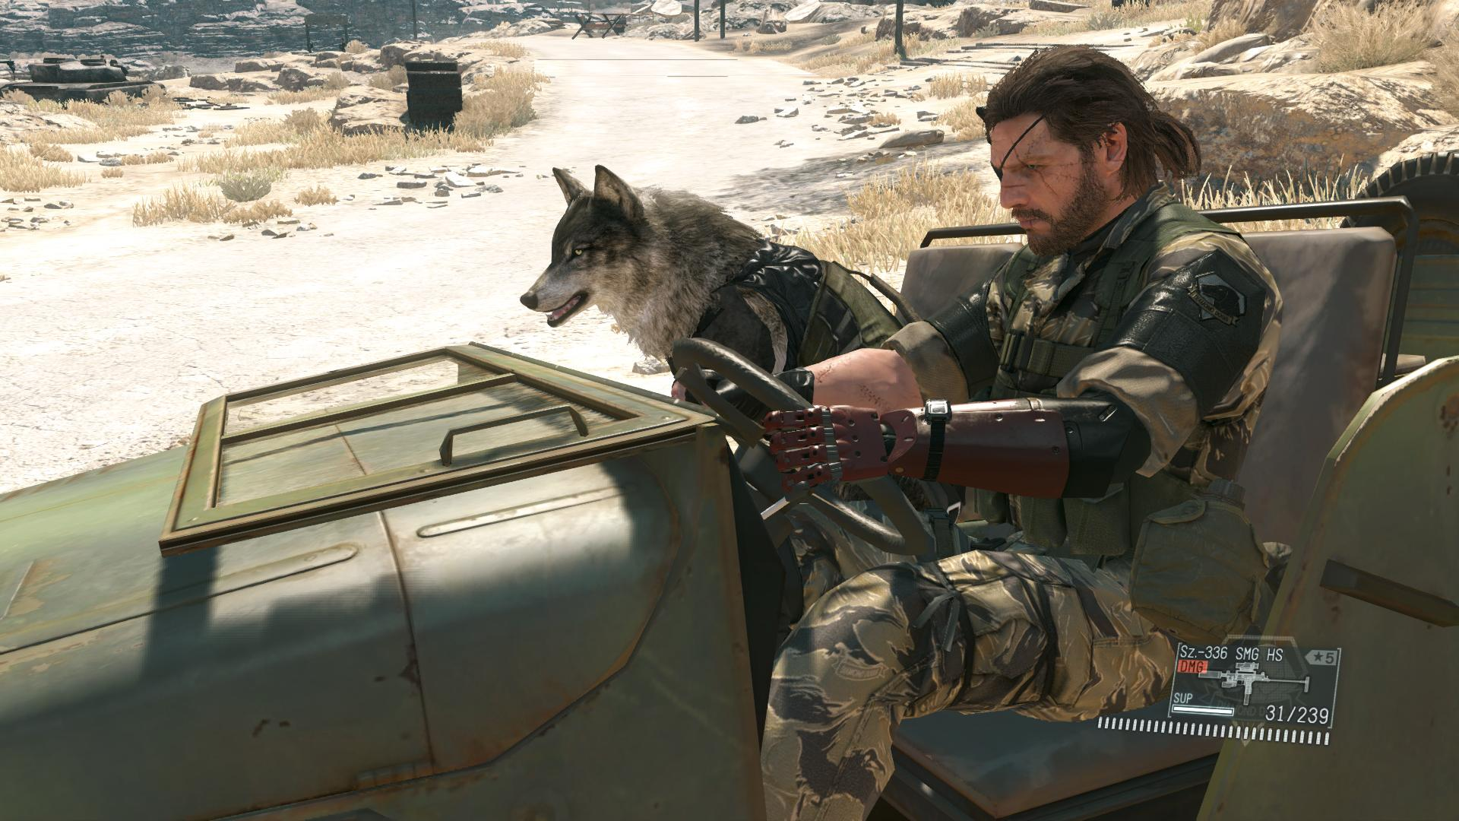
Team Roles
Design
© 2022, 2024 Jeannie Novak All rights reserved.
Credit: Konami Holdings Corporation
Caption: Hideo Kojima is the designer of the Metal Gear Solid series (Metal Gear Solid V: The Phantom Pain, shown).

Slide 8
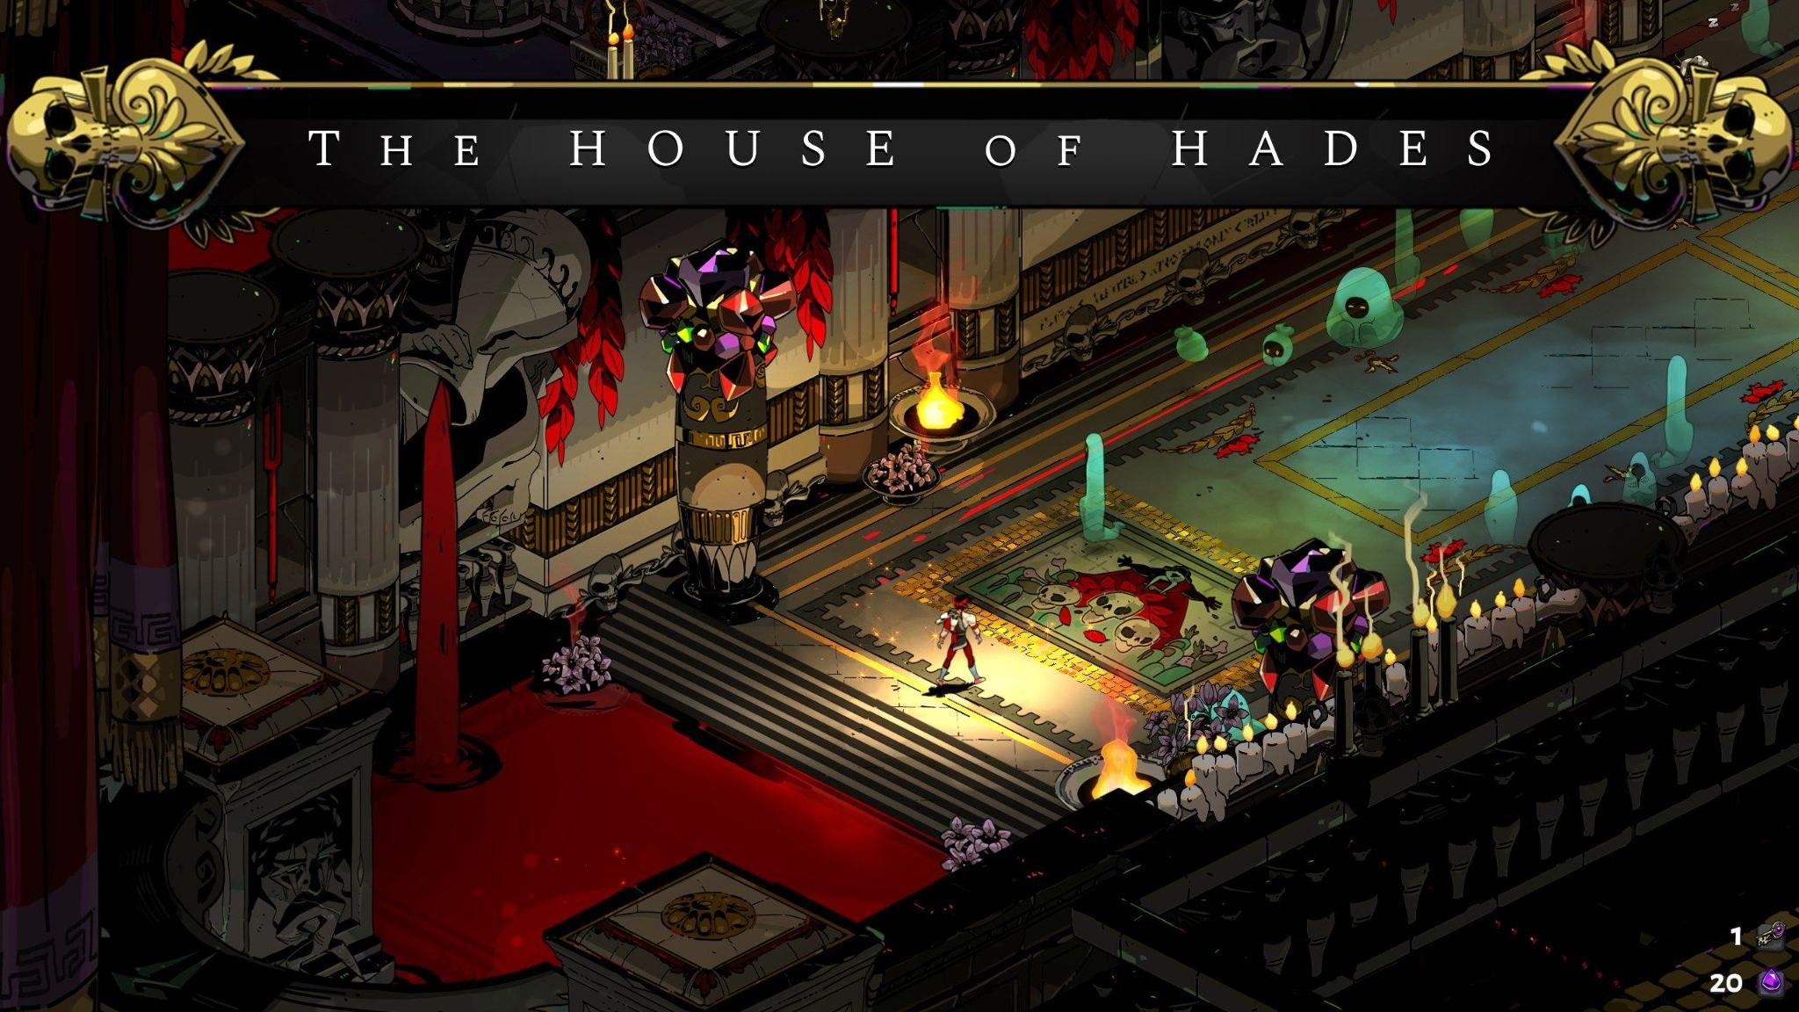
Team Roles
Art
© 2022, 2024 Jeannie Novak All rights reserved.
Credit: Sciere (MobyGames)
Caption: Jen Zee, Joann Tran, and Paige Carter created the art for Hades.

Slide 9
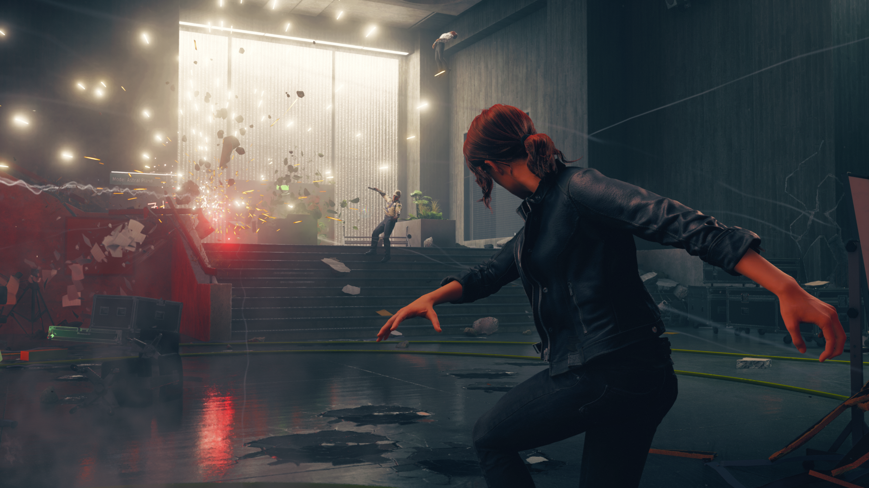
Team Roles
Programming
© 2022, 2024 Jeannie Novak All rights reserved.
Credit: 505 Games
Caption: Sean Donnelly was the lead gameplay programmer on Control.

Slide 10
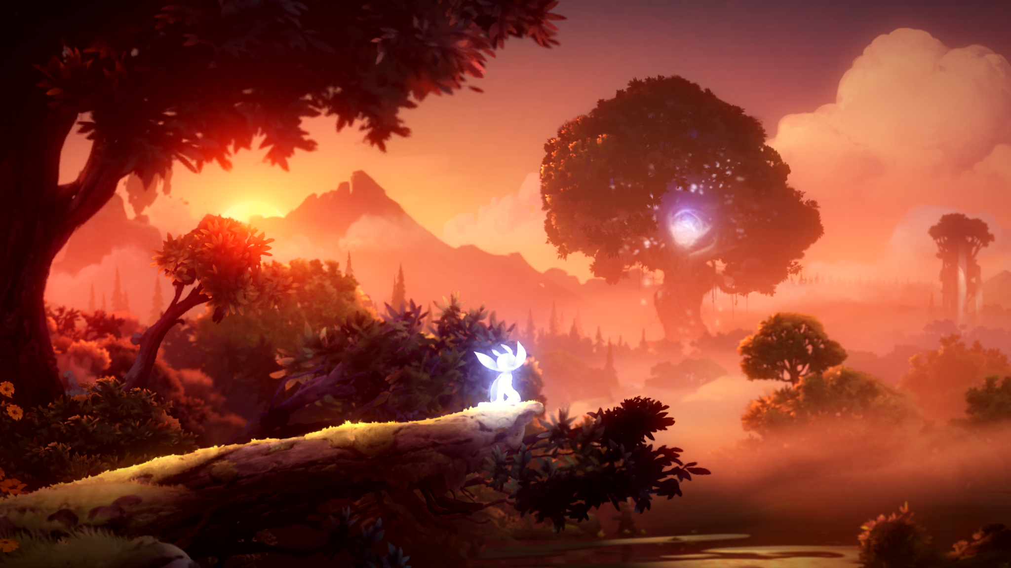
Team Roles
Audio
© 2022, 2024 Jeannie Novak All rights reserved.
Credit: Microsoft Corporation
Caption: Gareth Coker composed the score for Ori and the Will of the Wisps.

Slide 11
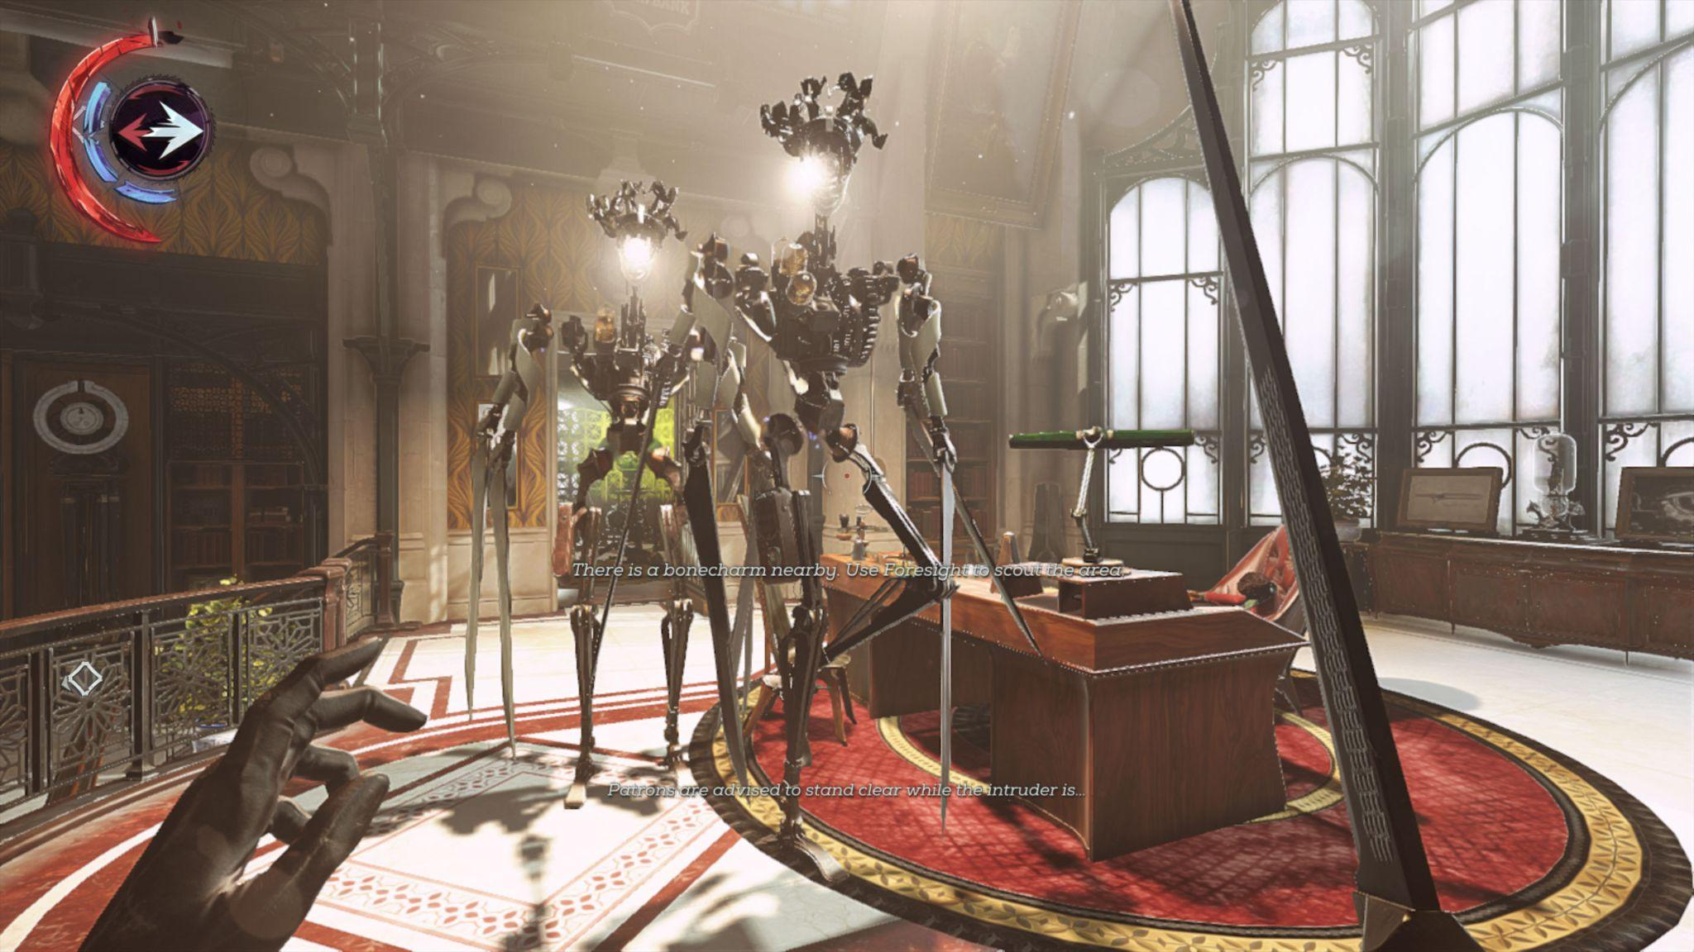
Team Roles
Testing & Quality Assurance
© 2022, 2024 Jeannie Novak All rights reserved.
Credit: MaxFreeman (MobyGames)
Caption: Amanda Burrelli was Quality Assurance Lead on Bethesda Softworks’ Dishonored: Death of the Outsider.

Slide 12
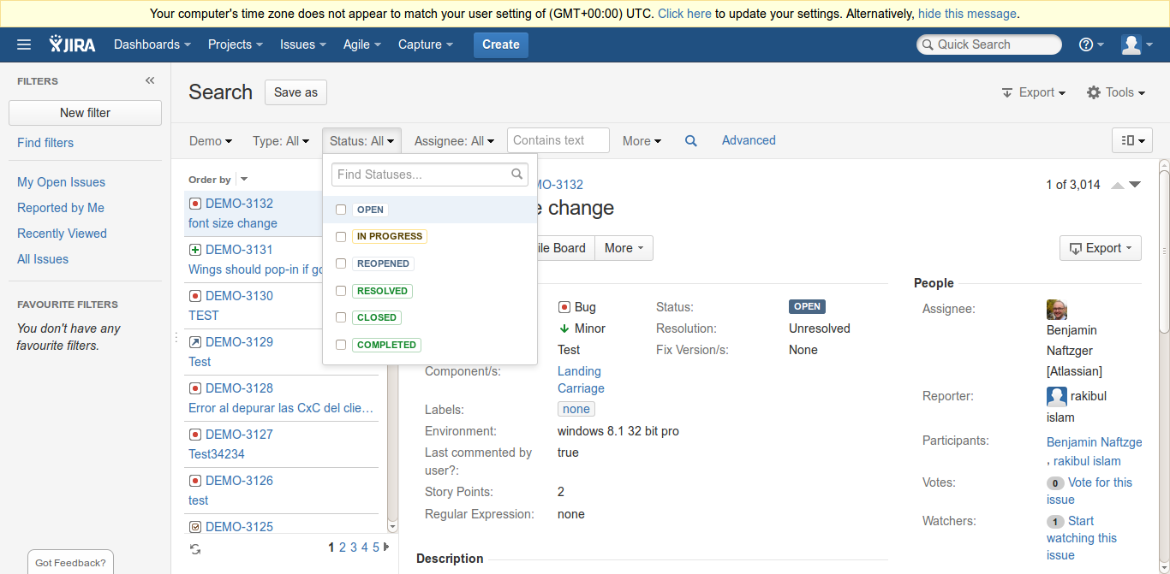
Tools & Techniques
Production
© 2022, 2024 Jeannie Novak All rights reserved.
Credit: Nguyen Hung Vu (flickr)
Credit: John Cummings (Wikimedia Commons
Caption: Project management and collaboration software packages such as Jira - left - and Asana - right - can be helpful tools in game production.

Slide 13
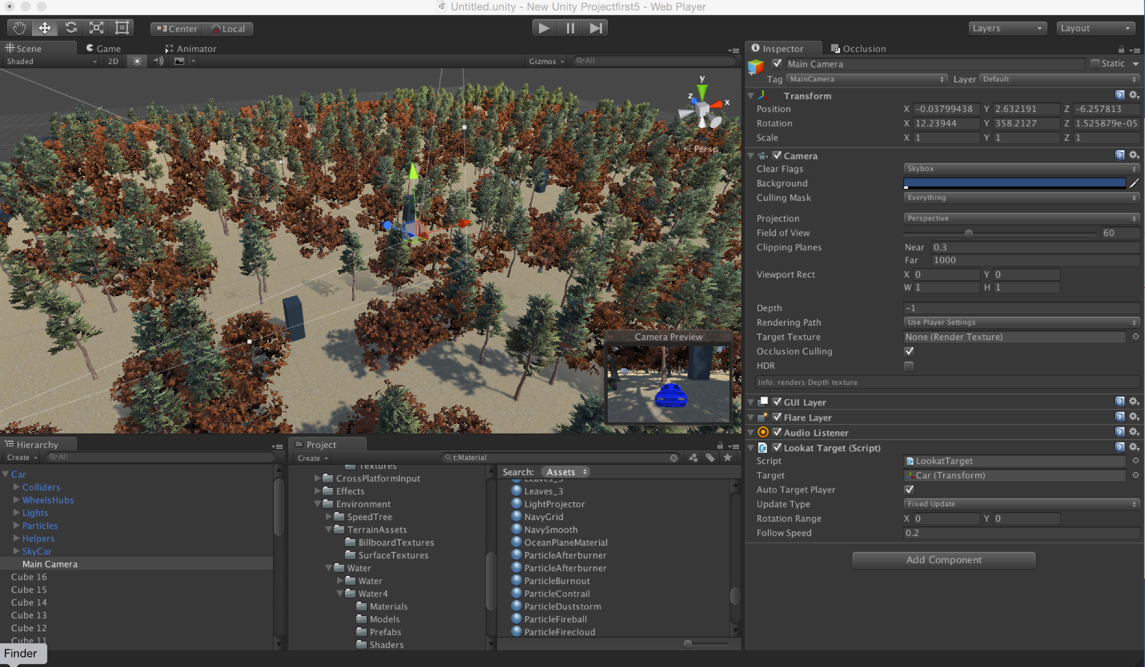
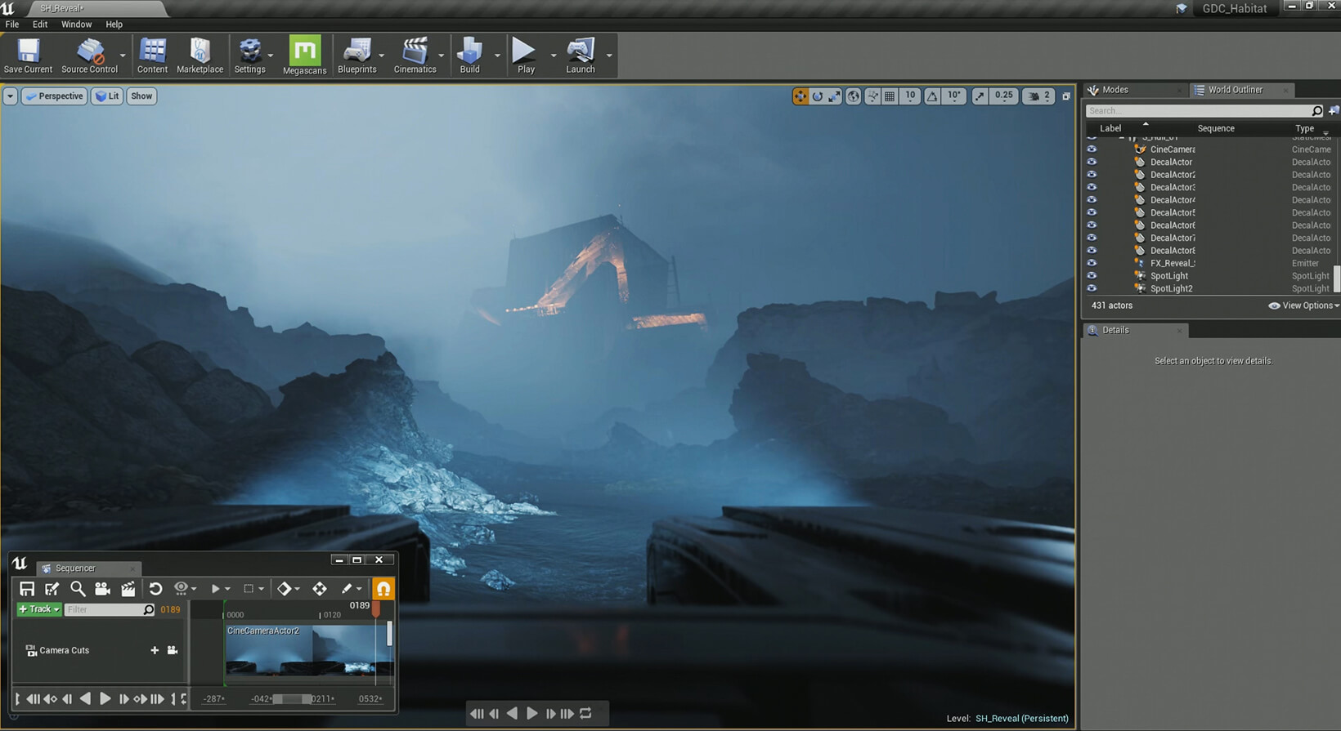
Tools & Techniques
Design & Programming
© 2022, 2024 Jeannie Novak All rights reserved.
Credit: Ian Hughes (flickr)
Credit: Epic Games
Caption: Game engines such as Unity - left - and Unreal Engine - right - are used by both designers and programmers.

Slide 14
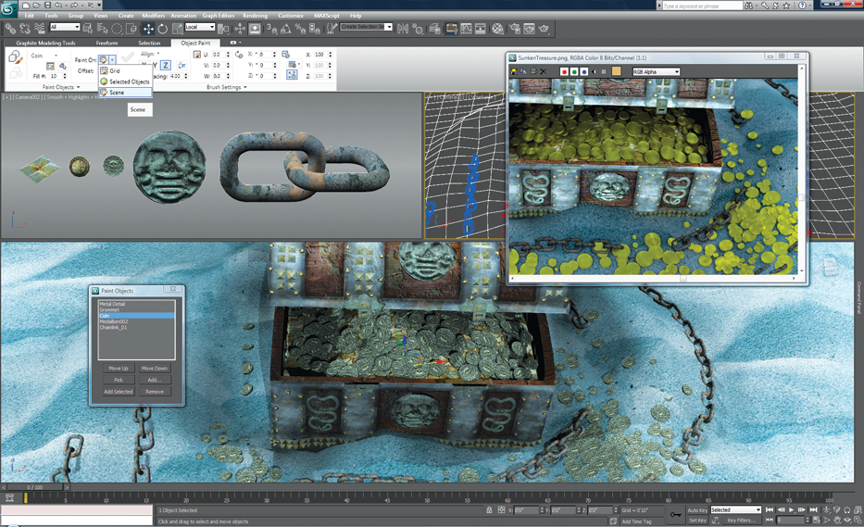
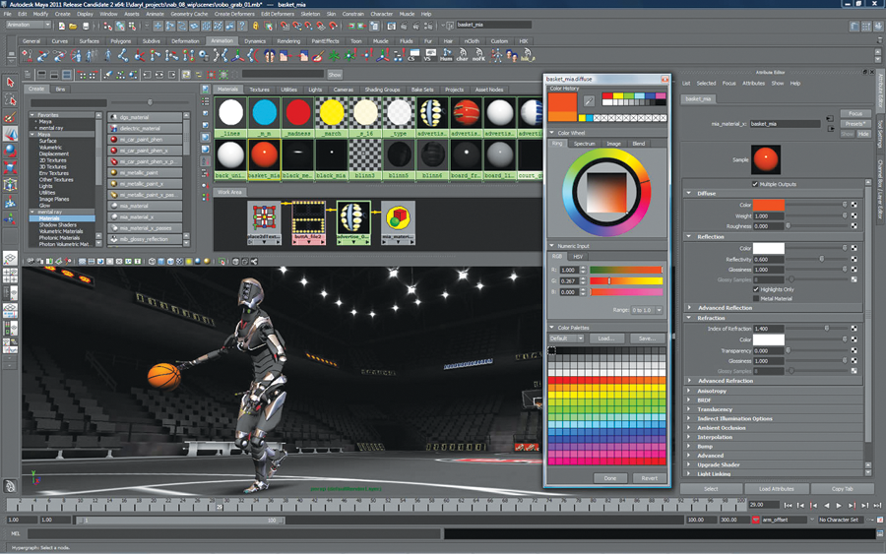
Tools & Techniques
Art
© 2022, 2024 Jeannie Novak All rights reserved.
Credit: Autodesk
Credit: Autodesk
Caption: Autodesk 3ds Max - left - and Maya - right - are industry standard game art asset creation, modeling, and animation tools.

Slide 15
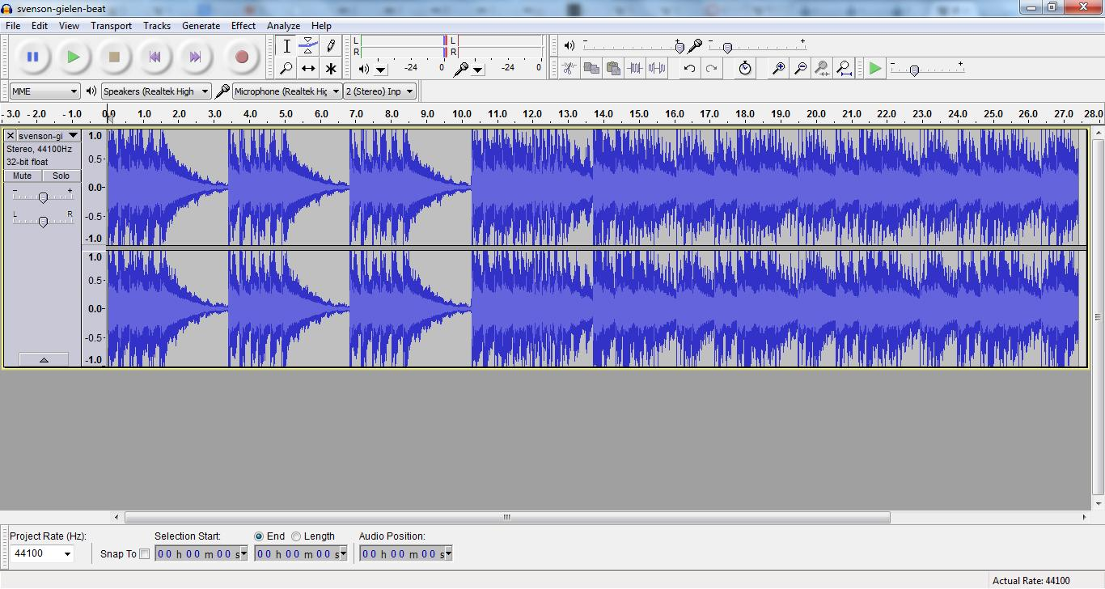
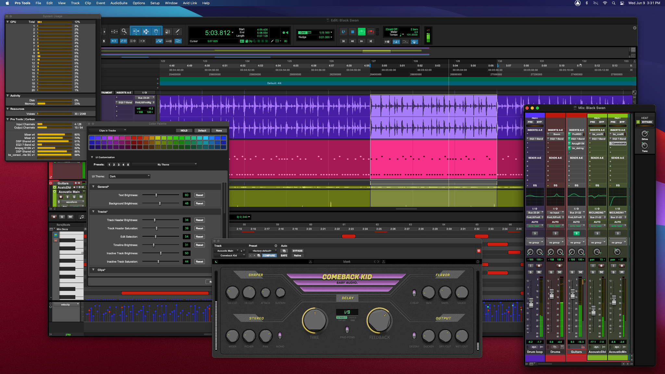
Tools & Techniques
Audio
© 2022, 2024 Jeannie Novak All rights reserved.
Credit: SourceForge & The Audacity Team
Credit: Avid Technology
Caption: Game audio professionals use everything from free software such as Audacity - left - to digital audio workstation software such as Pro Tools - right.

Slide 16
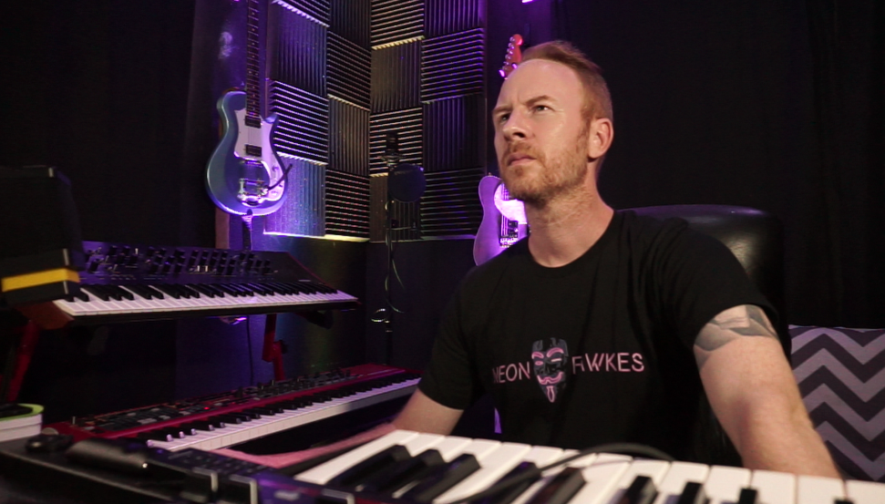
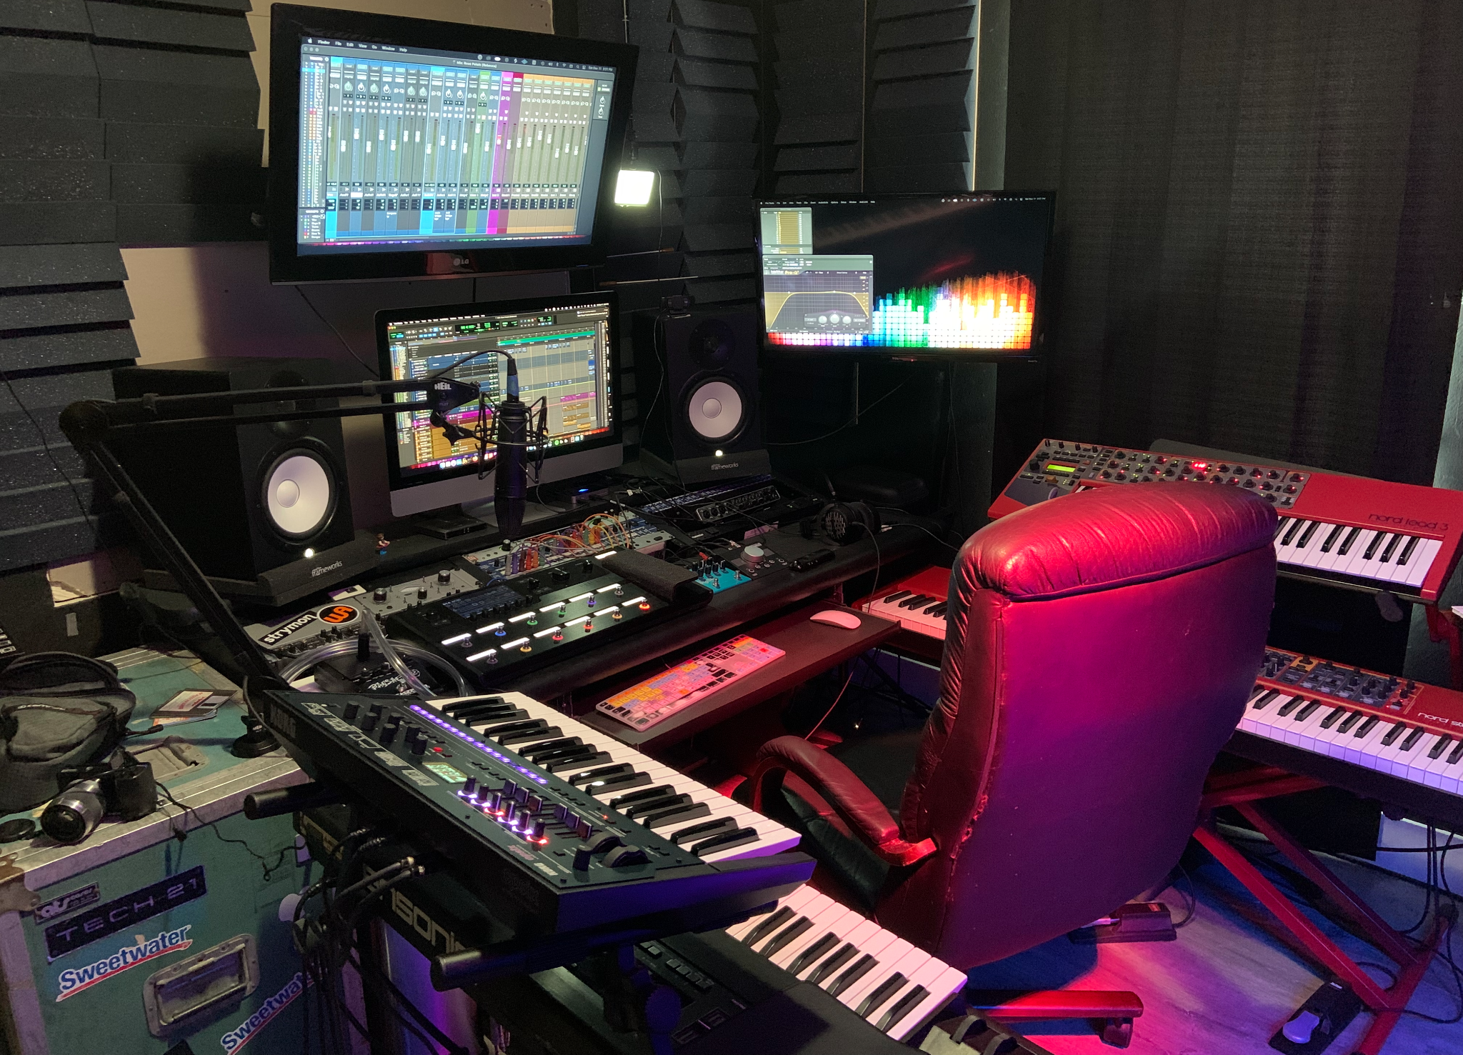
Tools & Techniques
Audio
© 2022, 2024 Jeannie Novak All rights reserved.
Credit: Kati Callahan
Credit: Kai Callahan
Caption: Composer Bobby Vickery in studio featuring Nord Lead 3 Synthesizer, Nord Stage 2 EX Piano, Korg Prologue Synthesizer, and Apple iMac running Avid Pro Tools.

Slide 17
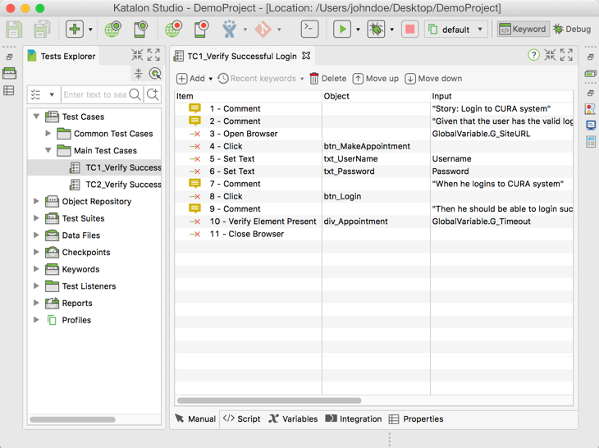
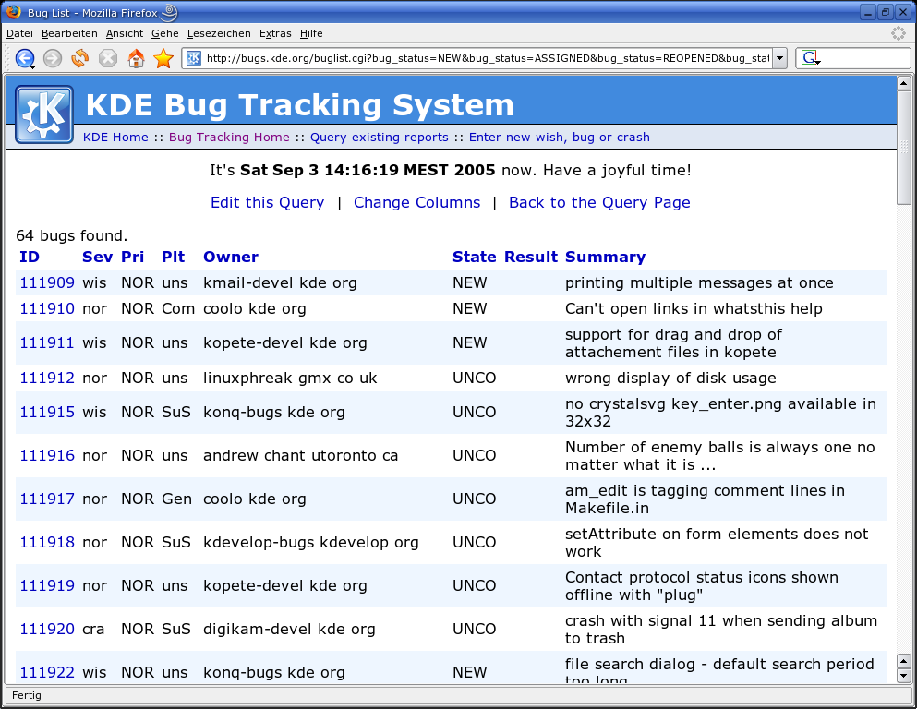
Tools & Techniques
Testing & Quality Assurance
© 2022, 2024 Jeannie Novak All rights reserved.
Credit: Katalon LLC (Wikimedia Commons)
Credit: Sven Krohlas (Wikimedia Commons)
Caption: Katalon Studio - left - and Bugzilla - right - are examples of open-source testing tools.

Slide 18
CHAPTER 10
© 2022, 2024 Jeannie Novak All rights reserved.
REVIEW EXERCISES
1
How do companies such as studios, publishers, licensors, and manufacturers work together to bring a
game to market? Compare and contrast business models as part of your answer.
2
The roles of artist and designer are sometimes confused with one another. How do these roles differ? Using one game as a reference, discuss three examples of how art is used in the game, and three examples of how design is used in the game. Does the game utilize art and design successfully?
Put together a team for an original game. Analyze each sub-team (art, design, tech, audio, testing) to determine the number of people you will have on each, along with their specialized roles. Consider the unique features of your game idea.
3

Slide 19
CHAPTER 10
© 2022, 2024 Jeannie Novak All rights reserved.
REVIEW EXERCISES
Experiment with tools such as game engines, level editors, and development suites. List their
features—comparing and contrasting them with each other. Which tool are you most comfortable
with, and why?
4
What are the benefits and drawbacks of running an independent game studio? How does this structure differ from third-party developers and publishers? If you were running an independent studio and you could initially hire only two team members, what roles would you assign to them?
5

