Slide 2
CHAPTER 9
Audio creating the atmosphere
© 2022, 2024 Jeannie Novak All rights reserved.

Slide 3
CHAPTER OBJECTIVES
© 2022, 2024 Jeannie Novak All rights reserved.
After reading this chapter, you should be able to:
Discuss why audio is an important aspect of game development.
Recognize how voiceovers, sound effects, and music are used effectively in a game.
Differentiate between looping and adaptive music.
Distinguish between composing for games and movies.
Compare the various formats and tools used in game audio.

Slide 4
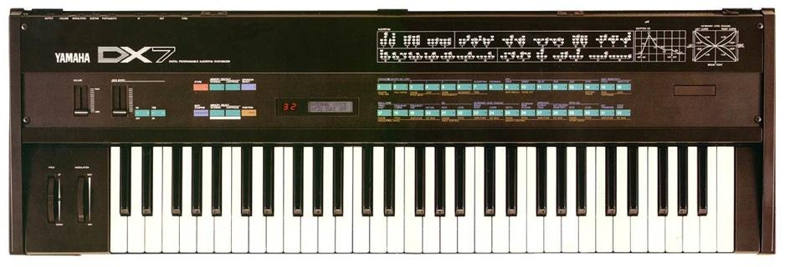
Formats & Tools
© 2022, 2024 Jeannie Novak All rights reserved.
Credit: Finnianhughes101 (Wikimedia Commons)
Caption: Yamaha licensed FM synthesis technology to create the DX7—the first successful digital synthesizer.

Slide 5
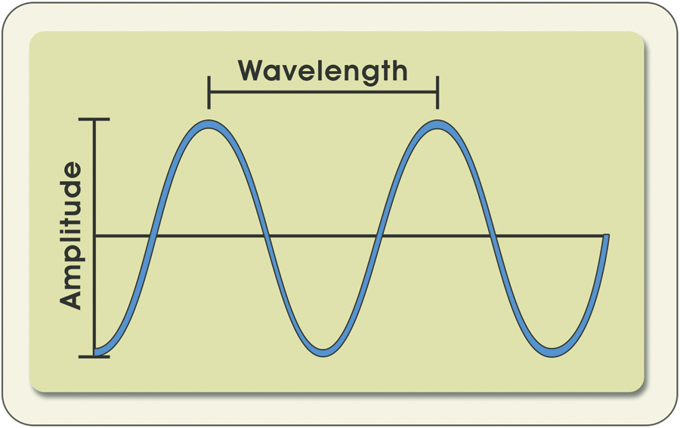
Formats & Tools
© 2022, 2024 Jeannie Novak All rights reserved.
Credit: Diagram by Per Olin
Caption: FM synthesis involves generating sounds from mathematical data associated with sound waves.

Slide 6
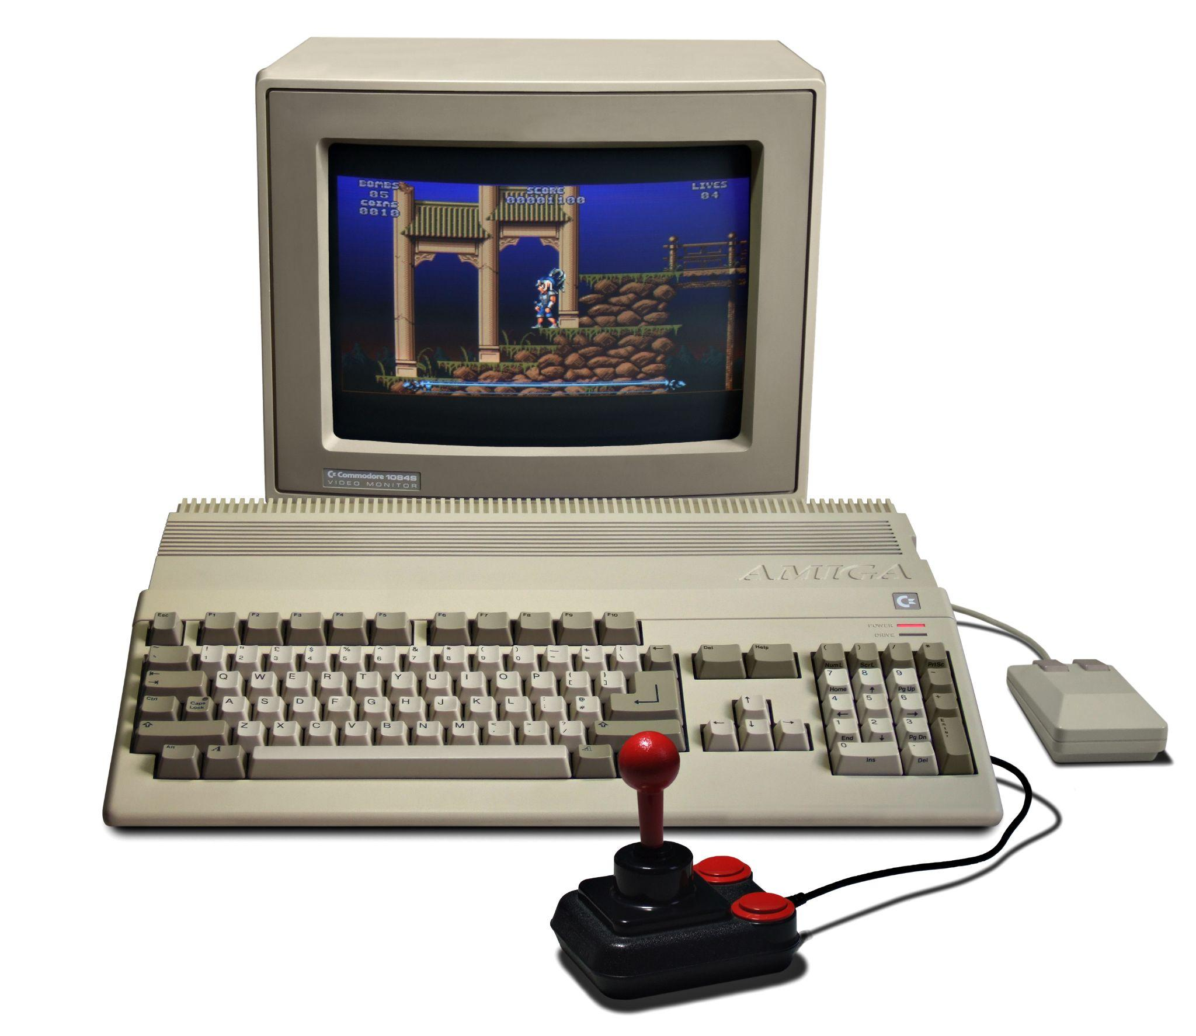
Formats & Tools
© 2022, 2024 Jeannie Novak All rights reserved.
Credit: Bill Bertram (Wikimedia Commons)
Caption: A basic version of the MOD format was introduced with the Commodore Amiga.

Slide 7
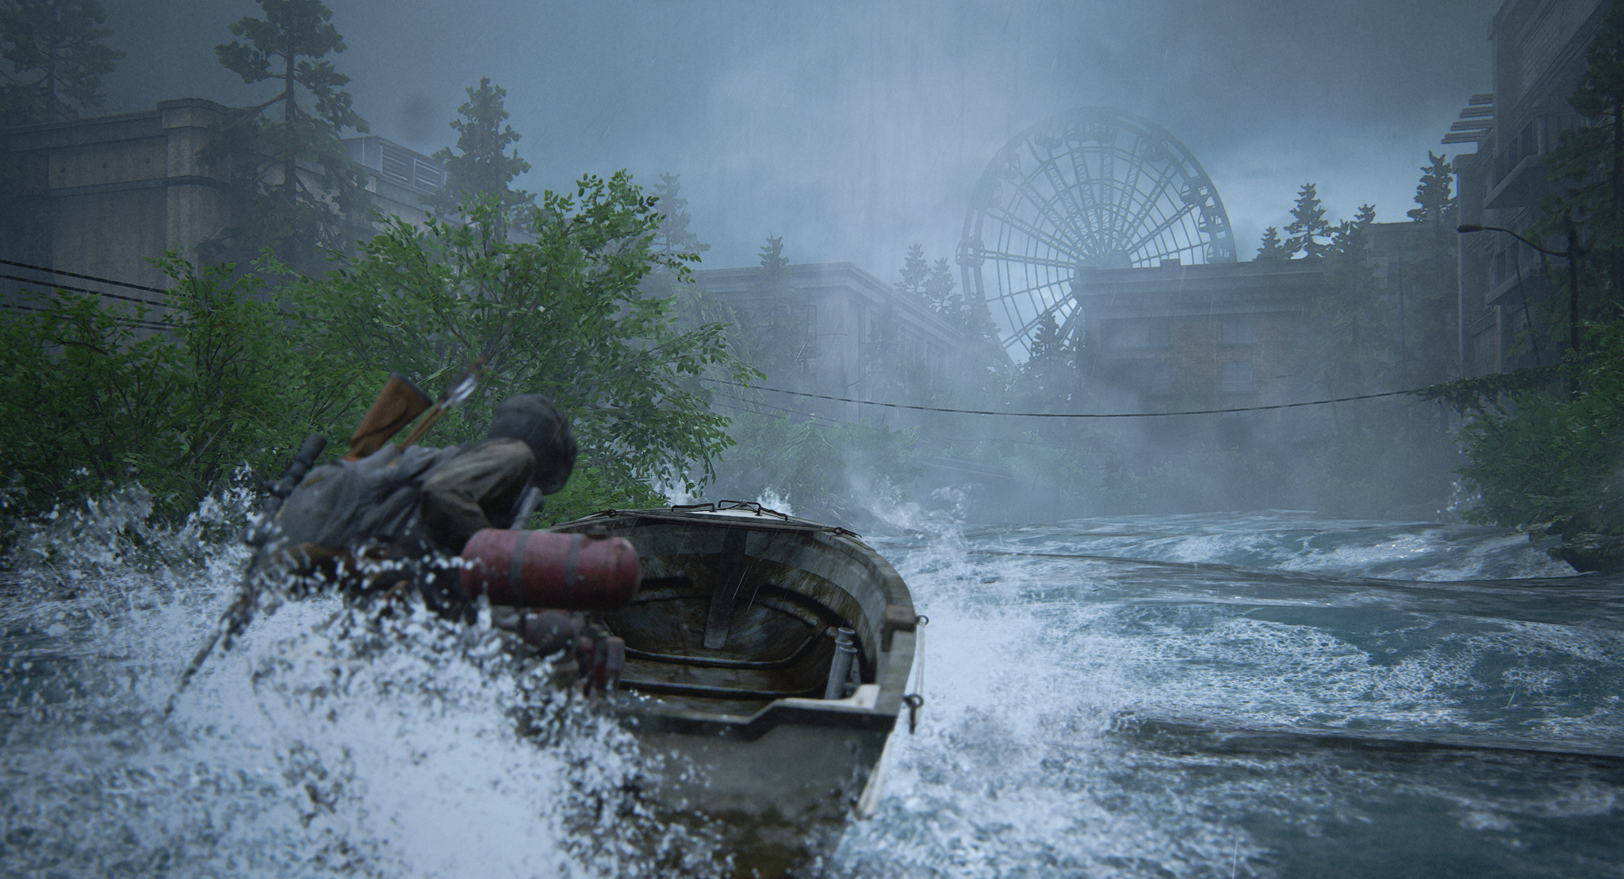
Sound Effects
© 2022, 2024 Jeannie Novak All rights reserved.
Credit: Sony Interactive Entertainment
Caption: The Last of Us Part II has garnered awards for excellence in sound design.

Slide 8
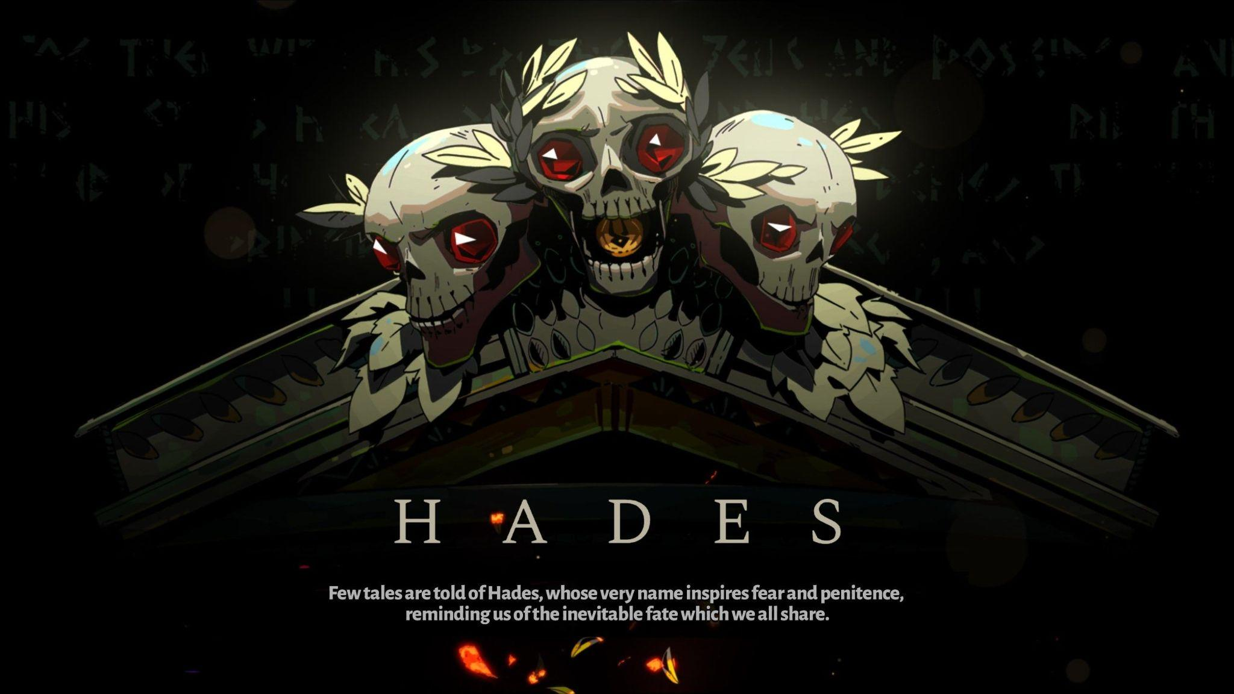
Voiceovers
© 2022, 2024 Jeannie Novak All rights reserved.
Credit: Sciere (MobyGames)
Caption: Logan Cunningham won a BAFTA award for voicing a number of characters in Supergiant Games’ Hades—including The Storyteller, Charon, Asterius, Poseidon, Achilles, and Hades.

Slide 9
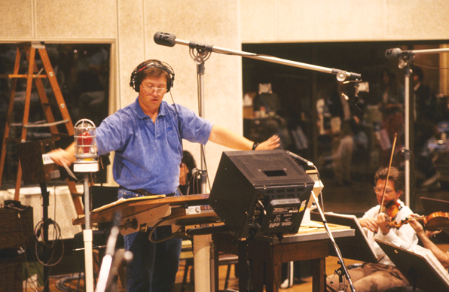
Music
Game vs. Film Scoring
© 2022, 2024 Jeannie Novak All rights reserved.
Credit: RJ
Caption: Composer Ron Jones conducting an orchestra.

Slide 10
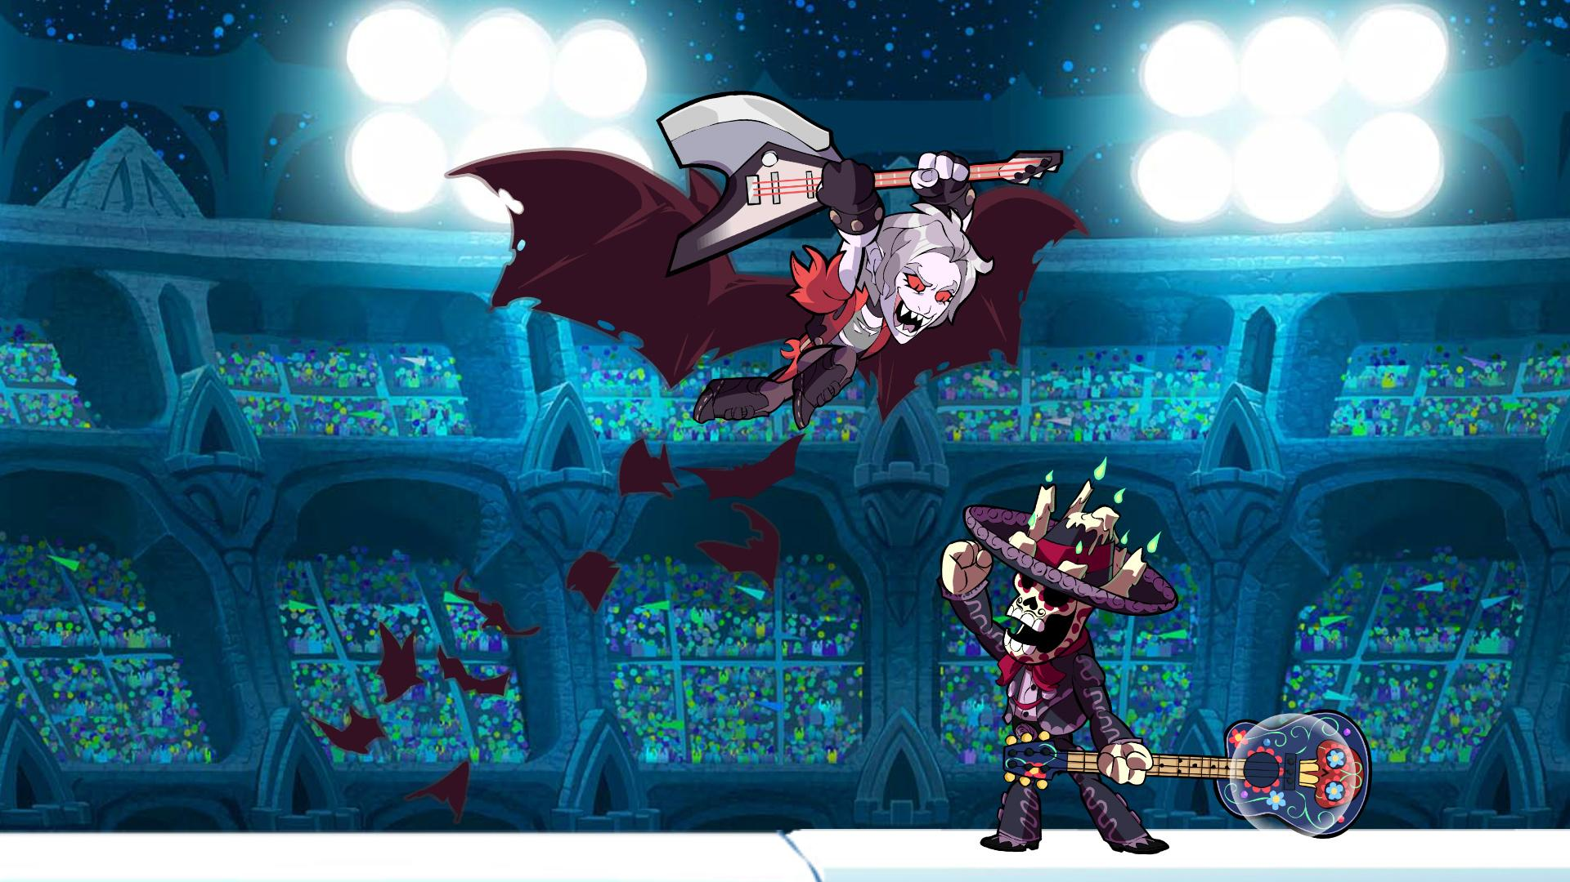
Music
Looping Music
© 2022, 2024 Jeannie Novak All rights reserved.
Credit: Blue Mammoth Games
Caption: Brawlhalla features a score that consists primarily of cleverly constructed looping music.

Slide 11
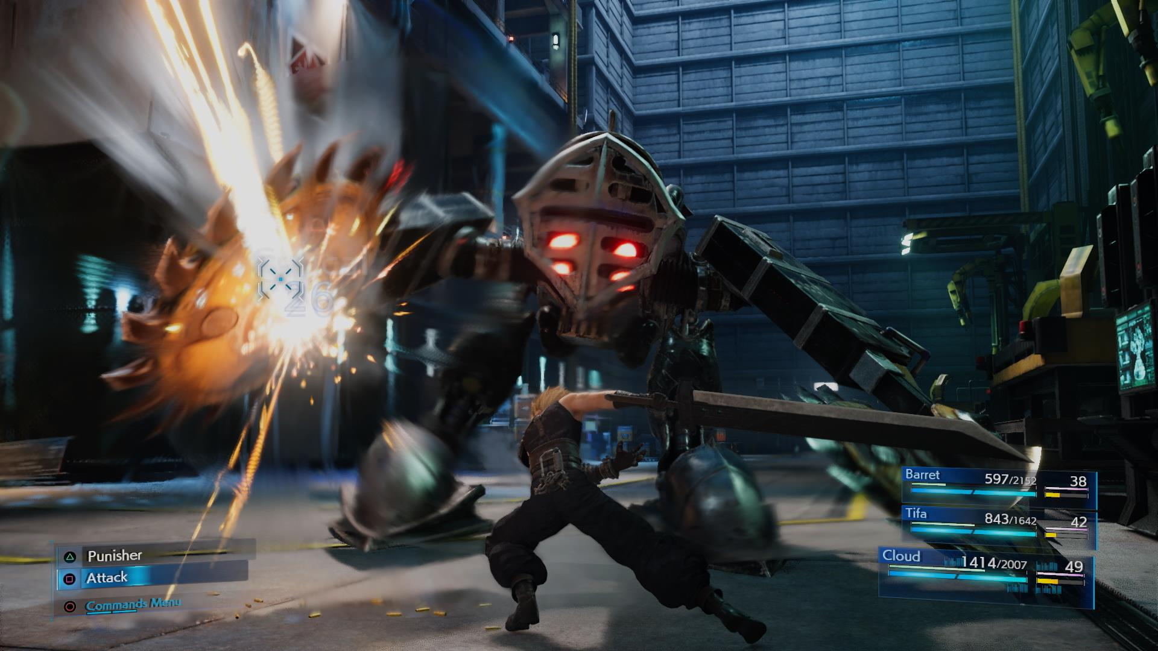
Music
Adaptive Music
© 2022, 2024 Jeannie Novak All rights reserved.
Credit: Square Enix
Caption: Final Fantasy VII Remake features a wholly adaptive, dynamic score that responses to in-game action.

Slide 12
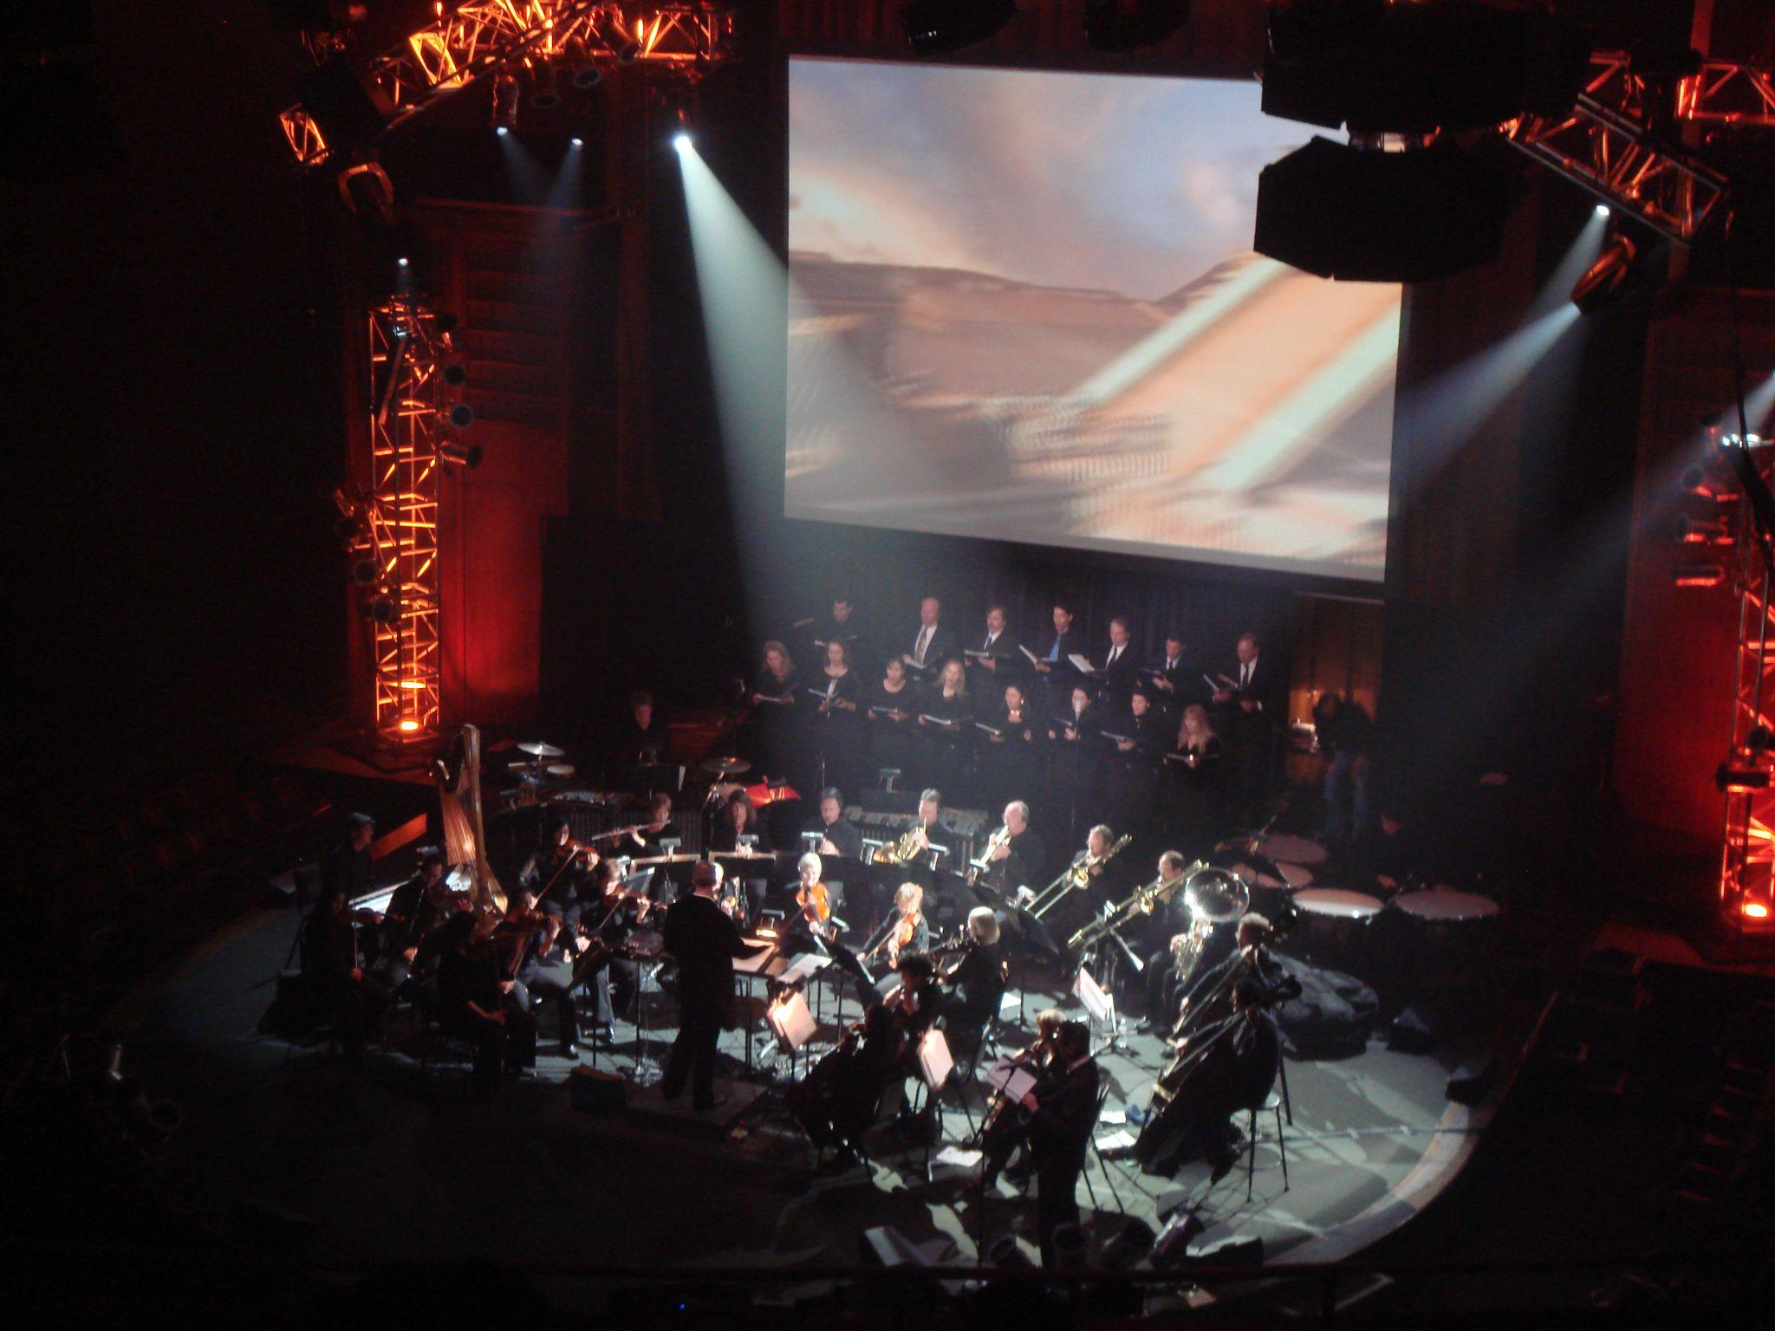
Music
Events
© 2022, 2024 Jeannie Novak All rights reserved.
Credit: Noelle Paduan (flickr)
Caption: Video Games Live has had more than 400 shows worldwide to date.

Slide 13
CHAPTER 9
© 2022, 2024 Jeannie Novak All rights reserved.
REVIEW EXERCISES
1
What functions does audio serve in games? Why is audio an important (but often overlooked) element in game development? Can you think of a purpose of game audio that wasn’t discussed in this chapter?
2
What’s the difference between looping and adaptive music in games? Discuss how two current games use these forms of music. Why can adaptive music sometimes be more effective than looping music?
3
What are some essential tools utilized by audio professionals in the game industry? What do these tools help audio professionals accomplish?

Slide 14
CHAPTER 9
© 2022, 2024 Jeannie Novak All rights reserved.
REVIEW EXERCISES
How are voiceovers, sound effects, and music used effectively in a game? How would you integrate all three audio forms into your original game? Consider the genre, subject matter, style of play, platform, and mood of your game in your answer.
4
5
Game and film scoring are very different from each other. Analyze and discuss the major distinctions between these two media. Tie these differences into what you have learned about gameplay, story, and character development.

Slide 15
CHAPTER 9
© 2022, 2024 Jeannie Novak All rights reserved.
REVIEW EXERCISES
How is voice acting in games different from other media? What are the benefits and disadvantages of working as a voice actor in this medium? If you were producing a game dialogue session, how would you change the way the session was structured to get the best performances out of your actors?
6
7
If you were designing sound for a game, in what instances would you create your own sounds versus utilizing pre-existing material from a library? Similarly, when would you create (or hire someone to create) original music rather than licensing pre-existing material from a library or label?

Slide 16
CHAPTER 9
© 2022, 2024 Jeannie Novak All rights reserved.
REVIEW EXERCISES
Experiment with foley and come up with new ways to create sound effects that were not listed in this chapter. Capture your foley creations with a recorder. Take the recorder with you wherever you go and capture unique sounds from the environment. Catalog your recordings in a spreadsheet and consider what types of game sounds could be reflected by your recordings. Apply some of what you have recorded to your own original game.
8

