Slide 2
CHAPTER 8
INTERFACE CREATING THE CONNECTION
© 2022, 2024 Jeannie Novak All rights reserved.

Slide 3
CHAPTER OBJECTIVES
© 2022, 2024 Jeannie Novak All rights reserved.
After reading this chapter, you should be able to:
Understand how game interfaces relate to player-centered design.
Explain how an interface can support game features such as gameplay, story, and world.
Distinguish between a physical and visual interface.
Differentiate between a passive and active interface.
Discuss why usability and accessibility are important in game interface design.

Slide 4
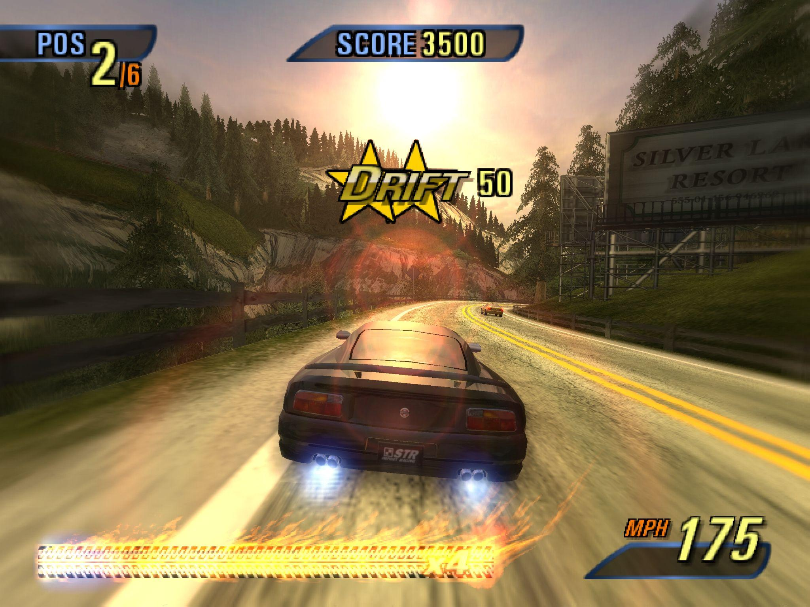
Interface & Game Features
Gameplay
© 2022, 2024 Jeannie Novak All rights reserved.
Credit: Electronic Arts
Caption: The Burnout 3: Takedown interface supports gameplay.

Slide 5
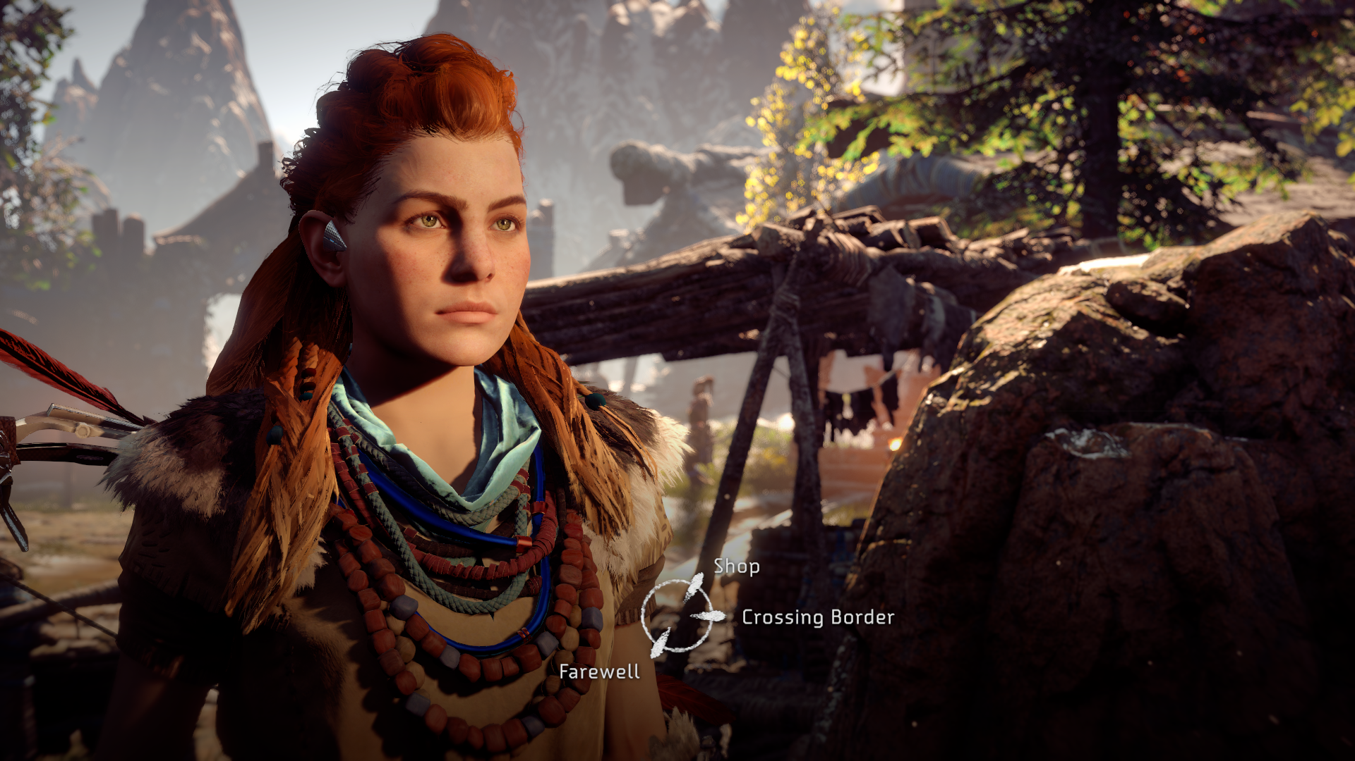
Interface & Game Features
Story
© 2022, 2024 Jeannie Novak All rights reserved.
Credit: Sony Interactive Entertainment
Caption: Interface elements are used to support a rich storyline in Horizon Zero Dawn.

Slide 6
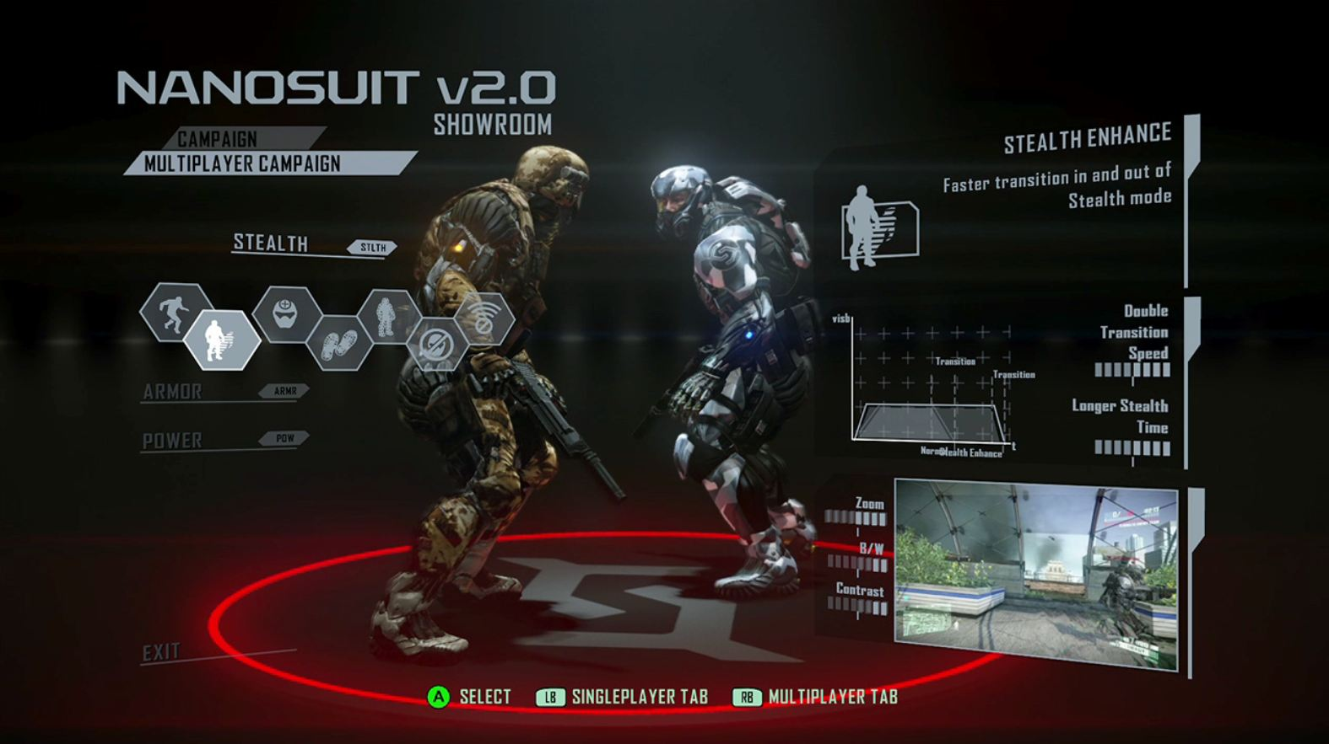
Interface & Game Features
Character
© 2022, 2024 Jeannie Novak All rights reserved.
Credit: Electronic Arts
Caption: Interfaces can support character abilities and equipment, as shown in the Nanosuit Showroom in Crysis 2.

Slide 7
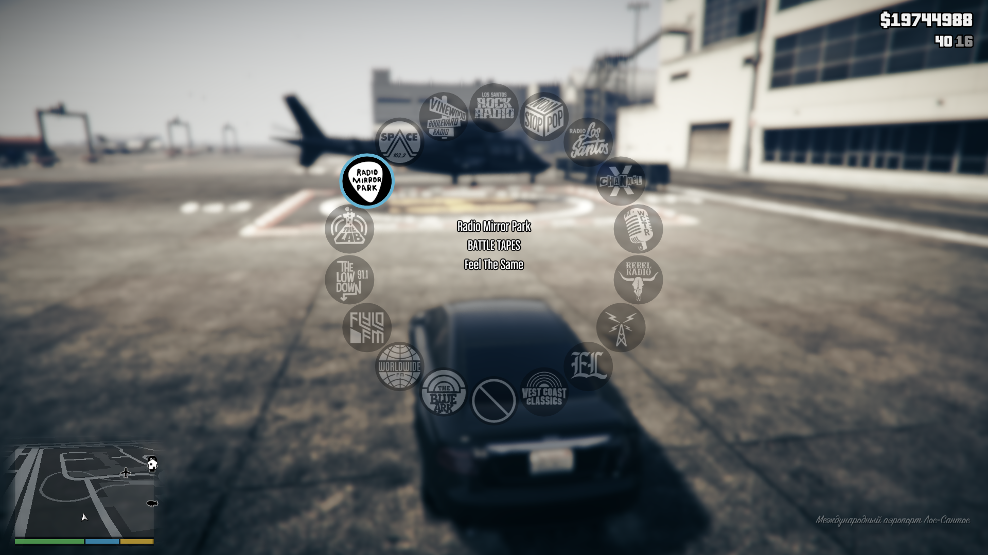
Interface & Game Features
Audio
© 2022, 2024 Jeannie Novak All rights reserved.
Credit: GTramp (MobyGames)
Caption: In Grand Theft Auto V, players can select the radio station through the interface.

Slide 8
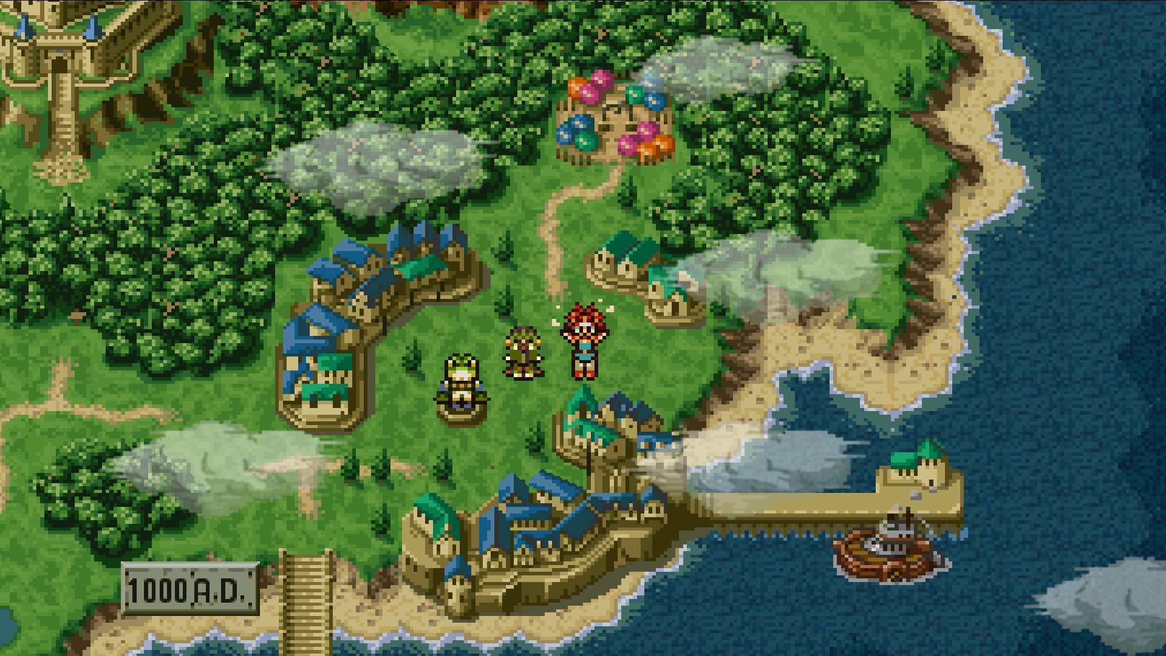
Interface & Game Features
World
© 2022, 2024 Jeannie Novak All rights reserved.
Credit: Square Enix
Caption: In Chrono Trigger, players may select a location or level through the overworld map.

Slide 9
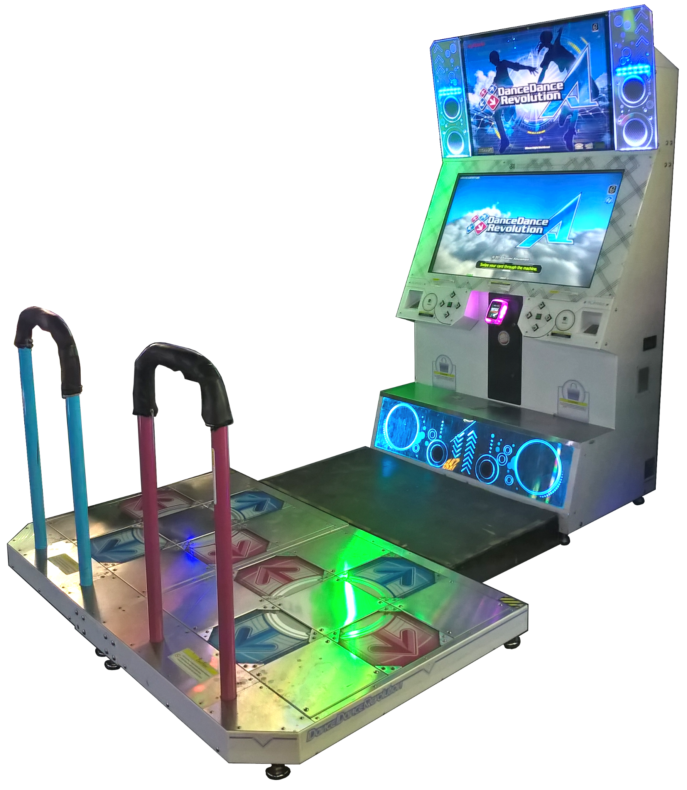
Physical Interfaces
Arcade
© 2022, 2024 Jeannie Novak All rights reserved.
Credit: LABcrabs (Wikimedia Commons)
Caption: Dance Dance Revolution uses a dance pad as a physical interface.

Slide 10
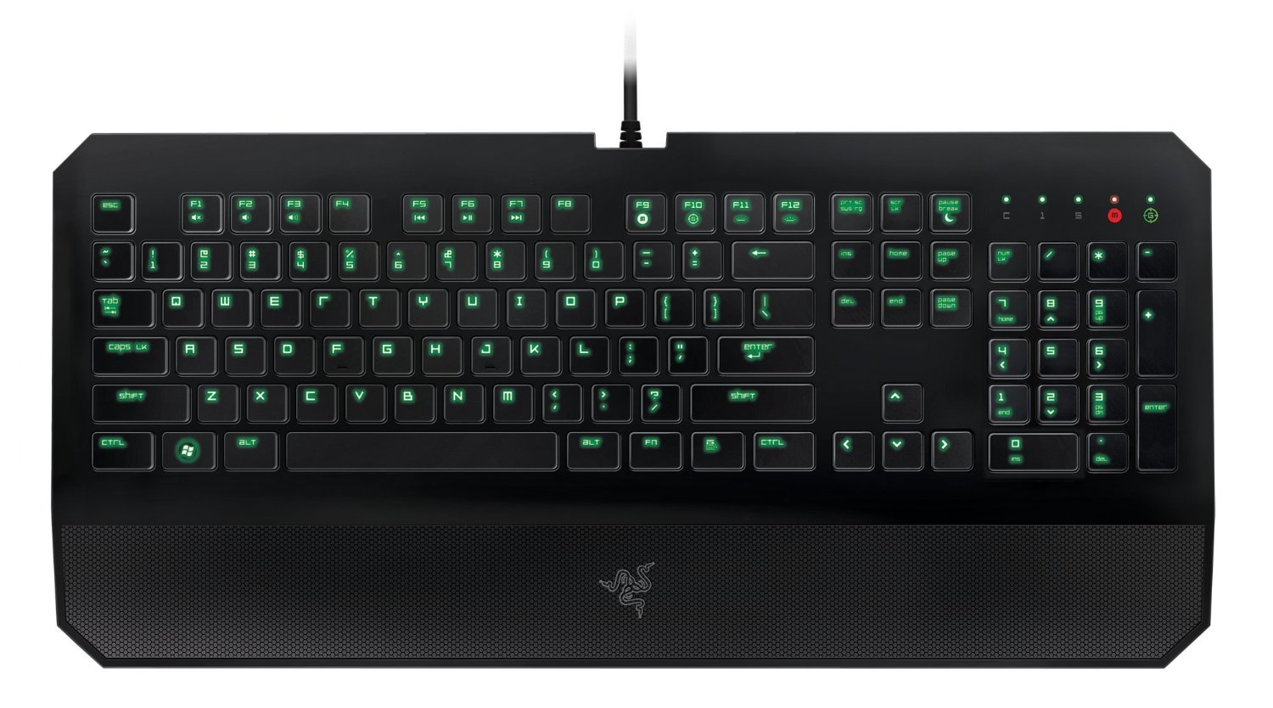
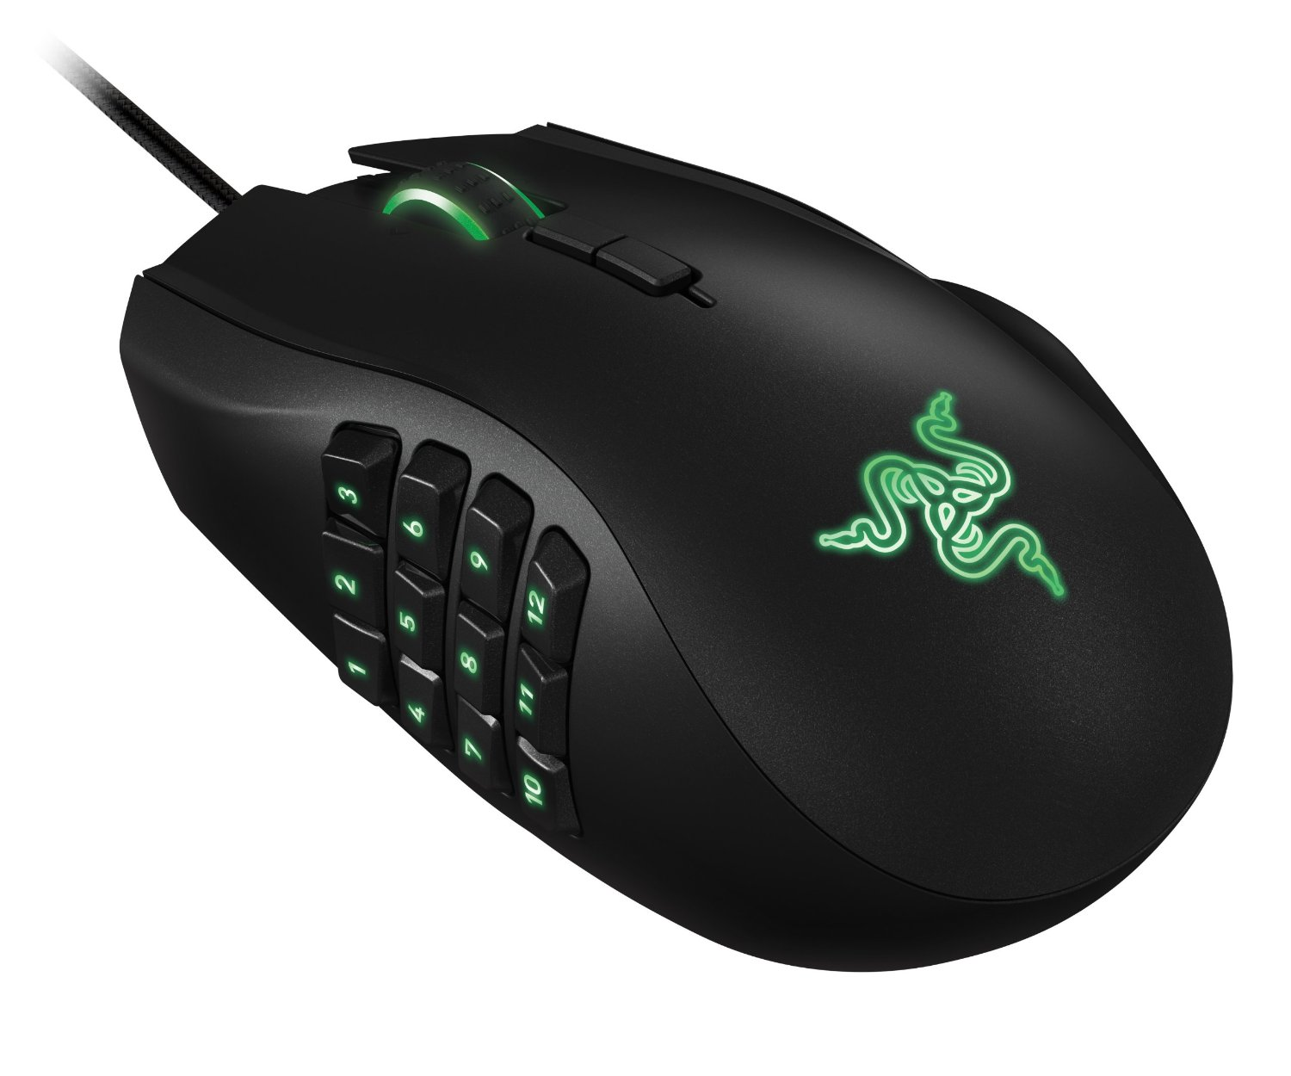
Physical Interfaces
Computer
© 2022, 2024 Jeannie Novak All rights reserved.
Credit: Shakib Saifi (flickr)
Credit: osman gucel (Wikimedia Commons)
Caption: Razer’s DeathStalker Expert backlit membrane gaming keyboard - left - and Naga 2014 ergonomic MMO gaming mouse - right.

Slide 11
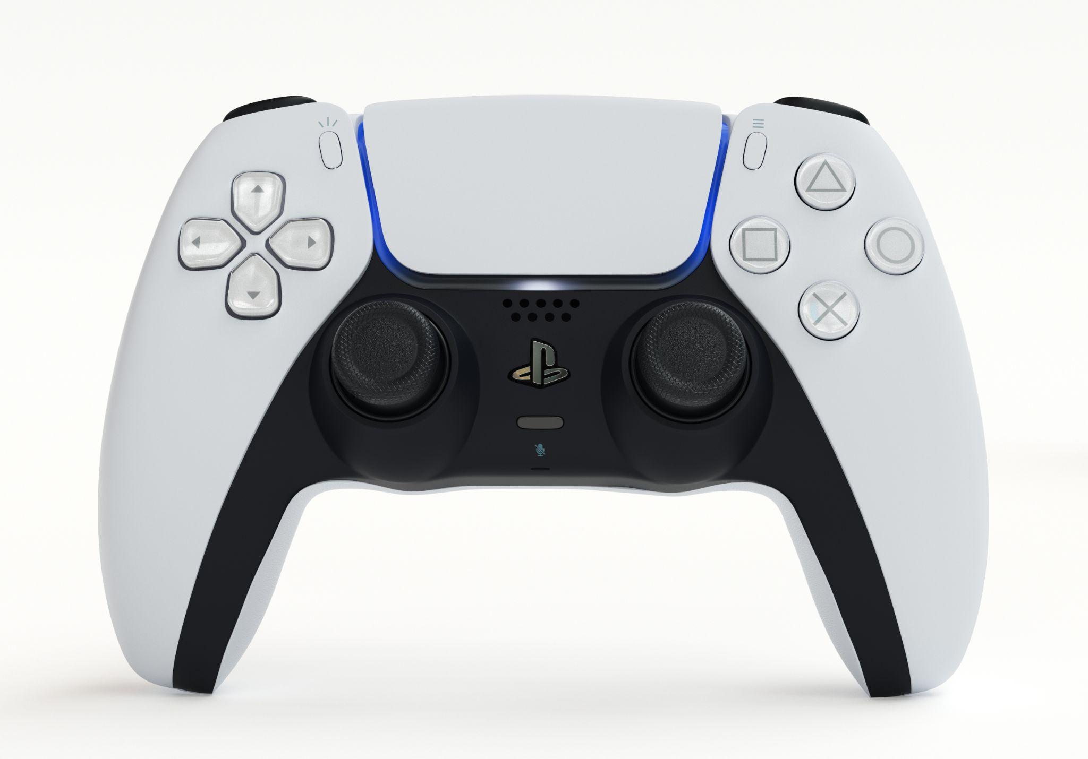
Physical Interfaces
Console & Handheld
© 2022, 2024 Jeannie Novak All rights reserved.
Credit: ALDECA studio (Shutterstock) - modified by Justin Sadur
Caption: PlayStation 5 DualSense wireless controller in white/black

Slide 12
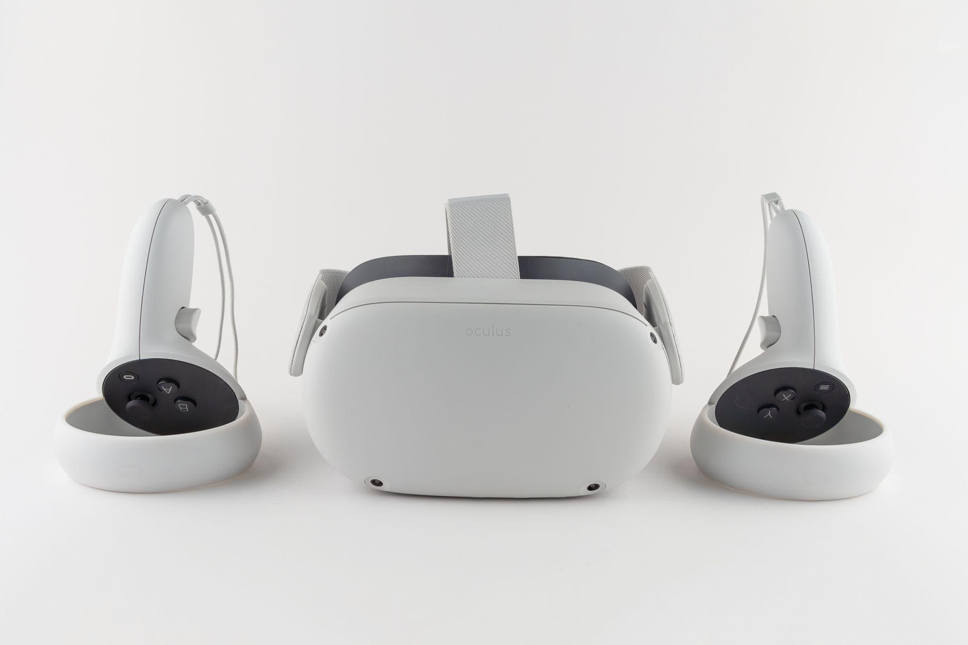
Physical Interfaces
Immersive
© 2022, 2024 Jeannie Novak All rights reserved.
Credit: Craig Russell (Shutterstock) - modified by Justin Sadur
Caption: Meta Quest 2 headset and Touch controllers

Slide 13
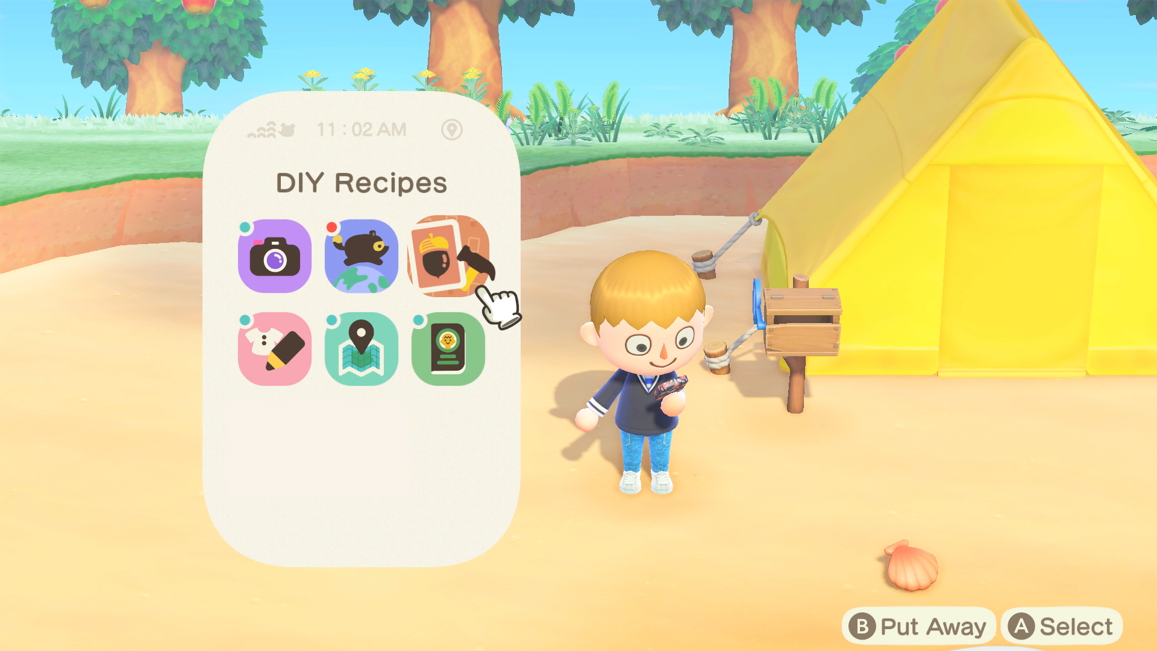
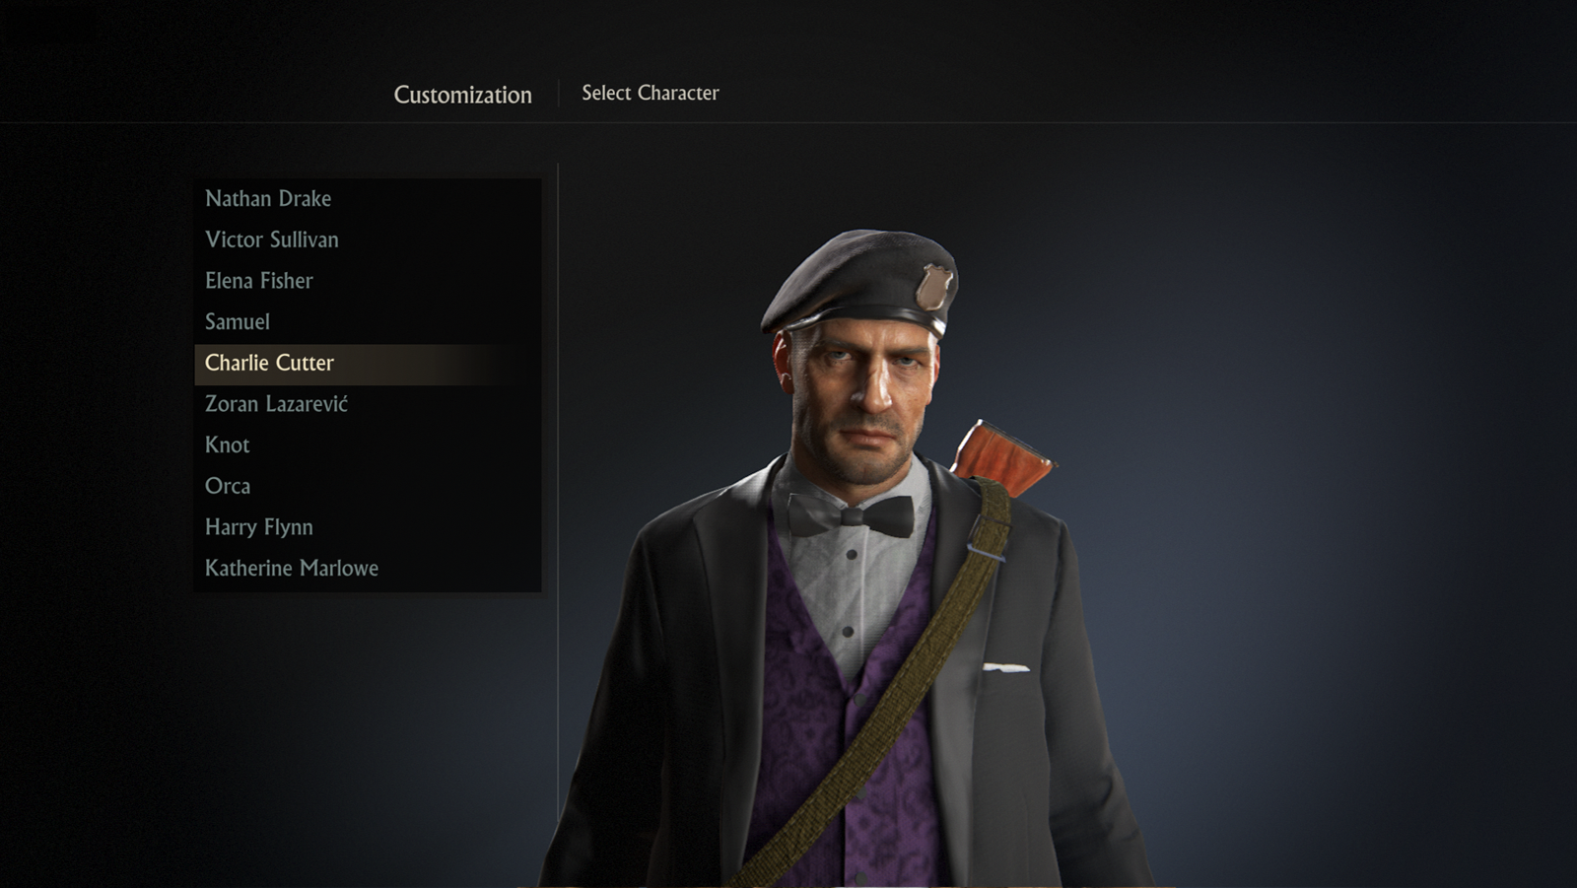
Visual Interfaces
Classification
© 2022, 2024 Jeannie Novak All rights reserved.
Credit: Nintendo
Credit: Sony Interactive Entertainment
Caption: Active interface menus include crafting in Animal Crossing: New Horizons - left - and character customization/selection in Uncharted 4: A Thief’s End - right.

Slide 14
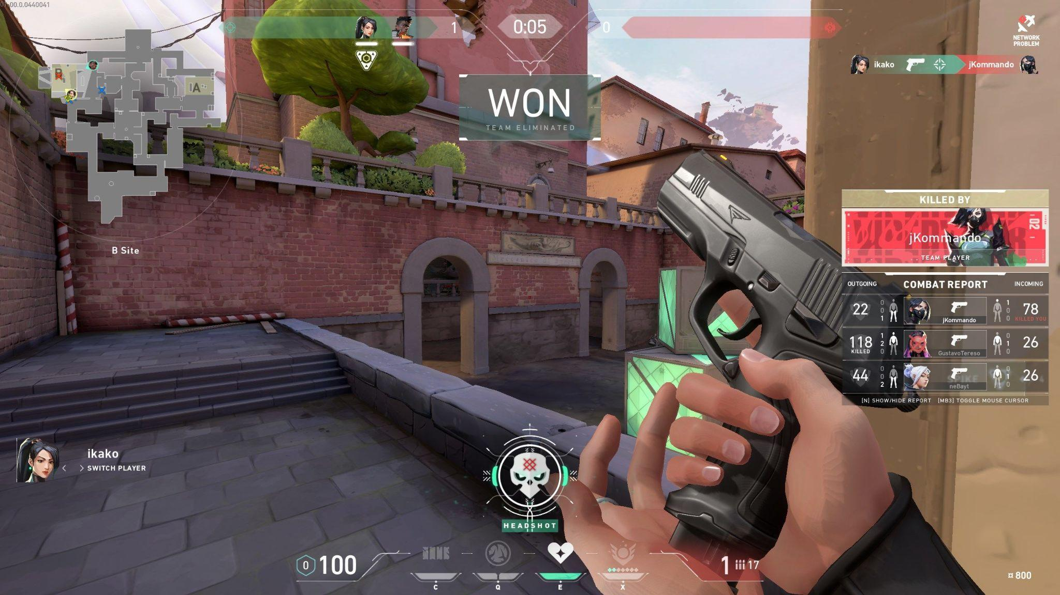
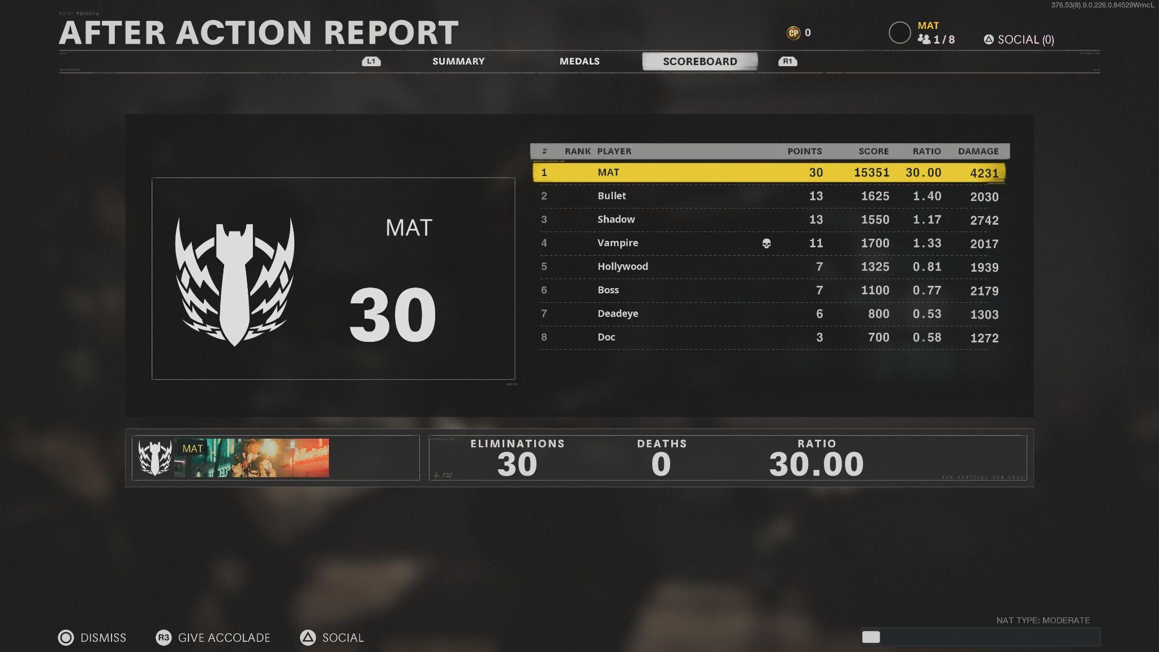
Visual Interfaces
Components
© 2022, 2024 Jeannie Novak All rights reserved.
Credit: Sciere (MobyGames)
Credit: MAT (MobyGames)
Caption: Scores can appear in-game as part of a heads-up display (Valorant - left) or in a separate menu (Call of Duty: Black Ops - Cold War - right).

Slide 15
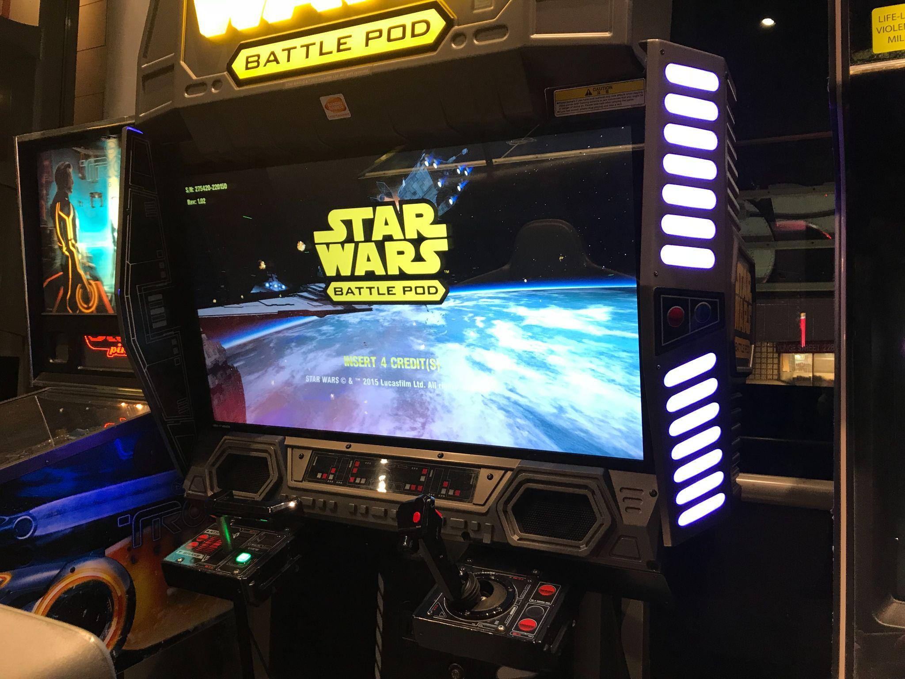
Visual Interfaces
Platform-Specific Features
© 2022, 2024 Jeannie Novak All rights reserved.
Credit: PvOberstein (Wikimedia Commons)
Caption: Start screen on Star Wars Battle Pod arcade cabinet.

Slide 16
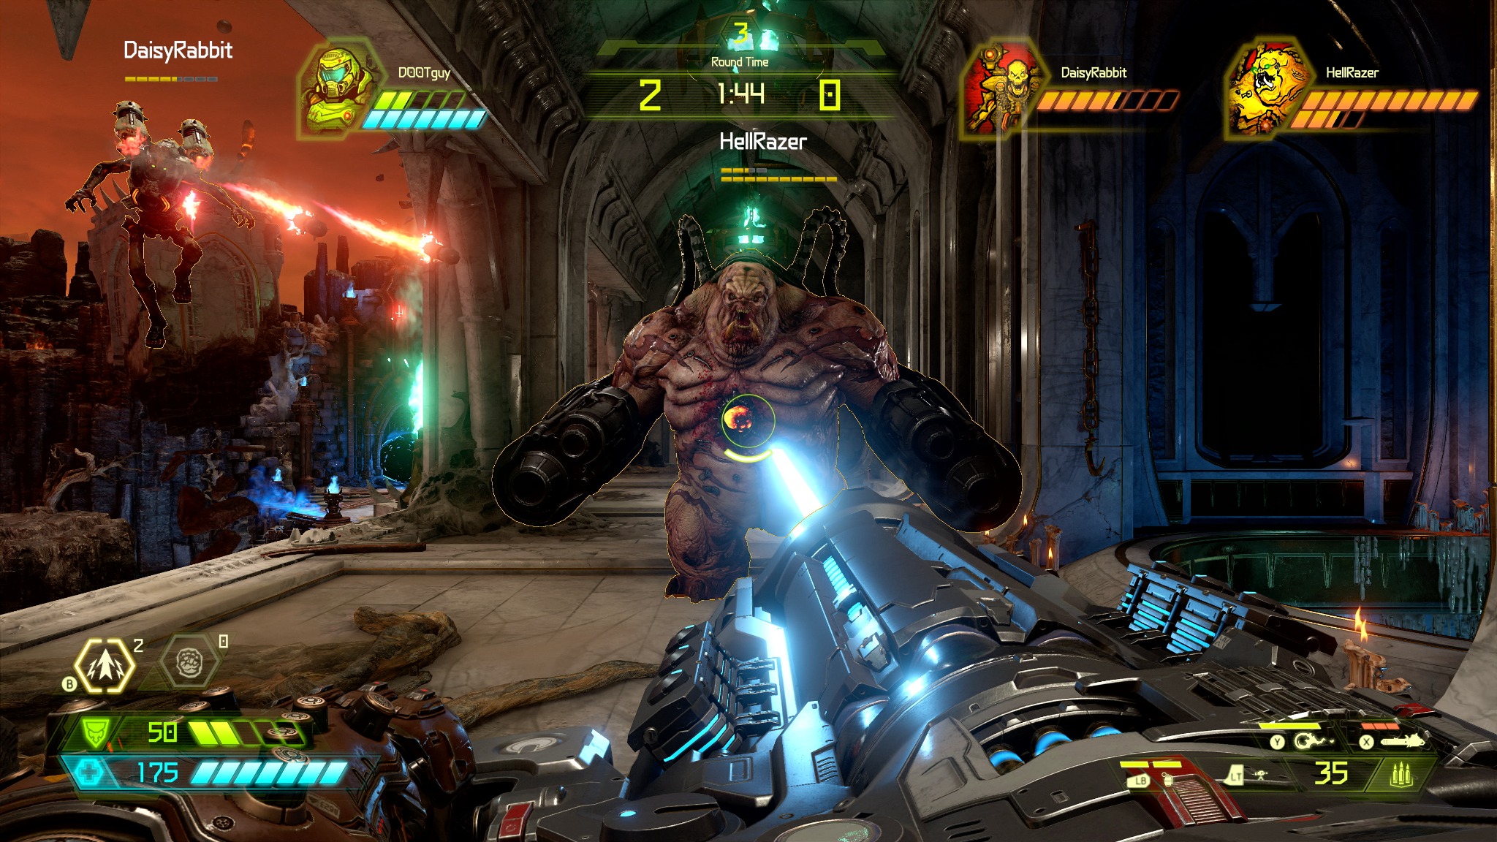
Visual Interfaces
Genre-Specific Features
© 2022, 2024 Jeannie Novak All rights reserved.
Credit: Bethesda Softworks LLC
Caption: HUDs are common in action games such as Doom Eternal.

Slide 17
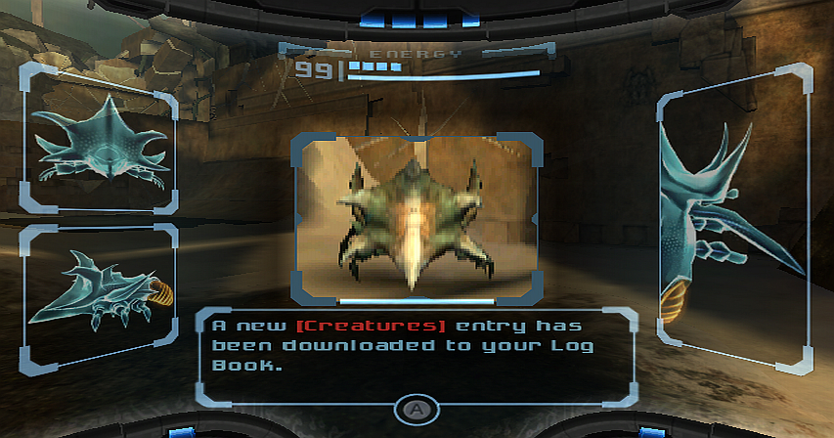
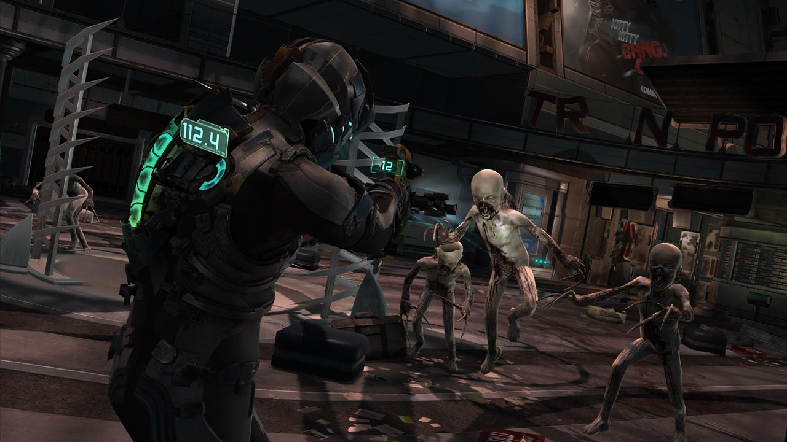
Usability
© 2022, 2024 Jeannie Novak All rights reserved.
Credit: Nintendo
Credit: Electronic Arts
Caption: Interfaces designed with usability in mind include the Scan Visor HUD from Metroid Prime - left - and the player’s suit displaying health and stasis bars in Dead Space 2 - right.

Slide 18
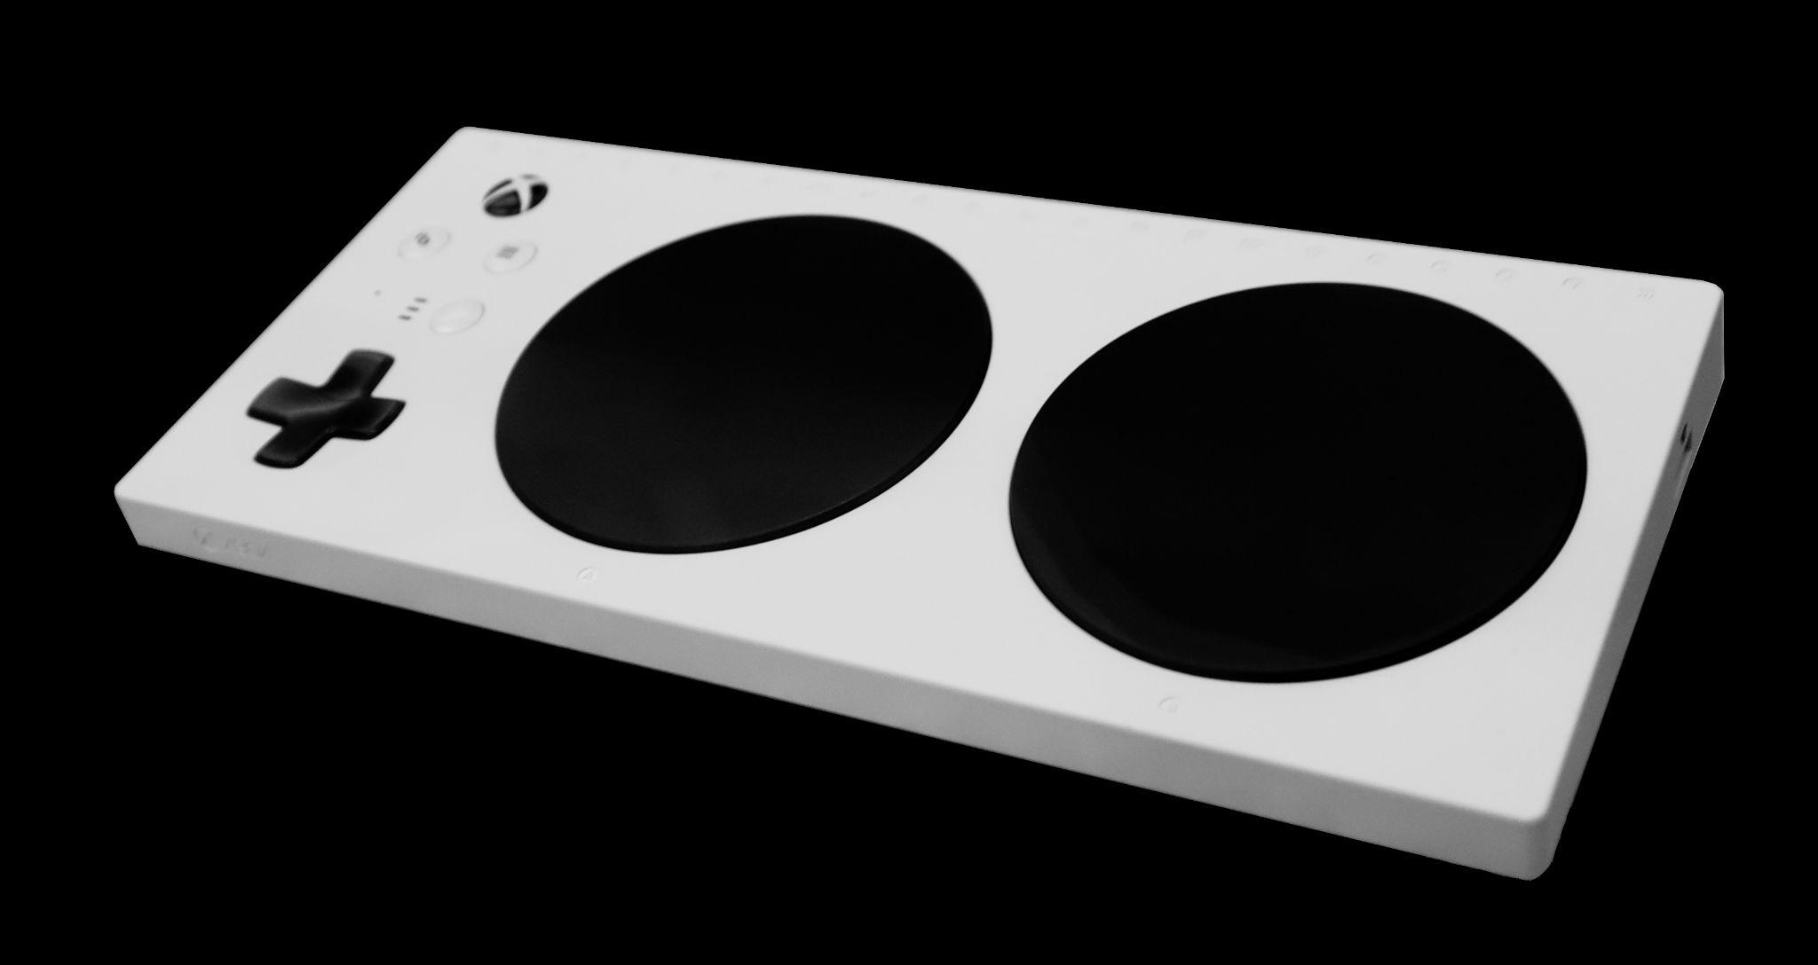
Usability
Accessibility
© 2022, 2024 Jeannie Novak All rights reserved.
Credit: Geni (Wikimedia Commons) - modified by Justin Sadur
Caption: Xbox Adaptive Controller

Slide 19
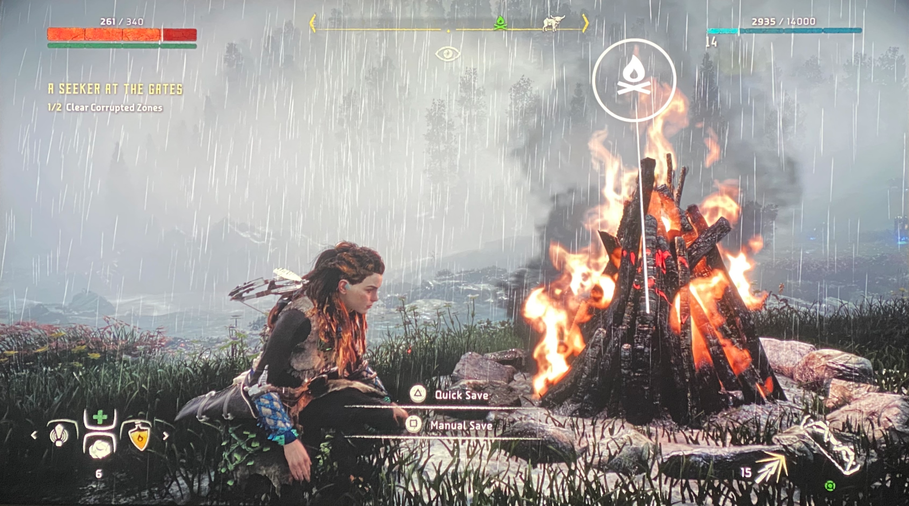
Usability
Save-Game Options
© 2022, 2024 Jeannie Novak All rights reserved.
Credit: JN
Caption: Sony Interactive Entertainment’s Horizon Zero Dawn allows the player to quick-save when visiting a campfire.

Slide 20
CHAPTER 8
© 2022, 2024 Jeannie Novak All rights reserved.
REVIEW EXERCISES
1
Using one of your favorite games as an example, discuss ways in which the game’s interface allows you to feel you have some control during gameplay.
There are several unique physical interfaces—such as foot pads, maracas, a microphone, and a fishing
pole—that are designed to enhance the game-playing experience. Disregarding the obvious (such as guns for first-person shooters), recommend a unique physical interface that could be used as an alternative physical device for one of your favorite games. If you were asked to create an original physical interface for your own game, what would it be—and how would it make the player’s experience of the game more enjoyable?
2

Slide 21
CHAPTER 8
© 2022, 2024 Jeannie Novak All rights reserved.
REVIEW EXERCISES
The area of accessibility is gradually being addressed by the game industry. Choose one of the five disabilities discussed in this chapter and come up with a unique way to address the disability in a game interface.
3
4
Knowing that the save-game debate hasn’t been resolved, what type of save-game option would you incorporate into your game—and why? Can you think of a new way of saving the game?
How do the components of a game interface work together to make a game usable and functional for the player? Choose a game and analyze its usability features. Suggest at least three improvements to the interface, and create a rough sketch redesigning the interface based on your analysis.
5

Slide 22
CHAPTER 8
© 2022, 2024 Jeannie Novak All rights reserved.
REVIEW EXERCISES
Begin a task-and-needs analysis of a game by asking the following questions: What tasks does the visual interface allow the player to accomplish? Do these tasks correspond to gameplay goals? Detail a task-and-needs analysis for your original game idea. Provide a list of five necessary tasks that players must complete to advance in the game. Provide a list of the top five items or actions that players will need to accomplish these tasks during the game. How will your interface address these needs and tasks?
6

Slide 23
CHAPTER 8
© 2022, 2024 Jeannie Novak All rights reserved.
REVIEW EXERCISES
7
Construct a draft interface template for your original game. Define the layout, content, and navigation components of your template.
Choose a genre and discuss specific interface design features that correspond to that genre. Add another interface component that has not been discussed in this chapter to address a genre-specific need that might not be immediately obvious.
8

