Slide 2
CHAPTER 7
LEVELS CREATING THE WORLD
© 2022, 2024 Jeannie Novak All rights reserved.

Slide 3
CHAPTER OBJECTIVES
© 2022, 2024 Jeannie Novak All rights reserved.
After reading this chapter, you should be able to:
Define level design and how it’s related to gameplay.
Describe the structural features of game worlds—such as duration, availability, relationship, and progression.
Differentiate between the temporal features of game worlds—such as authentic, variable, player-adjusted, and altered.
Identify the spatial features of game worlds—such as perspective, scale, and boundaries.
Explain how reality and style are achieved in a game environment.

Slide 4
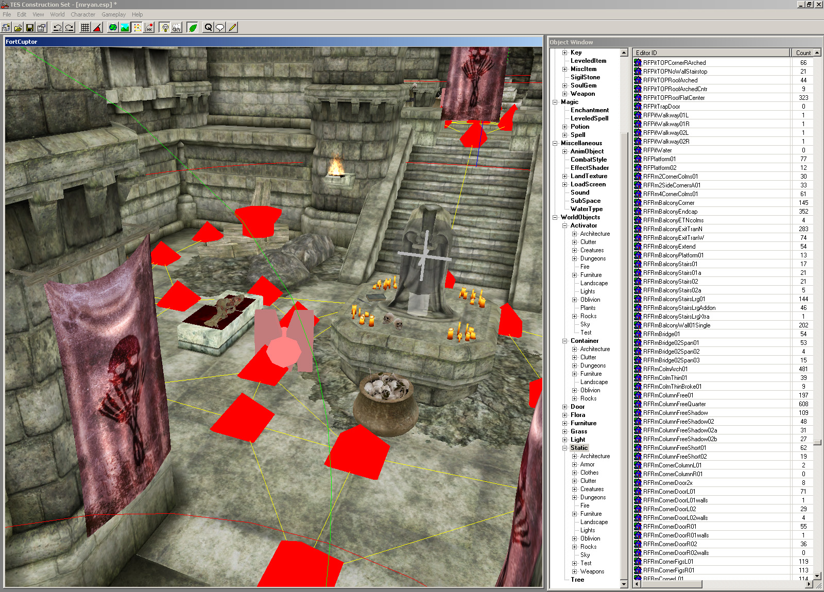
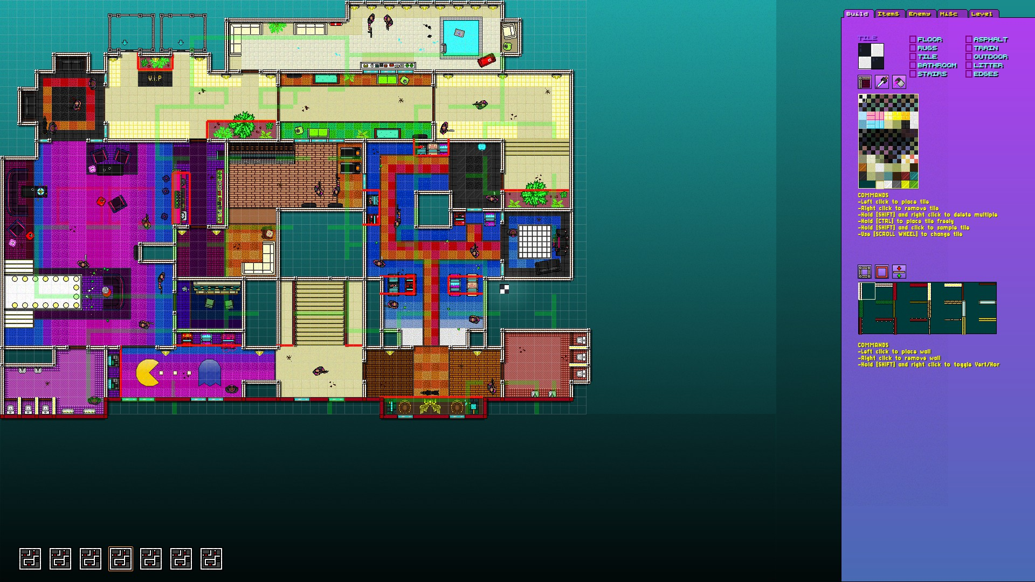
Level Design
© 2022, 2024 Jeannie Novak All rights reserved.
Credit: 2K Games
Credit: Devolver Digital
Caption: Level editing tools are shipped with many games (The Elder Scrolls Online Construction SET - Oblivion - left - Hotline Miami 2: Wrong Number Level Editor - right).

Slide 5
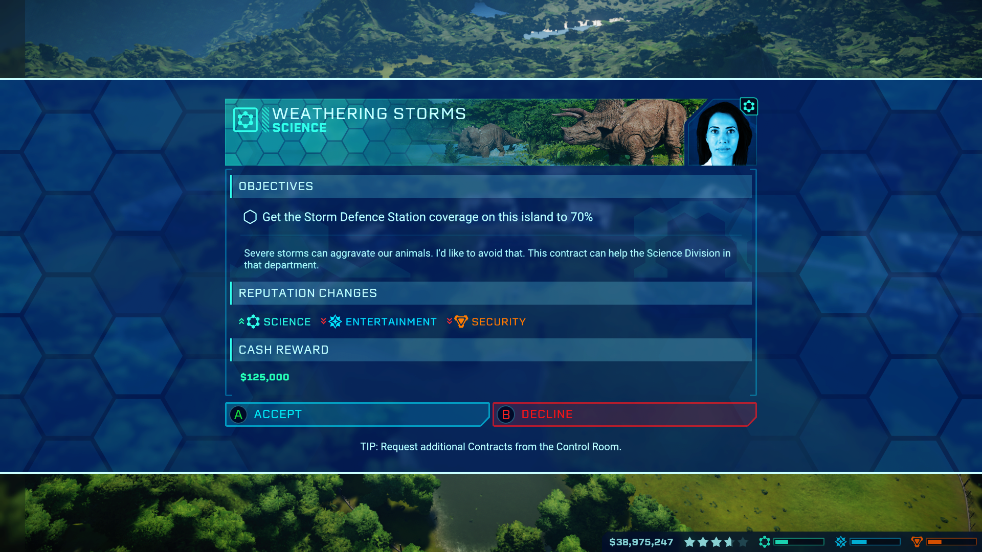
Structure
Objectives
© 2022, 2024 Jeannie Novak All rights reserved.
Credit: Kennyannydenny (MobyGames)
Caption: Objectives from the Science division in Frontier Developments’ Jurassic World: Evolution.

Slide 6
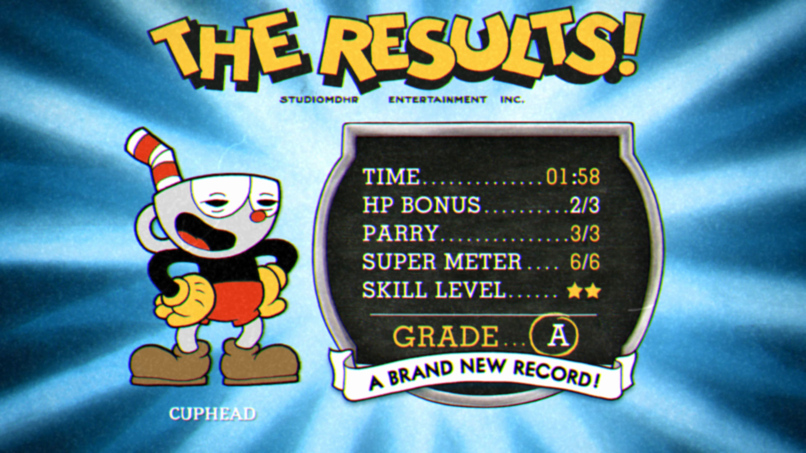
Structure
Flow
© 2022, 2024 Jeannie Novak All rights reserved.
Credit: goldenxp (MobyGames)
Caption: “Results” screen in Cuphead showing whether a level has been cleared—along with the score information.

Slide 7
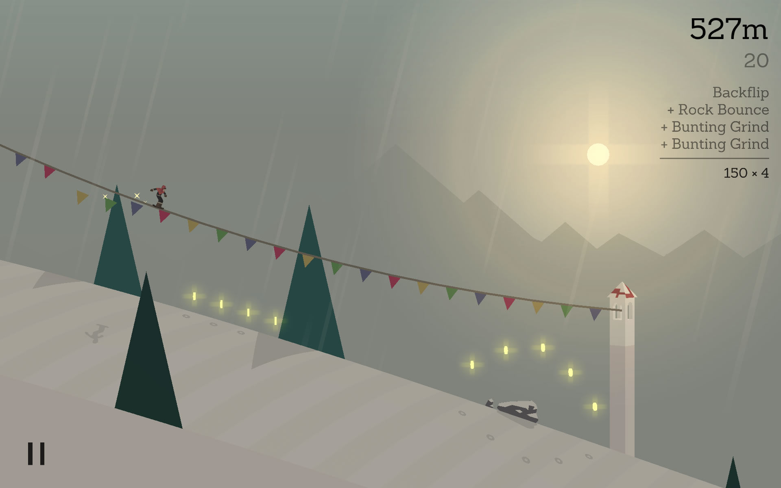
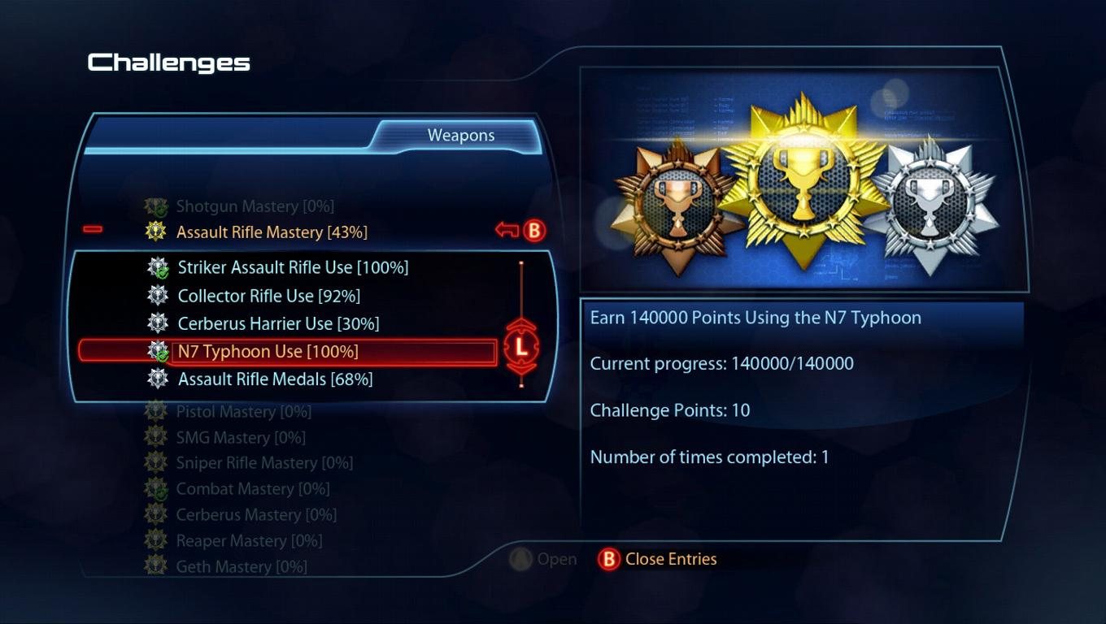
Structure
Duration
© 2022, 2024 Jeannie Novak All rights reserved.
Credit: Sciere (MobyGames)
Credit: Electronic Arts
Caption: Level duration in many mobile puzzle game such as Alto’s Adventure - left - is relatively short (minutes)—while stages and challenges in action role-playing games such as Mass Effect 3 - right - can conceivably last upwards of an hour.

Slide 8
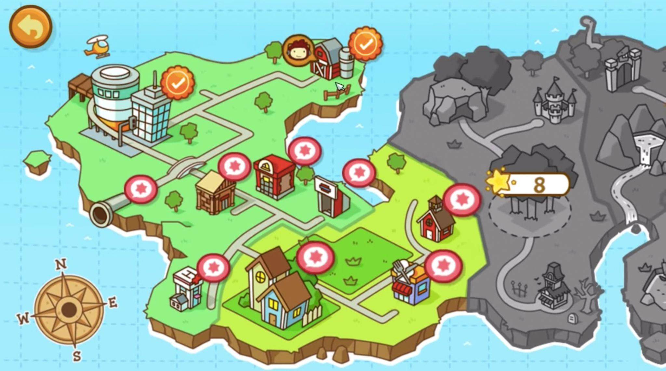
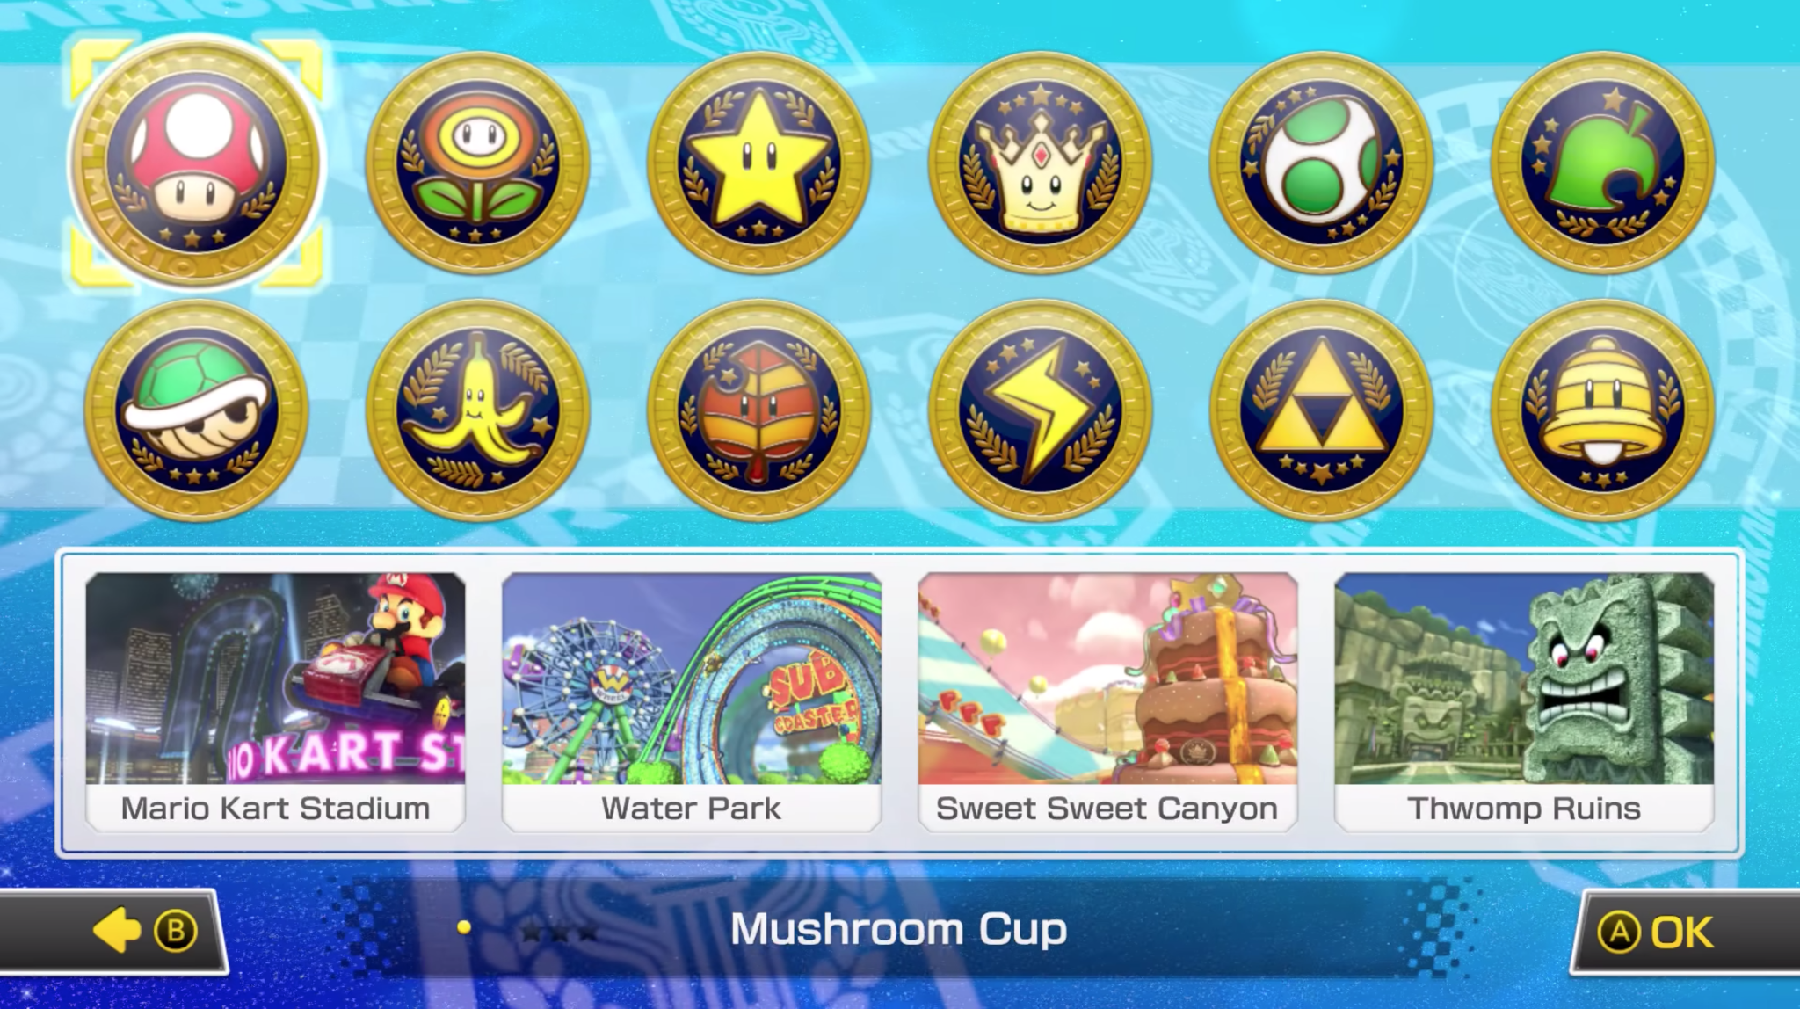
Structure
Availability
© 2022, 2024 Jeannie Novak All rights reserved.
Credit: JN
Credit: JN
Caption: In Scribblenauts Unlimited - left - the player must complete certain levels in order to unlock others on the map—while in Mario Kart 8 Deluxe - right - all levels are immediately available in the form of “cups” (sets of tracks).

Slide 9
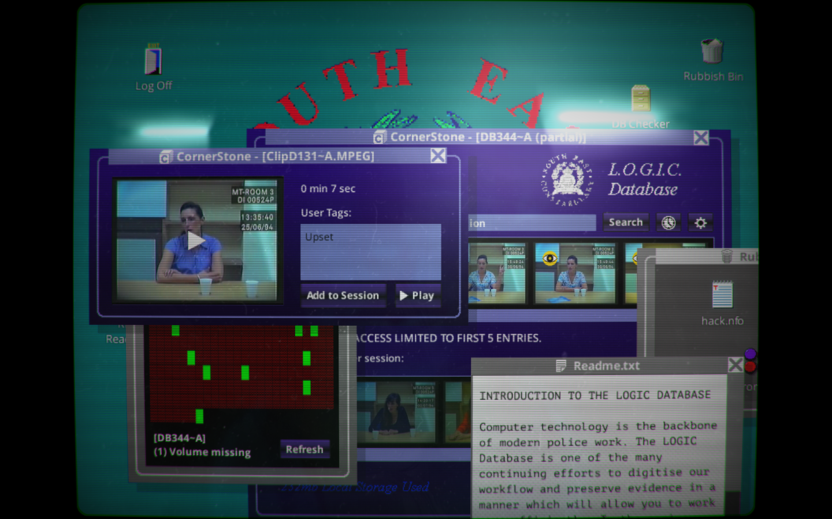
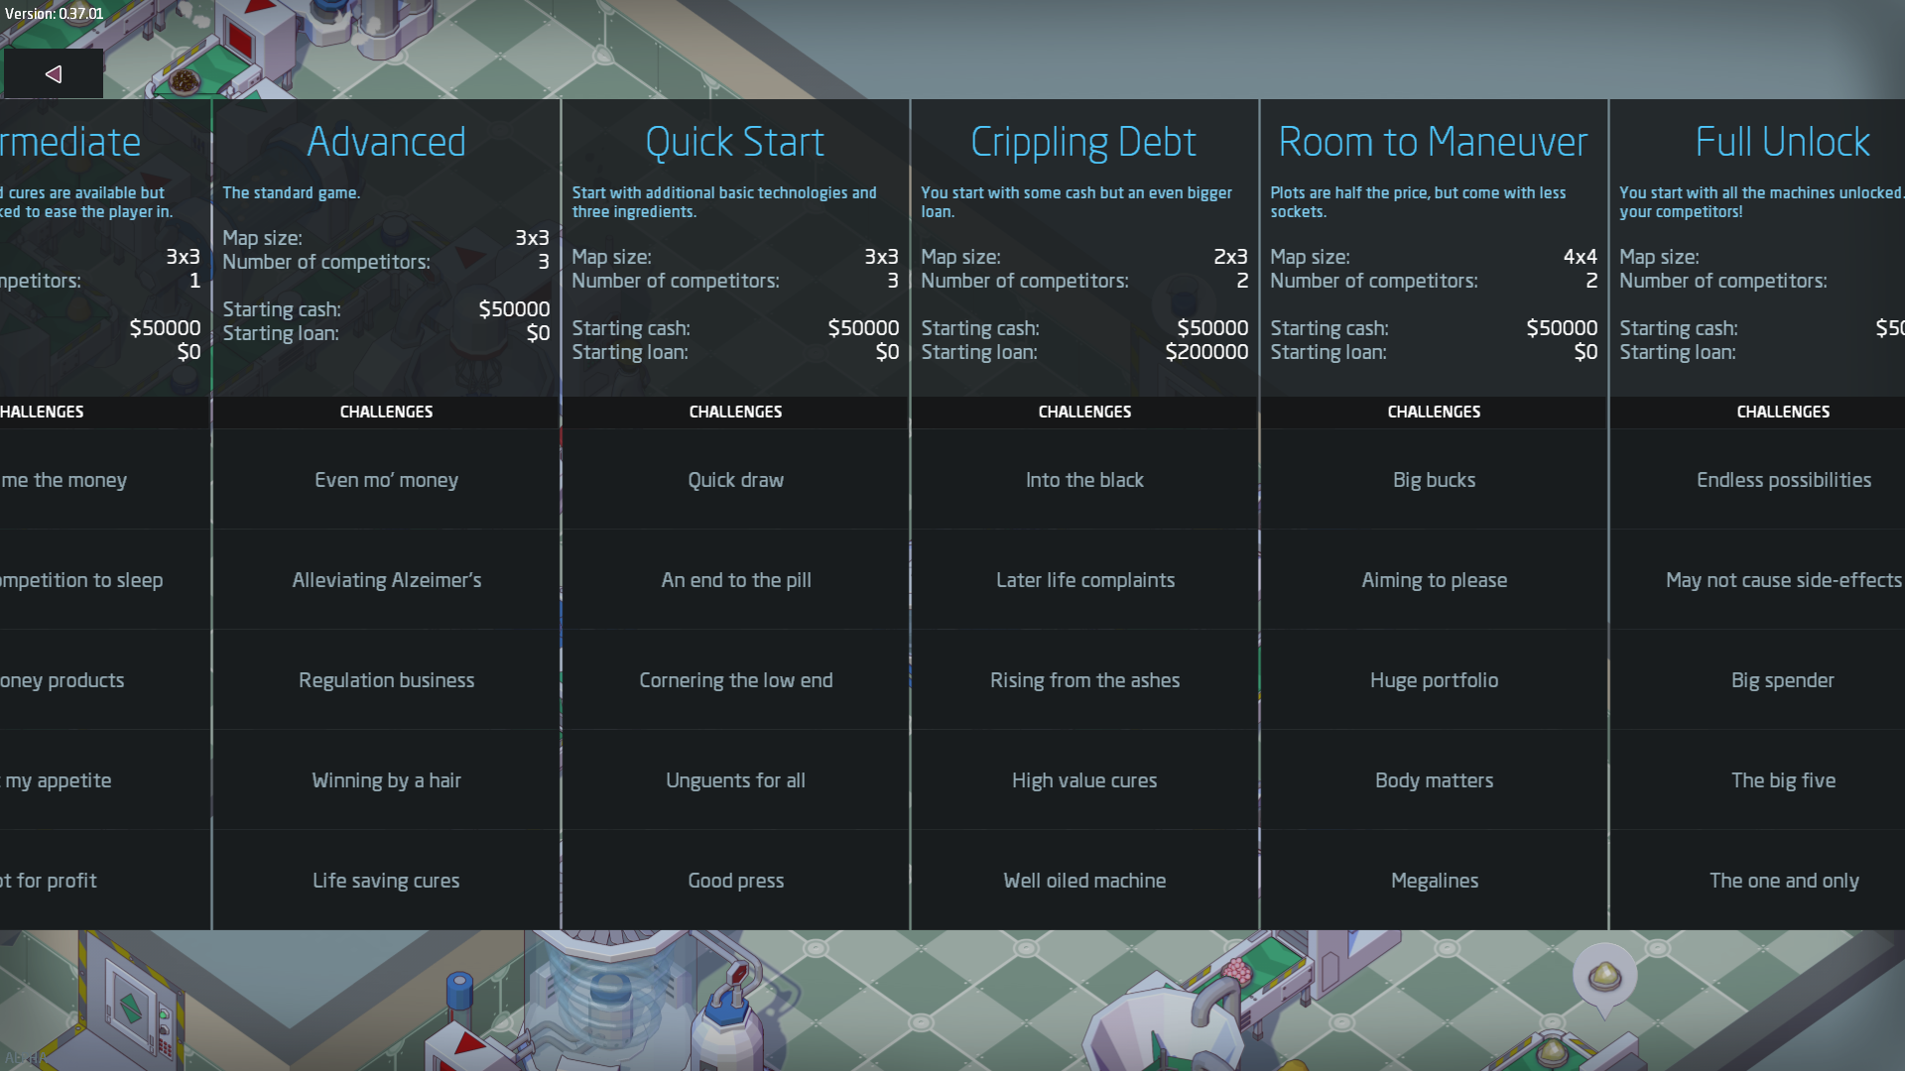
Structure
Relationship
© 2022, 2024 Jeannie Novak All rights reserved.
Credit: Sam Barlow
Credit: Positech Games
Caption: Levels in Her Story - left - consist of recordings in the LOGIC Database—while levels in Big Pharma are categorized by difficulty, with associated tasks displayed - right.

Slide 10
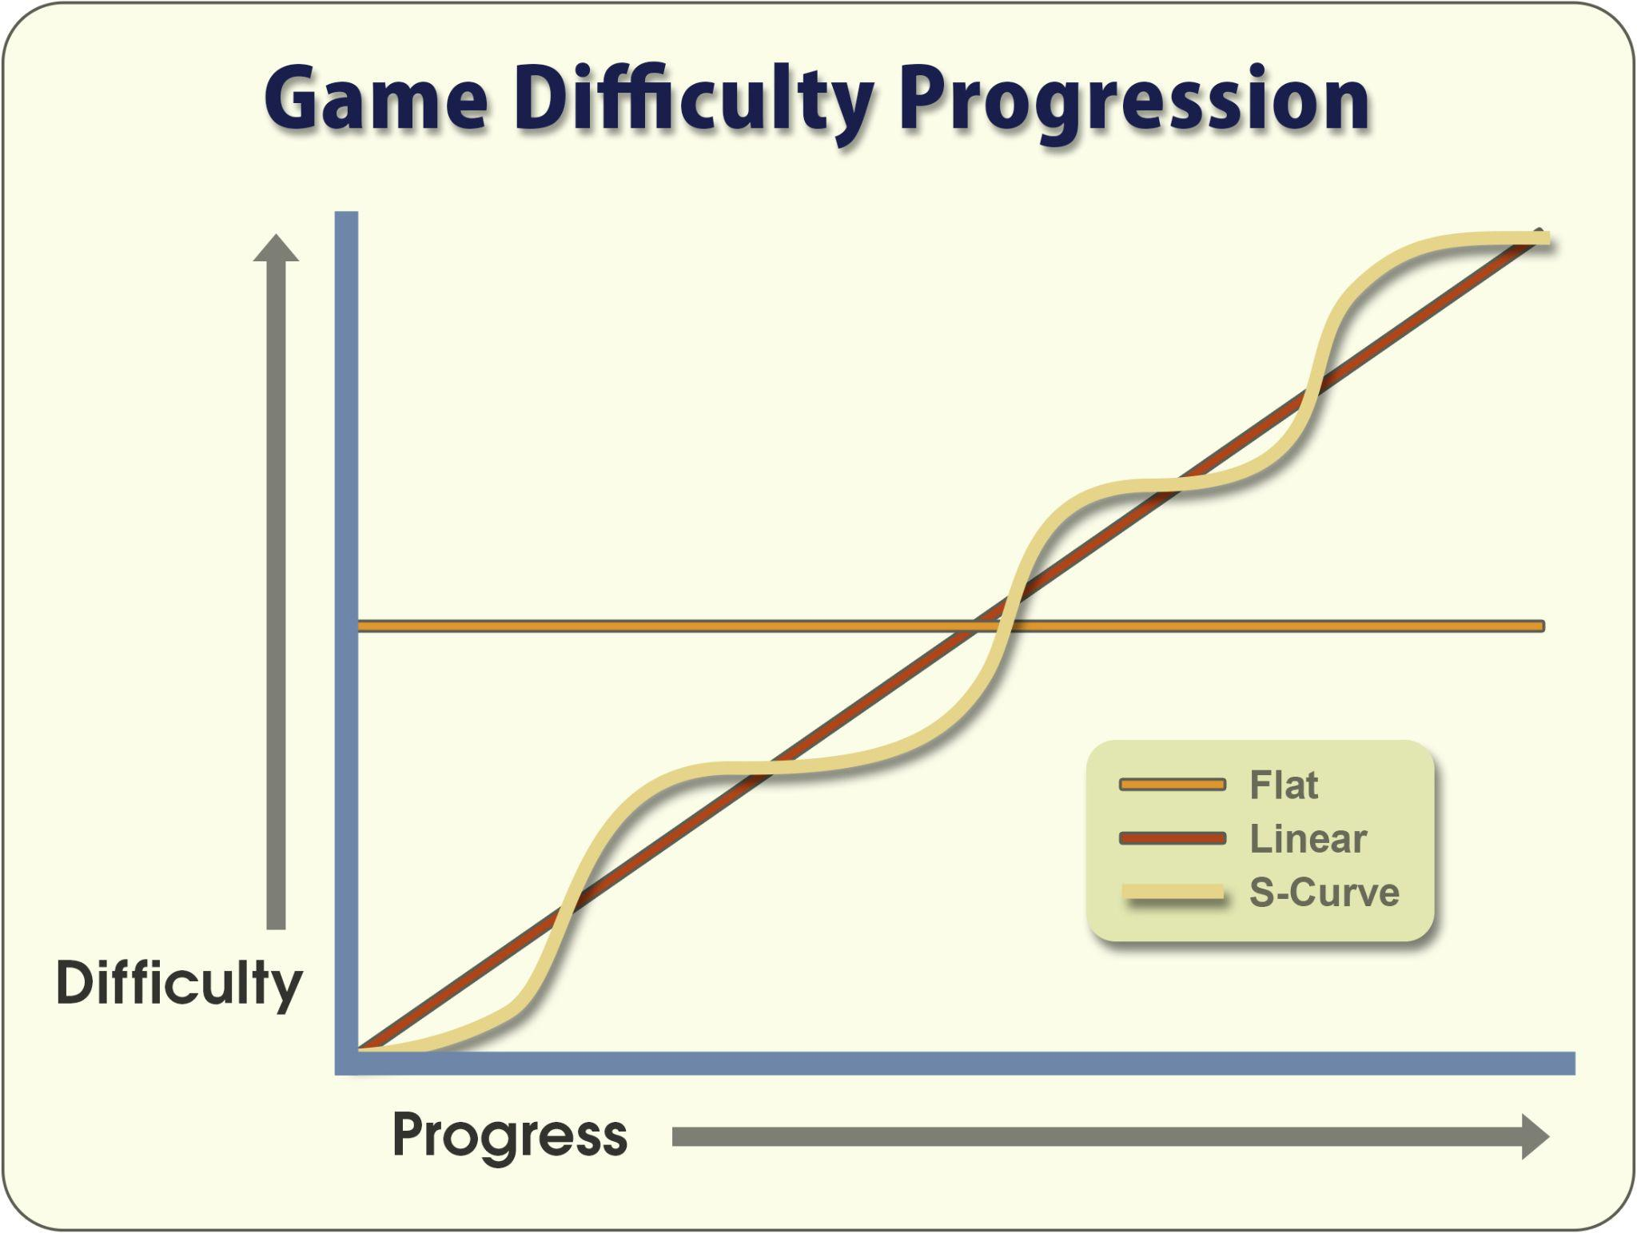
Structure
Progression
© 2022, 2024 Jeannie Novak All rights reserved.
Credit: Diagram by Per Olin
Caption: Comparison of linear, flat, and s-curve progressions.

Slide 11
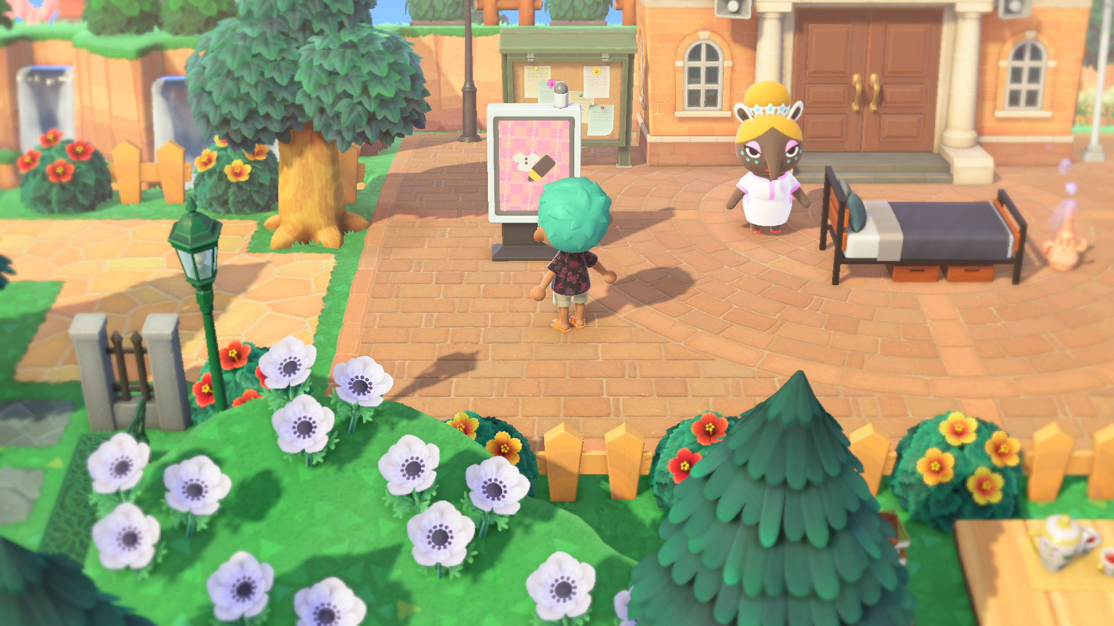
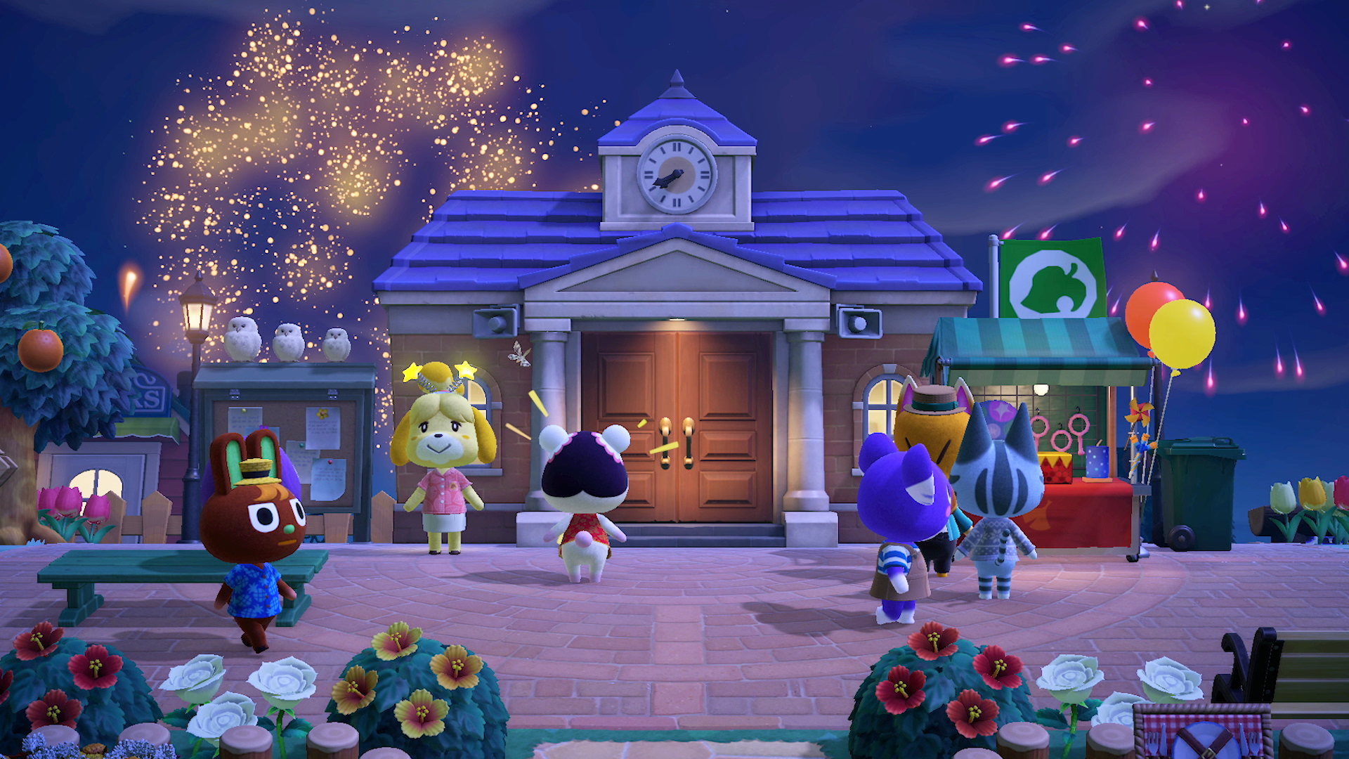
Time
Authentic
© 2022, 2024 Jeannie Novak All rights reserved.
Credit: Nintendo
Credit: Nintendo
Caption: Animal Crossing: New Horizons features an elaborate, authentic day/night cycle—incorporating seasonal changes.

Slide 12
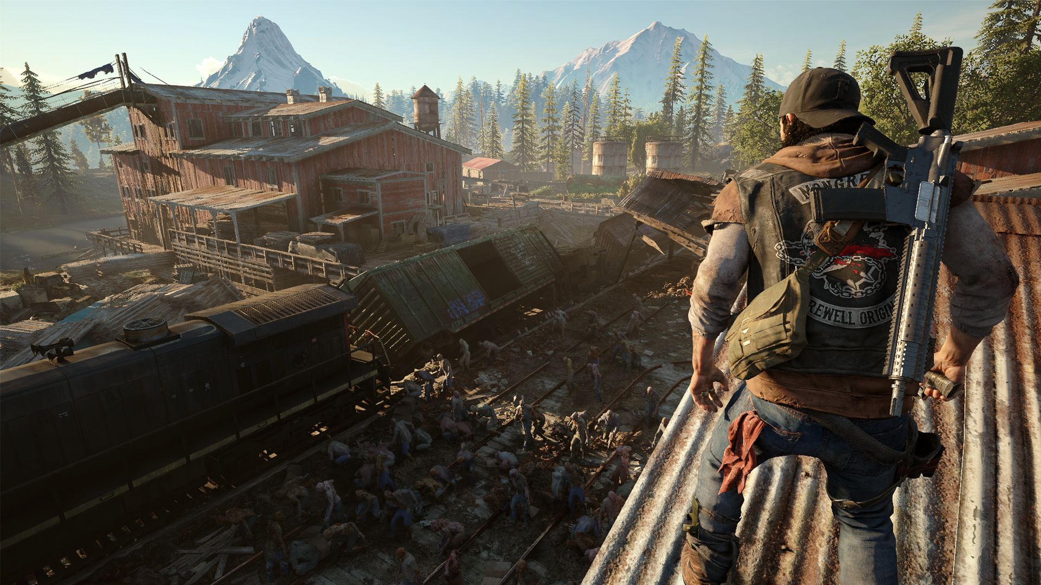
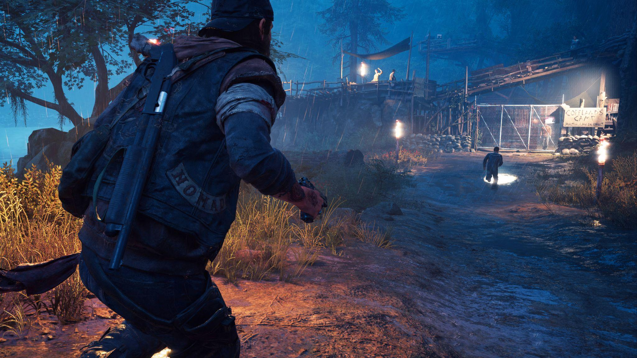
Time
Limited
© 2022, 2024 Jeannie Novak All rights reserved.
Credit: Sony Interactive Entertainment
Credit: Sony Interactive Entertainment
Caption: Certain missions are ideal to attempt at night in Days Gone, which uses a limited day/night cycle.

Slide 13
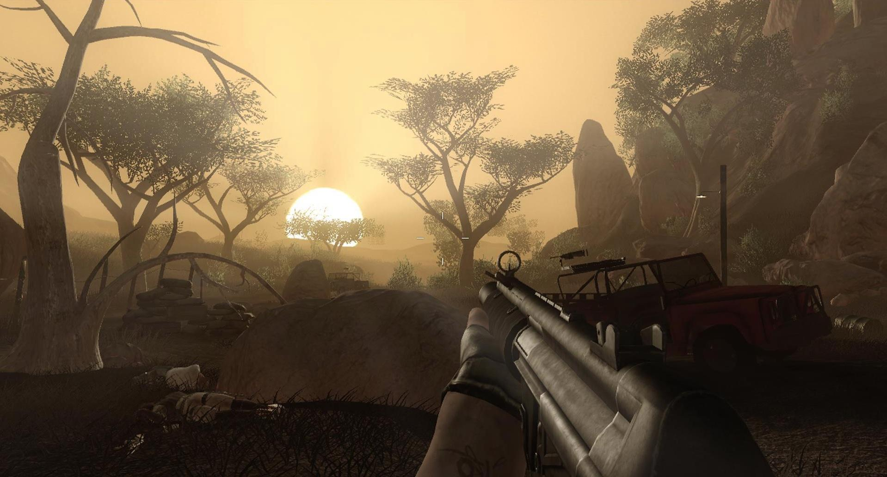
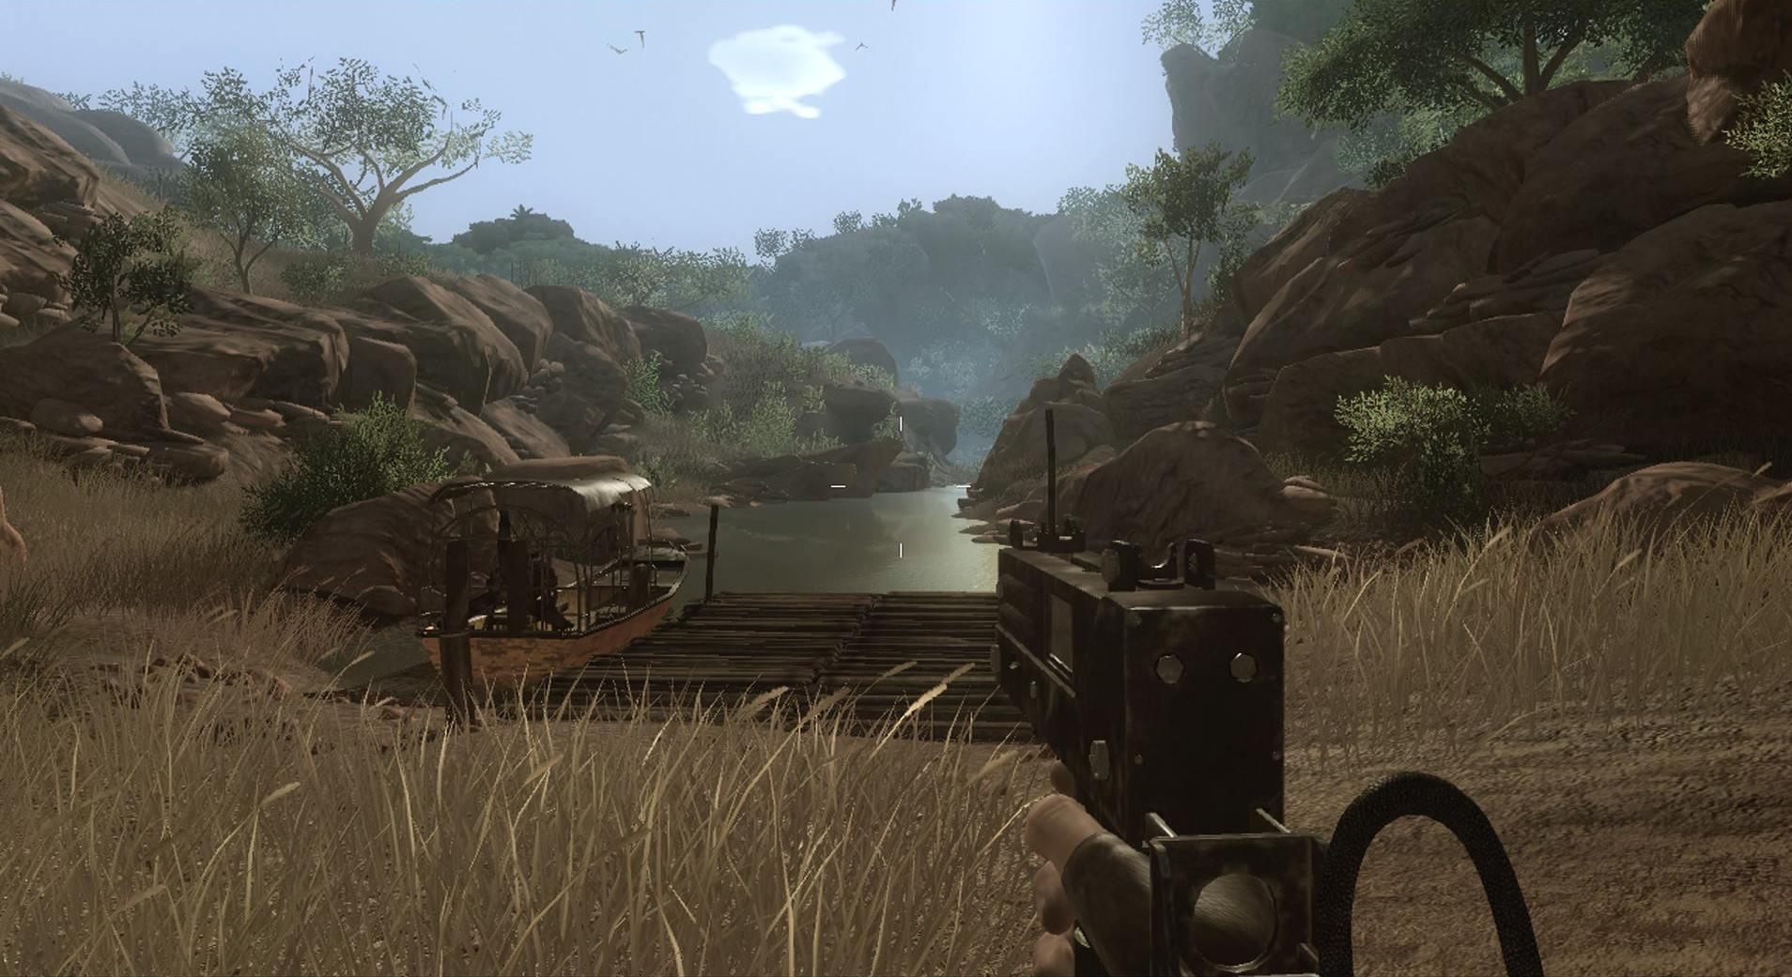
Time
Variable
© 2022, 2024 Jeannie Novak All rights reserved.
Credit: JN
Credit: JN
Caption: Far Cry 2 incorporates a distinct day/night cycle—but gameplay isn’t required at night.

Slide 14
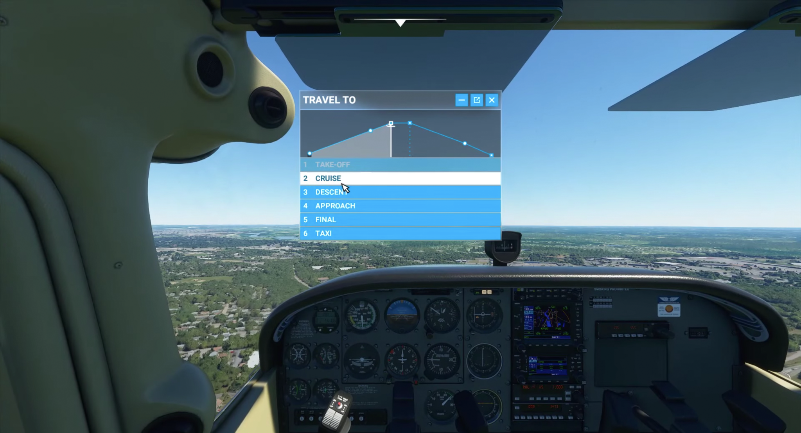
Time
Player-Adjusted
© 2022, 2024 Jeannie Novak All rights reserved.
Credit: JN
Credit: Microsoft Corporation
Caption: Players can shorten their flights by skipping to different phases, such as Cruise, in Microsoft Flight Simulator (2020).

Slide 15
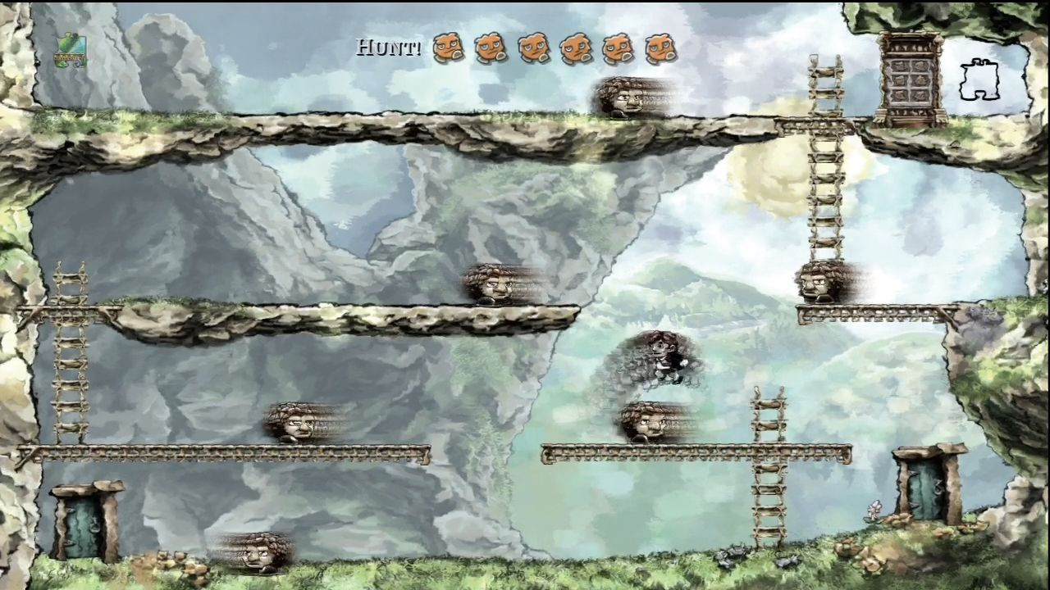
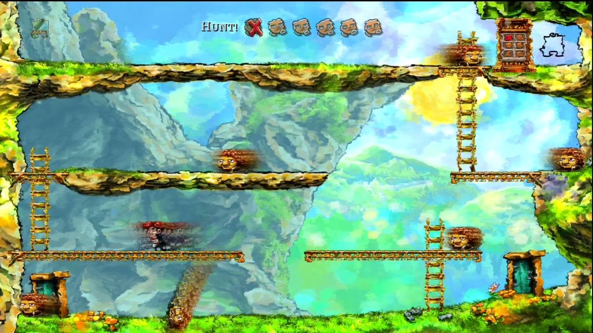
Time
Altered
© 2022, 2024 Jeannie Novak All rights reserved.
Credit: BurningStickMan (MobyGames)
Credit: BurningStickMan (MobyGames)
Caption: Altered time—specifically rewind - left - and fast-forward - right - is a key game mechanic in Jonathan Blow’s Braid.

Slide 16
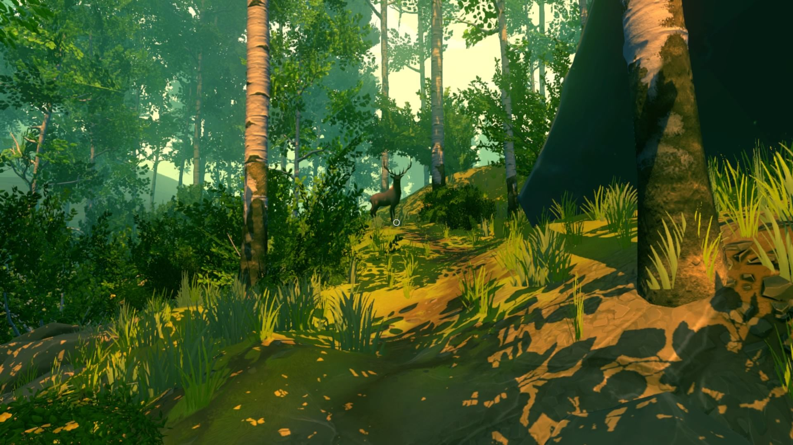
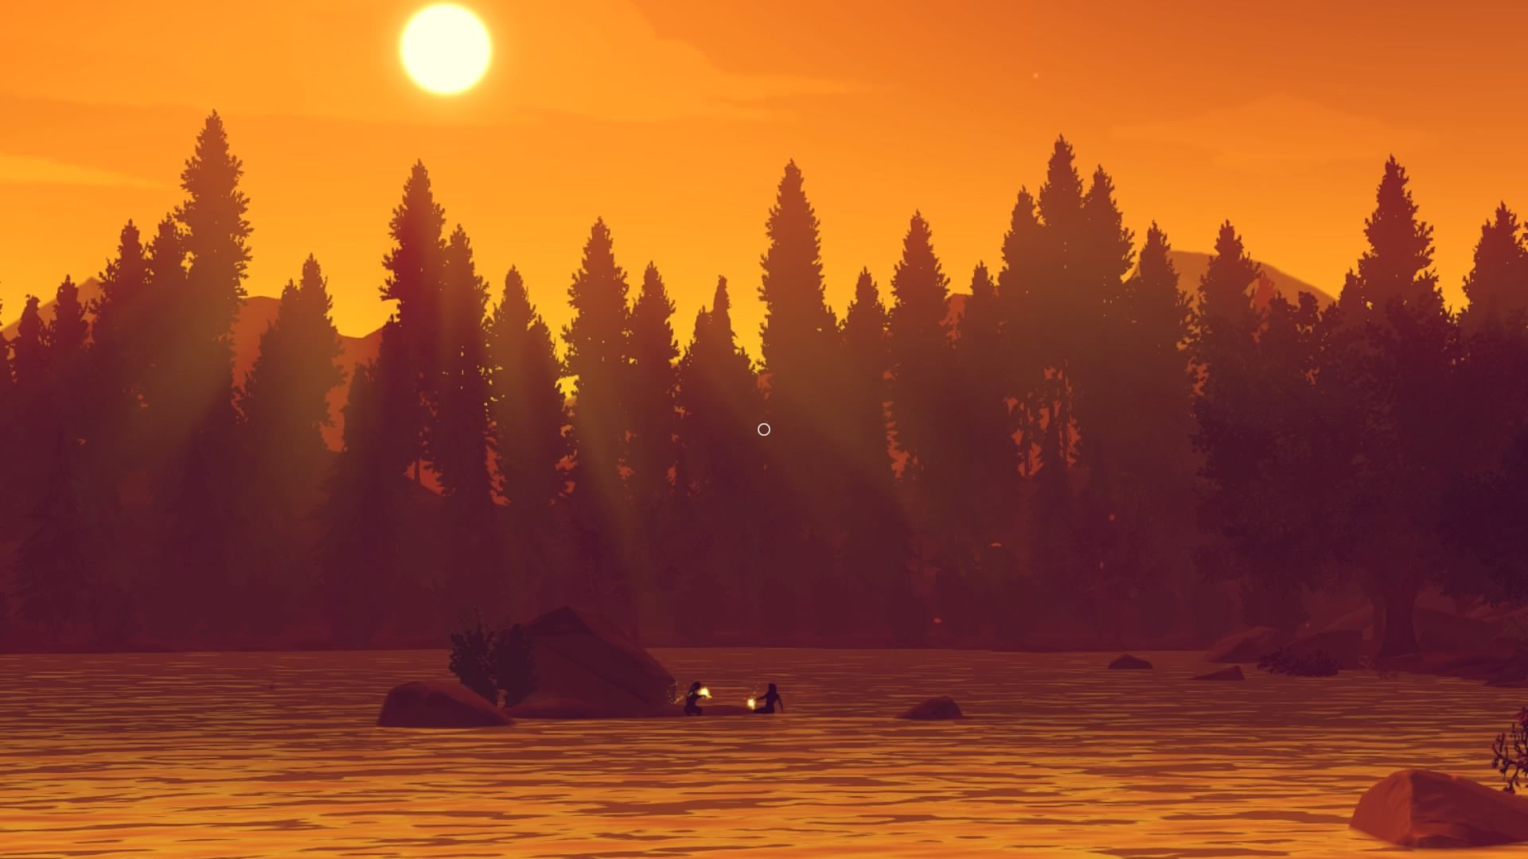
Time
Cosmetic
© 2022, 2024 Jeannie Novak All rights reserved.
Credit: MAT (MobyGames)
Credit: MAT (MobyGames)
Caption: Campo Santo’s Firewatch boasts an aesthetically-pleasing day/night cycle that’s purely cosmetic—enhancing the game’s atmosphere and sense of place.

Slide 17
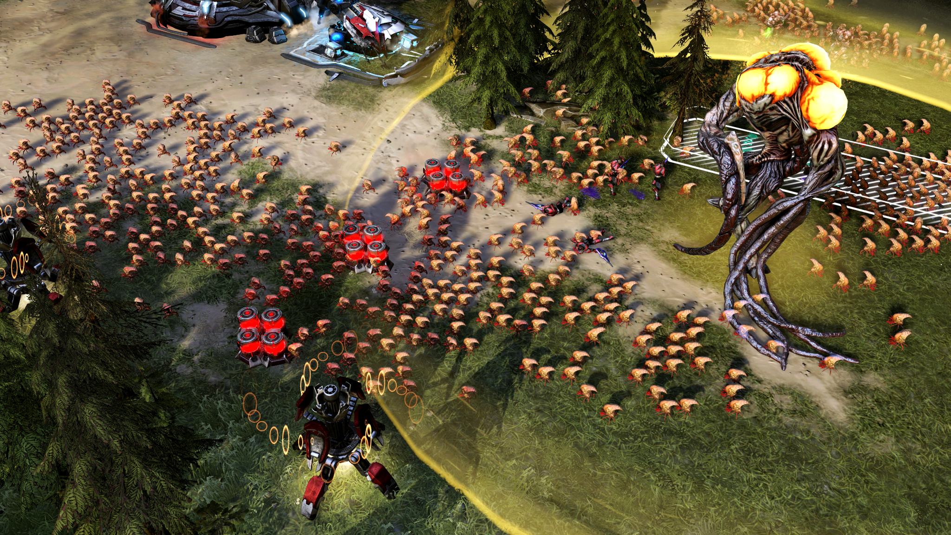
Space
Perspective
© 2022, 2024 Jeannie Novak All rights reserved.
Credit: Microsoft Corporation
Caption: Halo Wars 2 makes use of omnipresent perspective so that players can monitor all areas of the battlefield at any given time.

Slide 18
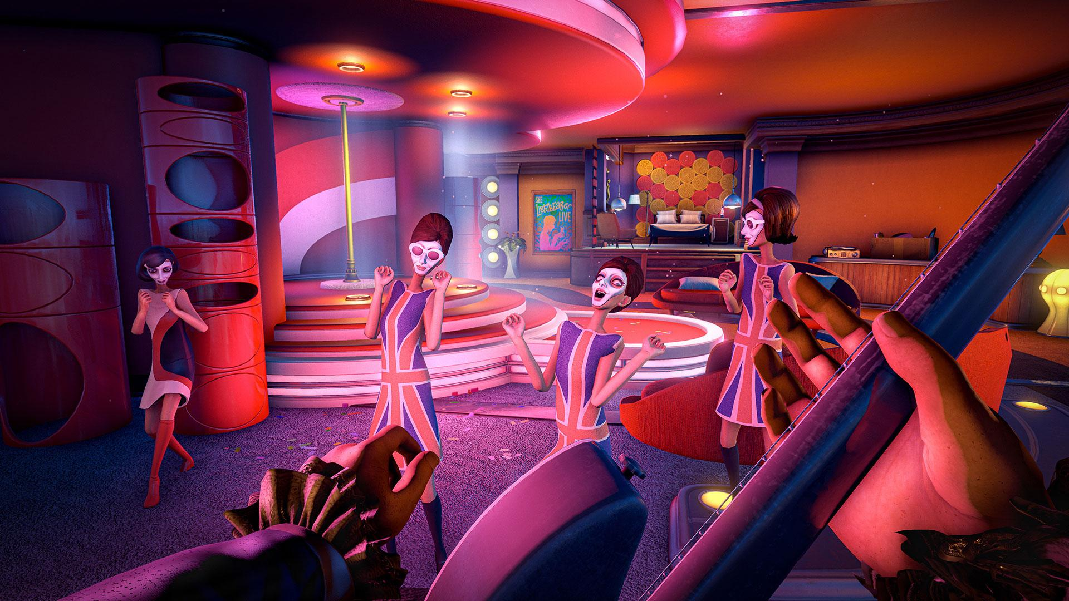
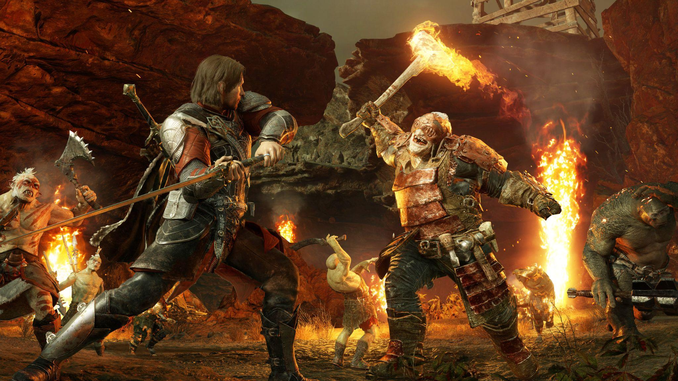
Space
Terrain & Materials
© 2022, 2024 Jeannie Novak All rights reserved.
Credit: Compulsion Games
Credit: Warner Brothers Interactive Entertainment
Caption: Bright interiors made of plastic, vinyl, rubber, and latex in We Happy Few - left - contrast the exteriors depicting fire, stone, leather, dirt, and muted tones in Middle-Earth: Shadow of War - right.

Slide 19
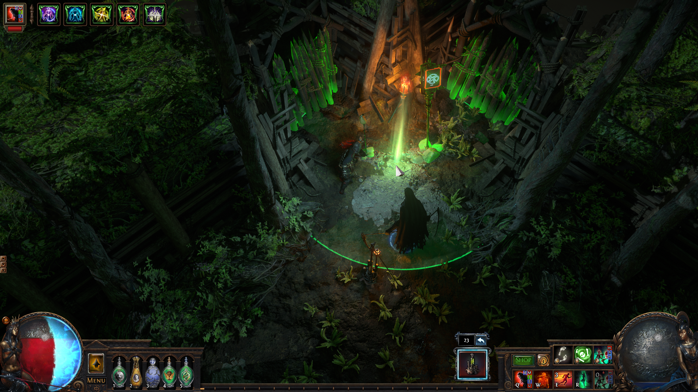
Space
Visual Effects
© 2022, 2024 Jeannie Novak All rights reserved.
Credit: Grinding Gear Games
Credit: Sony Interactive Entertainment
Caption: The use of lighting in Path of Exile - left - and particle effects in God of War [2018] - right - enhances the gameplay experience.

Slide 20
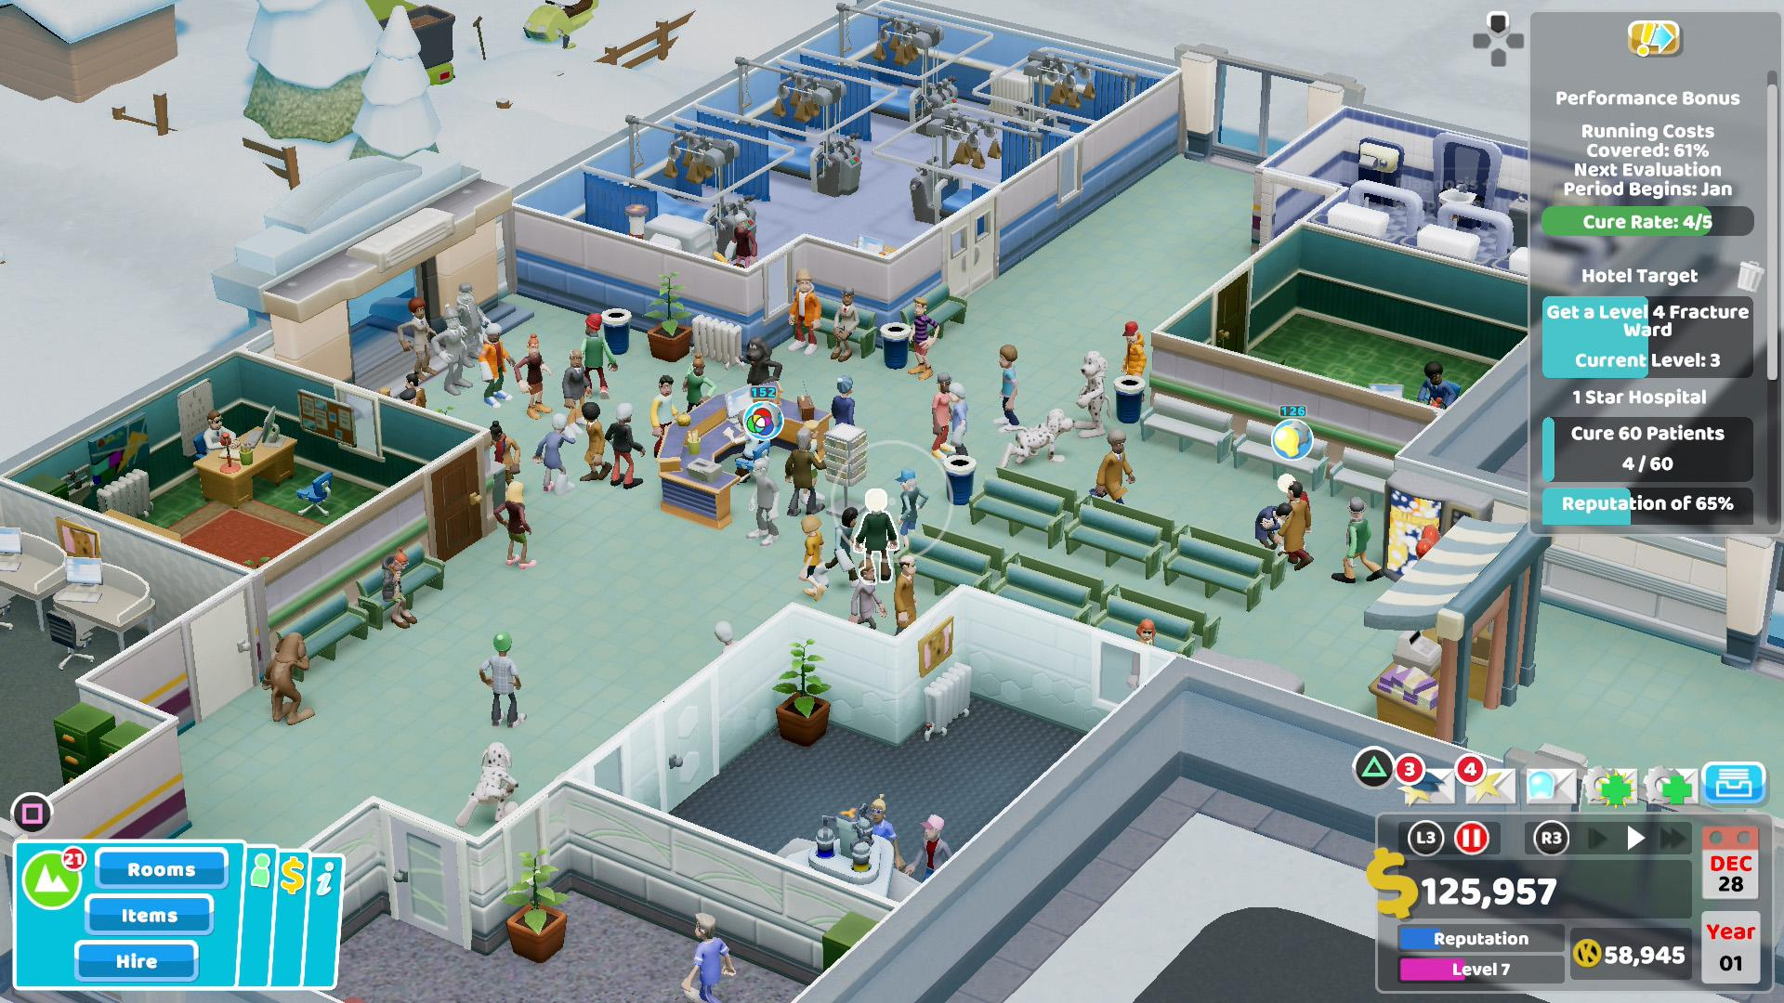
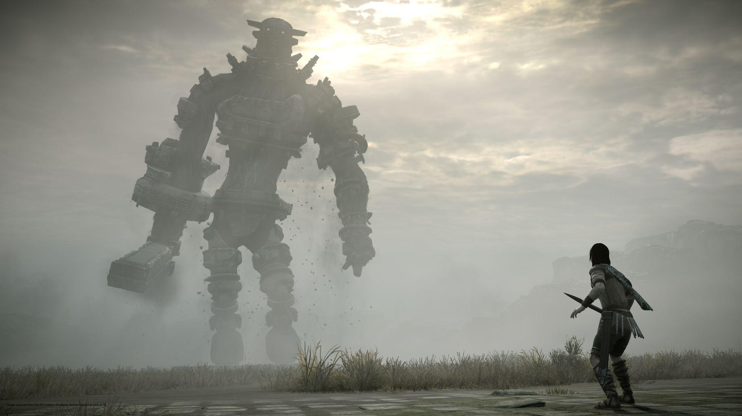
Space
Scale
© 2022, 2024 Jeannie Novak All rights reserved.
Credit: Sega Corporation
Credit: Sony Interactive Entertainment
Caption: Scale in games can be very small, as in Two Point Hospital - left - or include incredibly large characters such as the colossi in Shadow of the Colossus - right.

Slide 21
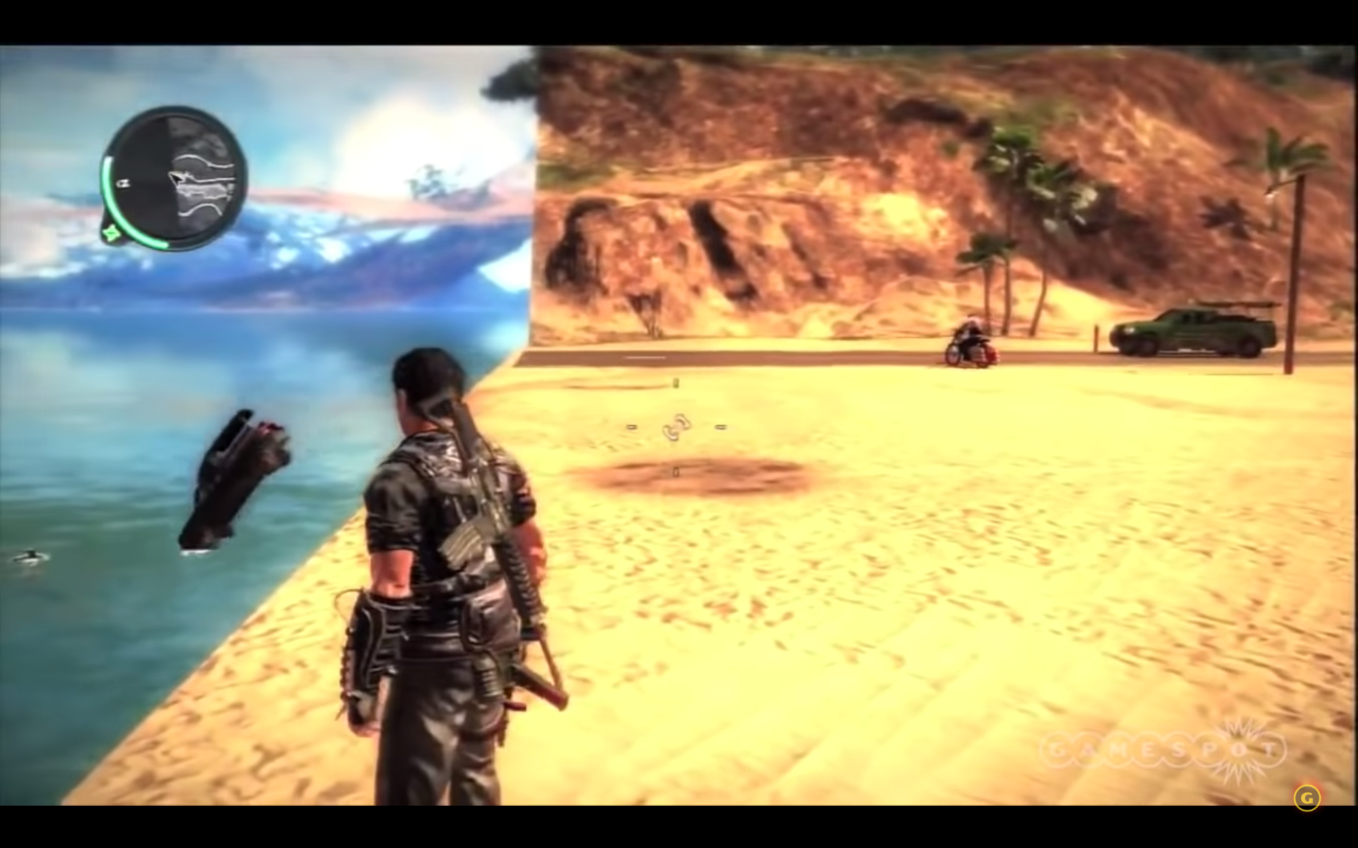
Space
Boundaries
© 2022, 2024 Jeannie Novak All rights reserved.
Credit: JN
Credit: JN
Caption: In Far Cry 2 - left - the player comes down with malaria when approaching a boundary—and in Just Cause 2 - right - one area of the map ends, with vehicles falling over the edge into the water.

Slide 22
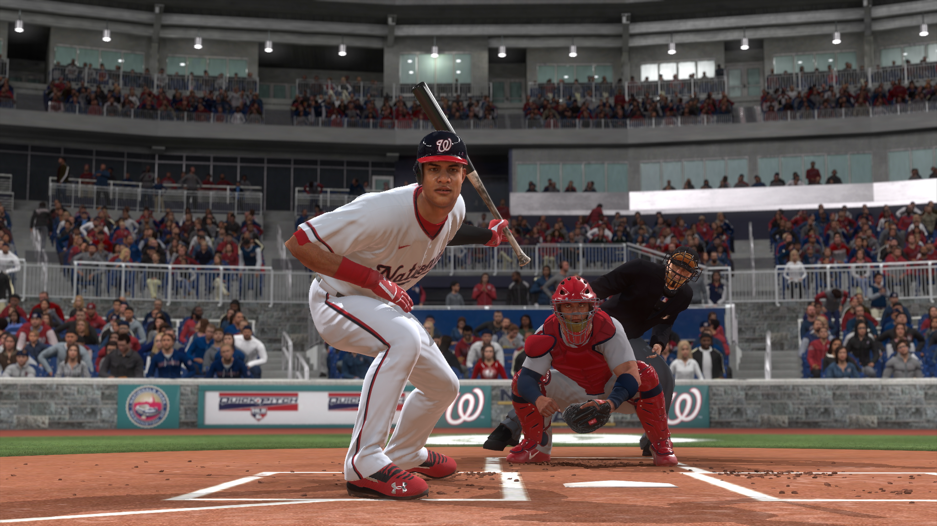
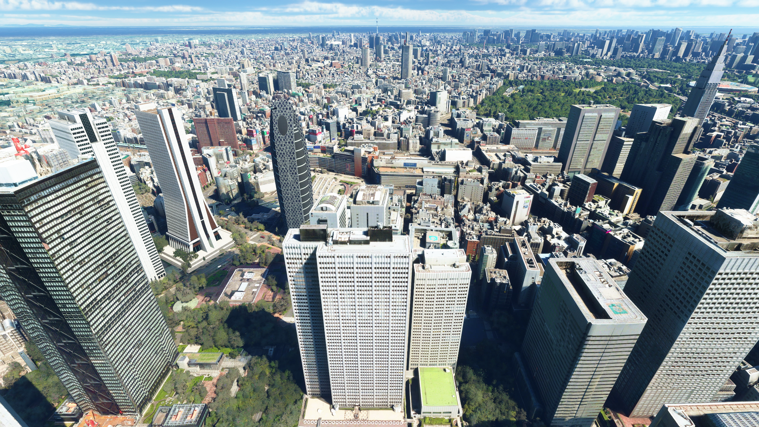
Space
Realism
© 2022, 2024 Jeannie Novak All rights reserved.
Credit: Sony Interactive Entertainment
Credit: Microsoft Corporation
Caption: MLB The Show 21 - left - and Microsoft Flight Simulator (2020) - right - use familiar details to portray the game world realistically.

Slide 23
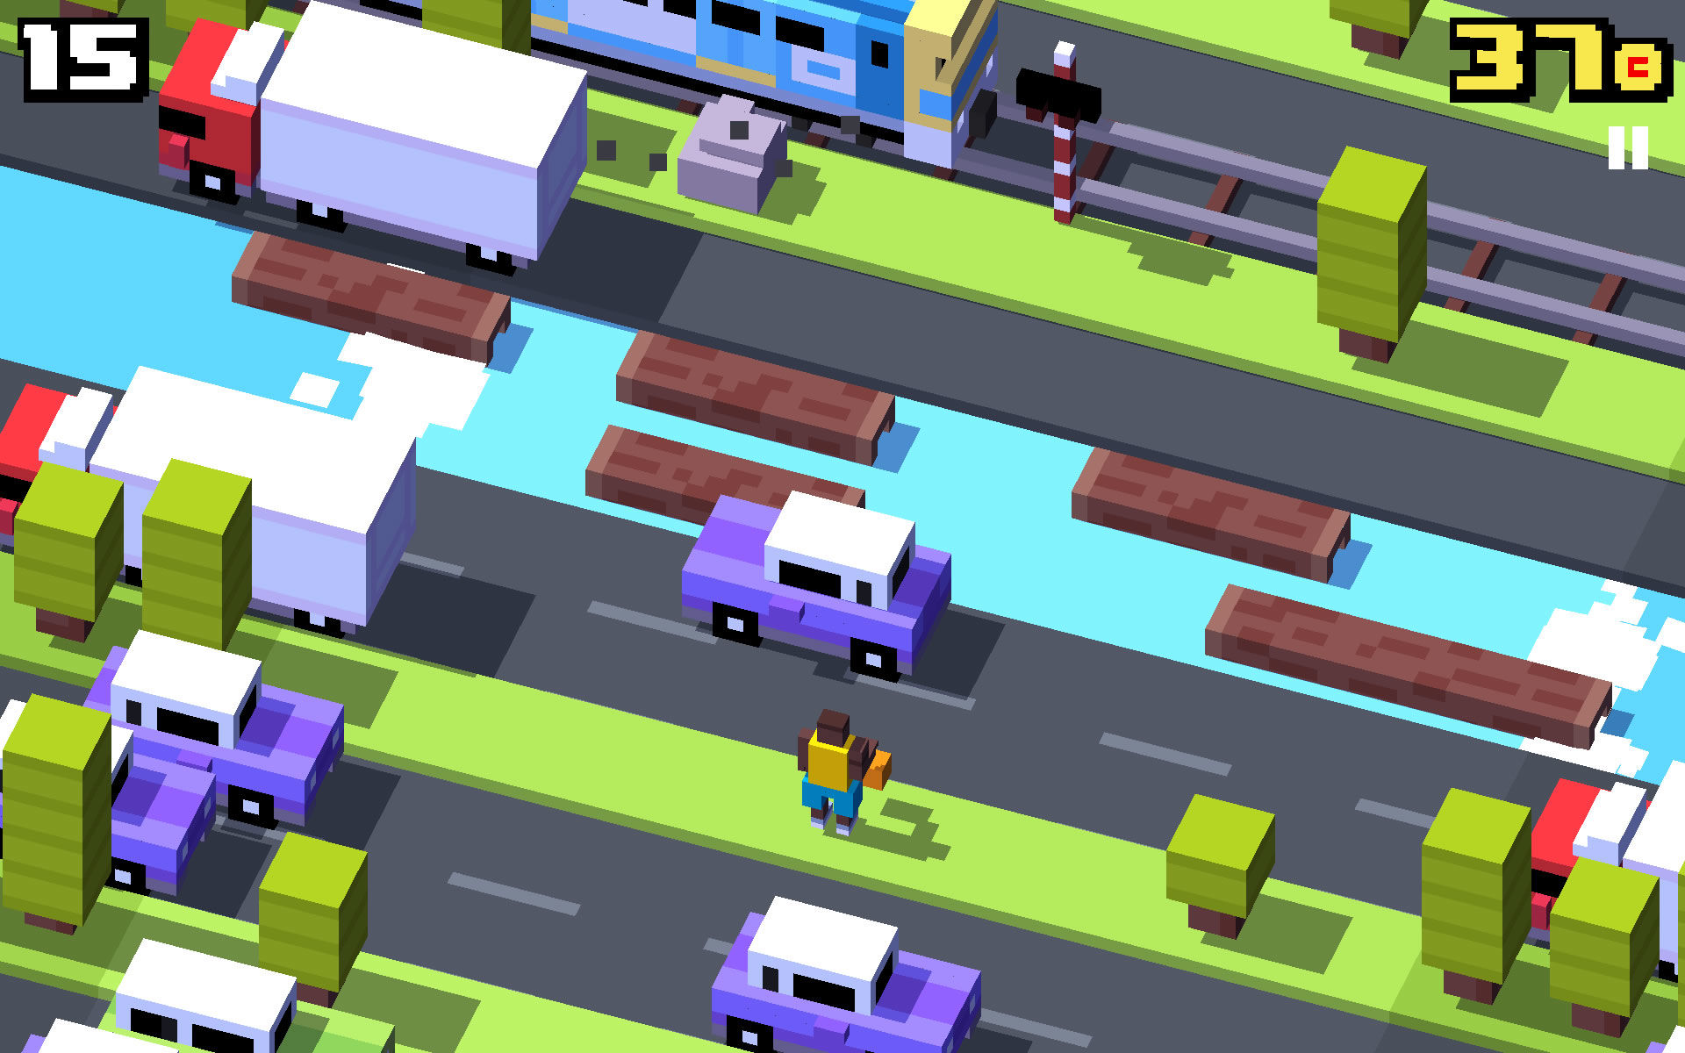
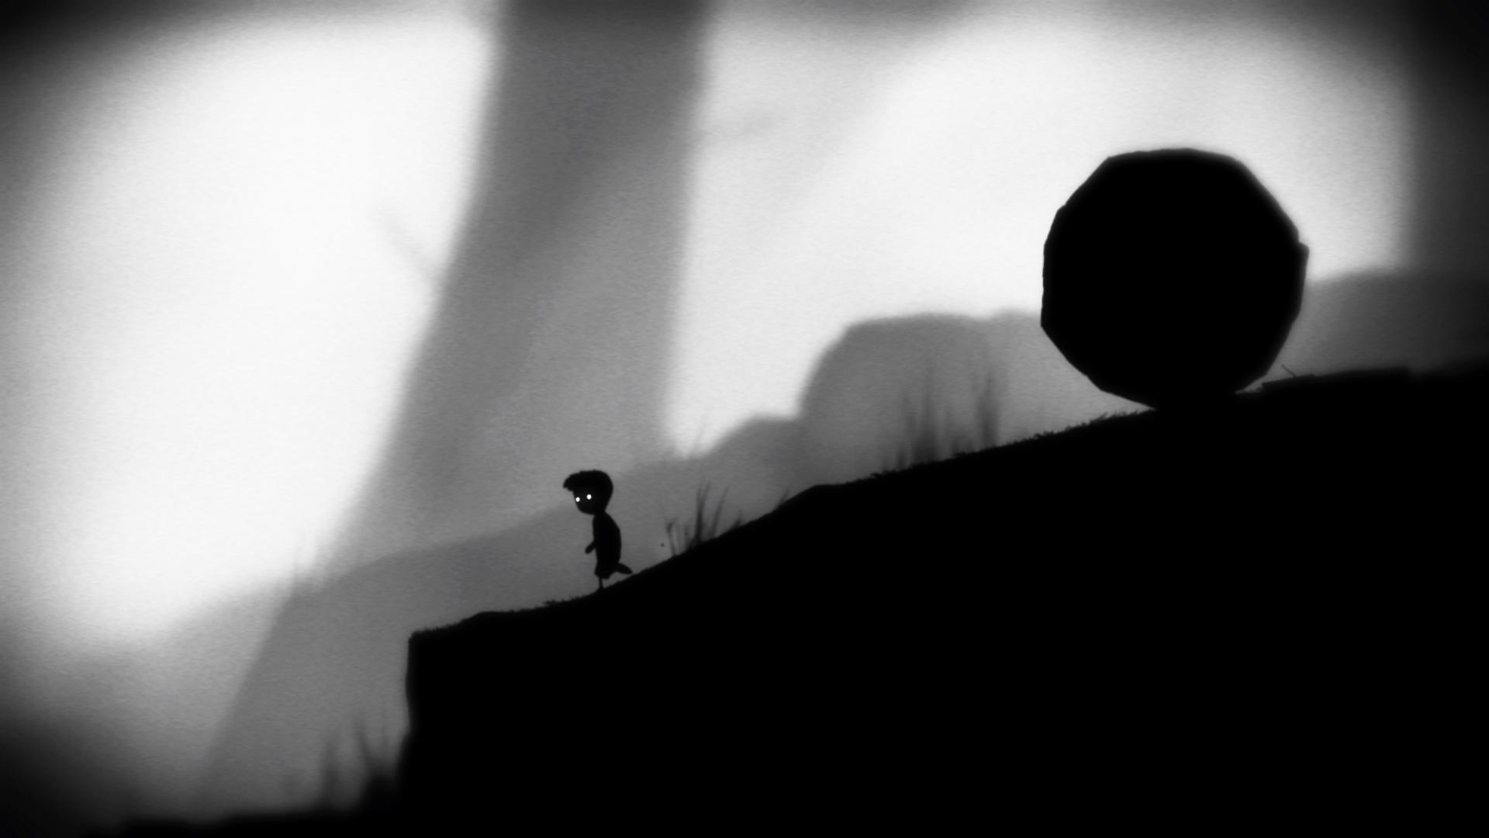
Space
Look & Feel
© 2022, 2024 Jeannie Novak All rights reserved.
Credit: Sciere (MobyGames)
Credit: Playdead aPs
Caption: The colorful vexel art style in Hipster Whale’s Crossy Road evokes a clean, light, playful world—while Limbo’s monochromatic, expressionistic tones elicit an eerie atmosphere and a sense of humor.

Slide 24
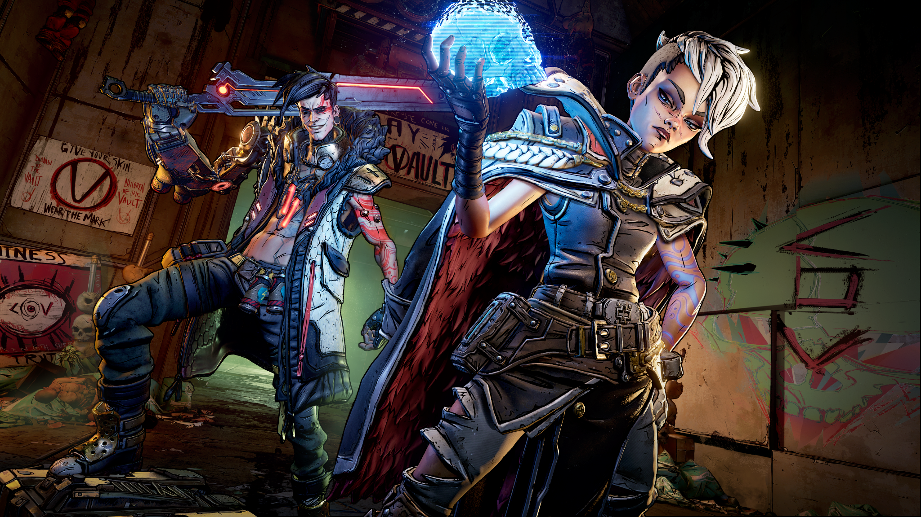
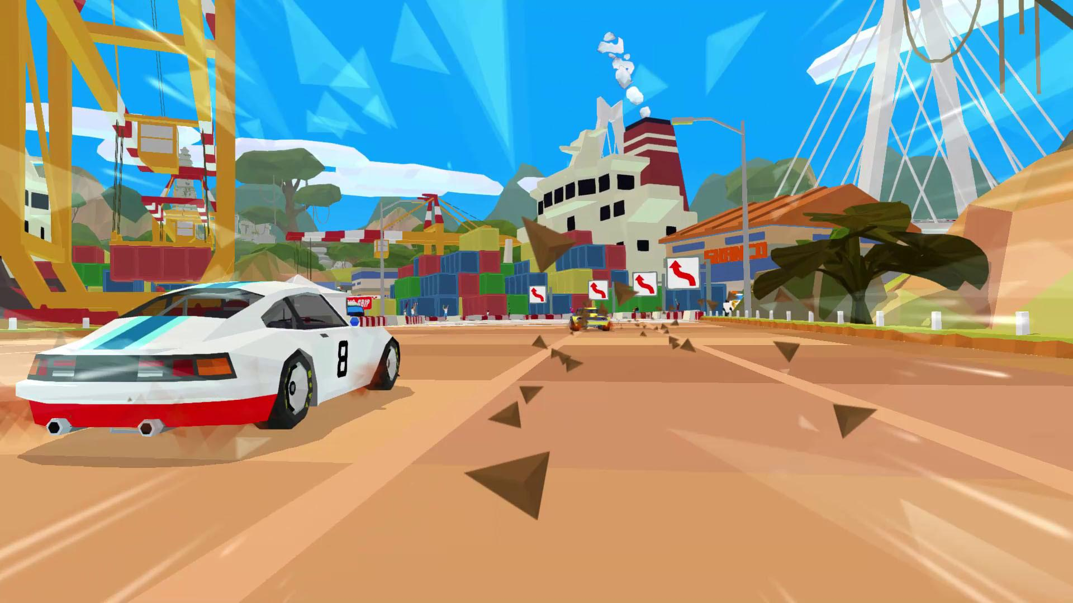
Space & Time: Levels, Gameplay & Story
© 2022, 2024 Jeannie Novak All rights reserved.
Credit: 2K Games
Credit: Curve Digital Limited
Caption: Borderlands - left - uses cel-shading to give a 2D look to a 3D world, while Hotshot Racing - right - uses flat-shading to emulate early 3D graphics.

Slide 25
CHAPTER 7
© 2022, 2024 Jeannie Novak All rights reserved.
REVIEW EXERCISES
1
What is level design and how does it relate to gameplay, story, and character development?
2
What are some unique ways games have utilized time—both real-world and game world—to make a game more compelling? Create an original game concept around one of these methods. Can you think of another method that has not been used?
3
What are some spatial perspective tricks used in level design that sometimes overcome the limitations of the game environment? Which of these tricks might you incorporate into your original game?

Slide 26
CHAPTER 7
© 2022, 2024 Jeannie Novak All rights reserved.
REVIEW EXERCISES
4
How can a game retain realism and authenticity through environmental design? Discuss some features you might use in developing a game centered around real-world rules?
5
Play a game in any genre and analyze how the game handles structure. Is the game split into levels? Does each subsequent level increase in difficulty? Does the game follow a linear, flat, or s-curve progression?
6
How does a game’s look and feel relate to its mood? Describe the mood of your original game. Then describe a particular scene in terms of setting and environmental atmosphere—incorporating that mood in your description.

Slide 27
CHAPTER 7
© 2022, 2024 Jeannie Novak All rights reserved.
REVIEW EXERCISES
Design an environment for your original game idea. First, go location scouting and take pictures of some unusual objects, textures, and scenes. Then, incorporate these textures into concept sketches of an original environment. What materials or terrain will you use in your design? What sorts of objects and structures will you add to the environment?
7
8
How does a game’s cultural context affect its environment? Create a culture around your original game idea, and discuss how this culture might determine the look of interiors, exteriors, objects, vehicles, and structures, and the rules of the game world.

