Slide 2
CHAPTER 6
GAMEPLAY CREATING THE EXPERIENCE
© 2022, 2024 Jeannie Novak All rights reserved.

Slide 3
CHAPTER OBJECTIVES
© 2022, 2024 Jeannie Novak All rights reserved.
After reading this chapter, you should be able to:
Understand how a game’s challenges and strategies are associated with gameplay.
Explain interactivity modes and how they relate to gameplay.
Describe the relationship between gameplay and story.
Differentiate between static and dynamic balance.
Discuss how the Prisoner’s Dilemma and tragedy of the commons can be applied to cooperative gameplay.

Slide 4
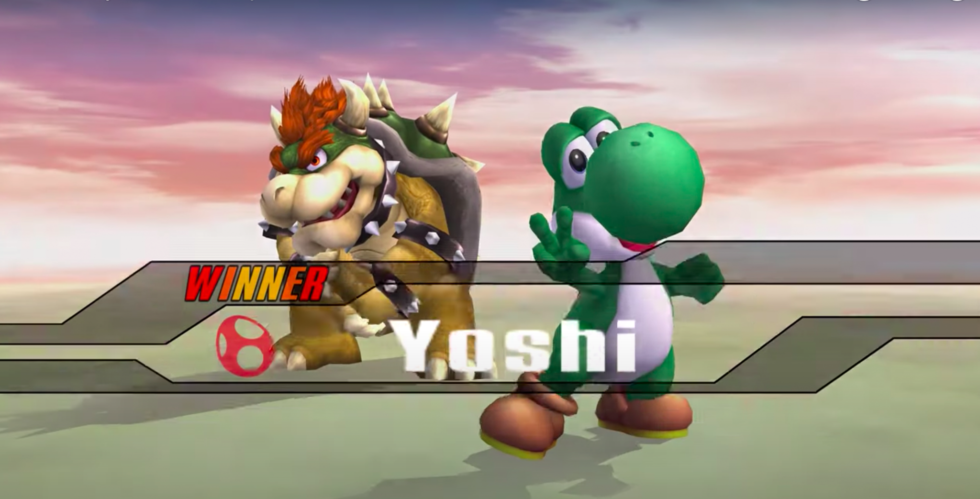
Rules of Play
Victory Condition
© 2022, 2024 Jeannie Novak All rights reserved.
Credit: JN
Caption: Victory screen in Super Smash Bros. Brawl.

Slide 5
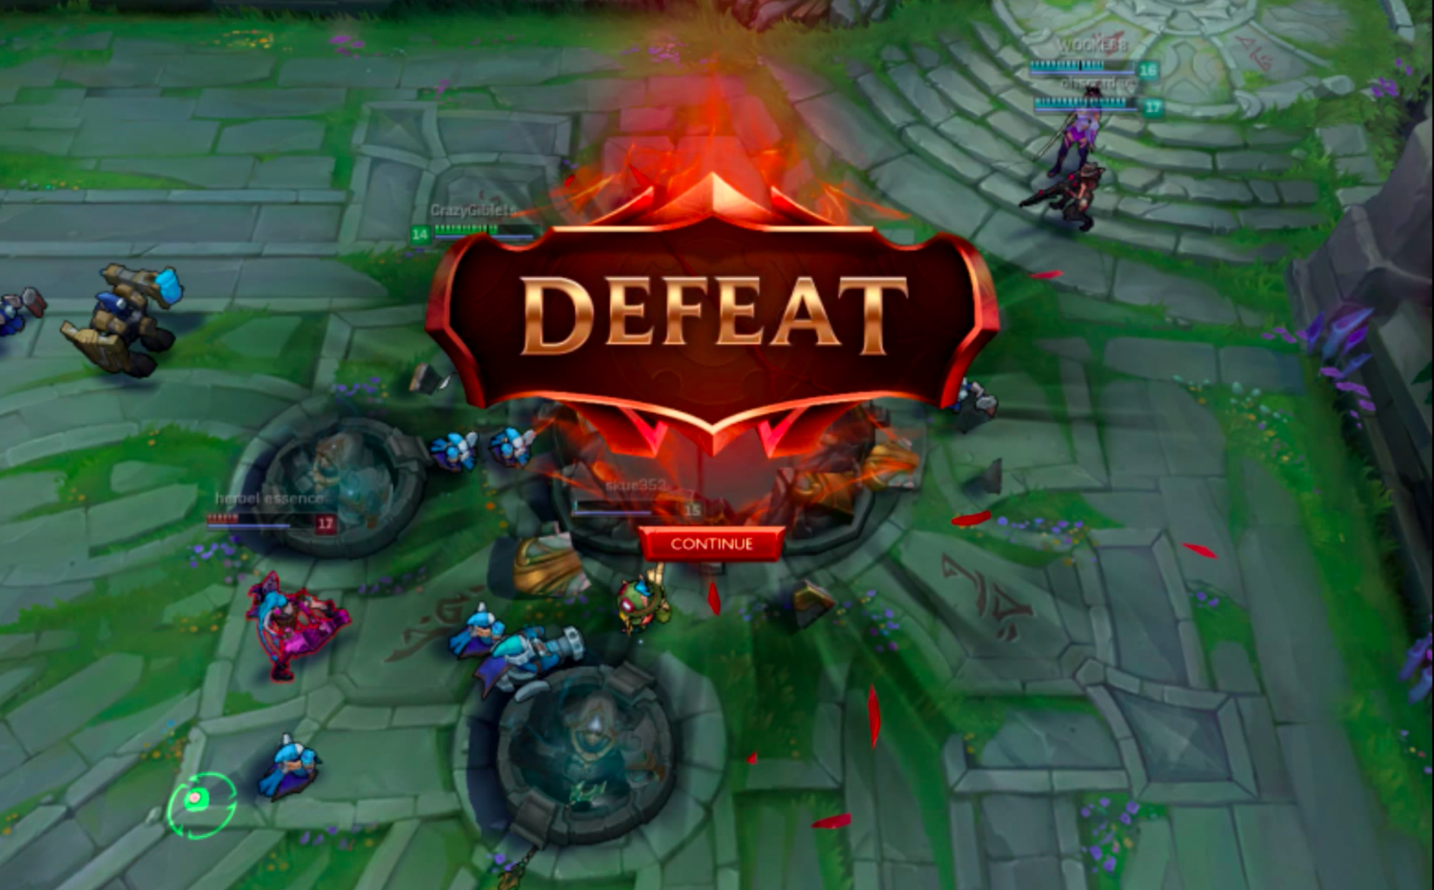
Rules of Play
Defeat Condition
© 2022, 2024 Jeannie Novak All rights reserved.
Credit: JN
Caption: Defeat screen in League of Legends.

Slide 6
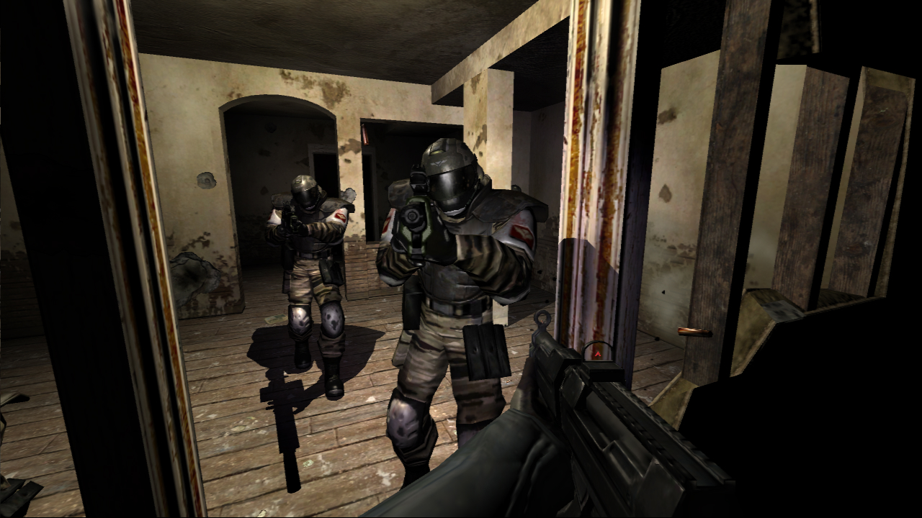
Interactivity Modes
Player-to-Game
© 2022, 2024 Jeannie Novak All rights reserved.
Credit: Monolith
Caption: Player-to-game interactivity involves interacting with a game’s AI—such as the ATC forces in FEAR.

Slide 7
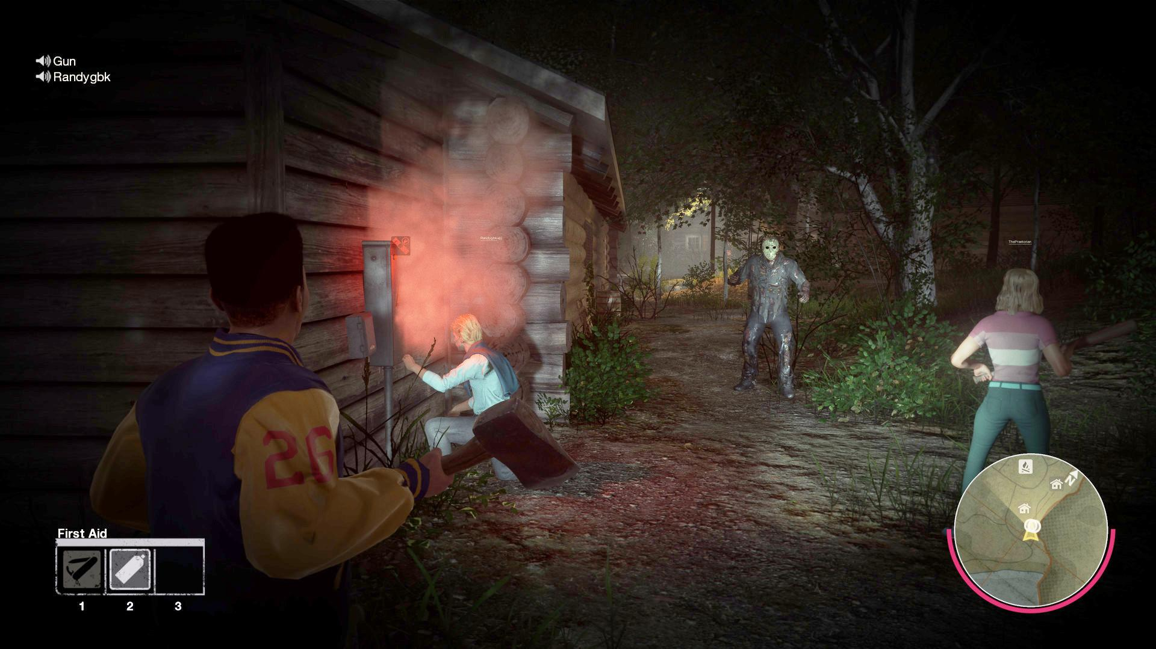
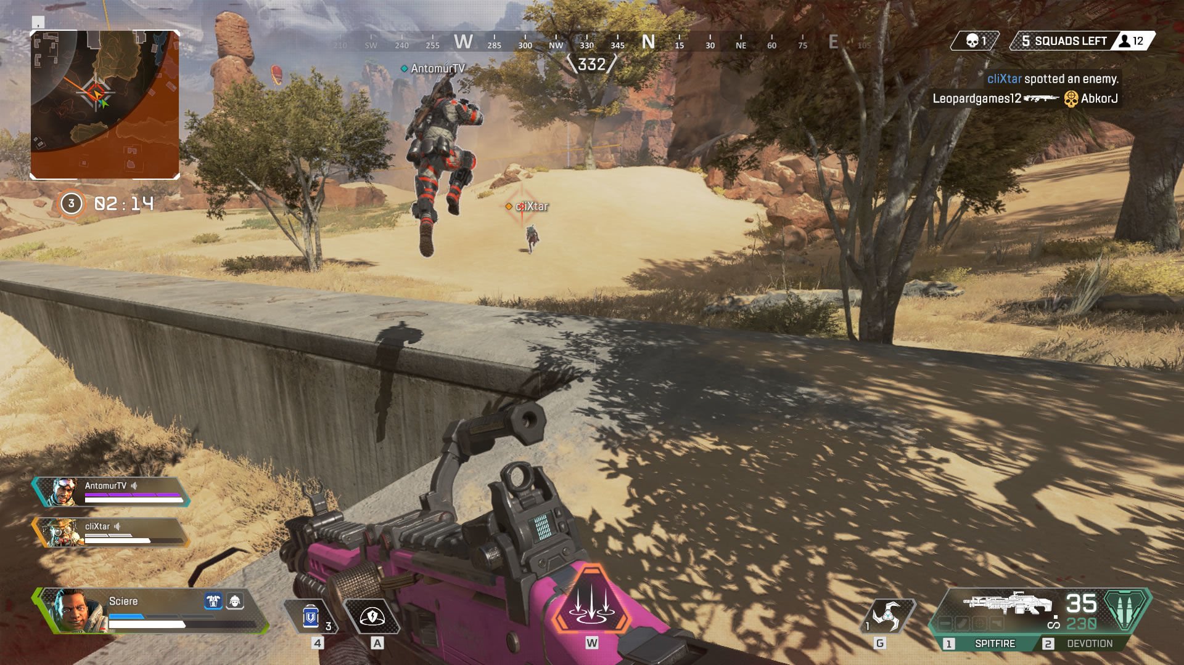
Interactivity Modes
Player-to-Player
© 2022, 2024 Jeannie Novak All rights reserved.
Credit: Gun Media Holdings
Credit: Sciere (MobyGames)
Caption: Friday The 13th: The Game - left - is an asymmetrical multiplayer game involving unilateral competition—while Apex Legends - right - involves multilateral team-based competition.

Slide 8
Interactivity Modes
Player-To-Developer
© 2022, 2024 Jeannie Novak All rights reserved.
Credit: Bungie
Caption: Player-to-developer interaction includes in-game events such as the “Deep Stone Crypt Raid” mission—introduced in the Destiny 2 Beyond Light expansion.

Slide 9
Interactivity Modes
Player-To-Platform
© 2022, 2024 Jeannie Novak All rights reserved.
Credit: ymgerman (Shutterstock)
Caption: Gran Turismo Sport played on a PS4 Pro with a steering wheel and PSVR headset.

Slide 10
Game Theory
Zero-Sum
© 2022, 2024 Jeannie Novak All rights reserved.
Credit: totojang1977 (Shutterstock)
Caption: Chess is a classic example of a zero-sum game.

Slide 11
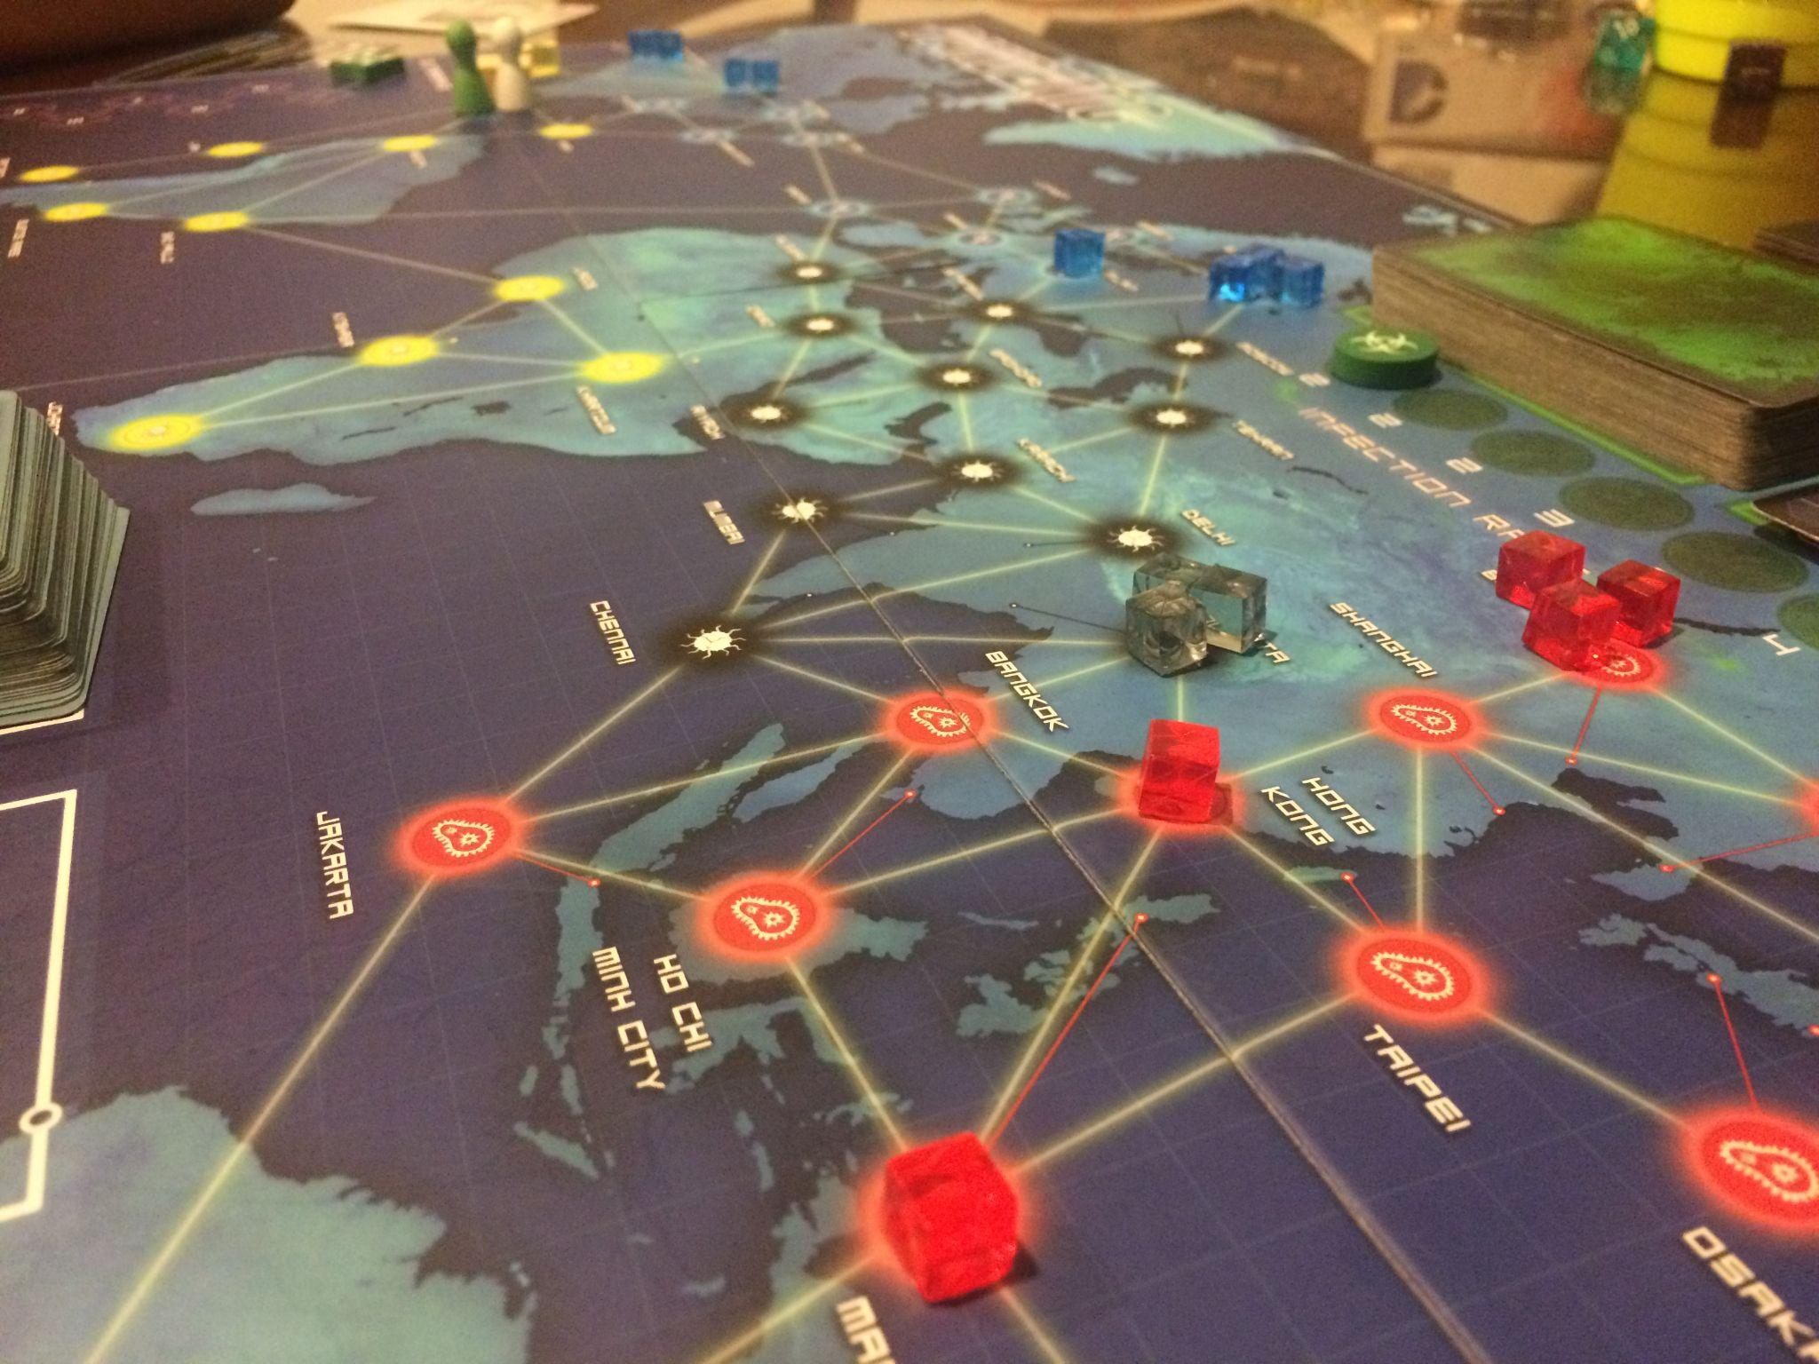
Game Theory
Non Zero-Sum
© 2022, 2024 Jeannie Novak All rights reserved.
Credit: Padaguan (Wikimedia Commons)
Caption: In the cooperative board game Pandemic, players join forces to discover cures to four diseases in order to stop them from spreading worldwide.

Slide 12
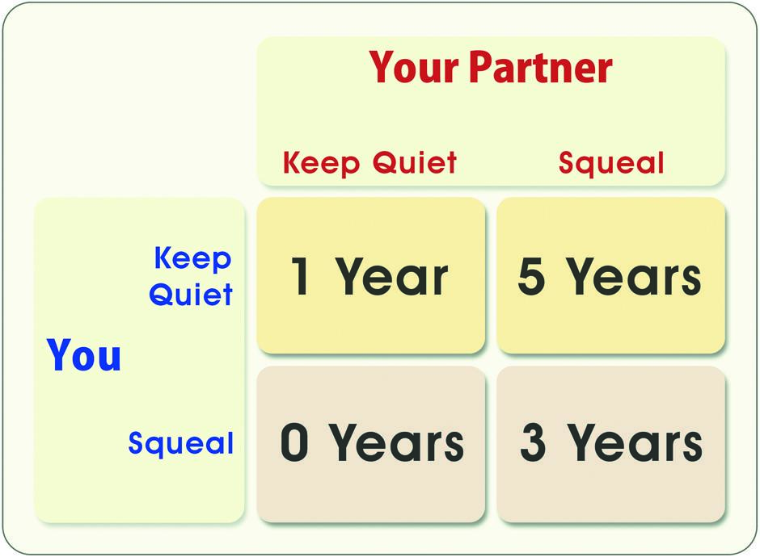
Game Theory
Prisoner’s Dilemma
© 2022, 2024 Jeannie Novak All rights reserved.
Credit: Diagram by Per Olin
Caption: The Prisoner’s Dilemma payoff matrix shows four possible outcomes for each player.

Slide 13
Game Theory
Tragedy of the Commons
© 2022, 2024 Jeannie Novak All rights reserved.
Credit: paintings (Shutterstock)
Credit: Illustration by Ben Bourbon

Slide 14
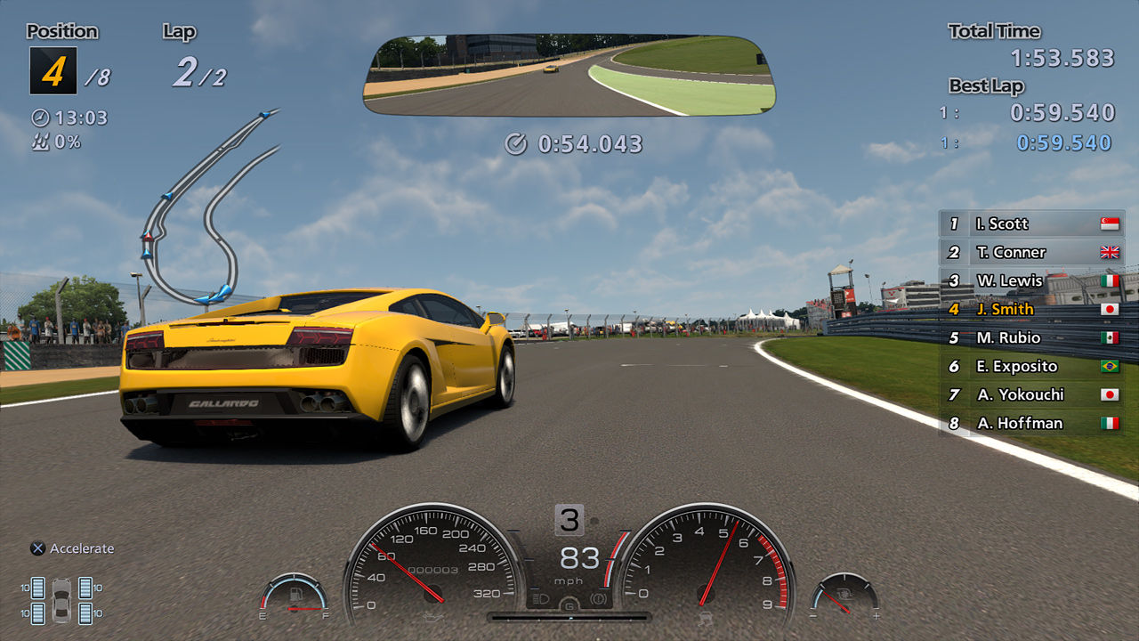
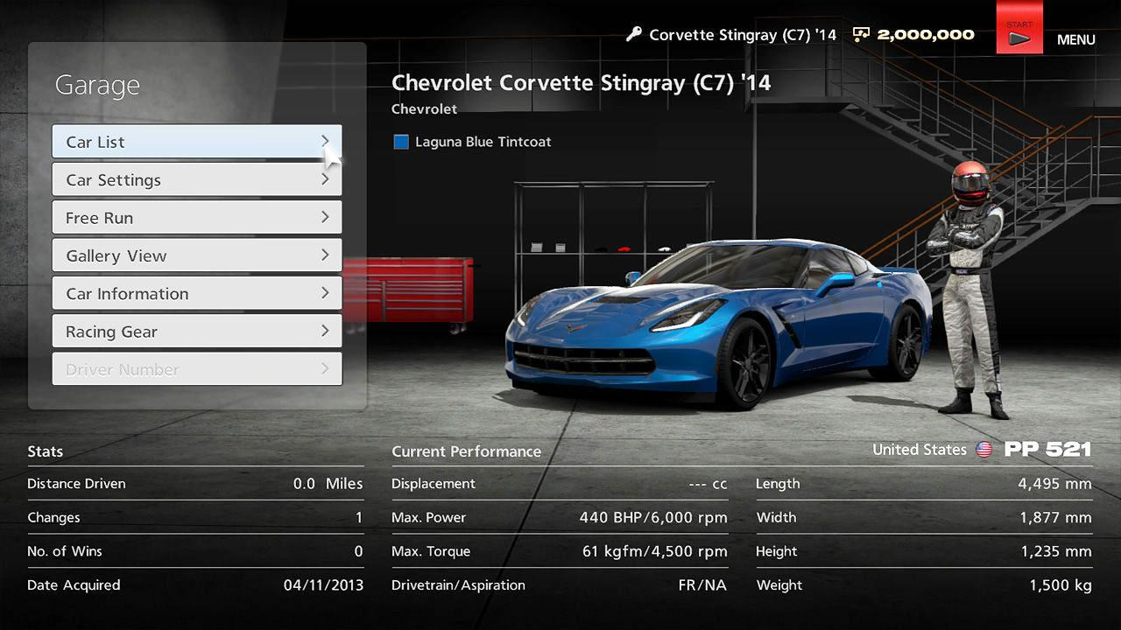
Challenges
Implicit & Explicit
© 2022, 2024 Jeannie Novak All rights reserved.
Credit: Pedro Cunha (MobyGames)
Credit: Pedro Cunha (MobyGames)
Caption: Challenges in Gran Turismo 6 are both explicit (win races, beat others) and implicit (adjust settings such as gear ratio, ride height, and downforce prior to each race).

Slide 15
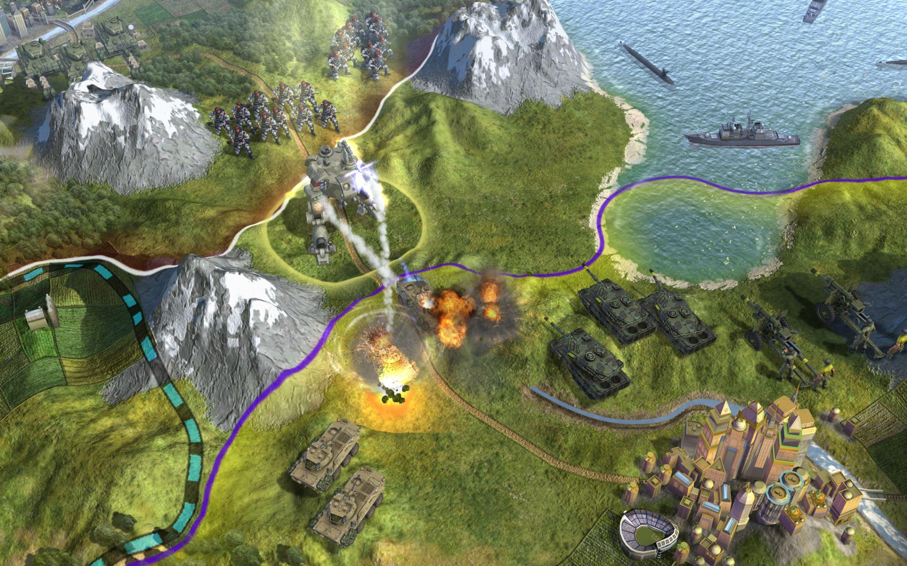
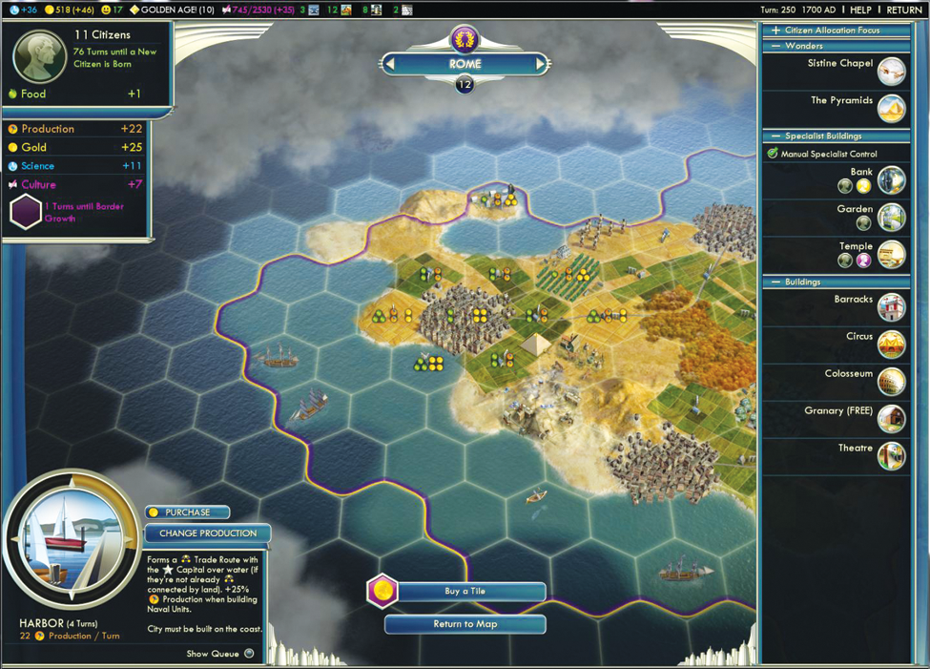
Challenges
Perfect & Imperfect Information
© 2022, 2024 Jeannie Novak All rights reserved.
Credit: 2K Games
Credit: 2K Games
Caption: Strategy games such as Civilization V use perfect - left - and imperfect - right - information—the latter in the form of fog of war.

Slide 16
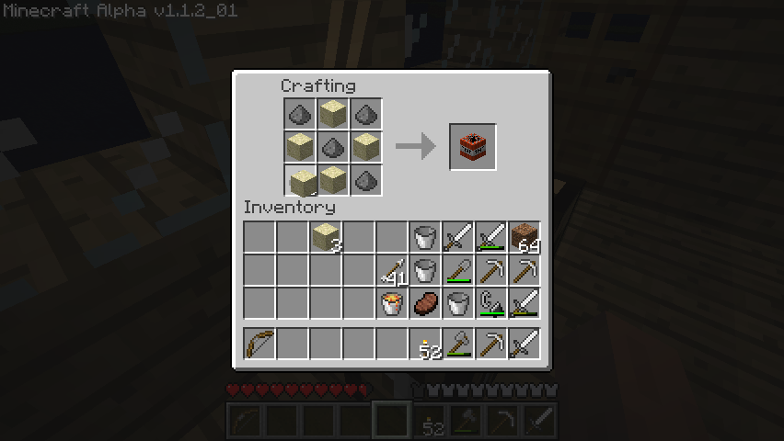
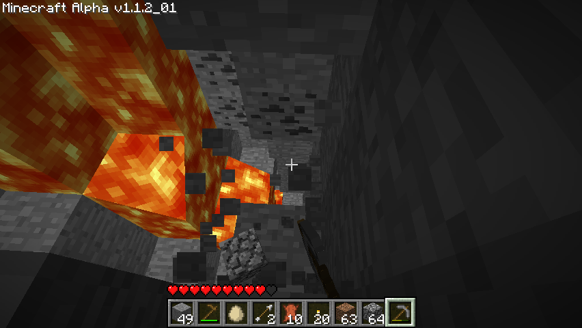
Challenges
Intrinsic & Extrinsic Knowledge
© 2022, 2024 Jeannie Novak All rights reserved.
Credit: vedder (MobyGames)
Credit: vedder (MobyGames)
Caption: In Minecraft, players apply intrinsic (For example, crafting recipes) and extrinsic knowledge (For example, wood burns, ore melts) in order to build anything they can imagine—including shelters that protect them from the monsters that come out at night!

Slide 17
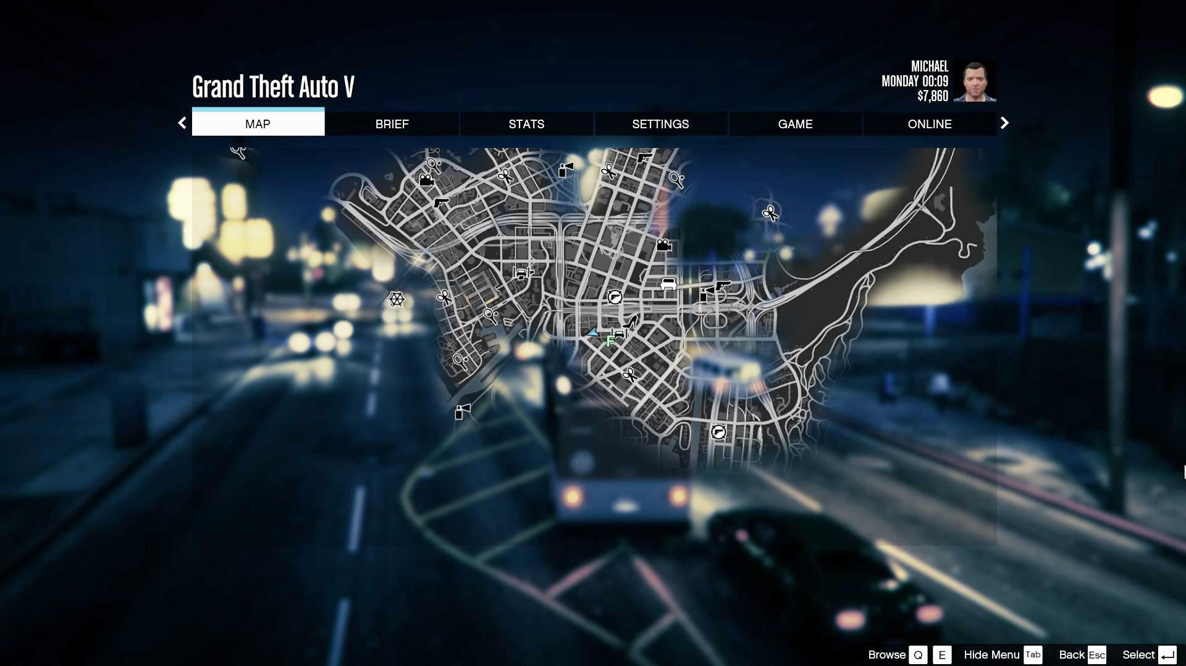
Challenges
Spatial Awareness
© 2022, 2024 Jeannie Novak All rights reserved.
Credit: Tomas Petersson (MobyGames)
Caption: Players navigate the streets of Los Santos in Grand Theft Auto V.

Slide 18
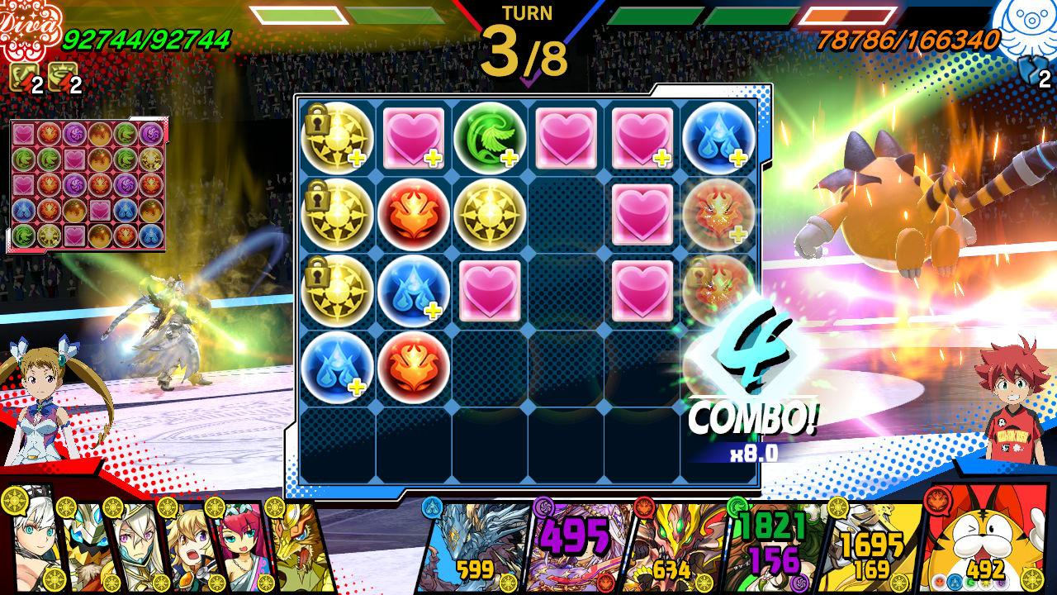
Challenges
Pattern Recognition & Matching
© 2022, 2024 Jeannie Novak All rights reserved.
Credit: GungHo Online Entertainment
Caption: Games such as Puzzles & Dragons incorporate pattern recognition mechanics through Match-3 gameplay.

Slide 19
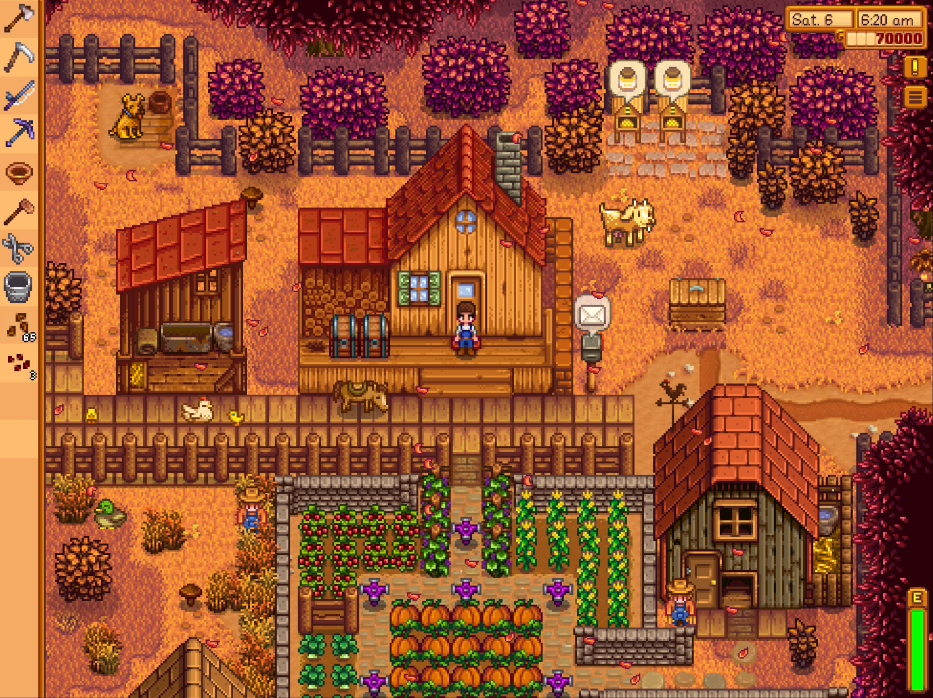
Challenges
Resource Management
© 2022, 2024 Jeannie Novak All rights reserved.
Credit: Chucklefish Limited
Caption: In Stardew Valley, the player must manage a variety of resources—including crops, livestock, products, goods, materials, and people.

Slide 20
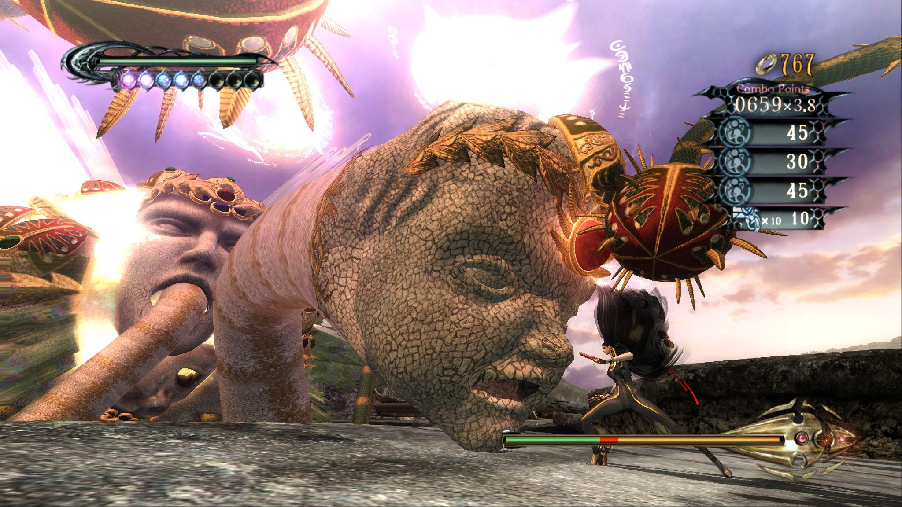
Challenges
Reaction Time
© 2022, 2024 Jeannie Novak All rights reserved.
Credit: Sega Corporation
Caption: Gameplay in Bayonetta is entirely based on reaction time and reflexes—including when to dodge, block, and attack.

Slide 21
Balance
© 2022, 2024 Jeannie Novak All rights reserved.
Credit: JN
Caption: As ominous as it looks, the Dark Souls “YOU DIED” defeat screen is a blunt reminder that the player hasn’t mastered a particular area.

Slide 22
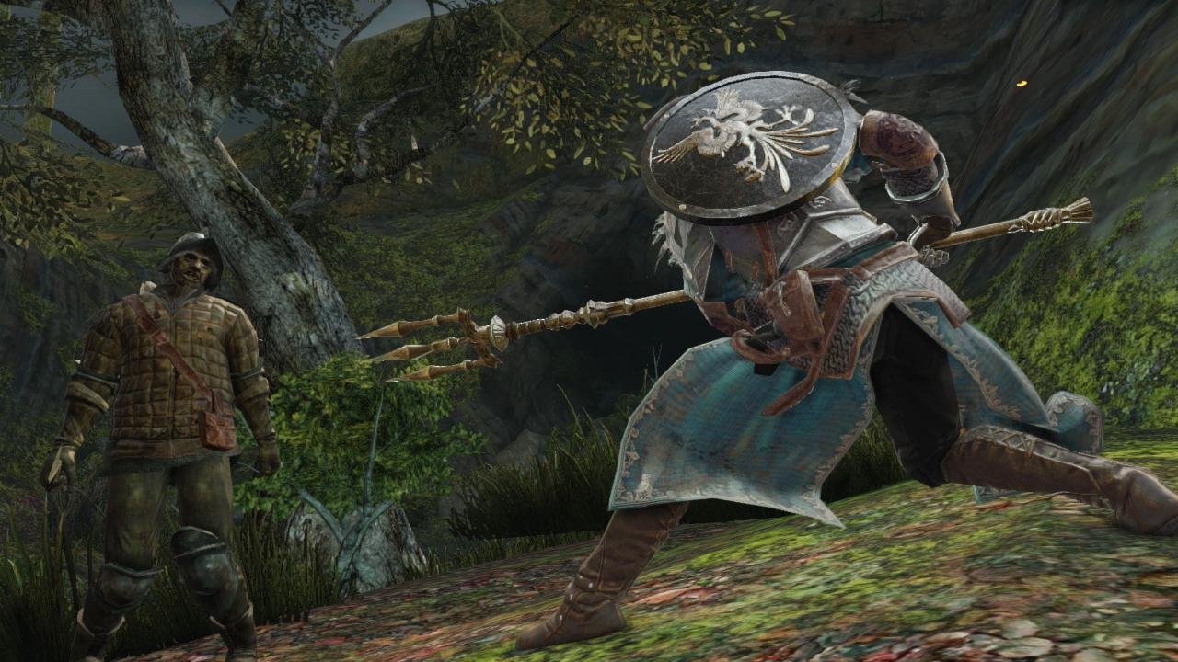
Balance
Static
© 2022, 2024 Jeannie Novak All rights reserved.
Credit: Bandai Namco Entertainment
Caption: In Dark Souls II, an obvious strategy when using the Channeler’s Trident is to battle an enemy from a safe distance.

Slide 23
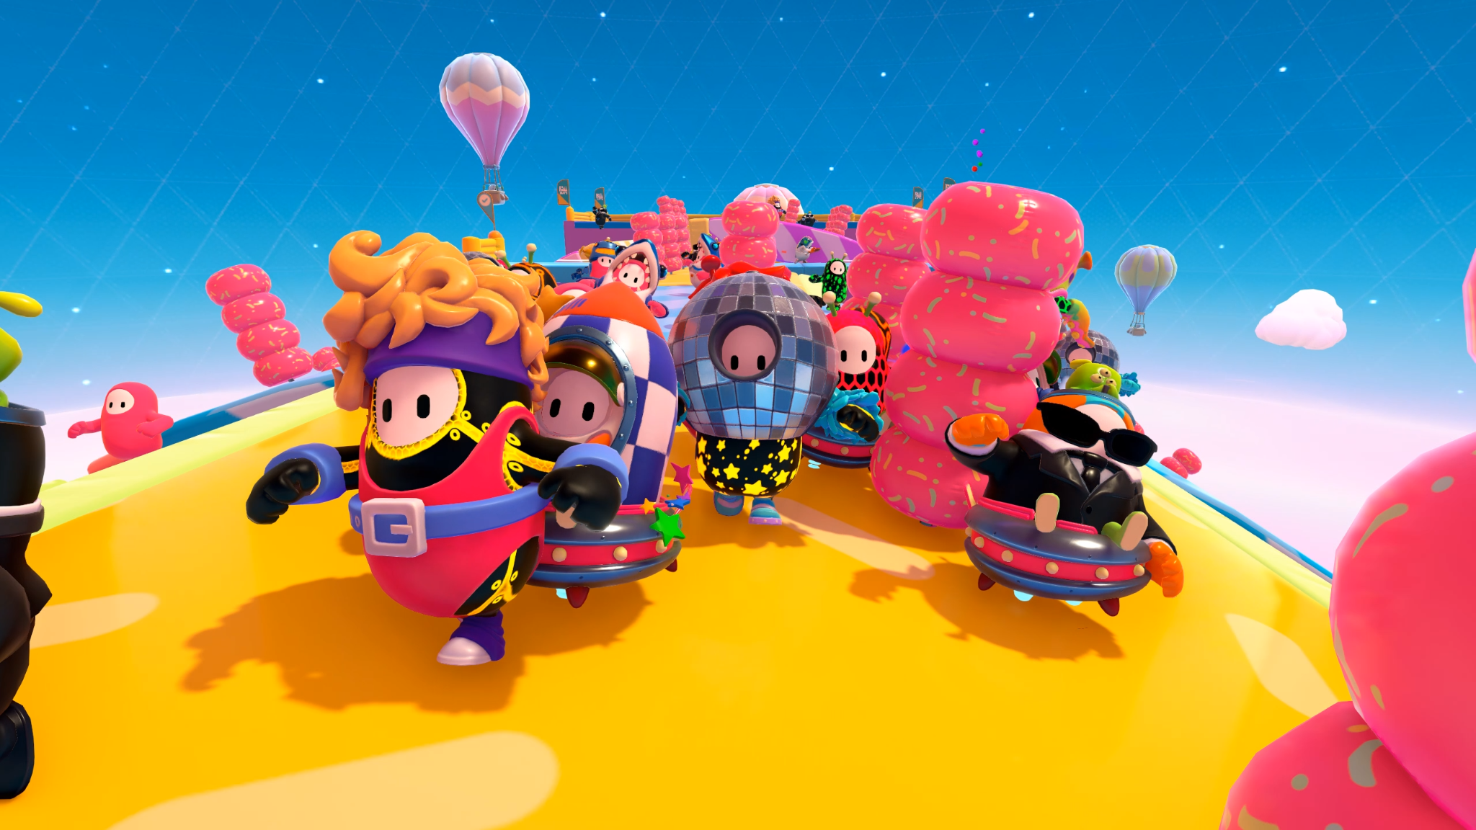
Balance
Symmetry
© 2022, 2024 Jeannie Novak All rights reserved.
Credit: Devolver Digital
Caption: In Fall Guys, players begin the game with the same resources.

Slide 24
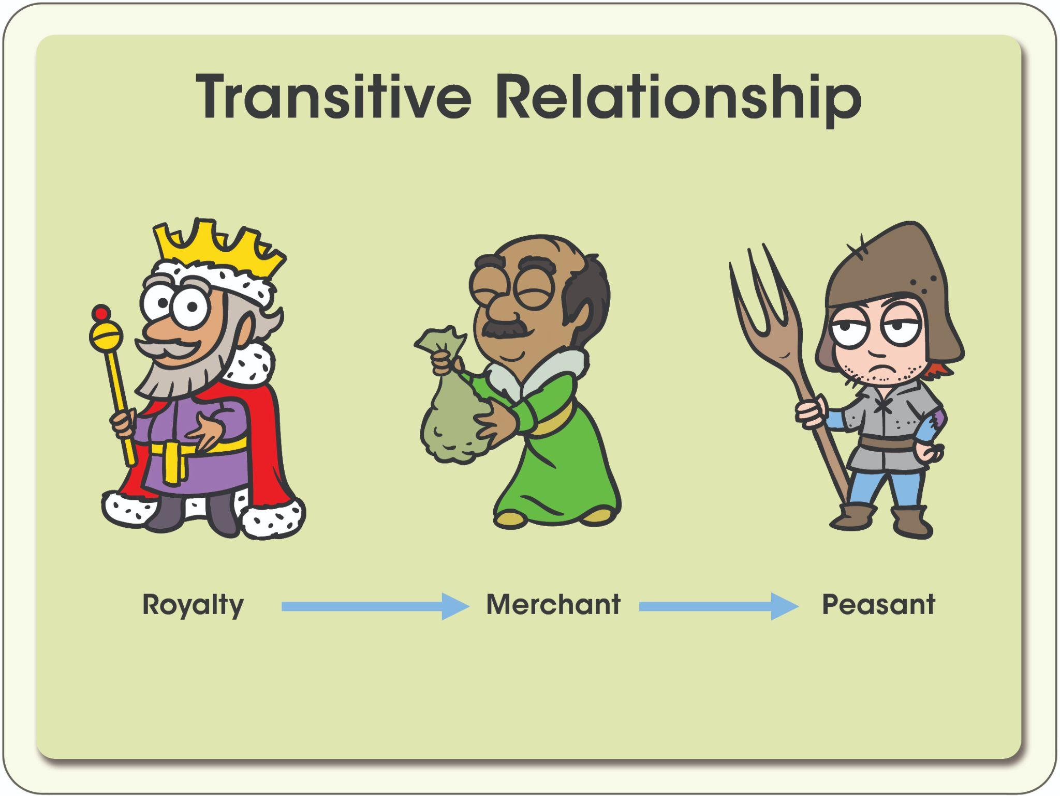
Balance
Symmetry
© 2022, 2024 Jeannie Novak All rights reserved.
Credit: Illustrations by Ben Bourbon | Diagram by Per Olin
Caption: A hierarchical caste system is a type of linear, transitive relationship.

Slide 25
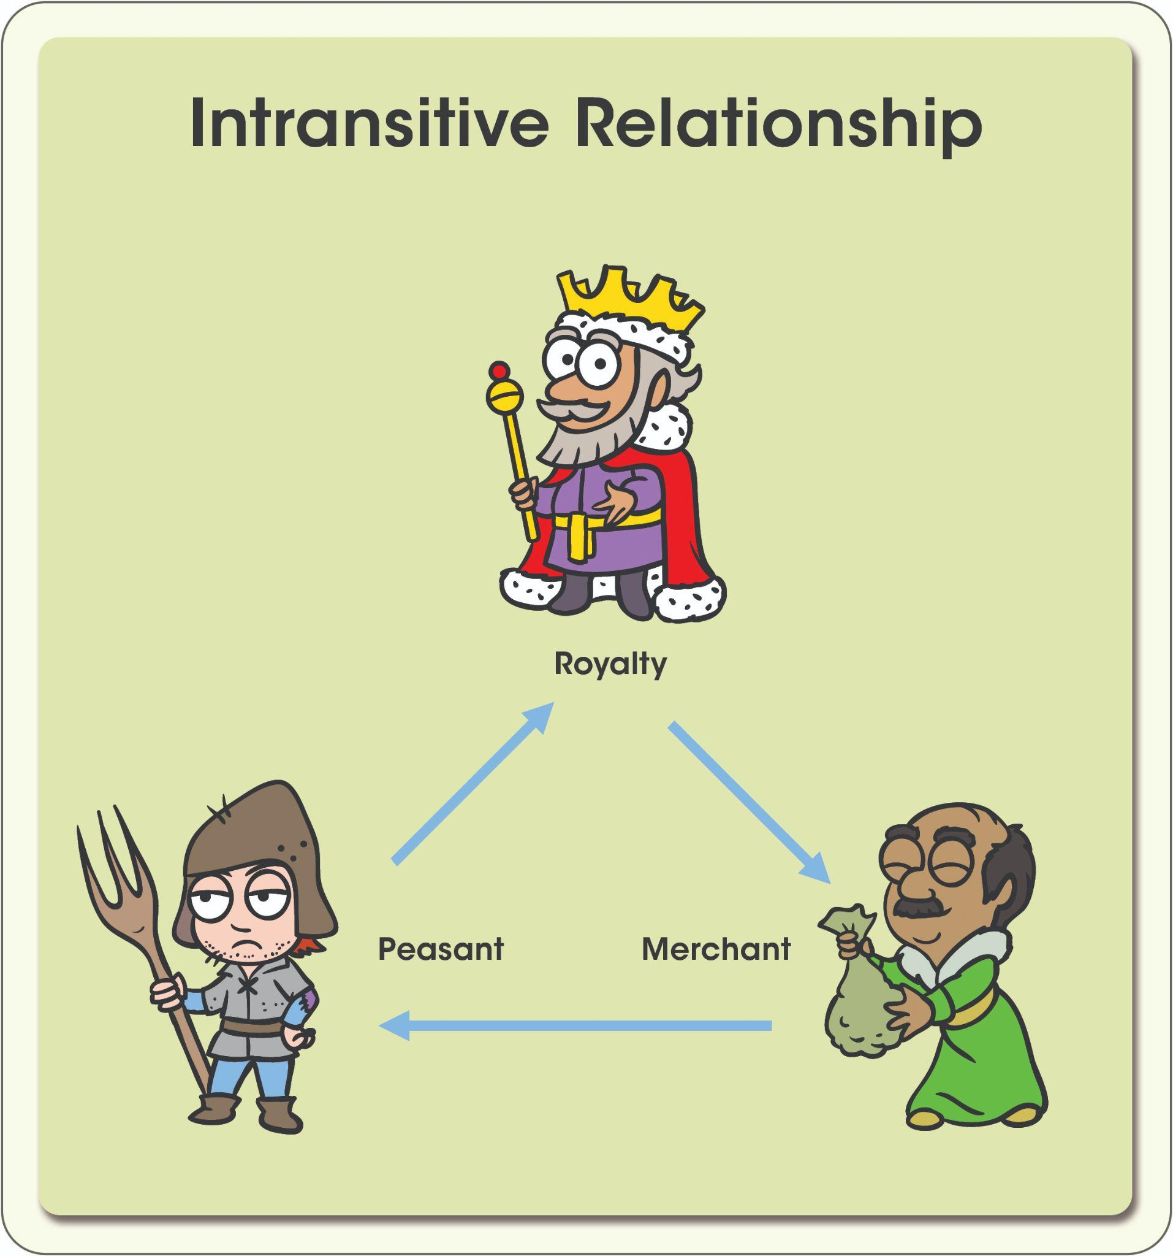
Balance
Symmetry
© 2022, 2024 Jeannie Novak All rights reserved.
Credit: Illustrations by Ben Bourbon | Diagram by Per Olin
Caption: A rock-paper-scissors system is a type of circular, intransitive relationship.

Slide 26
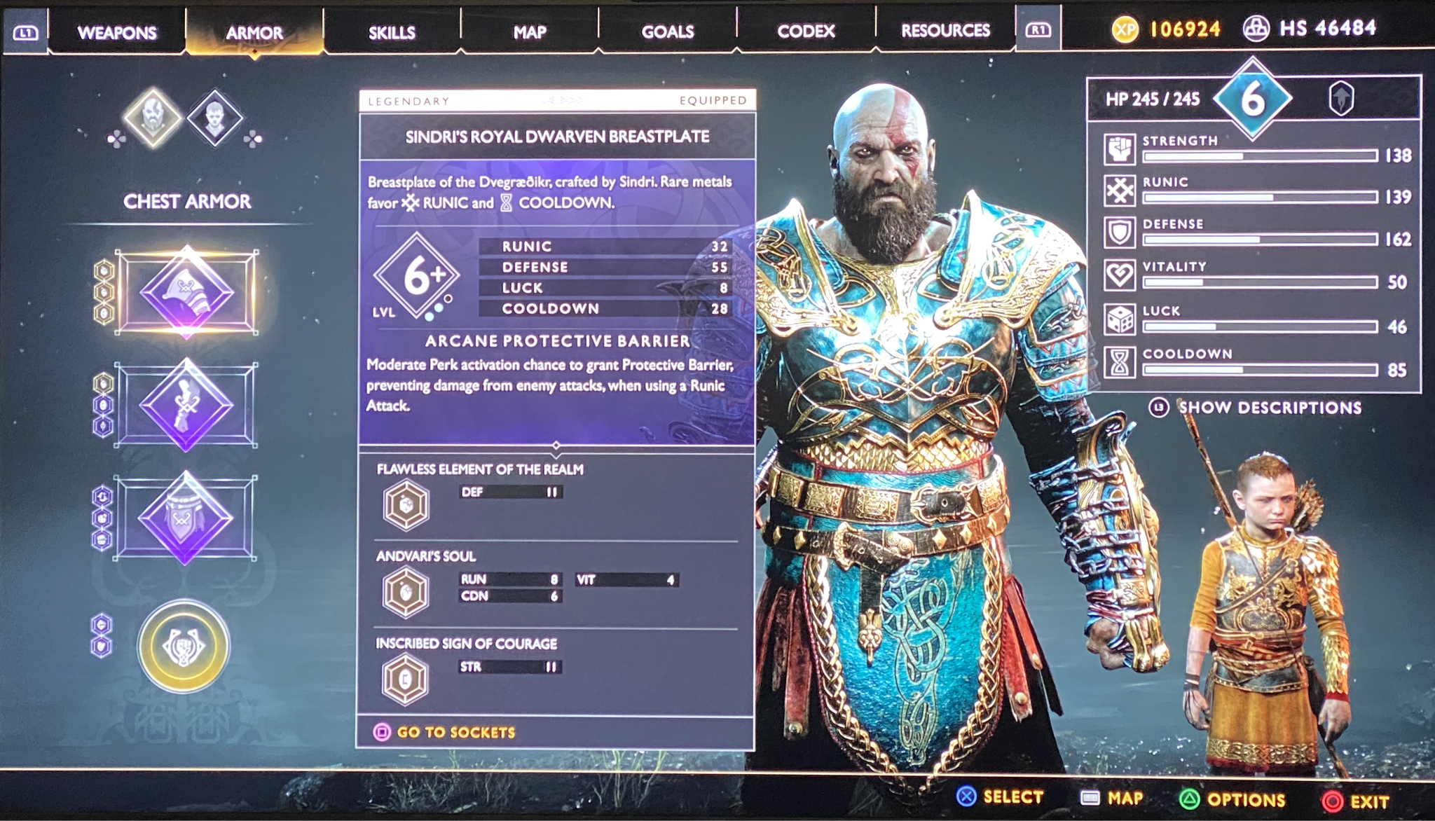
Balance
Trade-Offs
© 2022, 2024 Jeannie Novak All rights reserved.
Credit: JN
Caption: In God of War (2018), sturdier armor is often very useful in defense (blocking attacks and absorbing damage)–but it also takes away from the character’s overall strength.

Slide 27
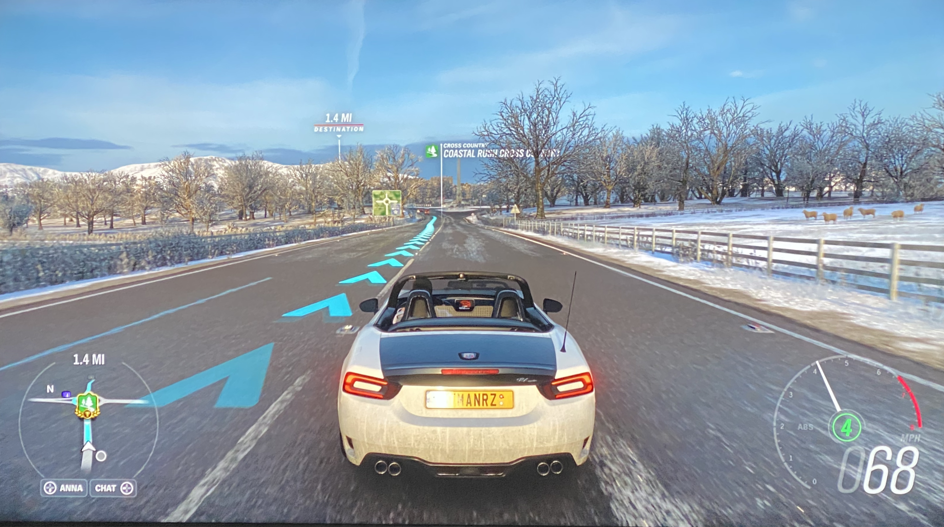
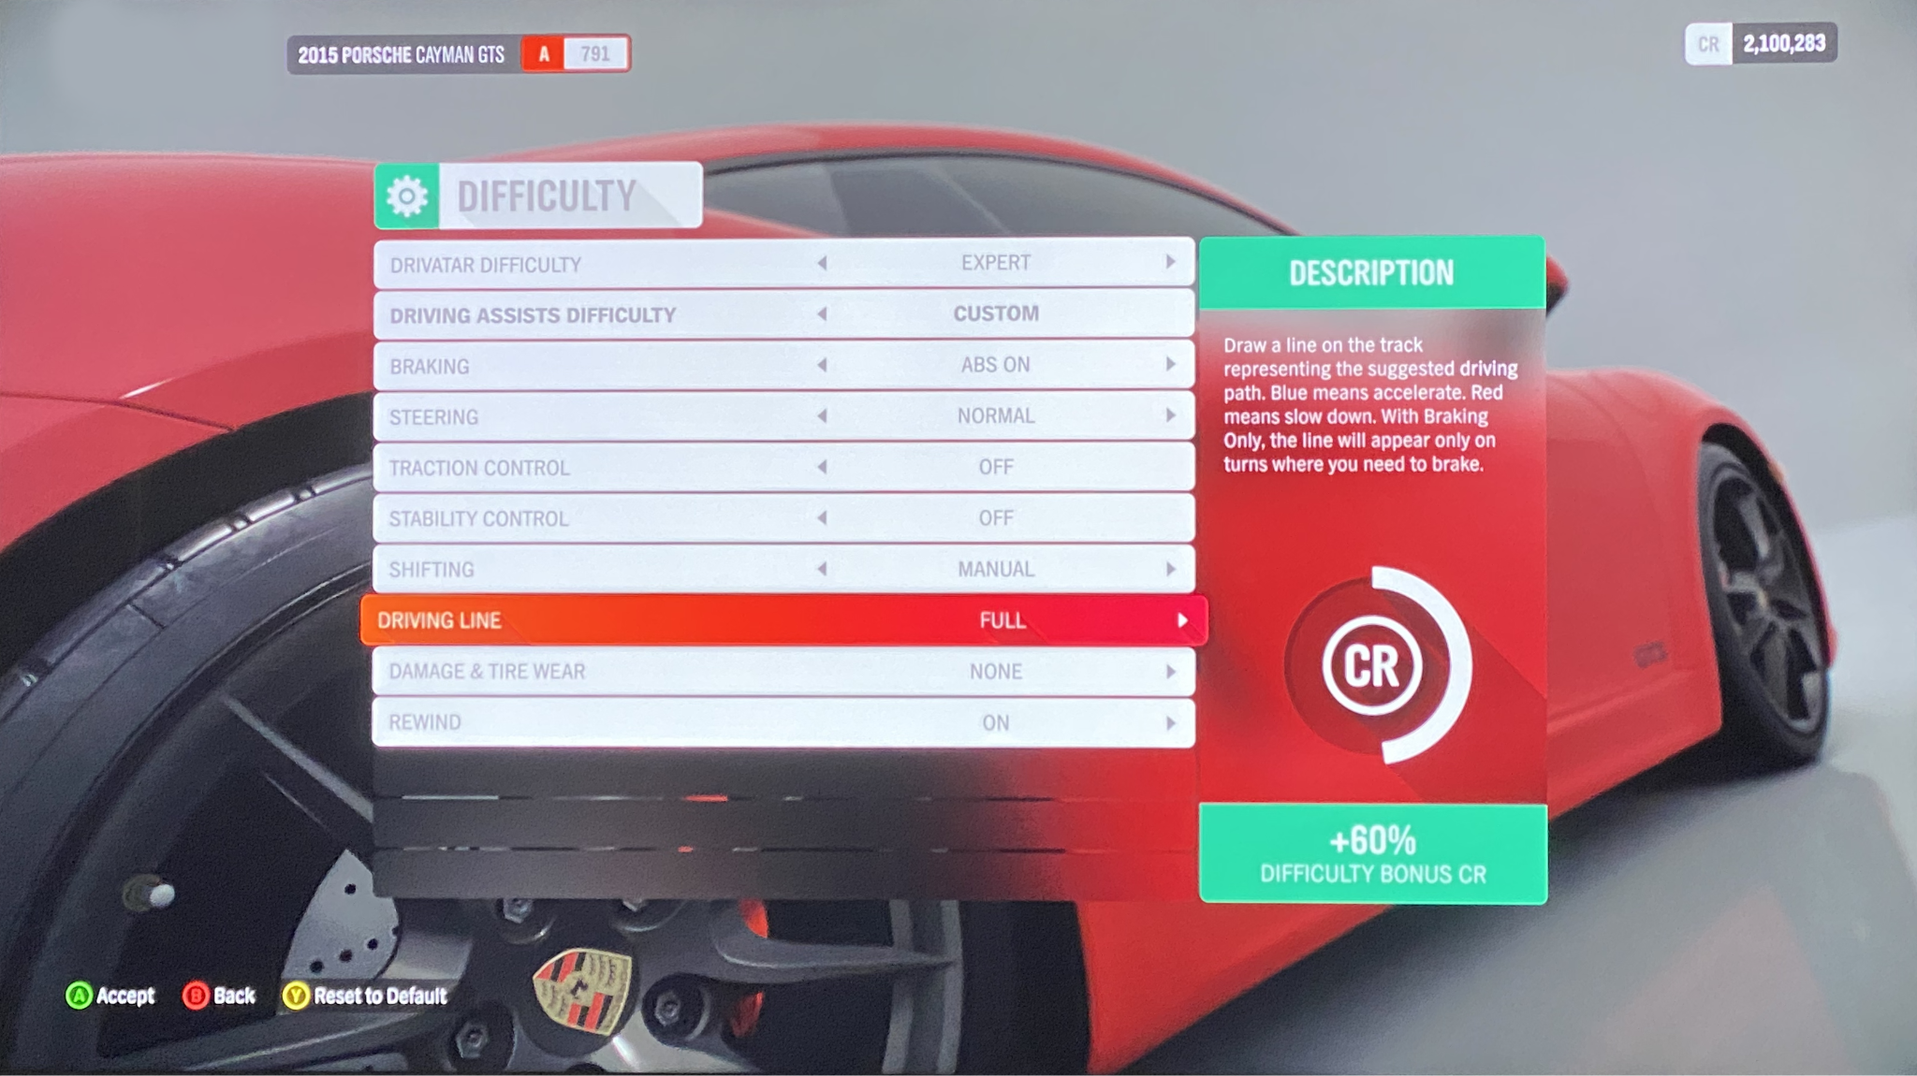
Balance
Feedback Loop
© 2022, 2024 Jeannie Novak All rights reserved.
Credit: JN
Credit: JN
Caption: Enabling the driving line in Forza Horizon 4 provides the player with an assist (positive feedback - left), while also lowering the player’s bonus by 10% (from 70 to 60 shown - right).

Slide 28
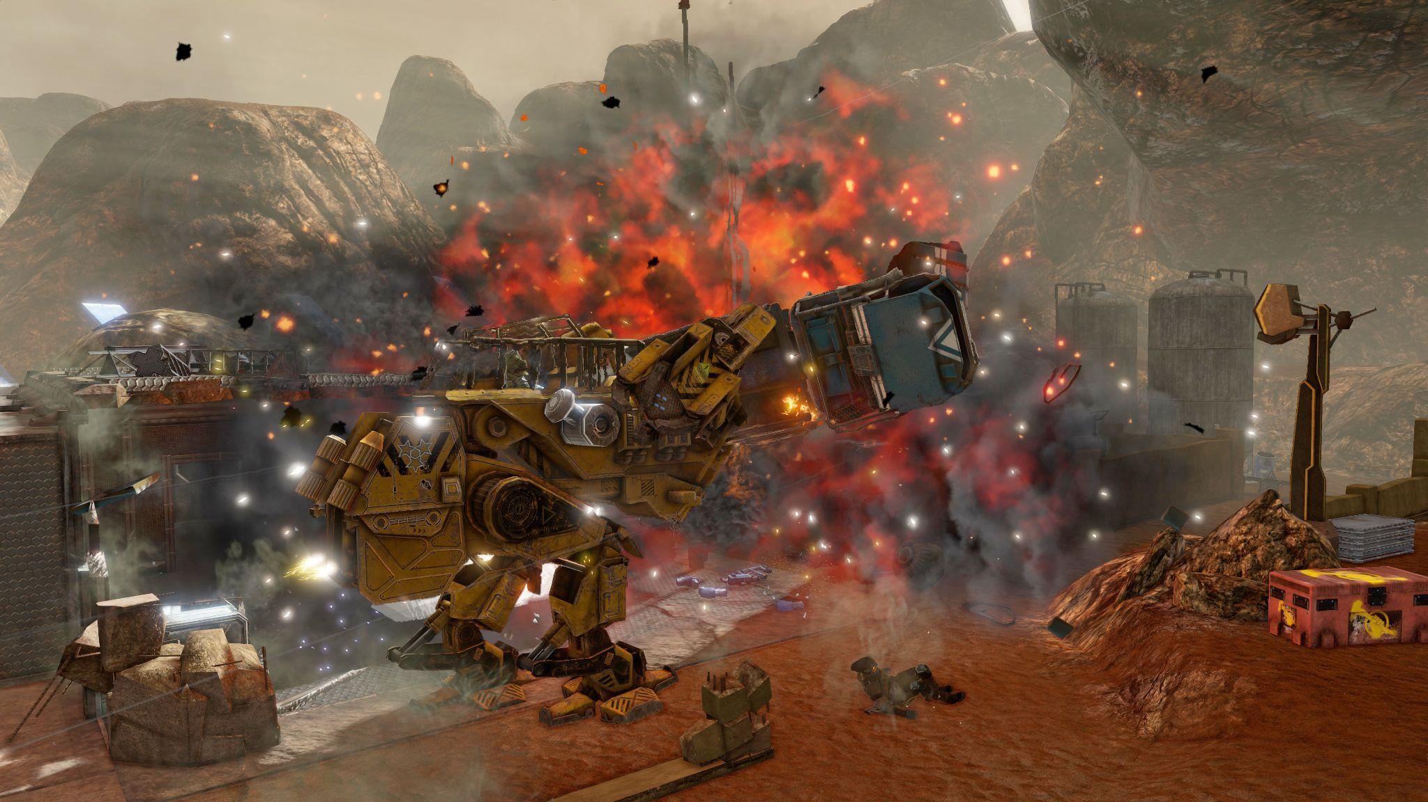
Balance
Dynamic
© 2022, 2024 Jeannie Novak All rights reserved.
Credit: THQ Nordic GmbH
Caption: In Red Faction: Guerilla Re-Mars-tered, players wreak havoc across Mars.

Slide 29
Balance
Maintenance
© 2022, 2024 Jeannie Novak All rights reserved.
Credit: Sega Corporation
Caption: Throughout Two Point Hospital, the player must maintain the balance of resources–including room availability, staff, reputation, and revenue.

Slide 30
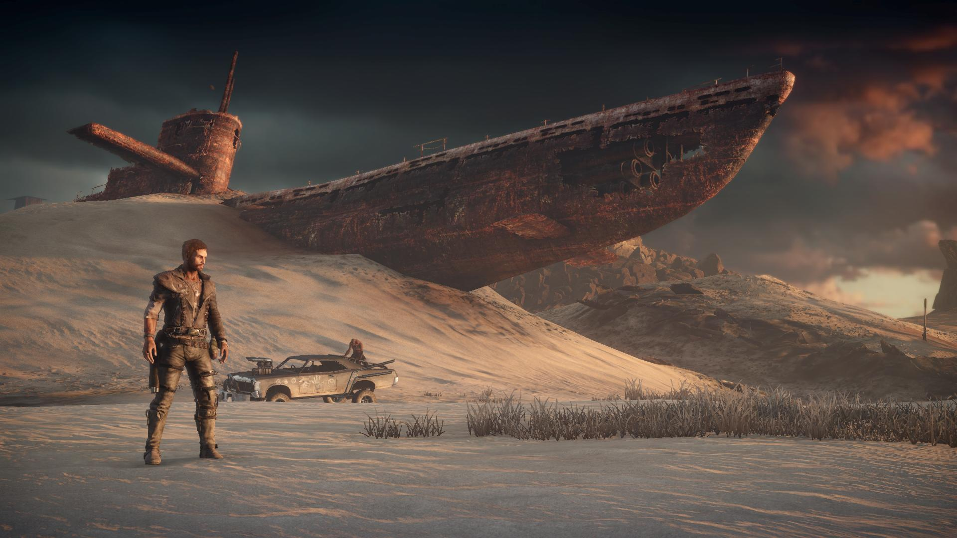
Balance
Restoration
© 2022, 2024 Jeannie Novak All rights reserved.
Credit: Warner Brothers Interactive Entertainment
Caption: In Mad Max, the player must take control of a world in anarchy.

Slide 31
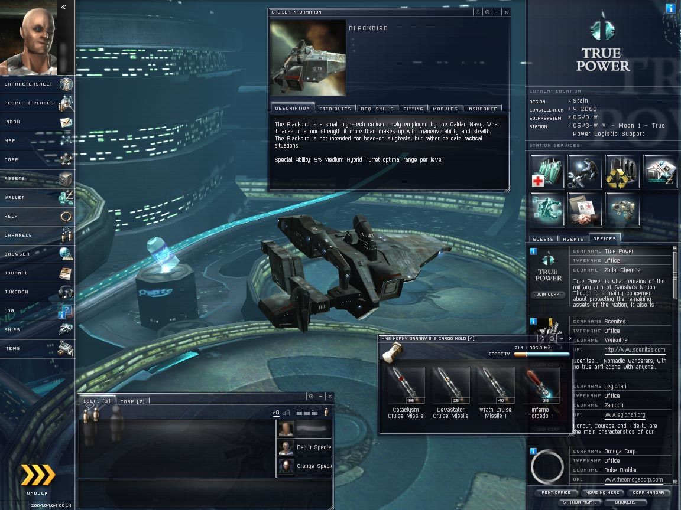
Economy
© 2022, 2024 Jeannie Novak All rights reserved.
Credit: sterm (MobyGames)
Caption: CCP Games’ EVE Online features a persistent state world and an enduring player-driven economy.

Slide 32
CHAPTER 6
© 2022, 2024 Jeannie Novak All rights reserved.
REVIEW EXERCISES
1
What is the difference between gameplay and story? Choose one game and discuss its story and gameplay elements separately. How do these two elements intersect?
2
Contrast the static and dynamic elements of an existing game. How do players modify the game to make it dynamic, and what does this have to do with game balance?
3
What are the players’ goals in a non zero-sum game? How can the Prisoner’s Dilemma and the tragedy of the commons be applied to gameplay? Create a scenario around one of these theories and discuss how a game involving both cooperation and competition could be compelling and interesting.

Slide 33
CHAPTER 6
© 2022, 2024 Jeannie Novak All rights reserved.
REVIEW EXERCISES
Play a card or board game (either a classic game like Monopoly or a modern tabletop game like those that can be found at sites such as BoardGameGeek). Analyze the rules—including victory and defeat conditions, gameplay process, and game goals. What steps would you take to create a digital version of this game? (Consider expanding on the game’s story as one strategy.)
4
How do goals relate to challenges in a game—and what strategies can be utilized to overcome these challenges? Choose one game goal and write a premise (discussed in Chapter 5) that incorporates that goal. List three plot points that incorporate challenges associated with the game goal you chose. Discuss several strategies that a player might utilize to overcome each challenge. By doing this, how are you integrating gameplay with story?
5

Slide 34
CHAPTER 6
© 2022, 2024 Jeannie Novak All rights reserved.
REVIEW EXERCISES
Imagine that you’ve created an original game in which you and other players must escape from a deserted island. There are three objects that could be built that might help players leave the island: boat, raft, and lifesaver. The boat is the most difficult to build, but it is the most stable escape object; the lifesaver is the easiest to build; and the less stable raft falls in the middle. The relationship between these objects is linear, or transitive. How would you alter the objects so that the relationship becomes intransitive?
6

Slide 35
CHAPTER 6
© 2022, 2024 Jeannie Novak All rights reserved.
REVIEW EXERCISES
A game’s premise indicates “You are given immunity from a deadly disease that causes humans to age rapidly. It is up to you alone to find the cure. Use your powers of deduction to uncover the mysterious origins of this disease and find an antidote—before it’s too late!” Discuss the game’s specific victory and defeat conditions. Giving the game a genre of your choice, make up a set of rules.
7
8
There are plenty of games that focus on the application of either intrinsic or extrinsic knowledge, but it’s not as common to combine both in one game. Create an original game idea that makes use of both forms of knowledge as strategy elements.

