Slide 2
CHAPTER 5
Story & character development
CREATING THE NARRATIVE
© 2022, 2024 Jeannie Novak All rights reserved.

Slide 3
CHAPTER OBJECTIVES
© 2022, 2024 Jeannie Novak All rights reserved.
After reading this chapter, you should be able to:
Understand how story elements in games differ from those in film and other entertainment media.
Describe some traditional story structures and character archetypes.
Define interactivity and how it can be applied to storytelling.
Discuss some dramatic storytelling devices used in games, and how they affect immersion.
Explain the different forms of character development, and how they specifically apply to game characters.

Slide 4
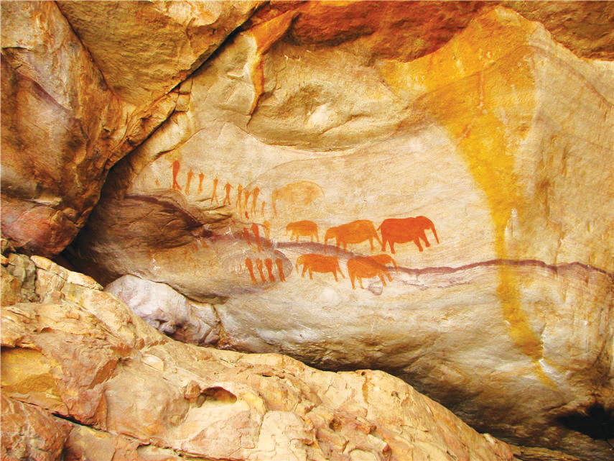
Storytelling Traditions
© 2022, 2024 Jeannie Novak All rights reserved.
Credit: Valroe (Wikimedia Commons)
Caption: Cave paintings (Lascaux, France, shown) are considered the first examples of visual storytelling.

Slide 5
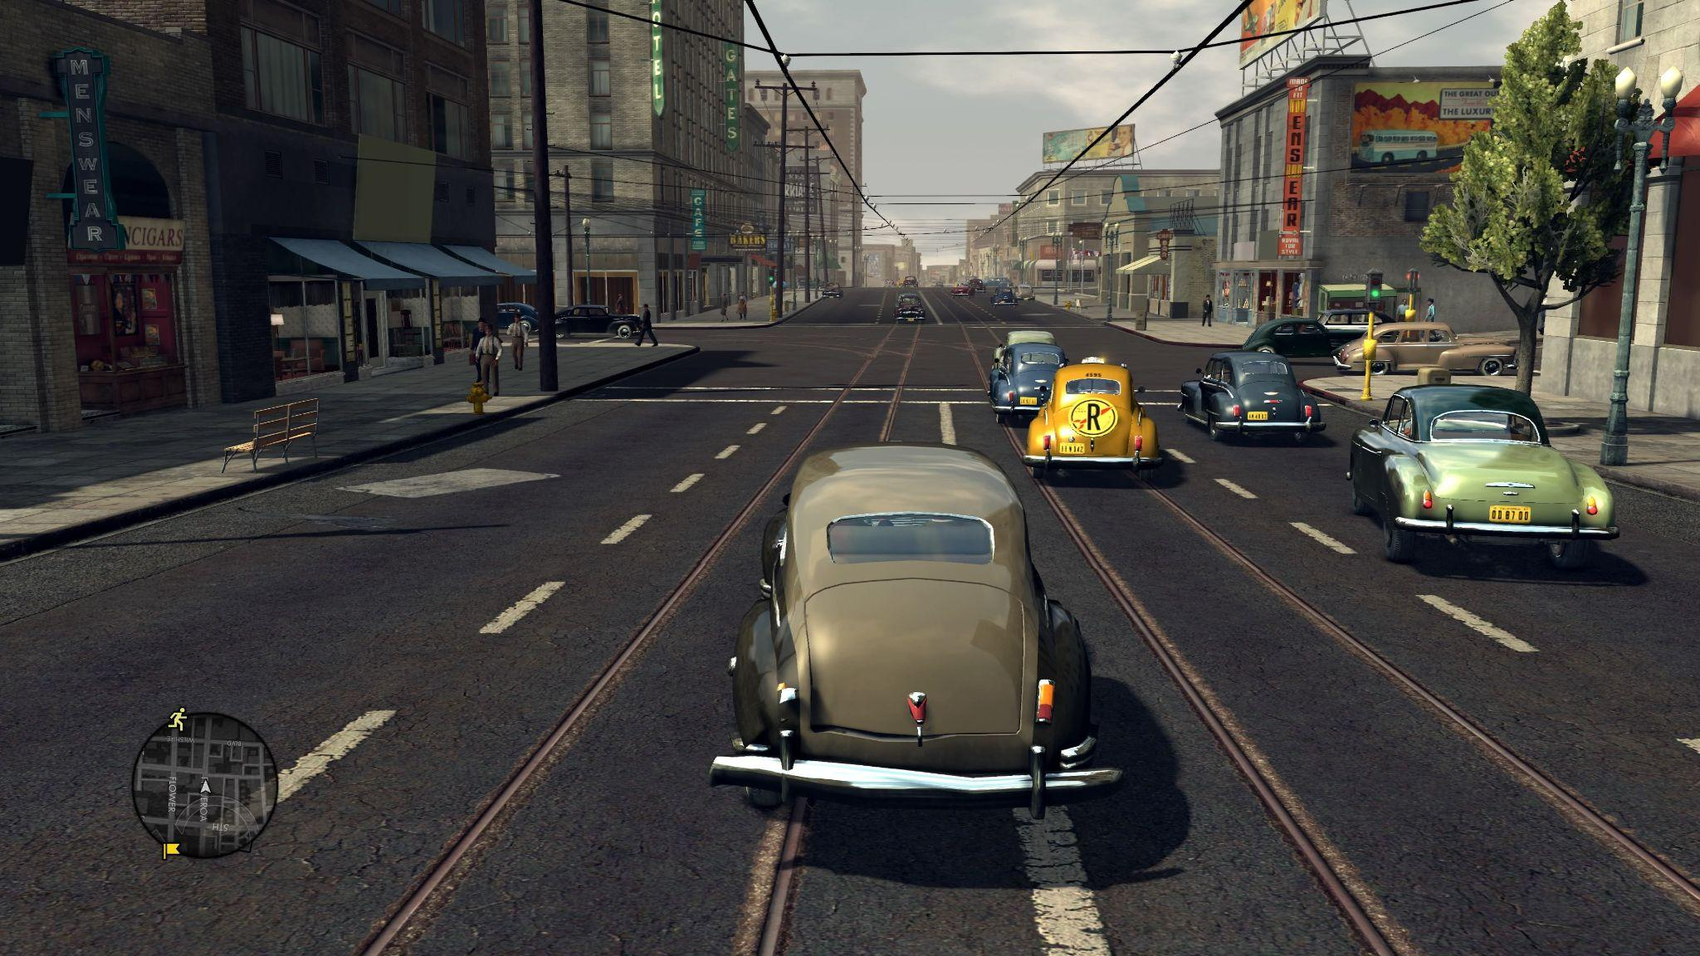
Generating Ideas
© 2022, 2024 Jeannie Novak All rights reserved.
Credit: Sciere (MobyGames)
Credit: MAT (MobyGames)
Caption: Game ideas might come from real-life events such as a family’s battle with cancer (Numinous Games’ That Dragon, Cancer - left) or the Black Dahlia murder case (Rockstar Games’ LA Noire - right).

Slide 6
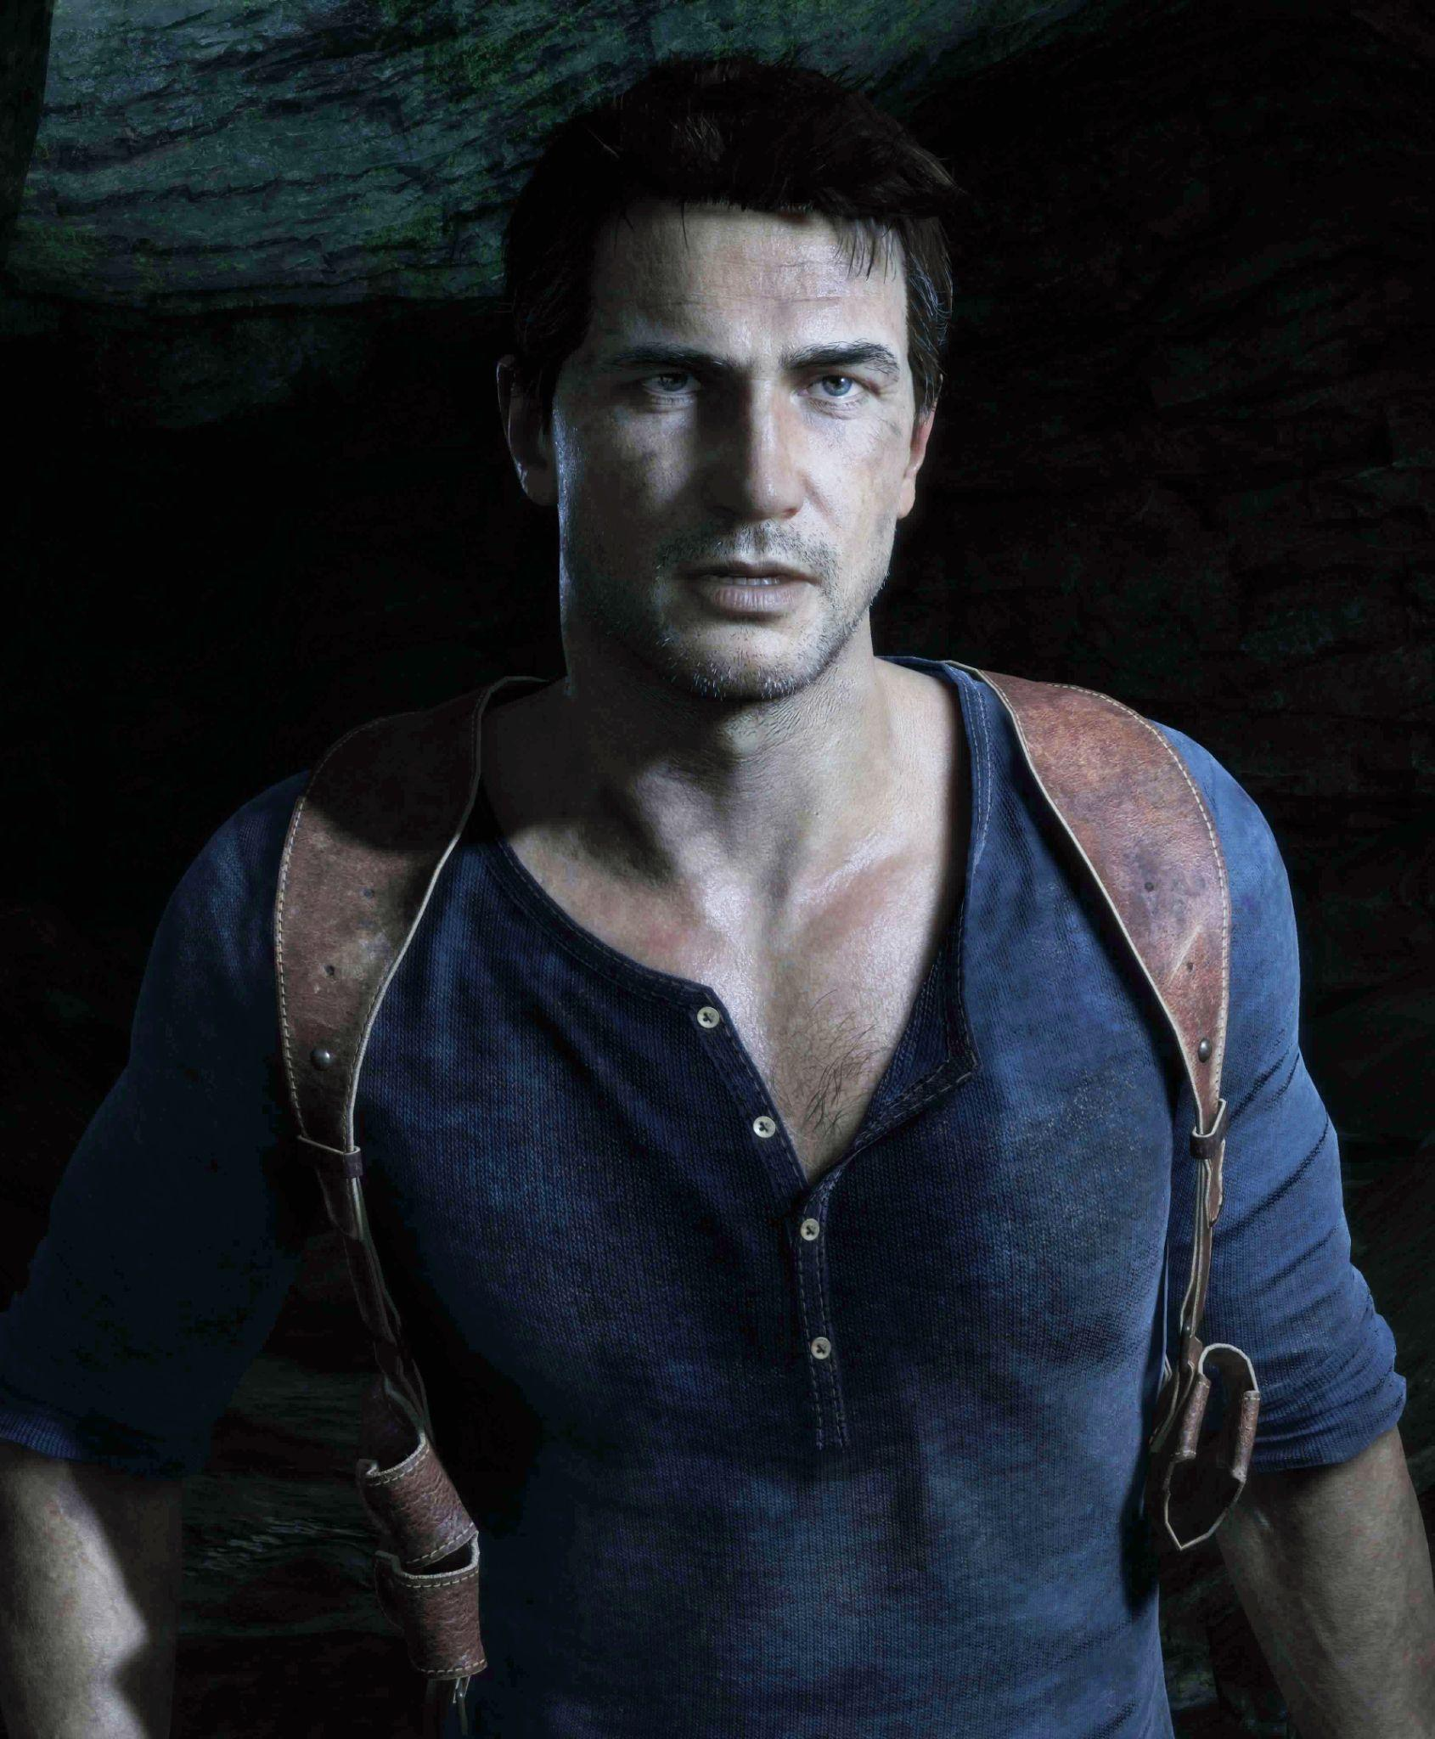
Classic Character Archetypes
Hero
© 2022, 2024 Jeannie Novak All rights reserved.
Credit: Sony Interactive Entertainment
Caption: Nathan Drake in the Uncharted series (Uncharted 4, shown) is the archetypal hero character.

Slide 7
Classic Character Archetypes
Shadow
© 2022, 2024 Jeannie Novak All rights reserved.
Credit: Nintendo
Caption: Wario is the shadow version of Mario (WarioWare: Get It Together! character art, shown).

Slide 8
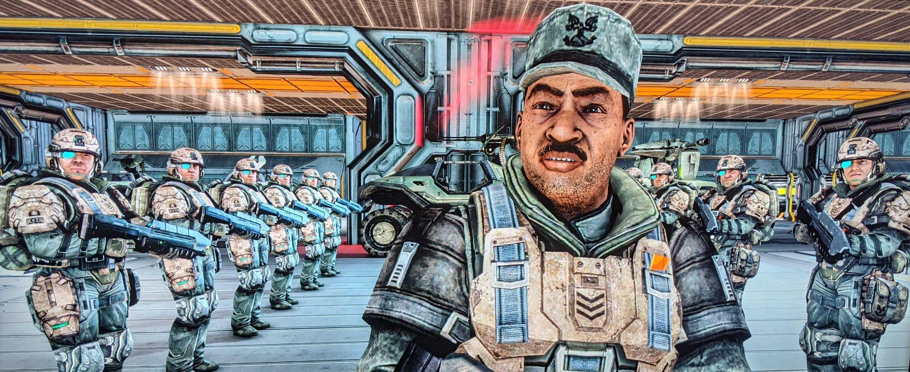
Classic Character Archetypes
Mentor
© 2022, 2024 Jeannie Novak All rights reserved.
Credit: JN
Caption: Sergeant Major Avery Junior Johnson in Halo is a mentor who provides the player with objectives, missions, and intelligence (Halo: Combat Evolved Anniversary, shown).

Slide 9
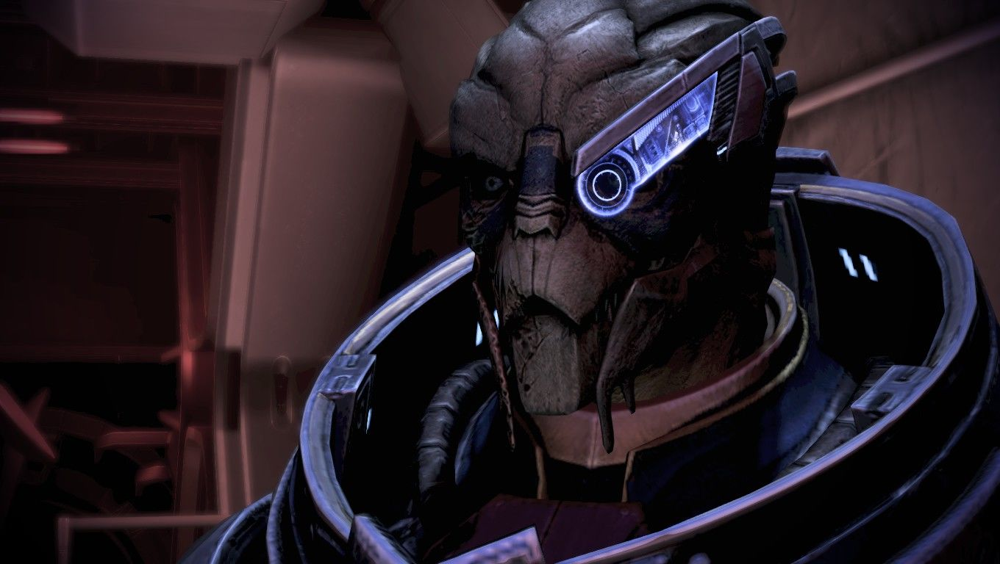
Classic Character Archetypes
Ally
© 2022, 2024 Jeannie Novak All rights reserved.
Credit: MegaMegaMan (MobyGames)
Caption: Garrus Vakarian is the quintessential ally in the Mass Effect series (Mass Effect 3, shown).

Slide 10
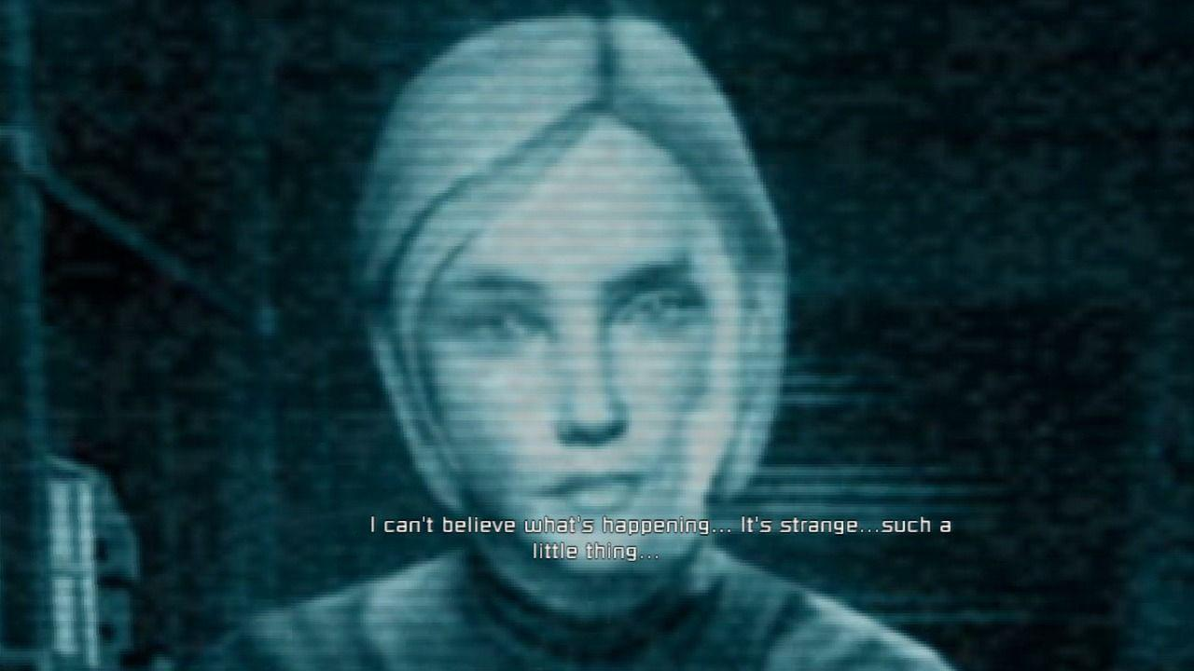
Classic Character Archetypes
Guardian
© 2022, 2024 Jeannie Novak All rights reserved.
Credit: MAT (MobyGames)
Caption: In Dead Space, Isaac Clarke’s girlfriend Nicole Brennan acts as a guardian in the form of a hallucination that encourages him while also blocking his advancement.

Slide 11
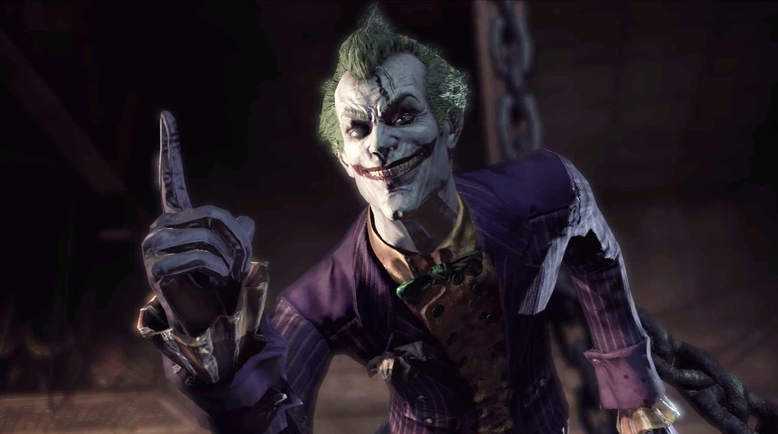
Classic Character Archetypes
Trickster
© 2022, 2024 Jeannie Novak All rights reserved.
Credit: Sicarius (MobyGames)
Caption: Grinning from ear to ear, the Joker is a trickster character in Batman: Arkham Asylum.

Slide 12
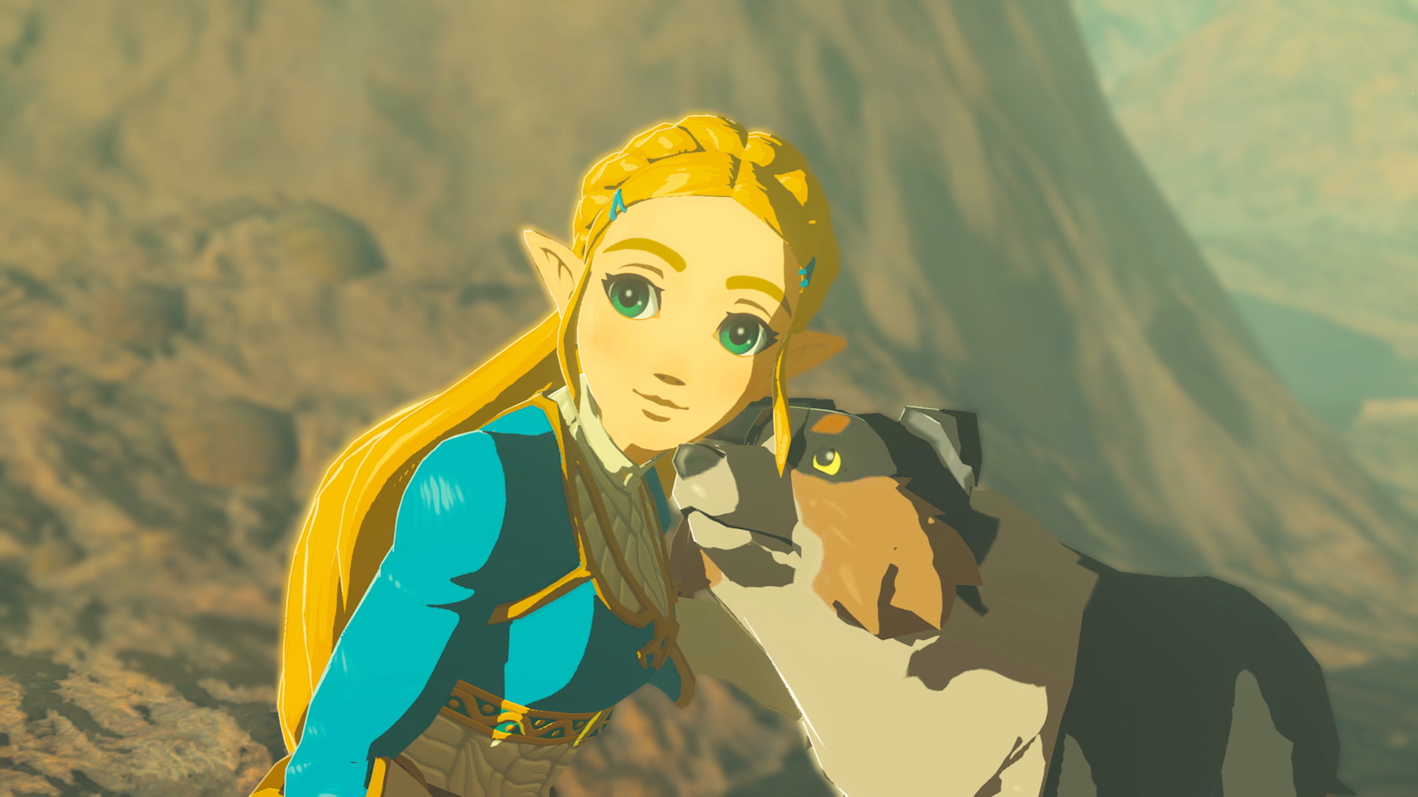
Classic Character Archetypes
Herald
© 2022, 2024 Jeannie Novak All rights reserved.
Credit: Nintendo
Caption: Princess Zelda repeatedly triggers Link’s actions in the The Legend of Zelda series (The Legend of Zelda: Breath of the Wild, shown).

Slide 13
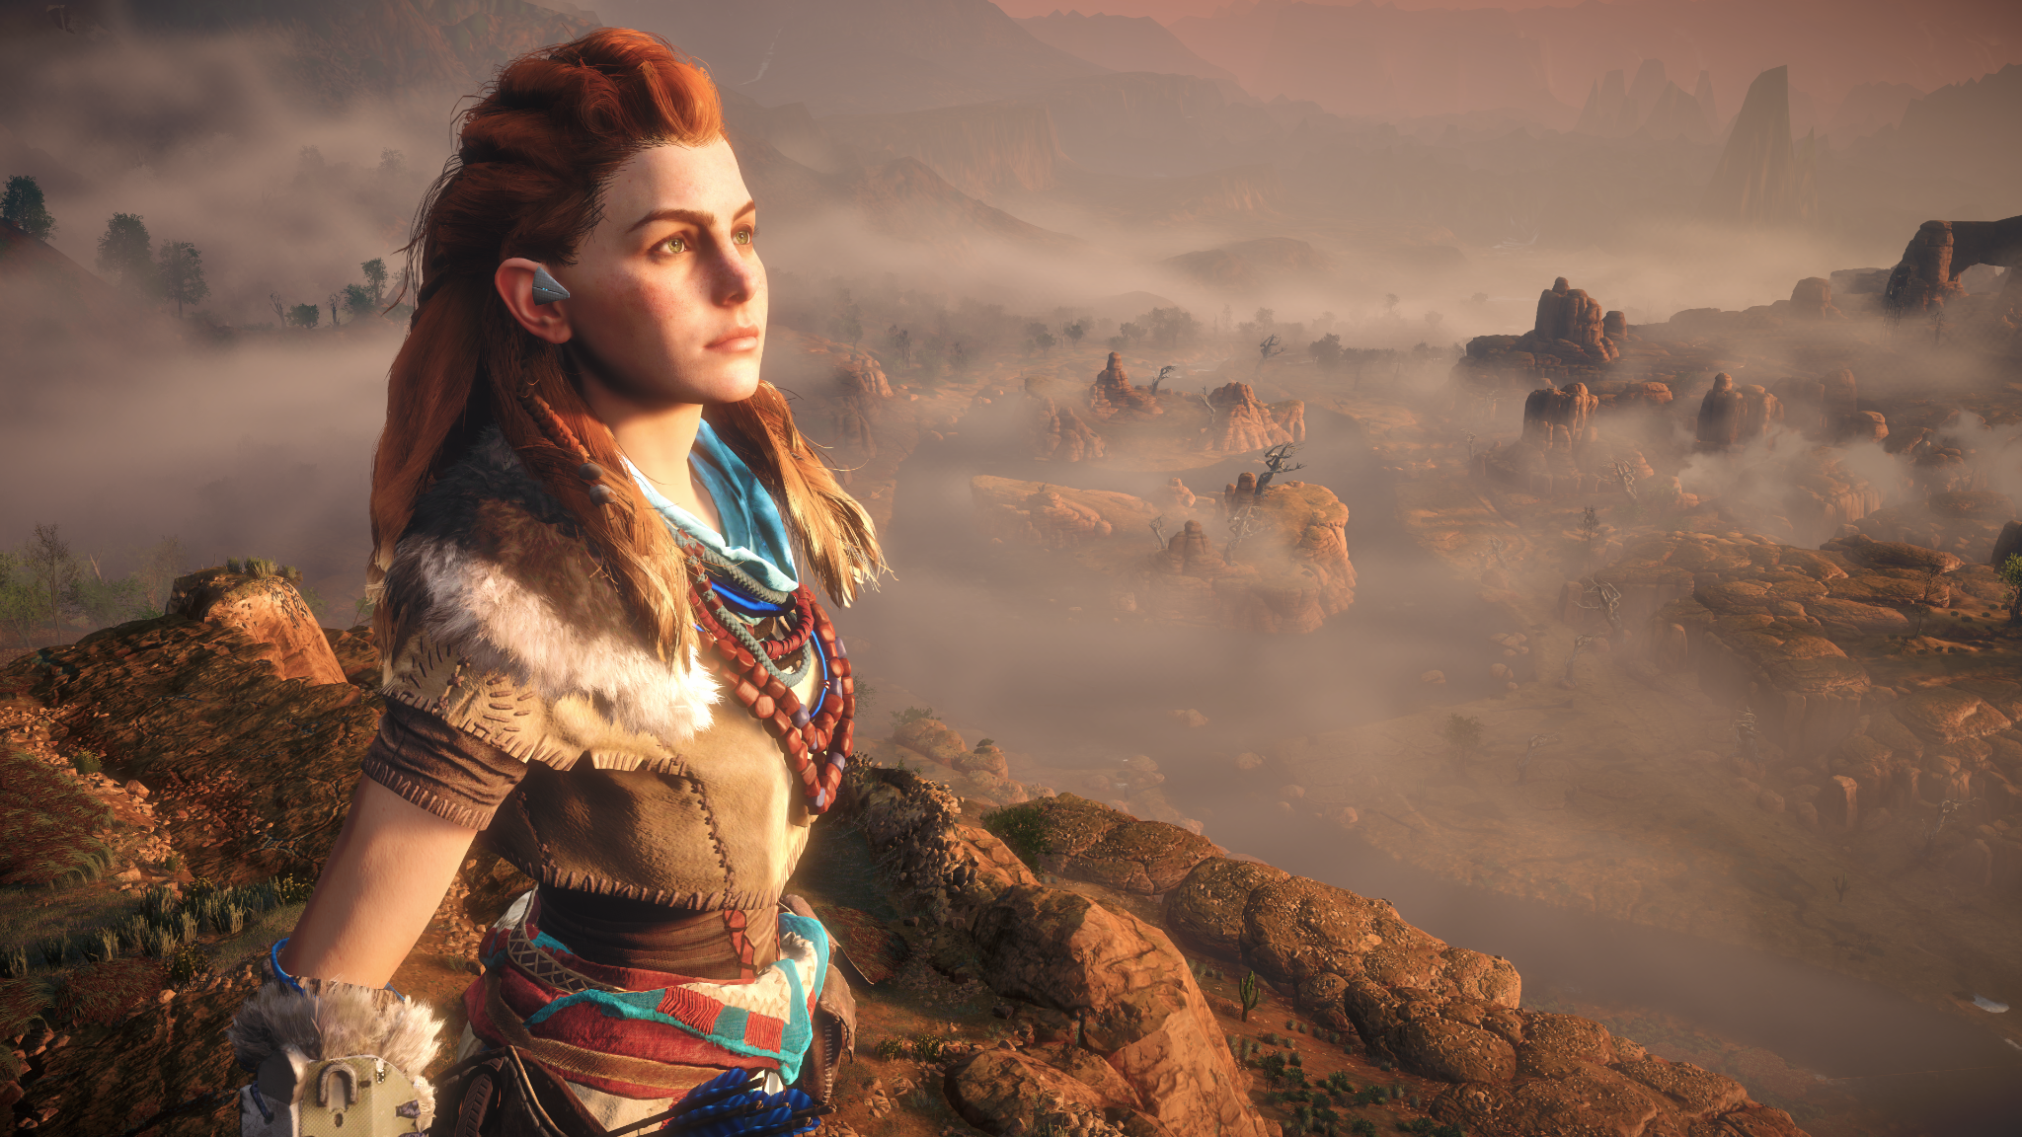
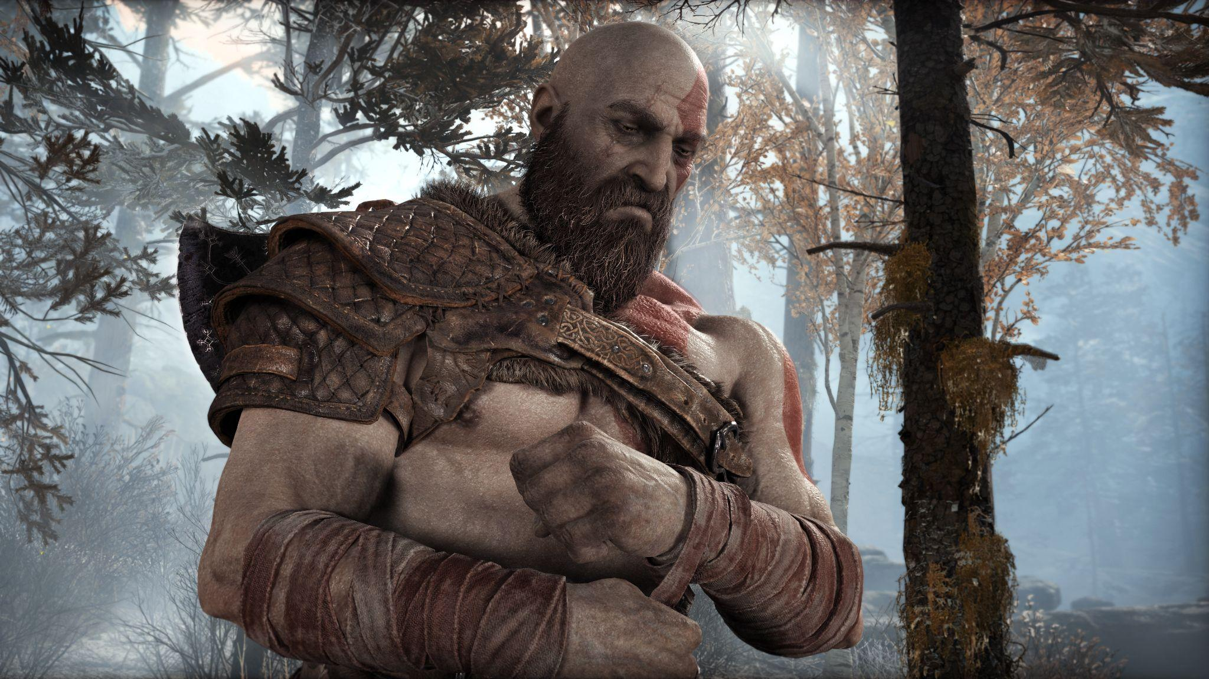
Classic Character Archetypes
Protagonist
© 2022, 2024 Jeannie Novak All rights reserved.
Credit: Sony Interactive Entertainment
Credit: Sony Interactive Entertainment
Caption: Aloy in Horizon Zero Dawn - left - and Kratos in God of War - right - are two classic protagonists.

Slide 14
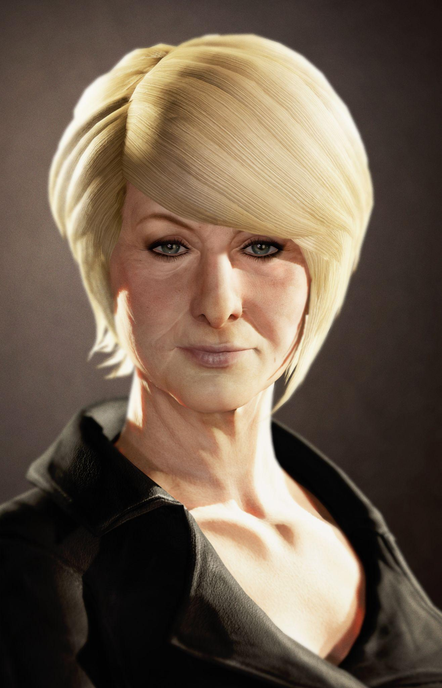
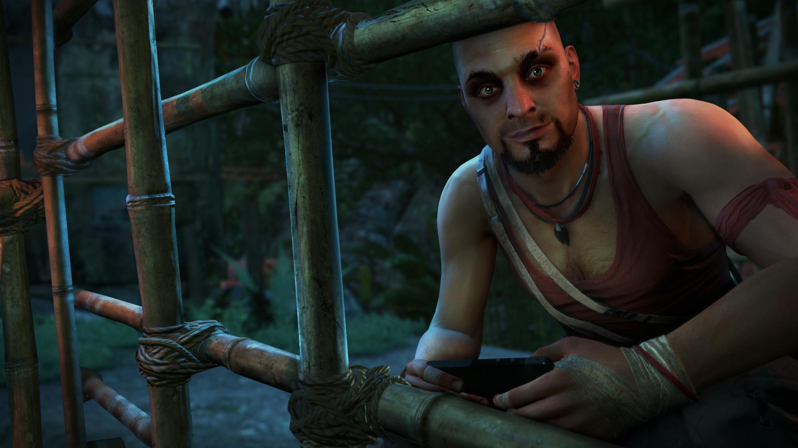
Classic Character Archetypes
Antagonist
© 2022, 2024 Jeannie Novak All rights reserved.
Credit: Sony Interactive Entertainment
Credit: Ubisoft Entertainment SA
Caption: Katherine Marlowe (concept art from Uncharted 3: Drake’s Deception - left) and Vaas Montenegro (Far Cry 3 - right) are villainous antagonists.

Slide 15
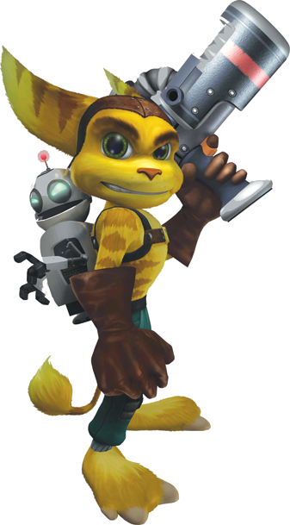
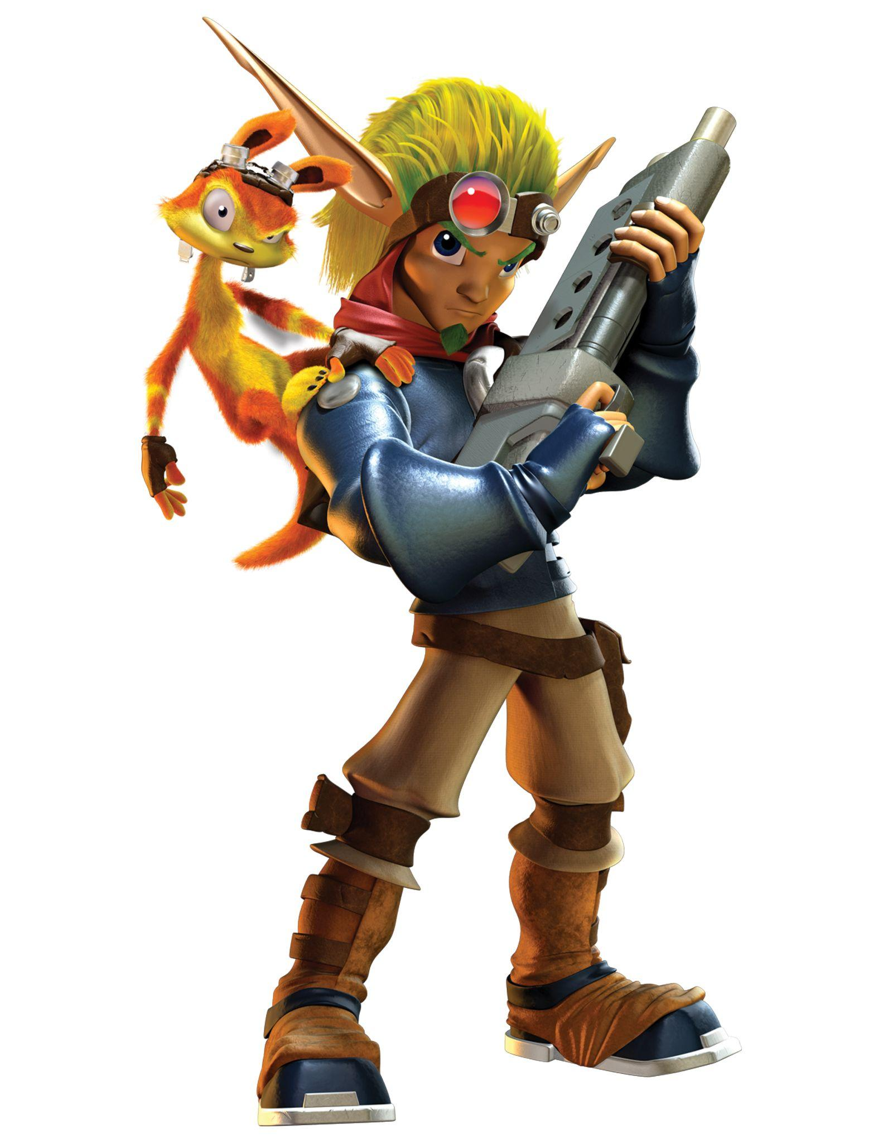
Classic Character Archetypes
Co-Protagonists
© 2022, 2024 Jeannie Novak All rights reserved.
Credit: Sony Interactive Entertainment
Credit: Sony Interactive Entertainment
Caption: Duos Ratchet & Clank - left - and Jak & Daxter - right - are examples of co-protagonists.

Slide 16
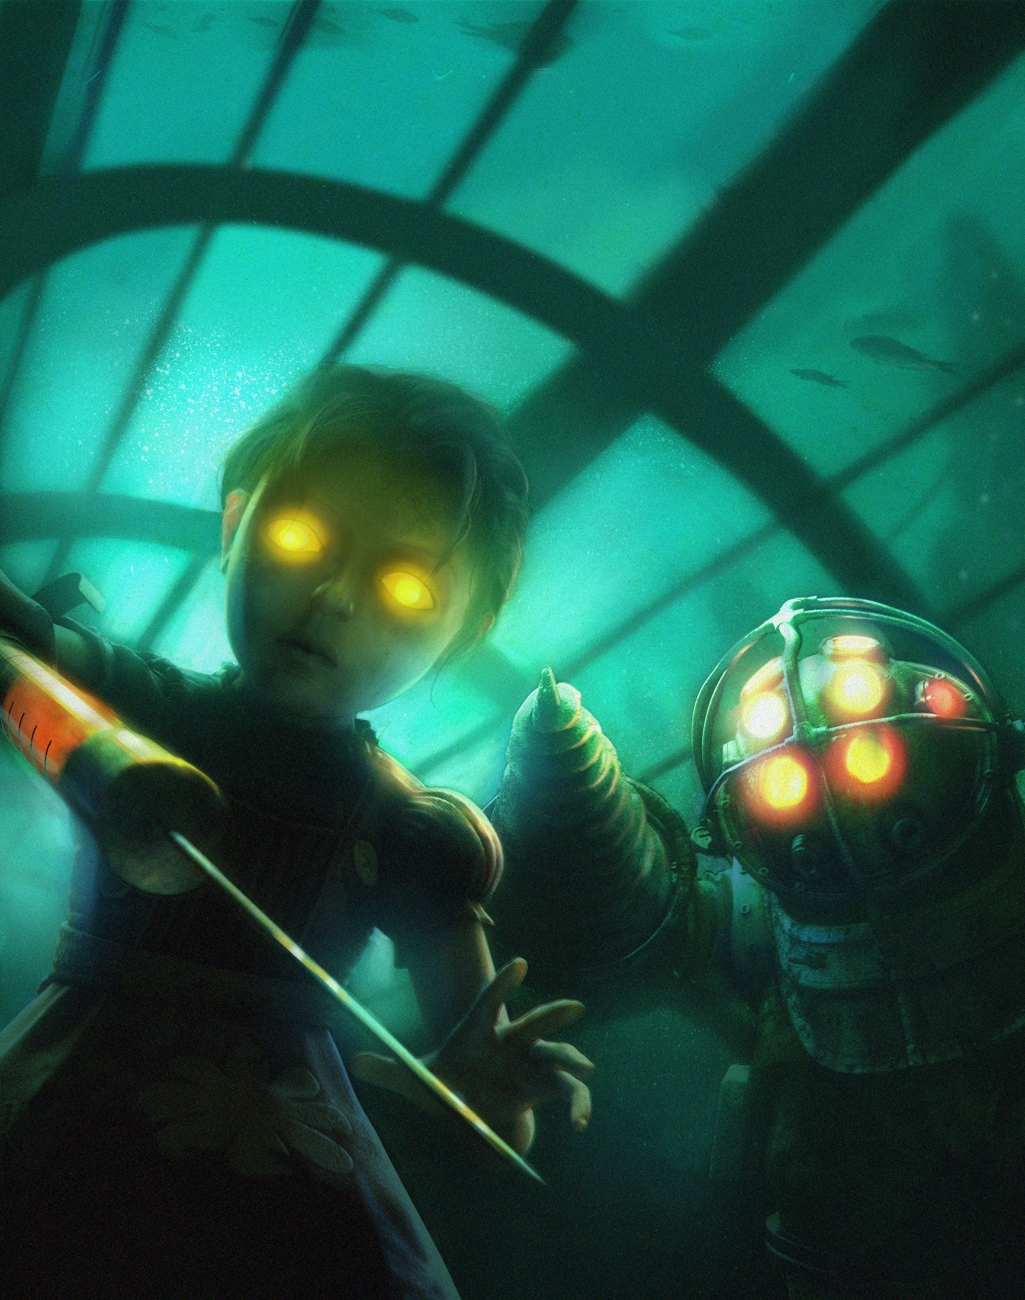
Classic Character Archetypes
Supporting Characters
© 2022, 2024 Jeannie Novak All rights reserved.
Credit: 2K Games
Caption: Little Sisters and Big Daddies appear as supporting characters in the BioShock series.

Slide 17
Traditional Story Structure
Hollywood Three-Act
© 2022, 2024 Jeannie Novak All rights reserved.
Credit: Diagram by Per Olin
Caption: Most Hollywood films employ a simple three-act story structure.

Slide 18
Traditional Story Structure
Monomyth & Hero’s Journey
© 2022, 2024 Jeannie Novak All rights reserved.
Credit: Hero1000faces (Wikimedia Commons) - modified by JN
Caption: The concept of the monomyth was introduced by Joseph Campbell in The Hero With a Thousand Faces.

Slide 19
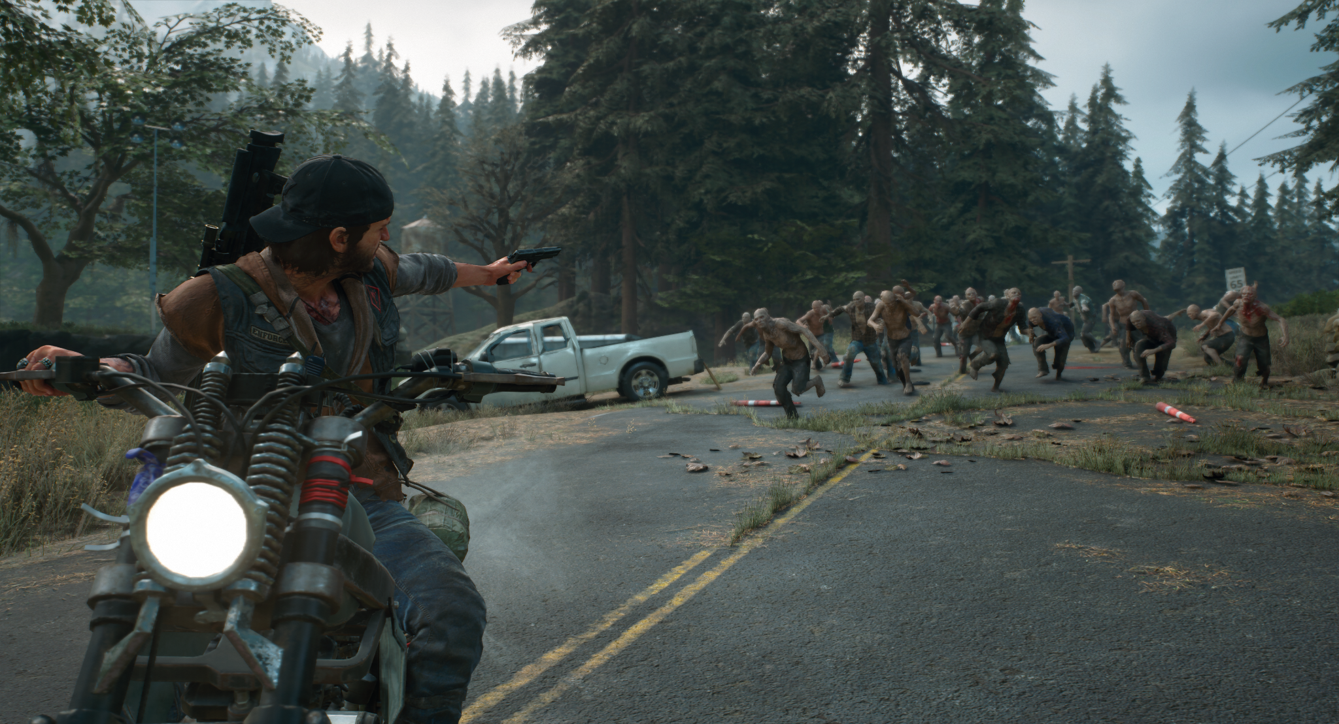
Story Elements
Premise
© 2022, 2024 Jeannie Novak All rights reserved.
Credit: Sony Interactive Entertainment
Caption: Does the premise of Days Gone entice you to play the game?

Slide 20
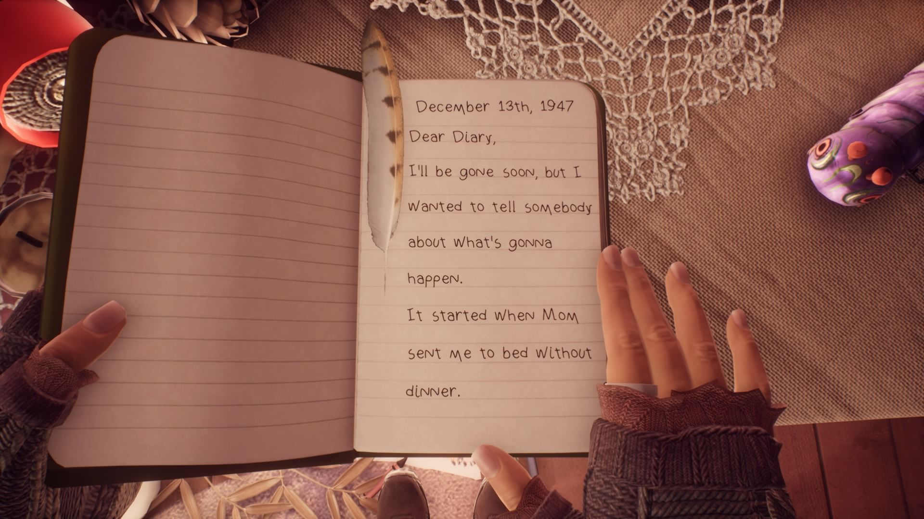
Story Elements
Backstory
© 2022, 2024 Jeannie Novak All rights reserved.
Credit: MAT (MobyGames)
Caption: What Remains of Edith Finch has a strong backstory that is referenced throughout the game as the title character solves mysteries related to past events.

Slide 21
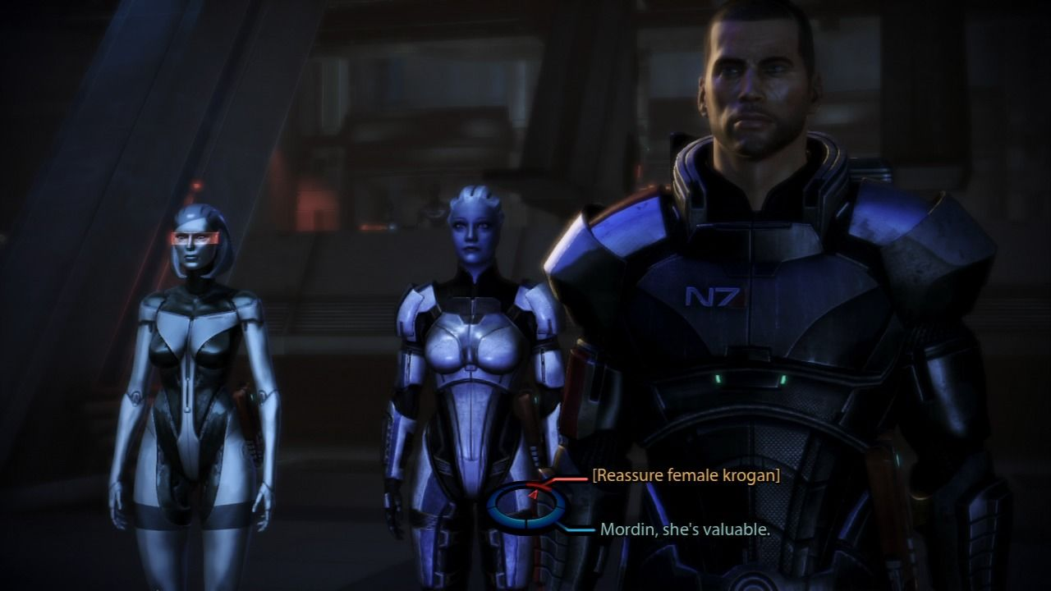
Story Elements
Synopsis
© 2022, 2024 Jeannie Novak All rights reserved.
Credit: MAT (MobyGames)
Caption: Player choice is so integral to the Mass Effect series that developer BioWare released infographics that break down these important choices (Mass Effect 3, shown).

Slide 22
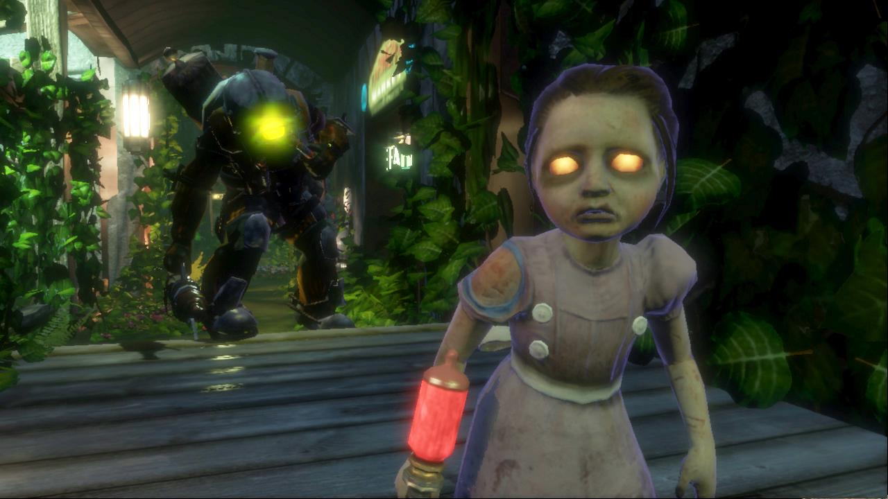
Story Elements
Theme
© 2022, 2024 Jeannie Novak All rights reserved.
Credit: 2K Games
Caption: BioShock explores themes of redemption, ambition, and remorse.

Slide 23
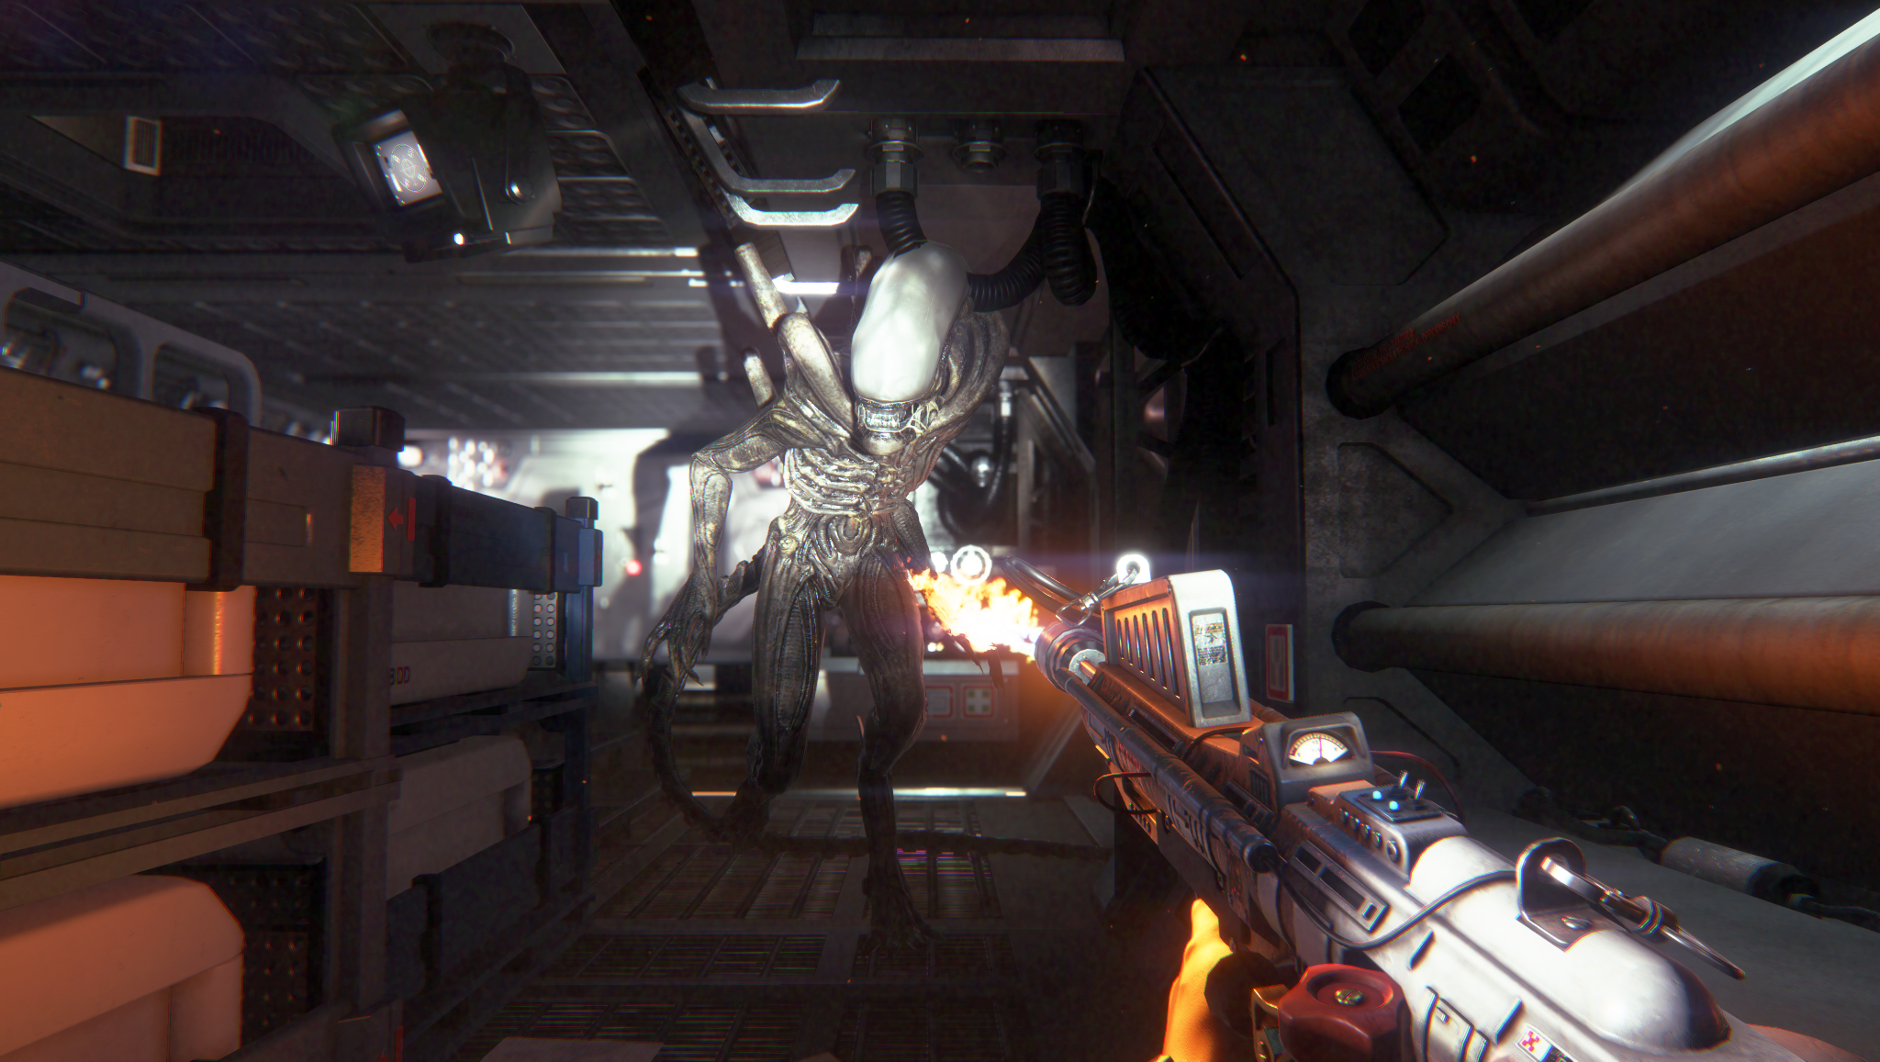
Story Elements
Setting
© 2022, 2024 Jeannie Novak All rights reserved.
Credit: Sega Corporation
Credit: Ubisoft Entertainment SA
Caption: Alien: Isolation - left - is set in a dark, claustrophobic space station — while Assassin’s Creed IV: Black Flag - right - takes place in exterior settings, including at sea.

Slide 24
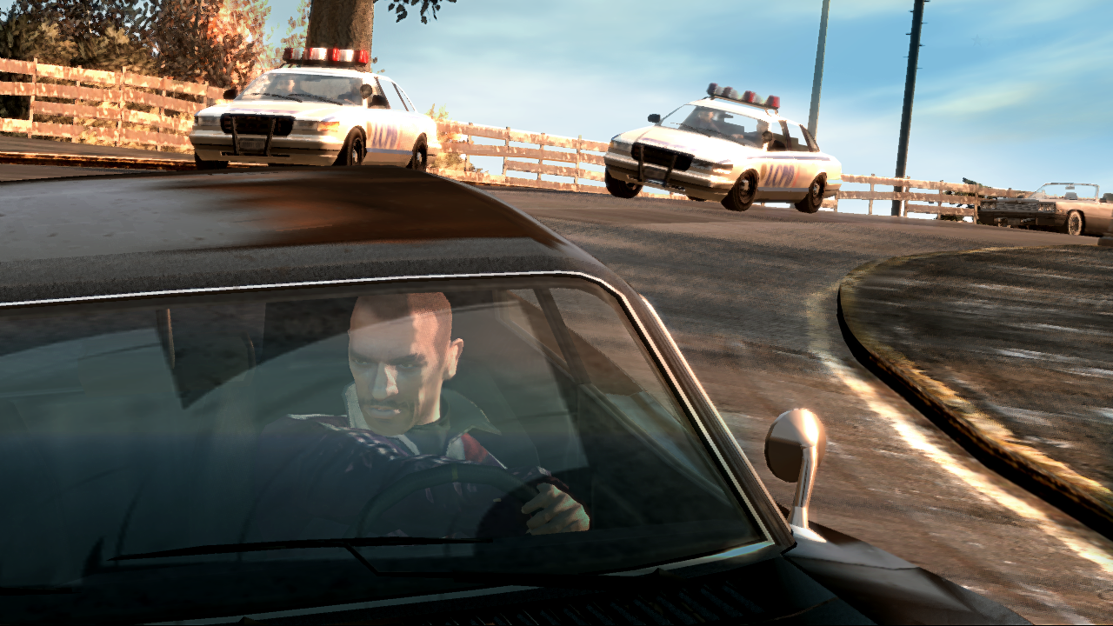
Story Elements
Plot
© 2022, 2024 Jeannie Novak All rights reserved.
Credit: Rockstar Games
Caption: Protagonist Niko Bellic is gradually drawn into the seedy side of Liberty City in Grand Theft Auto IV.

Slide 25
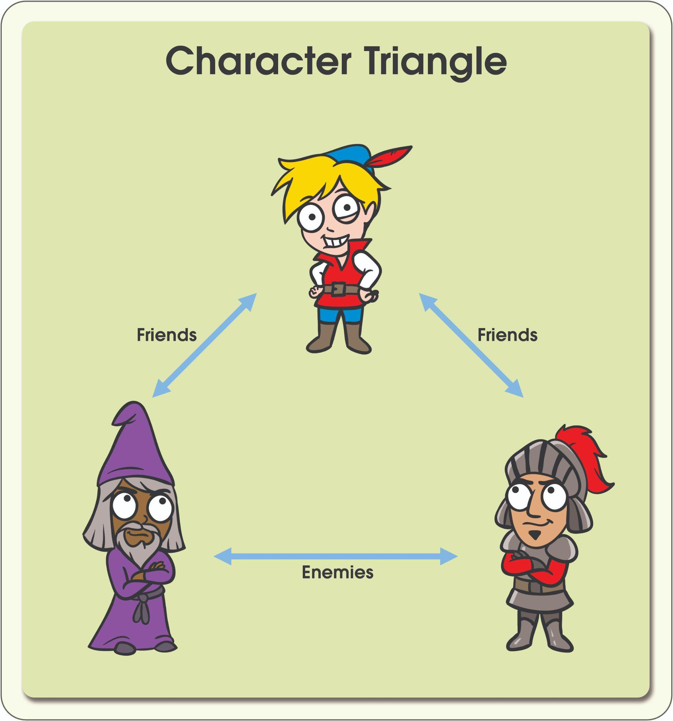
Character Development Elements
Character Triangle
© 2022, 2024 Jeannie Novak All rights reserved.
Credit: Illustrations by Ben Bourbon | Diagram by Per Olin
Caption: In a friendship triangle, two characters compete for the attention of one friend.

Slide 26
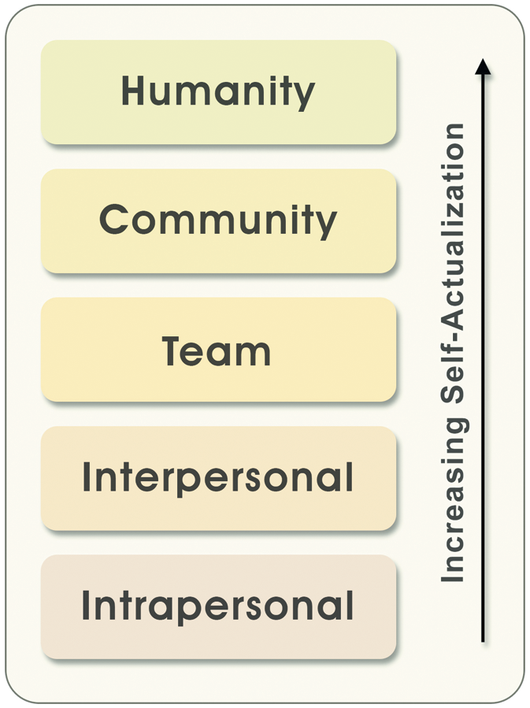
Character Development Elements
Character Arc
© 2022, 2024 Jeannie Novak All rights reserved.
Credit: Diagram by Per Olin
Caption: The social hierarchy of needs can be used to map a character arc in a story.

Slide 27
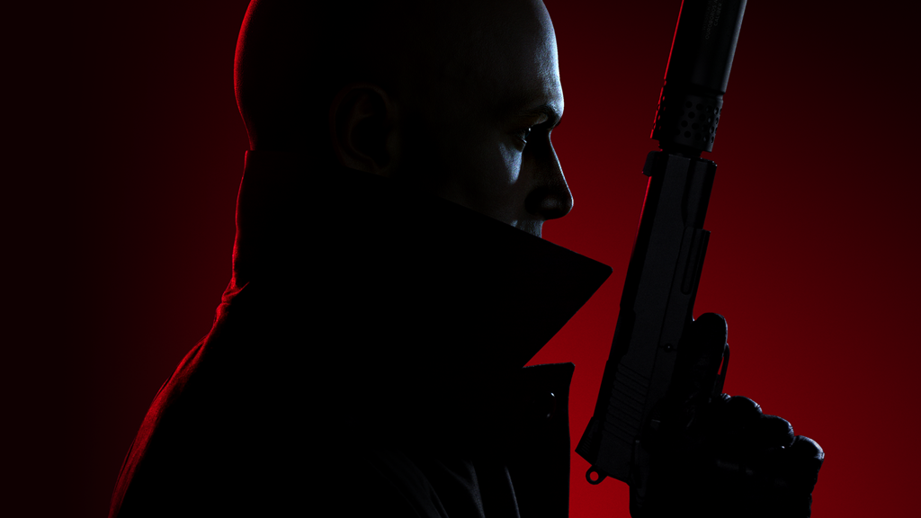
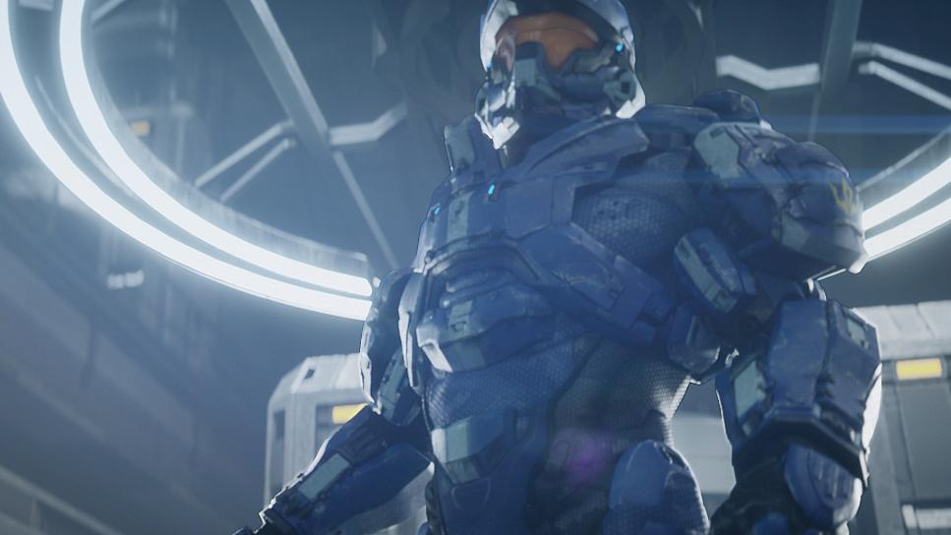
Character Development Elements
Character Arc
© 2022, 2024 Jeannie Novak All rights reserved.
Credit: Square Enix
Credit: Microsoft Corporation
Caption: Agent 47 (Hitman 3 - left) fights for his own selfish needs, while Master Chief (Halo 4 - right) fights for all of humanity.

Slide 28
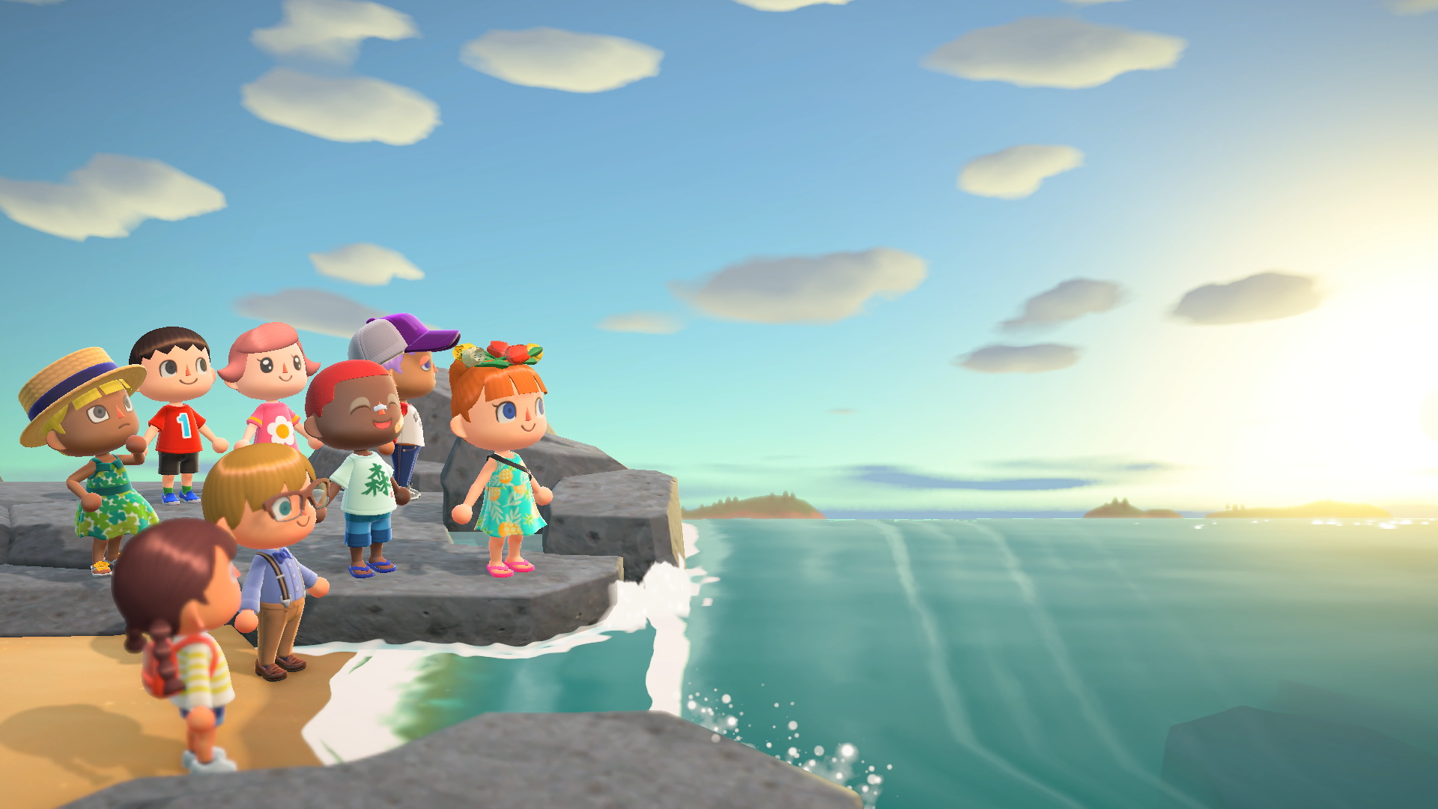
Game Story Devices
Interactivity
© 2022, 2024 Jeannie Novak All rights reserved.
Credit: Nintendo
Caption: In the Animal Crossing series, the player takes on the role of story-teller (Animal Crossing: New Horizons, shown).

Slide 29
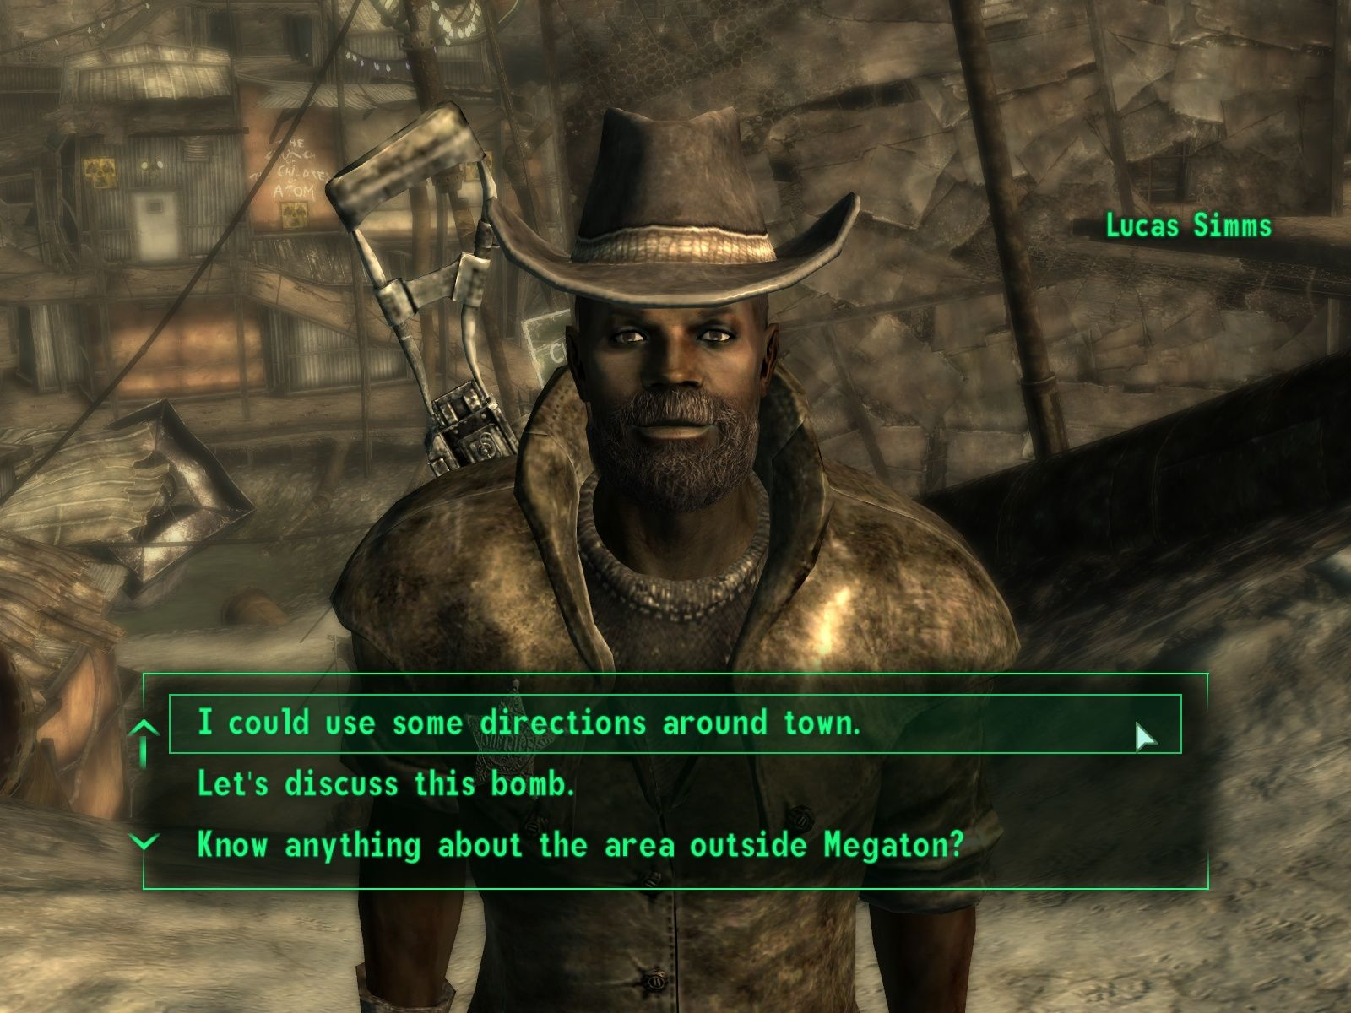
Game Story Devices
Non-Linearity
© 2022, 2024 Jeannie Novak All rights reserved.
Credit: Sicarius (MobyGames)
Caption: Bethesda Softworks’ Fallout series incorporates non-linearity through branching storylines (Fallout 3, shown).

Slide 30
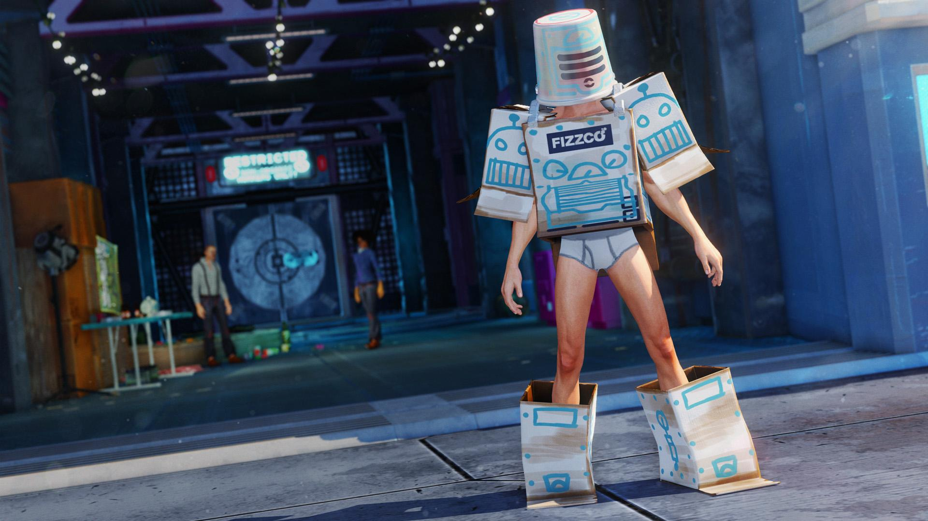
Game Story Devices
Player Control
© 2022, 2024 Jeannie Novak All rights reserved.
Credit: Microsoft Corporation
Caption: Sunset Overdrive is known for elaborate and quirky customization options (Dawn of the Rise of the Fallen Machines DLC, shown).

Slide 31
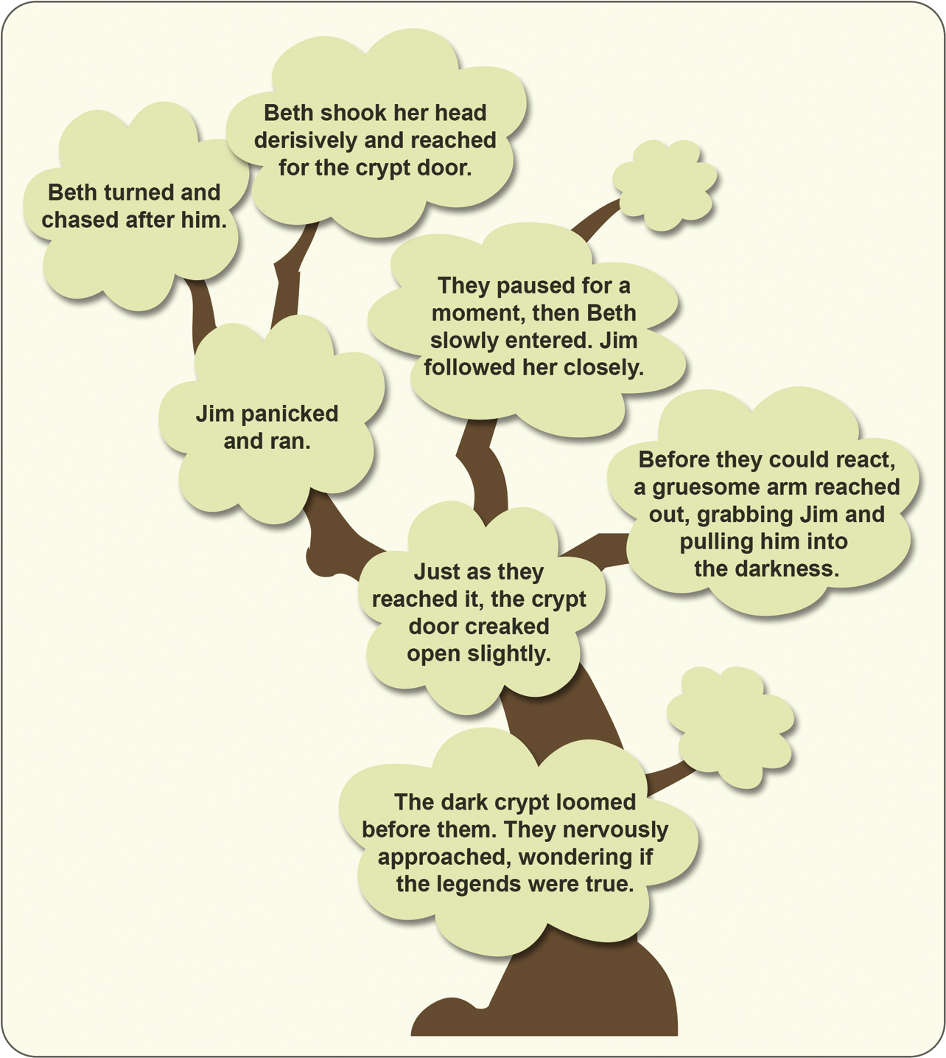
Game Story Devices
Collaboration
© 2022, 2024 Jeannie Novak All rights reserved.
Credit: Diagram by Per Olin
Caption: A story tree is used in collaborative storytelling to map out different possible paths in a scene.

Slide 32
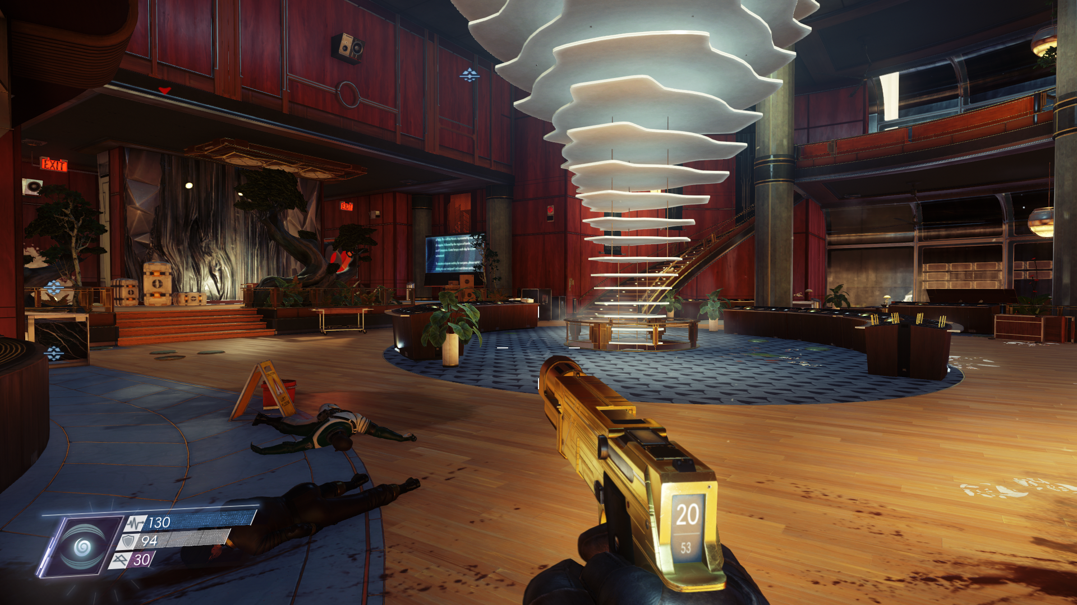
Game Story Devices
Immersion
© 2022, 2024 Jeannie Novak All rights reserved.
Credit: GTramp (MobyGames)
Caption: Bethesda Softworks’ Prey (2017) features a strong storyline and photorealistic setting that fully immerse the player into a fascinating yet terrifying reality.

Slide 33
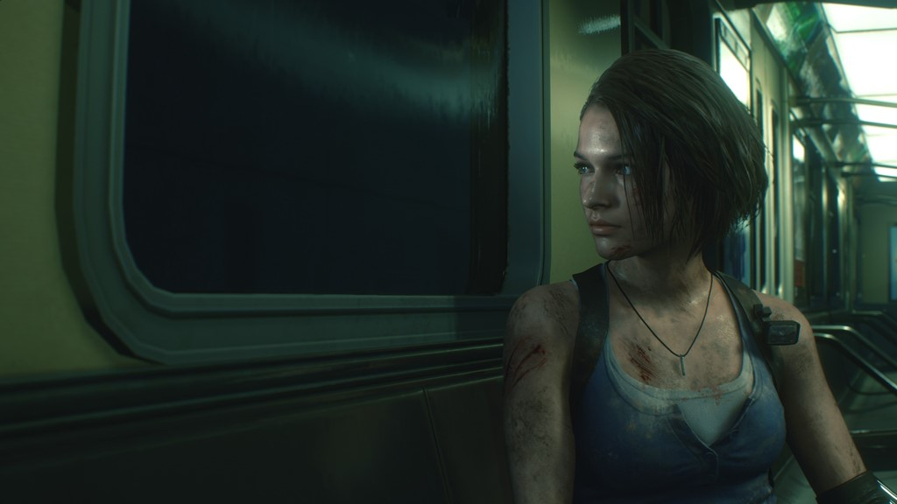
Game Character Types
Player Characters
© 2022, 2024 Jeannie Novak All rights reserved.
Credit: Capcom
Caption: Jill Valentine is a player character in the Resident Evil series (Resident Evil 3: Nemesis 2020 remake, shown).

Slide 34
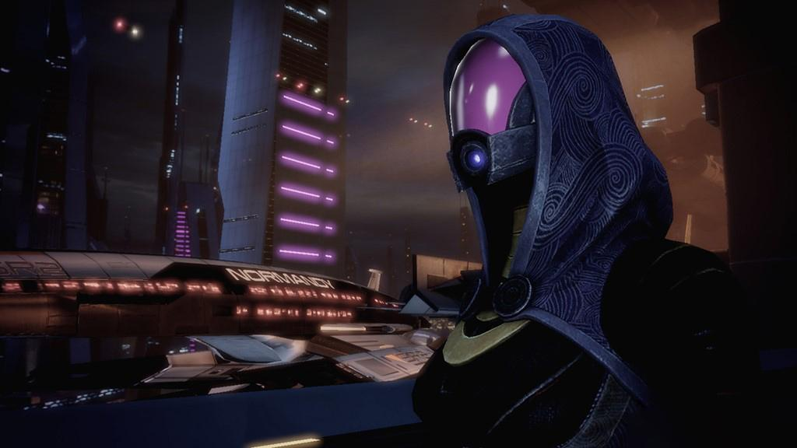
Game Character Types
Non-Player Characters
© 2022, 2024 Jeannie Novak All rights reserved.
Credit: Electronic Arts
Caption: The Mass Effect series has a wide variety of non-player characters, including Tali’Zorah (Mass Effect 2, shown).

Slide 35
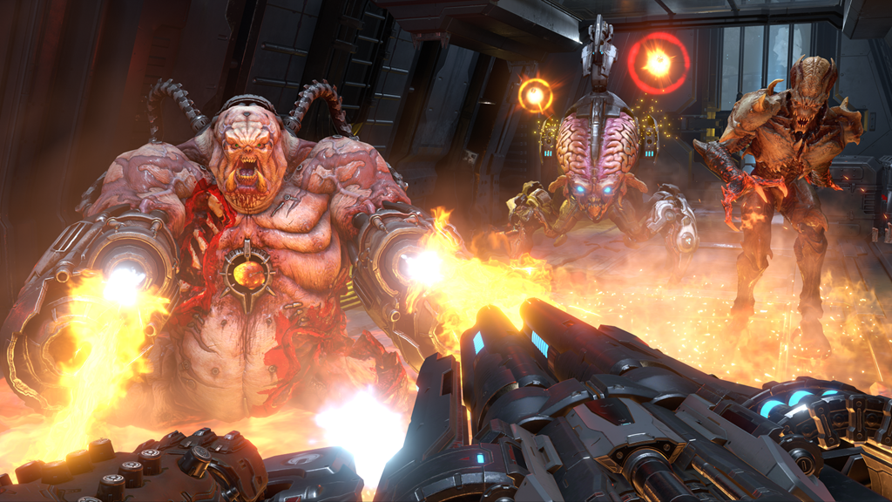
Point of View
First-Person
© 2022, 2024 Jeannie Novak All rights reserved.
Credit: Bethesda Softworks LLC
Caption: First-person point-of-view is used throughout Doom Eternal.

Slide 36
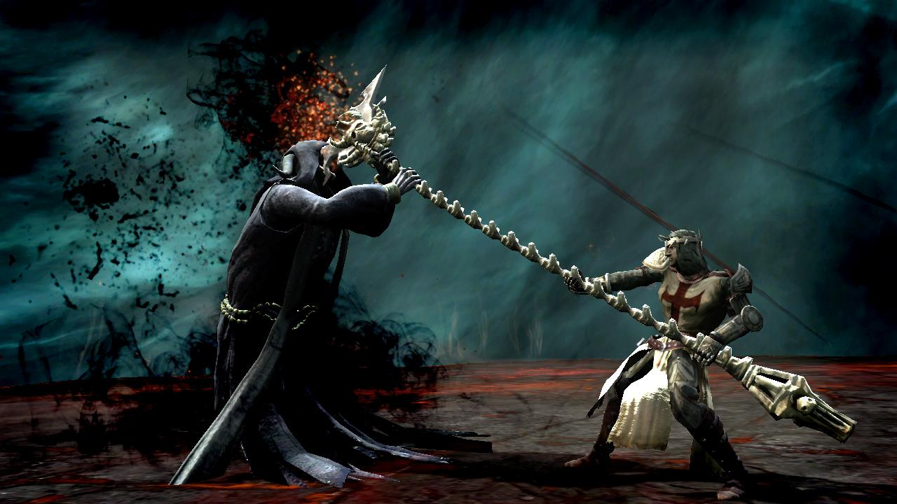
Point of View
Third-Person
© 2022, 2024 Jeannie Novak All rights reserved.
Credit: Electronic Arts
Caption: In Dante’s Inferno, the player controls Dante from a third-person point-of-view.

Slide 37
Visual Character Development
© 2022, 2024 Jeannie Novak All rights reserved.
Credit: Sega Corporation
Credit: Nintendo
Caption: Game characters come in a wide variety of styles — from the elaborate blue/black motif associated with Bayonetta (character art from Bayonetta 2 - left) to the pink, spherical Kirby (character art from Kirby Star Allies - right).

Slide 38
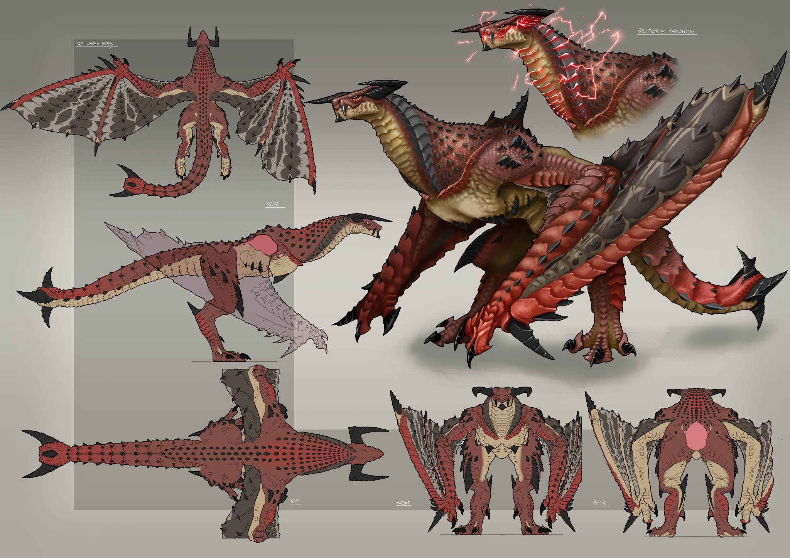
Visual Character Development
Techniques
© 2022, 2024 Jeannie Novak All rights reserved.
Credit: Esteban Moraga (Orion Arts)
Caption: Character sheet featuring concept art for regenerating dragon Ezxous in Galerider.

Slide 39
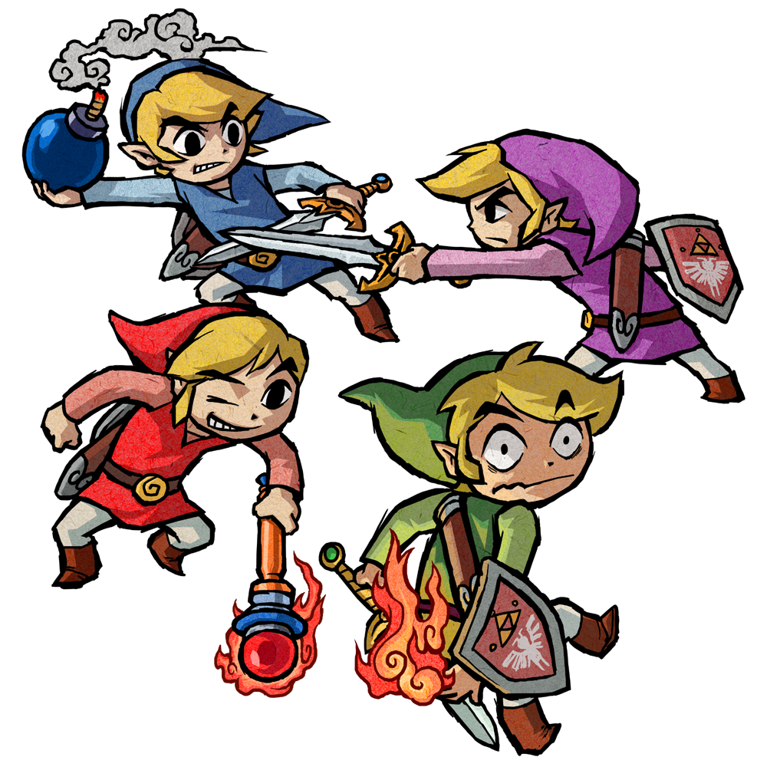
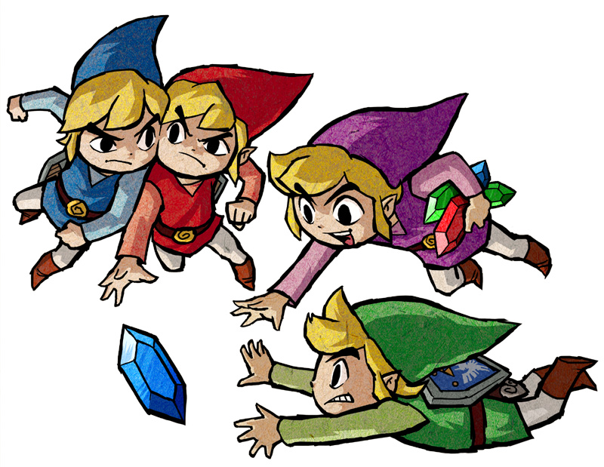
Visual Character Development
Techniques
© 2022, 2024 Jeannie Novak All rights reserved.
Credit: Nintendo
Credit: Nintendo
Caption: Character concept art showing action poses for Link and his three clones (character art from The Legend of Zelda: Four Swords Adventures, shown).

Slide 40
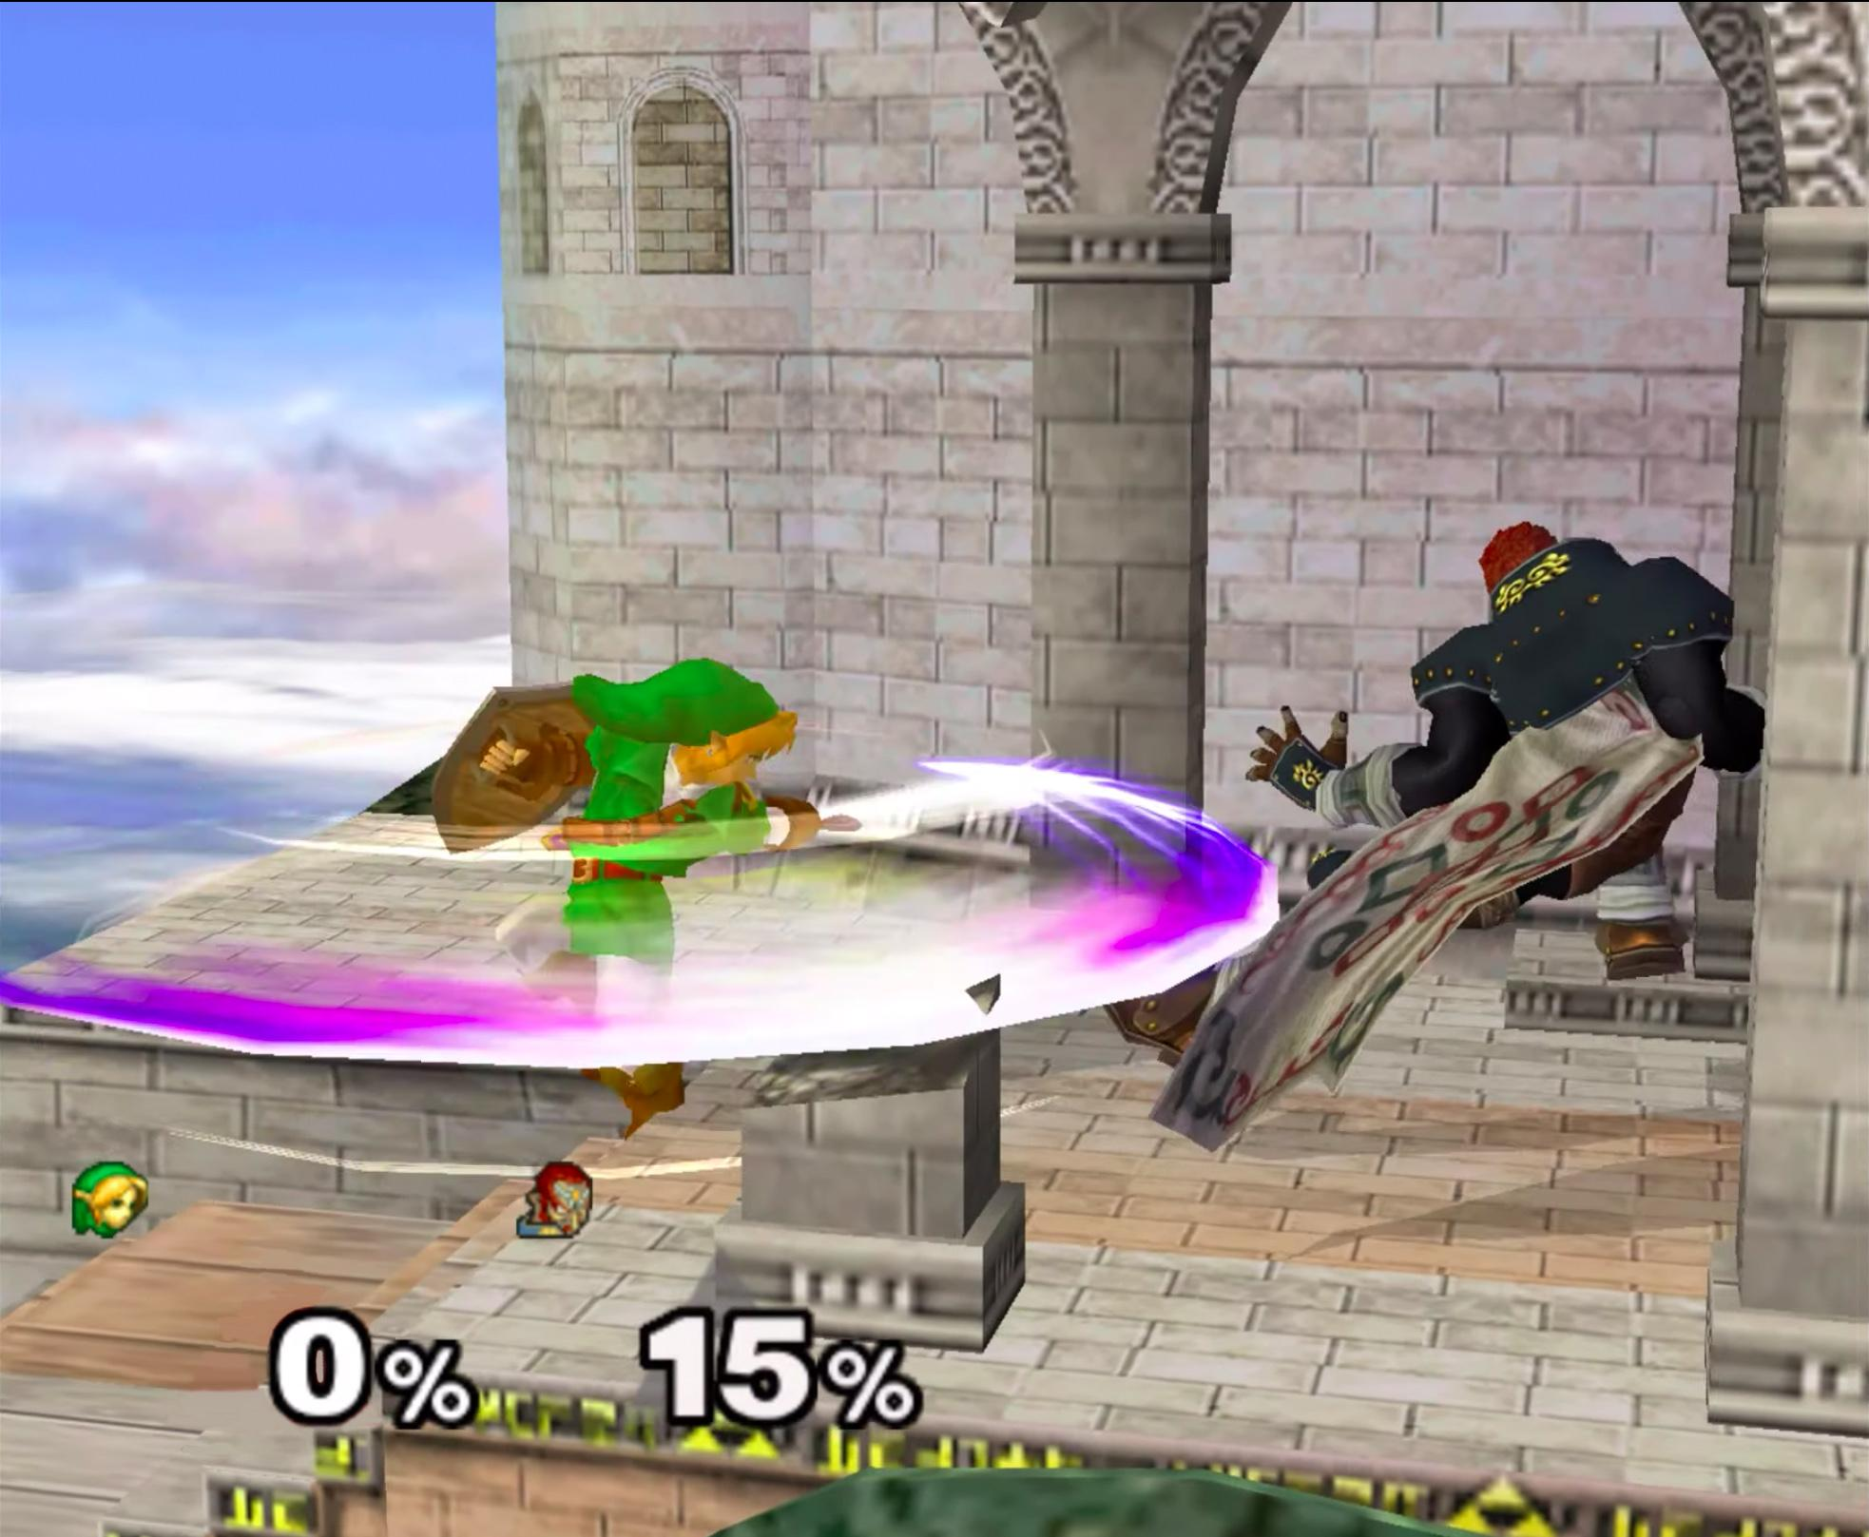
Visual Character Development
Movement
© 2022, 2024 Jeannie Novak All rights reserved.
Credit: JN
Caption: Link has several signature moves—including this spin attack from Super Smash Brothers Melee.

Slide 41
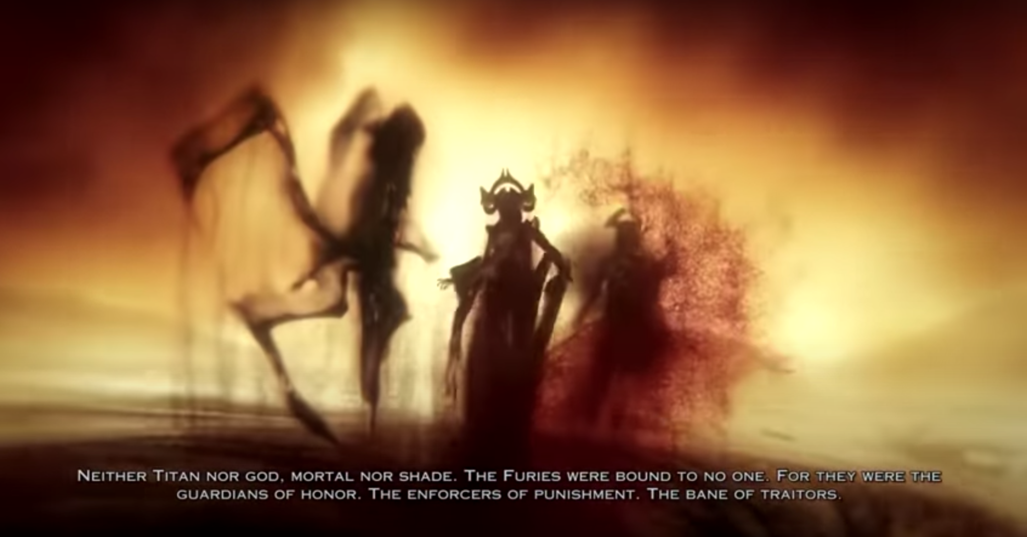
Verbal Character Development
Narration
© 2022, 2024 Jeannie Novak All rights reserved.
Credit: JN
Caption: First-person narrative in God of War: Ascension.

Slide 42
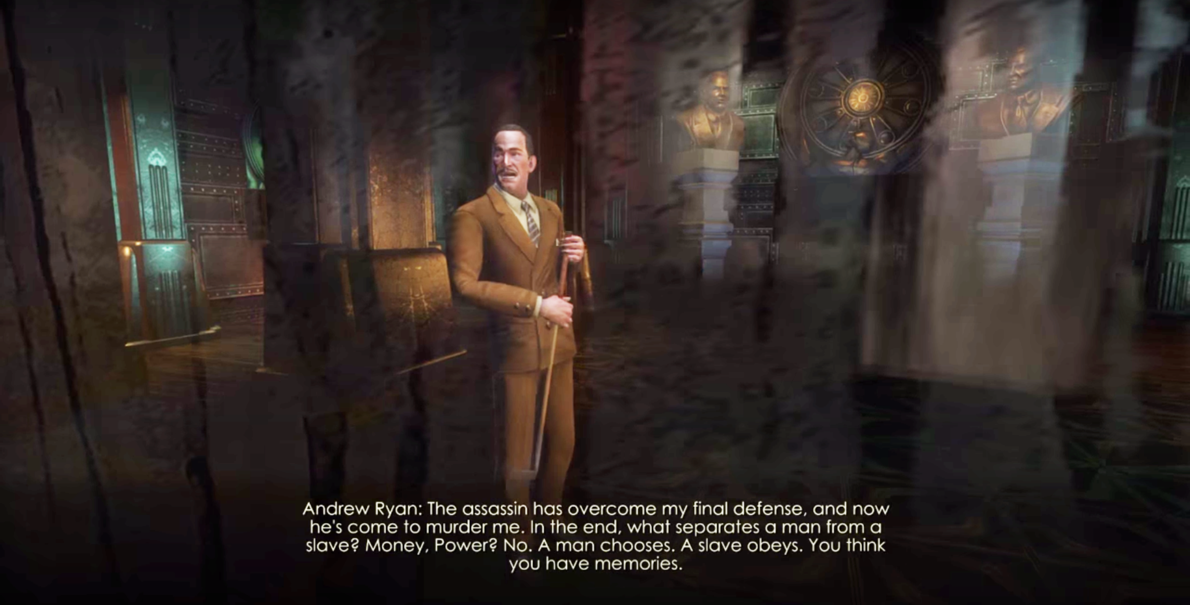
Verbal Character Development
Monologue
© 2022, 2024 Jeannie Novak All rights reserved.
Credit: JN
Caption: Themes of self-determination and choice (or lack thereof) are revealed in one of many monologues spoken by Andrew Ryan in 2K Games’ BioShock.

Slide 43
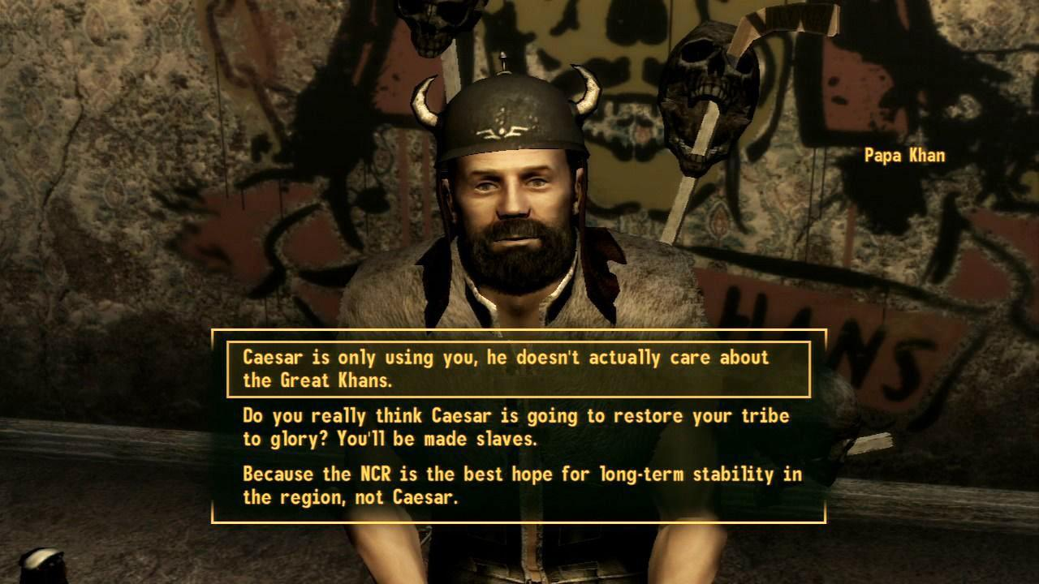
Verbal Character Development
Dialogue
© 2022, 2024 Jeannie Novak All rights reserved.
Credit: MAT (MobyGames)
Caption: Interacting with non-player characters in Fallout: New Vegas involves branching dialogue choices.

Slide 44
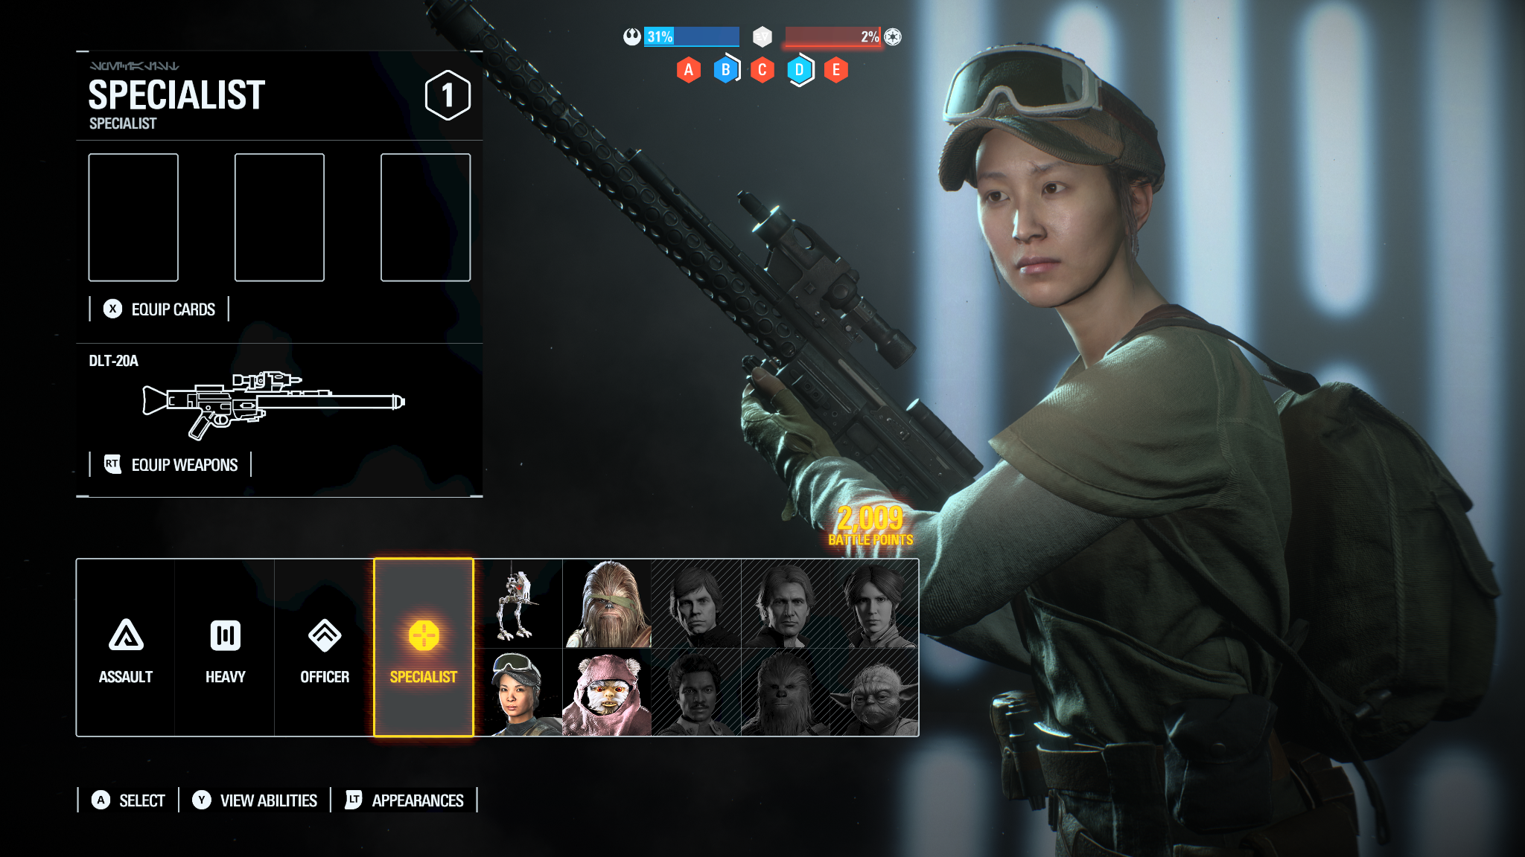
Character Advancement
Class
© 2022, 2024 Jeannie Novak All rights reserved.
Credit: JN
Caption: In Electronic Arts’ Star Wars Battlefront II (2017), players choose from standard classes—along with special classes based on faction.

Slide 45
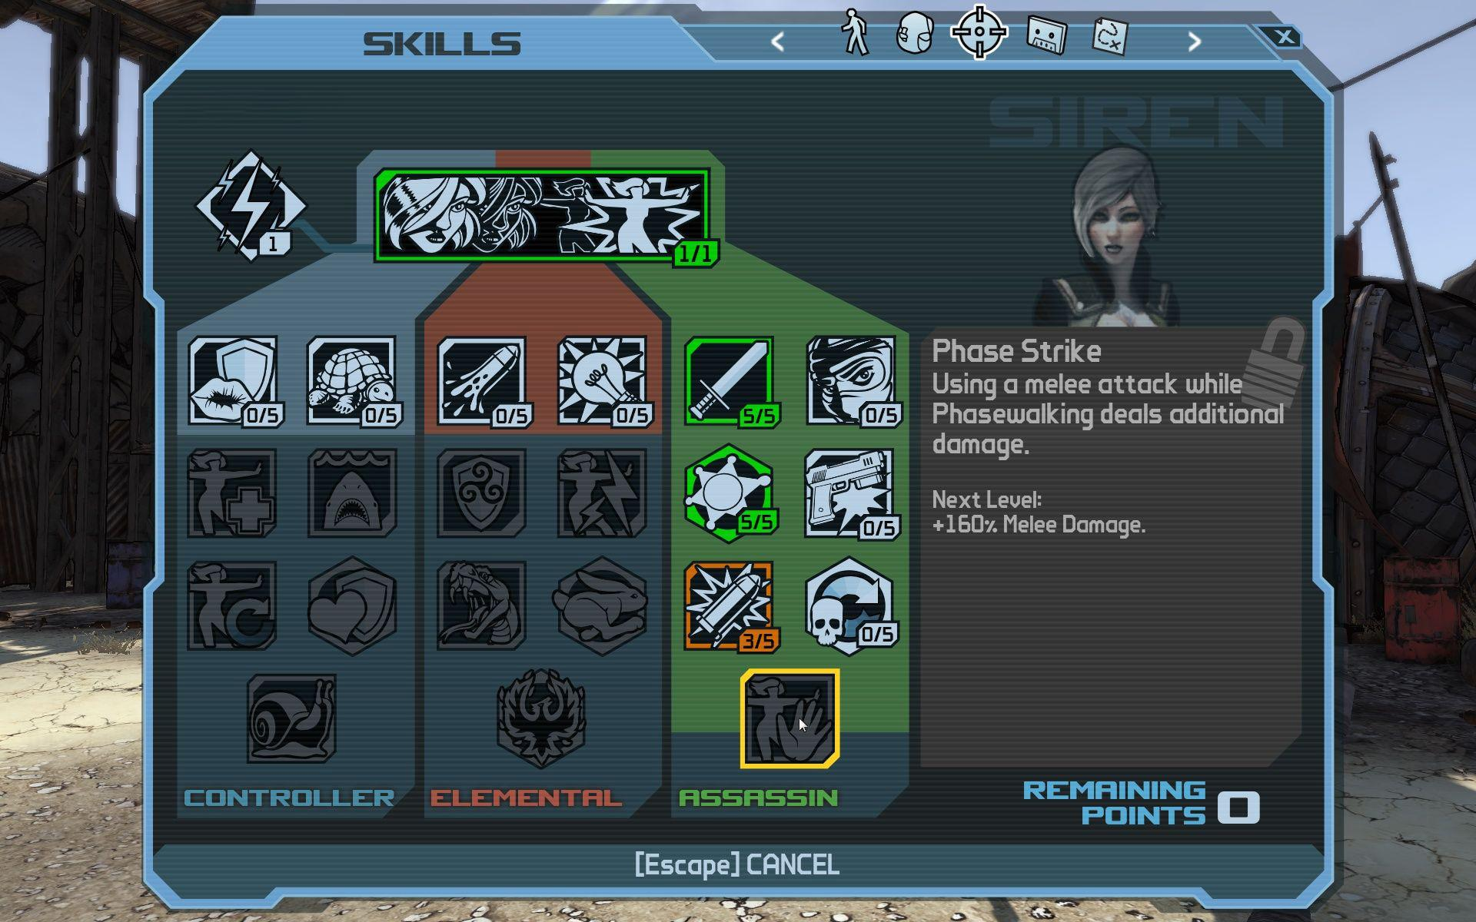
Character Advancement
Skill
© 2022, 2024 Jeannie Novak All rights reserved.
Credit: Sicarius (MobyGames)
Caption: In 2K Games’ Borderlands, each class has three skill trees and one action skill.

Slide 46
Character Description
© 2022, 2024 Jeannie Novak All rights reserved.
Credit: Sega Corporation
Caption: Sonic The Hedgehog strikes his signature pose in this character art for Sonic the Hedgehog 4: Episode 1.

Slide 47
CHAPTER 5
© 2022, 2024 Jeannie Novak All rights reserved.
REVIEW EXERCISES
Create a premise, backstory, and synopsis for an original game idea that targets a specific geographic, demographic, psychographic, or generational market segment. Describe your target market in detail, and outline why you chose to create this sort of content for this group. (Market segments were introduced in Chapter 4.)
1
What role do cut-scenes play in a game, and how can they sometimes compromise immersion? Choose a cut-scene from a pre-existing game and identify three reasons you think it is being used. Is the cut-scene necessary? If you were on the game development team and were told that the scene had to be removed, what would you do to ensure that the reasons for the cut-scene were still being fulfilled? Create a synopsis for an original cut-scene and discuss why it is essential to the game experience.
2

Slide 48
CHAPTER 5
© 2022, 2024 Jeannie Novak All rights reserved.
REVIEW EXERCISES
Choose a tabletop game with a distinct setting or premise. After familiarizing yourself with the game, discuss how you would adapt it to digital form. What story elements would you expand on to create a more enriching, immersive experience for the player?
3
Describe yourself in terms of a game character. What are your physical and personality characteristics, goals, strengths and weaknesses, likes and dislikes, general mood? Discuss other characters that might also appear in the game. (Note: These characters might not necessarily be helpful but could represent obstacles that prevent you from reaching your goals.)
4

Slide 49
CHAPTER 5
© 2022, 2024 Jeannie Novak All rights reserved.
REVIEW EXERCISES
Write three character descriptions associated with an original game idea. At least one character should be a player character. What elements will you include in your character descriptions, and how will the player and non-player characters differ?
5
How do you distinguish the main player character from the game environment? Choose one of your original characters and discuss three specific ways you could ensure that players can always easily detect where the player character is and what the character is doing.
6

Slide 50
CHAPTER 5
© 2022, 2024 Jeannie Novak All rights reserved.
REVIEW EXERCISES
How do the visual features of a game character reflect the character’s personality? Discuss how you would utilize profile, facial expressions, gestures, poses, costume, character movement, color scheme, and even associated objects to reflect the personality of one of the original characters you created.
7
Using the original game story you created, construct a five-page scene involving at least two of the characters you described in the previous exercise. Make sure one of your characters is a player character and one is a non-player character. How will you distinguish between the dialogue written for the player characters and NPCs? (Note: You’re not writing a linear cut-scene, but one in which the player still has control of the character.)
8

