Slide 2
CHAPTER 4
PLAYER ELEMENTS WHO PLAYS & WHY?
© 2022, 2024 Jeannie Novak All rights reserved.

Slide 3
CHAPTER OBJECTIVES
© 2022, 2024 Jeannie Novak All rights reserved.
After reading this chapter, you should be able to:
Identify several player motivation factors and how they affect the types of games that are developed.
Distinguish between geographic, demographic, psychographic, and generational segmentation.
Track how the player market has changed over time.
Compare geographic markets in the United States and other regions such as South Korea, Japan, China, Russia, and Germany.
Describe the different player generations in the United States.

Slide 4
Motivation
Social Interaction
© 2022, 2024 Jeannie Novak All rights reserved.
Credit: Travelpixs (Shutterstock)
Caption: Players who are motivated by social interaction are more likely to play social and multiplayer games—whether local or online.

Slide 5
Motivation
Solitude
© 2022, 2024 Jeannie Novak All rights reserved.
Credit: Koldunov (Shutterstock)
Caption: Players who are motivated by solitude may opt for single-player games or just want to be alone in their immediate environment.

Slide 6
Motivation
Competition
© 2022, 2024 Jeannie Novak All rights reserved.
Credit: Capcom
Caption: Competition is the motivation behind playing many fighting games such as Street Fighter V.

Slide 7
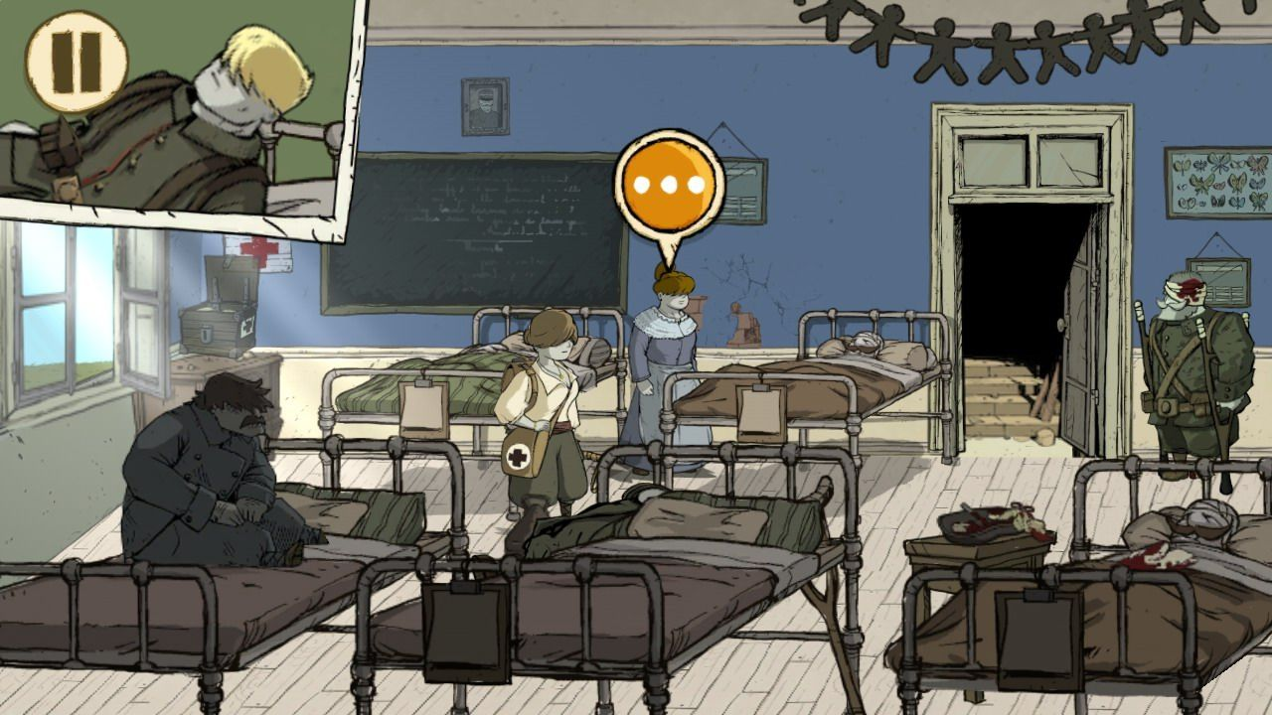
Motivation
Knowledge
© 2022, 2024 Jeannie Novak All rights reserved.
Credit: POMAH (MobyGames)
Caption: Valiant Hearts: The Great War provides players with facts about WWI and context behind the game’s story.

Slide 8
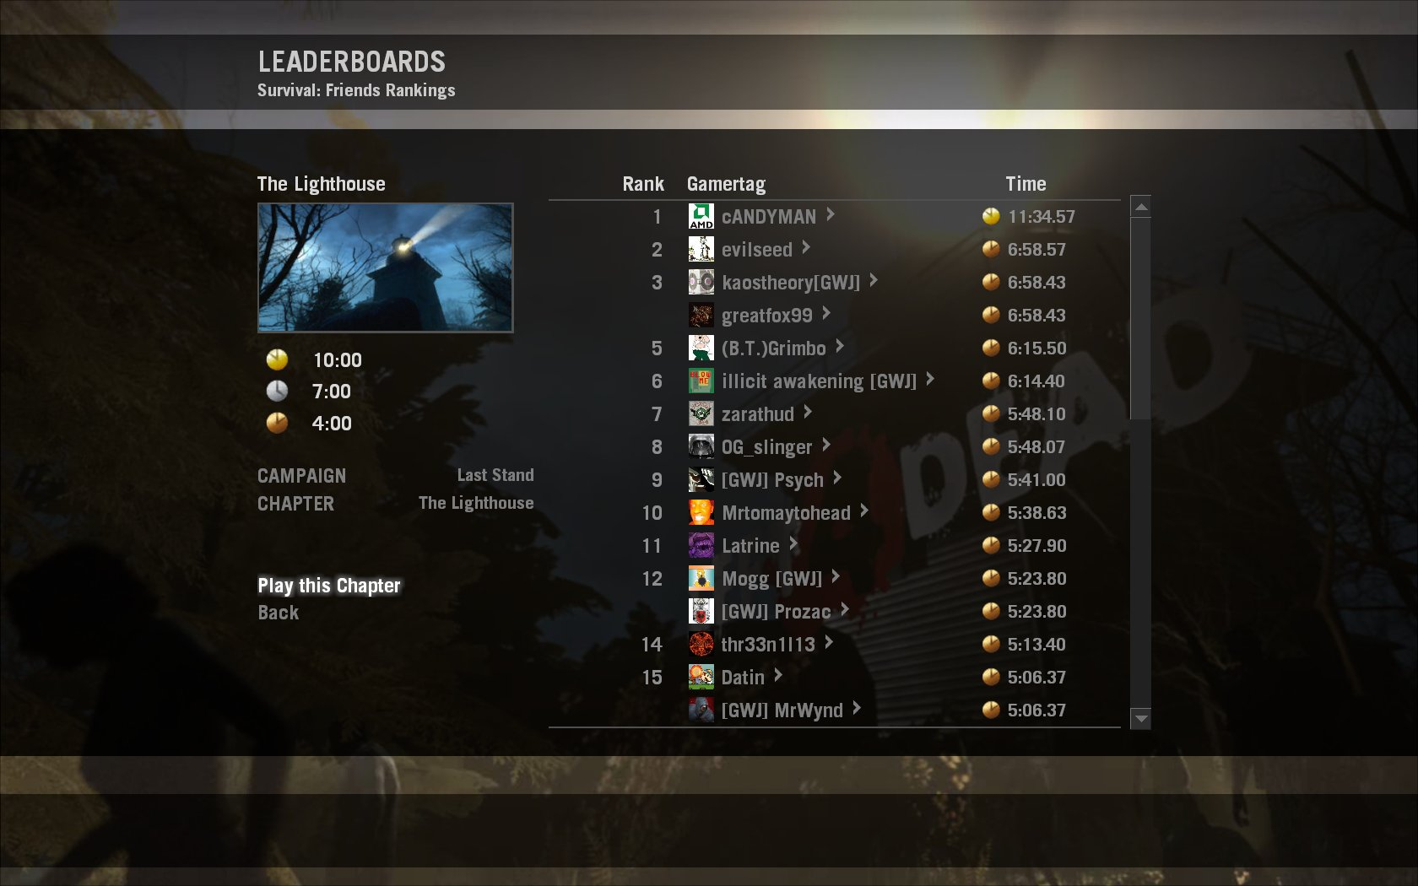
Motivation
Mastery
© 2022, 2024 Jeannie Novak All rights reserved.
Credit: mrwynd (flickr)
Caption: Leaderboards showing friends rankings (Left 4 Dead, shown) can motivate players to master a game.

Slide 9
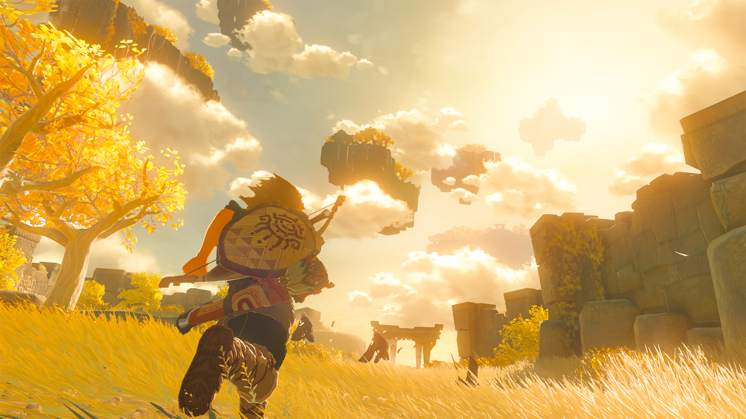
Motivation
Escapism
© 2022, 2024 Jeannie Novak All rights reserved.
Credit: Nintendo
Caption: Players might escape into vast, open worlds like The Legend of Zelda: Breath of the Wild (sequel, shown).

Slide 10
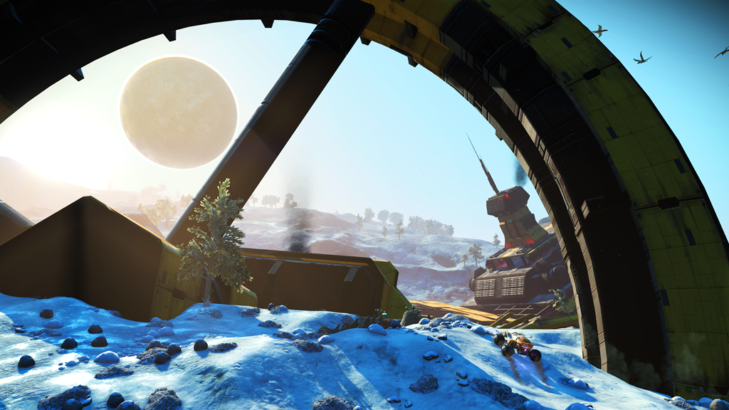
Motivation
Stress Relief
© 2022, 2024 Jeannie Novak All rights reserved.
Credit: Sony Interactive Entertainment
Caption: No Man’s Sky allows players to explore a massive universe full of unique and procedurally-generated planets.

Slide 11
Motivation
Creative Expression
© 2022, 2024 Jeannie Novak All rights reserved.
Credit: Karsa Orlong (MobyGames)
Caption: The Create Mode in LittleBigPlanet 3 allows players to build environments using tools, materials, and objects.

Slide 12
Geographic
South Korea
© 2022, 2024 Jeannie Novak All rights reserved.
Credit: PD
Caption: South Korea is the world leader in eSports and household broadband penetration.

Slide 13
Geographic
Japan
© 2022, 2024 Jeannie Novak All rights reserved.
Credit: PD
Caption: The home console manufacturers such as Sony, Sega, and Nintendo, Japan has a rich console gaming history.

Slide 14
Geographic
China
© 2022, 2024 Jeannie Novak All rights reserved.
Credit: PD
Caption: China is arguably the world’s largest game market.

Slide 15
Geographic
Russia & Germany
© 2022, 2024 Jeannie Novak All rights reserved.
Credit: PD
Credit: PD
Caption: Russia and Germany are the first and second largest markets for computer (PC) games.

Slide 16
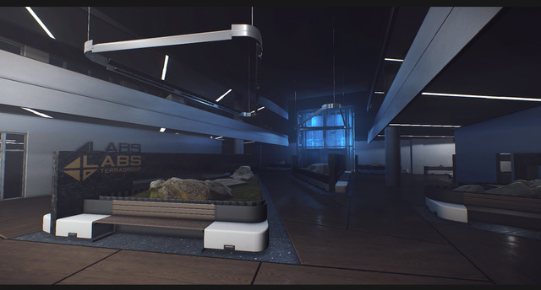
Geographic
Russia & Germany
© 2022, 2024 Jeannie Novak All rights reserved.
Credit: Battlestate Games
Caption: Environment from first-person shooter Escape from Tarkov developed in Saint Petersburg studio Battlestate Games.

Slide 17
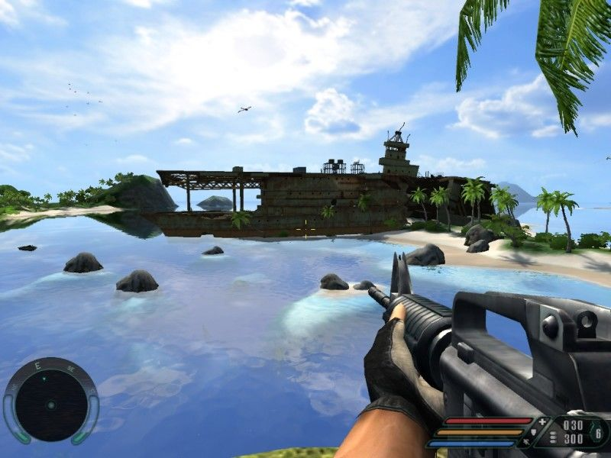
Geographic
Russia & Germany
© 2022, 2024 Jeannie Novak All rights reserved.
Credit: Mattias Kreku (MobyGames)
Caption: Far Cry is a well-known franchise created by German studio Crytek.

Slide 18
Demographic
Gender
© 2022, 2024 Jeannie Novak All rights reserved.
Credit: IxMaster (Shutterstock)
Credit: jn2k108 (Photobucket)
Caption: Early personal computer gaming was dominated by boys - left - but adult female players (including the Frag Dolls - right) have been found to outnumber male gamers ages 6-17).

Slide 19
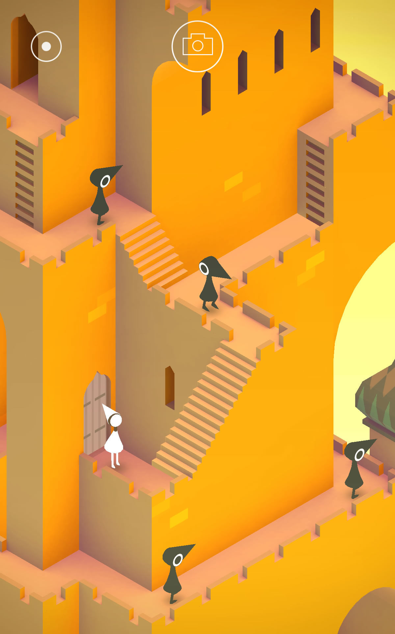
Demographic
Age
© 2022, 2024 Jeannie Novak All rights reserved.
Credit: Sciere (MobyGames)
Caption: Casual games such as Monument Valley form the most popular type of game played by all US age groups.

Slide 20
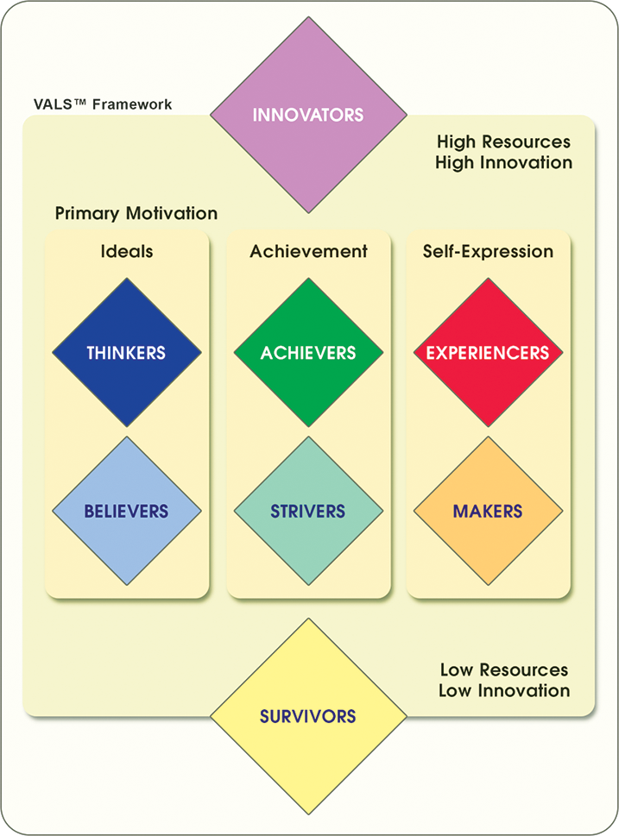
Psychographic
VALS Psychotypes
© 2022, 2024 Jeannie Novak All rights reserved.
Credit: Diagram by Per Olin
Caption: The VALS survey analyzes consumers based on psychographic dimensions related to motivations and resources. (Source: Strategic Business Insights.)

Slide 21
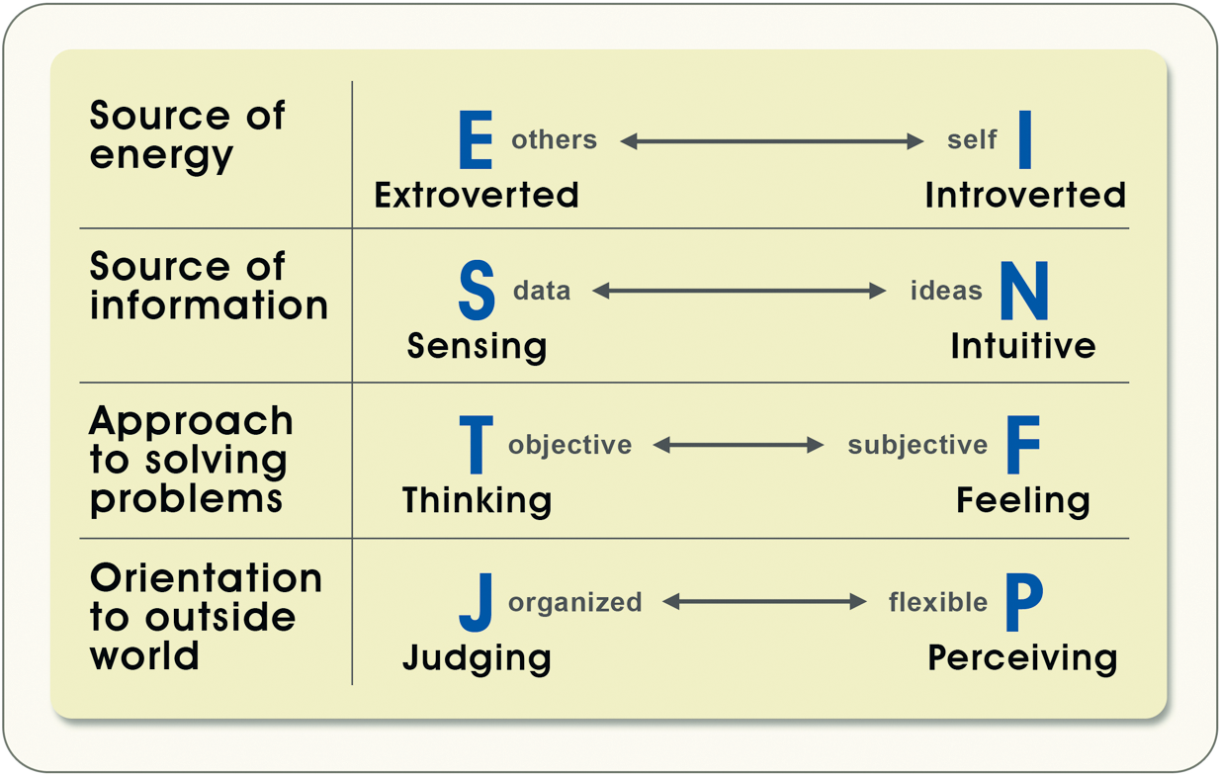
Psychographic
Myers-Briggs Type Indicator
© 2022, 2024 Jeannie Novak All rights reserved.
Credit: Diagram by Per Olin
Caption: Preferences on each scale of the MBTI instrument combine to yield a four-letter psychological type [For example, ISFJ, ENTP]. (Source: Myers & Briggs Foundation, Inc.)

Slide 22
Generational
© 2022, 2024 Jeannie Novak All rights reserved.
Credit: Diagram by Per Olin
Caption: Birth years associated with all current generations of players in the United States.

Slide 23
Generational
Silent Generation
© 2022, 2024 Jeannie Novak All rights reserved.
Credit: Ubisoft Entertainment SA
Caption: Games featuring stealth, intrigue, and spy-like protagonists (such as Sam Fisher on Tom Clancy’s Splinter Cell: Conviction, shown) embody elements associated with the Silent Generation.

Slide 24
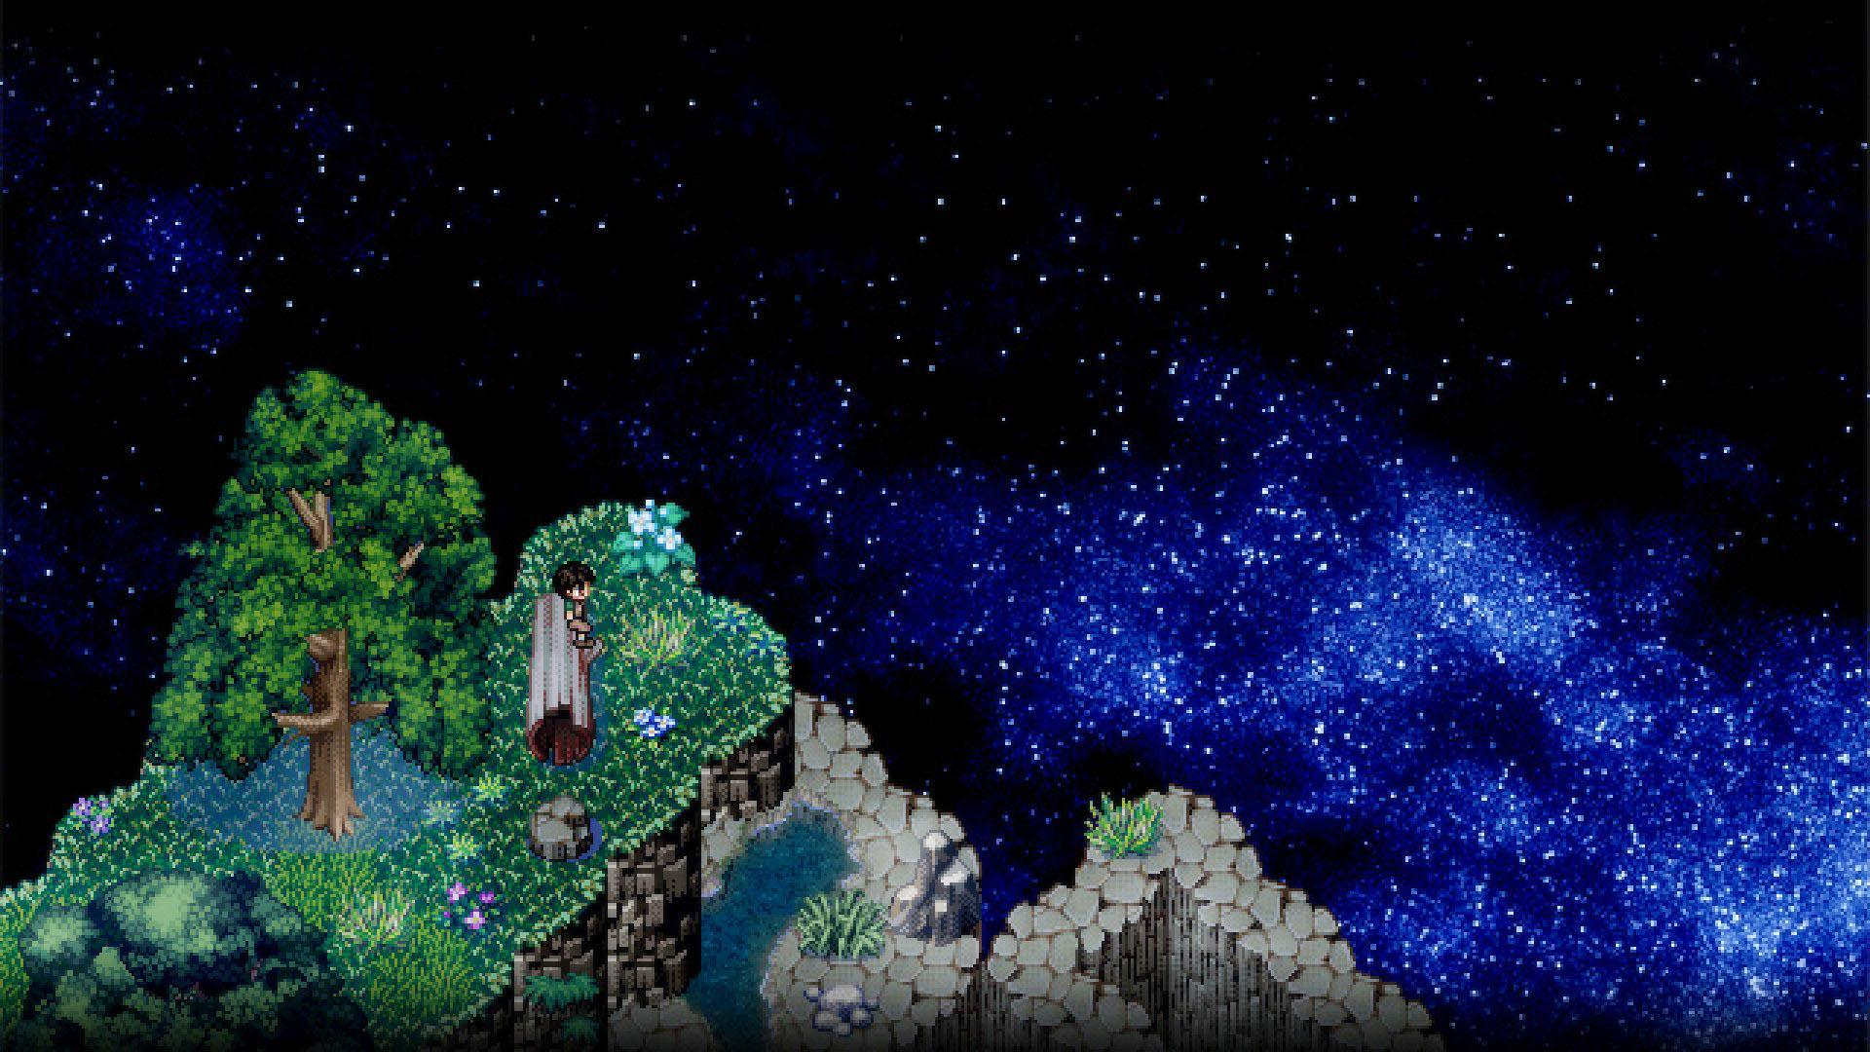
Generational
Boomer Generation
© 2022, 2024 Jeannie Novak All rights reserved.
Credit: Freebird Games
Caption: Meditative and introspective games such as To The Moon incorporate features that might be well-received by the Boomer Generation.

Slide 25
Generational
Generation X
© 2022, 2024 Jeannie Novak All rights reserved.
Credit: Square Enix
Credit: Valve
Caption: Tomb Raider’s Lara Croft and Half-Life’s Gordon Freeman are both depicted as lone heroes.

Slide 26
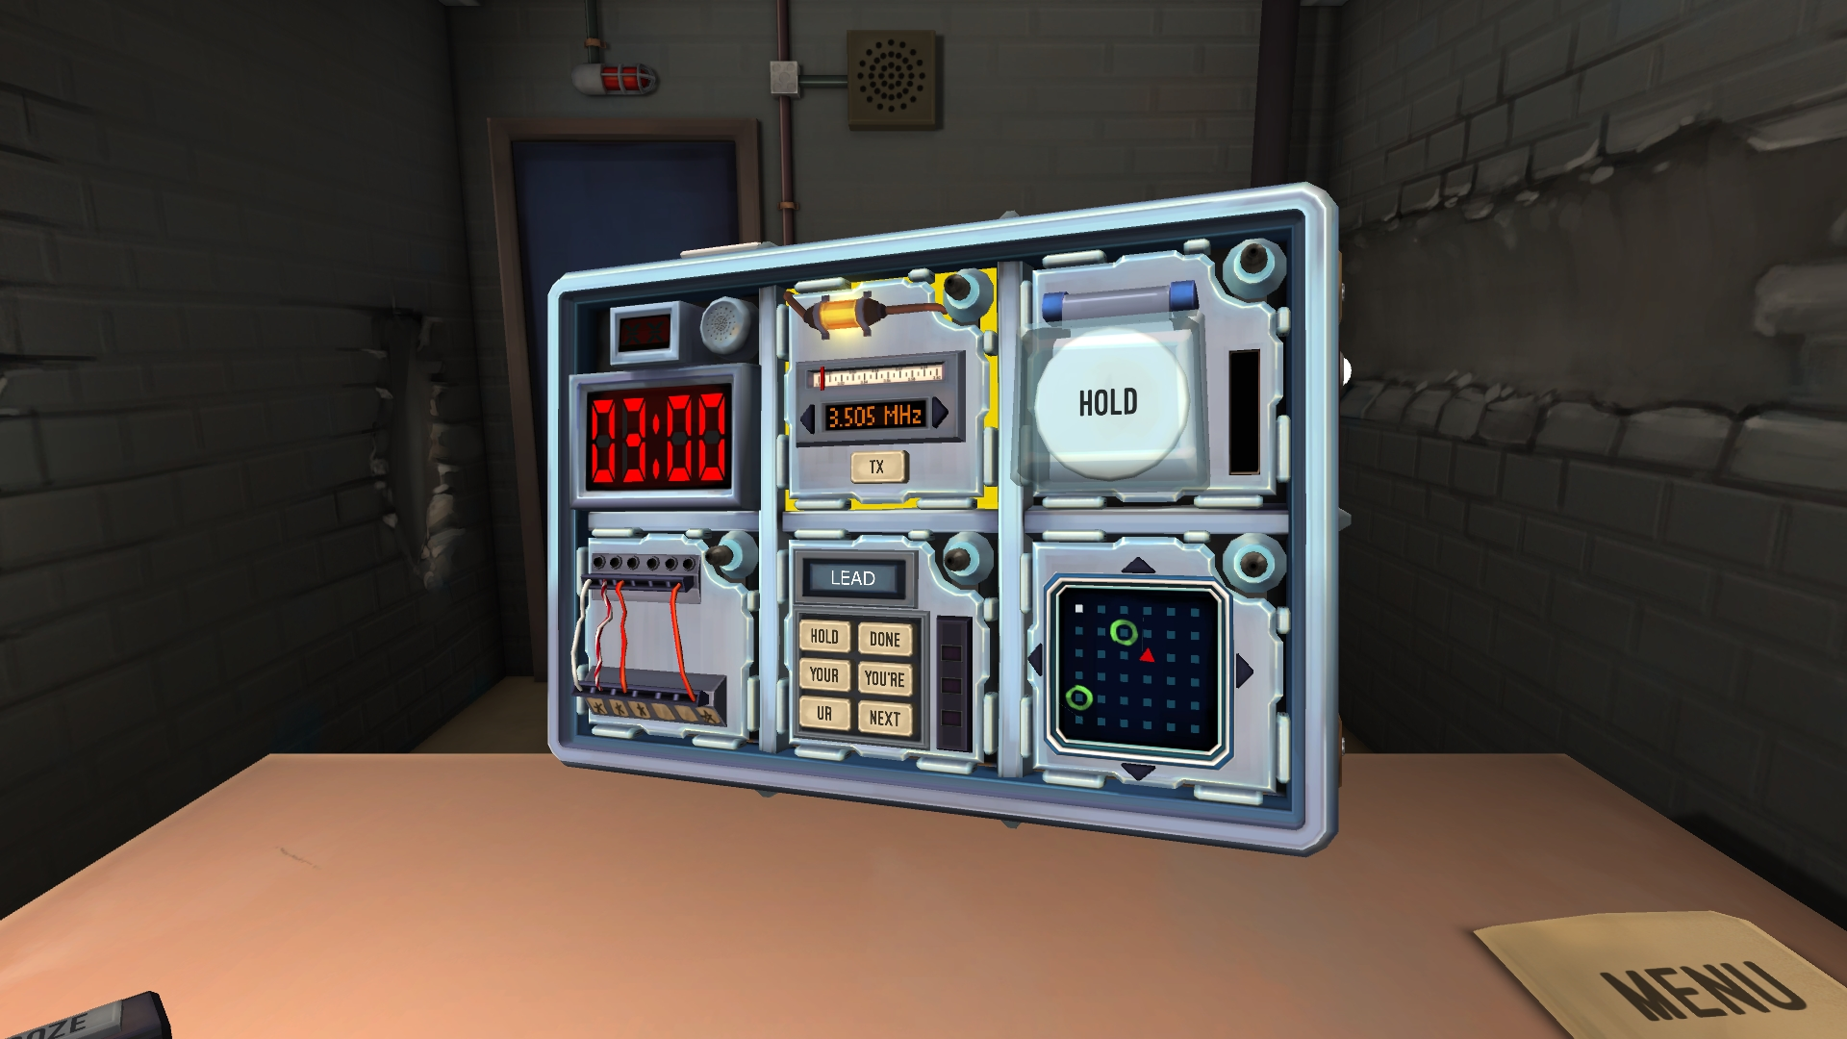
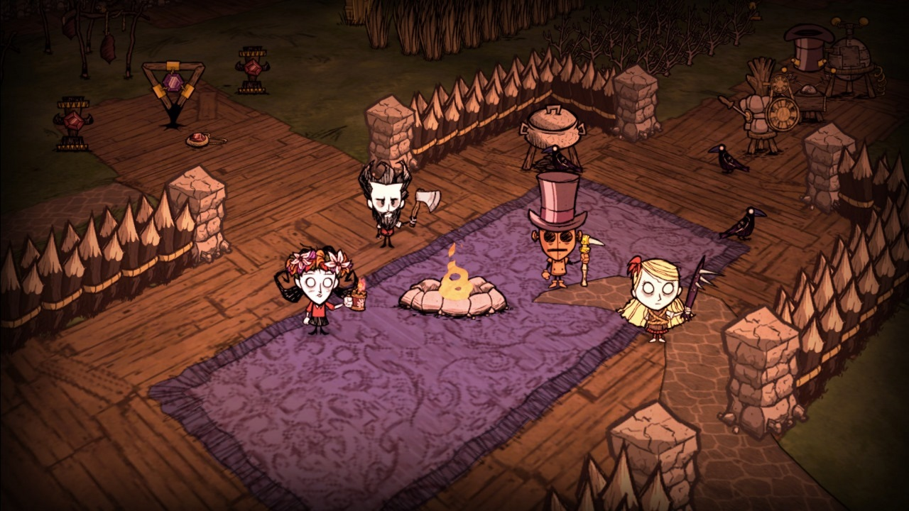
Generational
Millennial Generation
© 2022, 2024 Jeannie Novak All rights reserved.
Credit: Steel Crate Games
Credit: Rik Hideto (MobyGames)
Caption: Games that involve local or online co-op such as Keep Talking and Nobody Explodes - left - and Don’t Starve Together - right - incorporate Millennial characteristics.

Slide 27
Generational
Generation Z
© 2022, 2024 Jeannie Novak All rights reserved.
Credit: Epic Games
Caption: Multiplayer action games involving customization (and humor!) such as Fortnite are popular with Generation Z.

Slide 28
Generational
Generation Alpha
© 2022, 2024 Jeannie Novak All rights reserved.
Credit: Nintendo
Caption: Social simulation games that involve building and creativity, such as Animal Crossing: New Horizons, are popular with Generation Alpha players.

Slide 29
Rating
© 2022, 2024 Jeannie Novak All rights reserved.
Credit: Capcom
Credit: Capcom
Caption: PlayStation 5 and Xbox Series X box art for Resident Evil Village showing an ESRB rating of M (Mature 17+).

Slide 30
CHAPTER 4
© 2022, 2024 Jeannie Novak All rights reserved.
REVIEW EXERCISES
What motivates people to play games? Discuss three different motivational factors and provide examples of games that address these factors. Motivations such as exercise took game developers by surprise, and they might lead to a new series of games that address this player motivation. Come up with a new motivation that game developers might have overlooked, and discuss which types of new games might address this player motivation.
1
2
Why do you play games? What elements in your favorite games make you want to continue playing? If you were to test one of your favorite games for the fun factor, why would it pass the test?

Slide 31
CHAPTER 4
© 2022, 2024 Jeannie Novak All rights reserved.
REVIEW EXERCISES
How do game market geographics differ between the United States, South Korea, China, Japan, and Germany? What are the most popular genres, platforms, and trends in these respective countries—and what are the associated driving factors?
3
What is the importance of psychographics such as values, attitudes, and lifestyles in player markets? Discuss three games that incorporate a distinct belief system. If you were to create a game based on your own psychographics, on what features would you focus?
4

Slide 32
CHAPTER 4
© 2022, 2024 Jeannie Novak All rights reserved.
REVIEW EXERCISES
How have age and gender demographics in the player market changed over time? How might these changes affect the way games continue to be developed? Can you envision any particular trends in game content or structure that would help continue to broaden the player market?
5
6
Discuss the difference between generations such as Boomers, Gen Xers, Millennials, and Gen Z. If you were creating a game specifically targeted toward one of these groups, what features would be present in the game?

Slide 33
CHAPTER 4
© 2022, 2024 Jeannie Novak All rights reserved.
REVIEW EXERCISES
Violence continues to be blamed on the influence of entertainment content such as explicit films and song lyrics. Some games have been blamed for violent outbreaks. Provide a real-world example of a violent incident for which an electronic game was held responsible. Do you agree with this view, or do you believe that there isn’t a distinct correlation between real-world violence and the “fantasy” violence in games?
7
8
Which of Richard Bartle’s player suits best describes you as a player? What types of games naturally cater to your player suit? Take the VALS™ Survey—and the NERIS Type Explorer®, TypeFinder® Personality Test or other free personality test based on MBTI® principles. Do your results correspond to your player suit self-evaluation?

