Slide 2
CHAPTER 3
Goals & genres what are the possibilities?
© 2022, 2024 Jeannie Novak All rights reserved.

Slide 3
CHAPTER OBJECTIVES
© 2022, 2024 Jeannie Novak All rights reserved.
After reading this chapter, you should be able to:
Point out some non-entertainment goals associated with game development.
Recognize the characteristics associated with popular game genres.
Understand which goals and genres work particularly well together.
Identify what type of game content is traditionally associated with certain genres.
Discuss how genre hybrids and new types of genres change the way games are categorized.

Slide 4
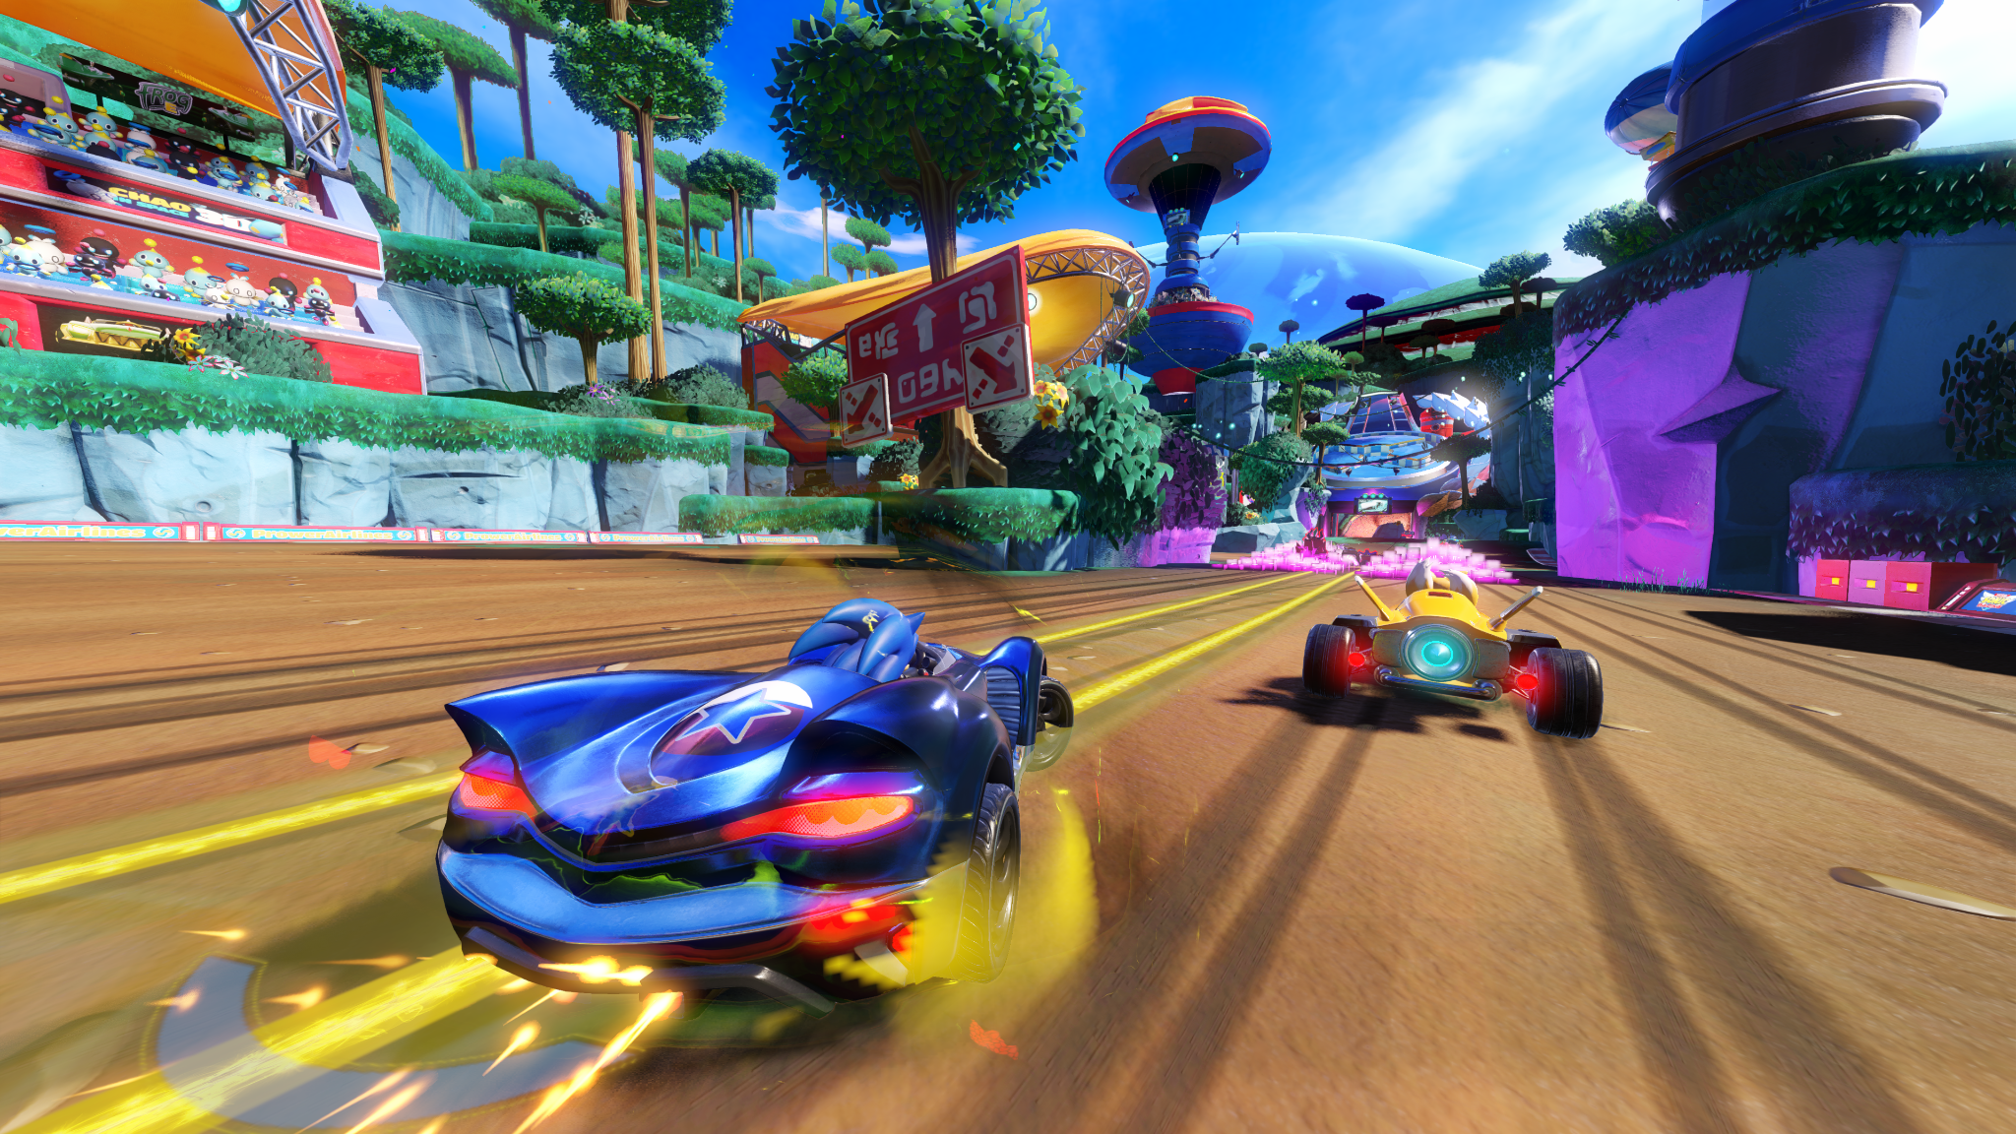
Goals
Entertainment
© 2022, 2024 Jeannie Novak All rights reserved.
Credit: Sega Corporation
Caption: Most games, such as Team Sonic Racing, are created for entertainment purposes.

Slide 5
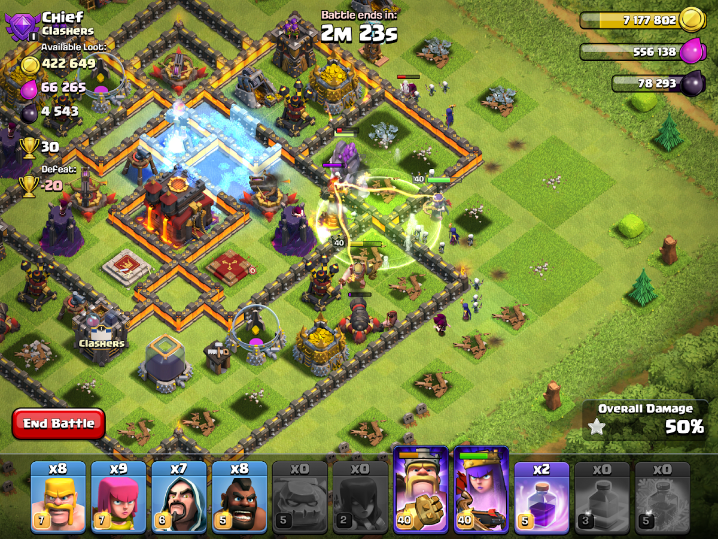
Goals
Social Interaction
© 2022, 2024 Jeannie Novak All rights reserved.
Credit: Pseudo_Intellectual (MobyGames)
Caption: Games such as Supercell’s Clash of Clans have social features that allow players to create clans, join existing clans, and request reinforcements.

Slide 6
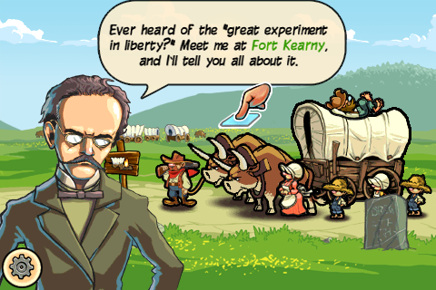
Goals
Education
© 2022, 2024 Jeannie Novak All rights reserved.
Credit: Gameloft SE
Caption: The Oregon Trail teaches American history as players journey into the West.

Slide 7
Goals
Recruitment & Training
© 2022, 2024 Jeannie Novak All rights reserved.
Credit: Applied Research Associates
Caption: In HumanSim, classroom lectures are replaced with interactivity and serious fun.

Slide 8
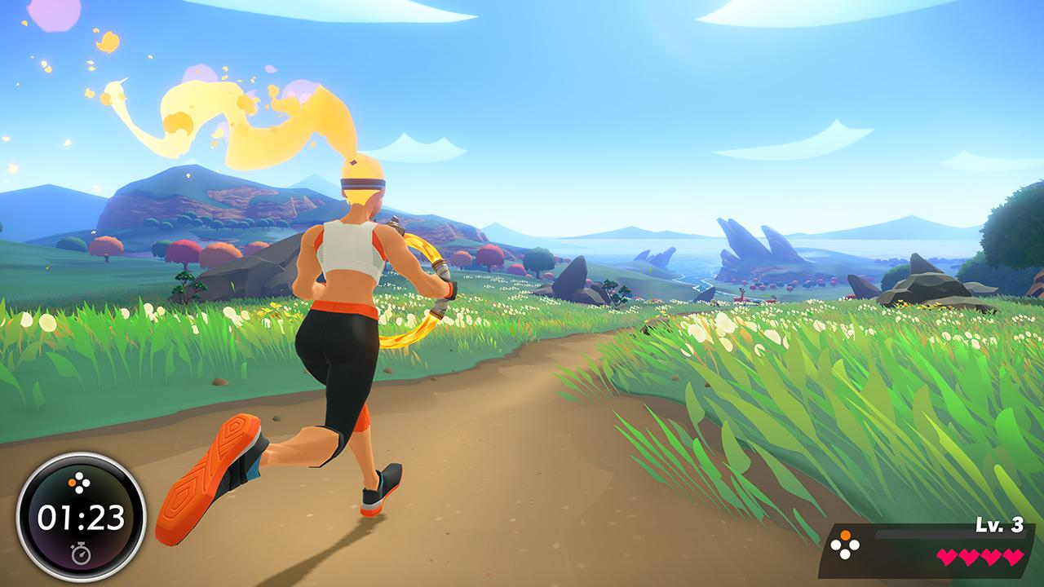
Goals
Health & Fitness
© 2022, 2024 Jeannie Novak All rights reserved.
Credit: Kam1Kaz3NL77 (MobyGames)
Caption: Nintendo’s Ring Fit Adventure combines exercise with action and role-playing.

Slide 9
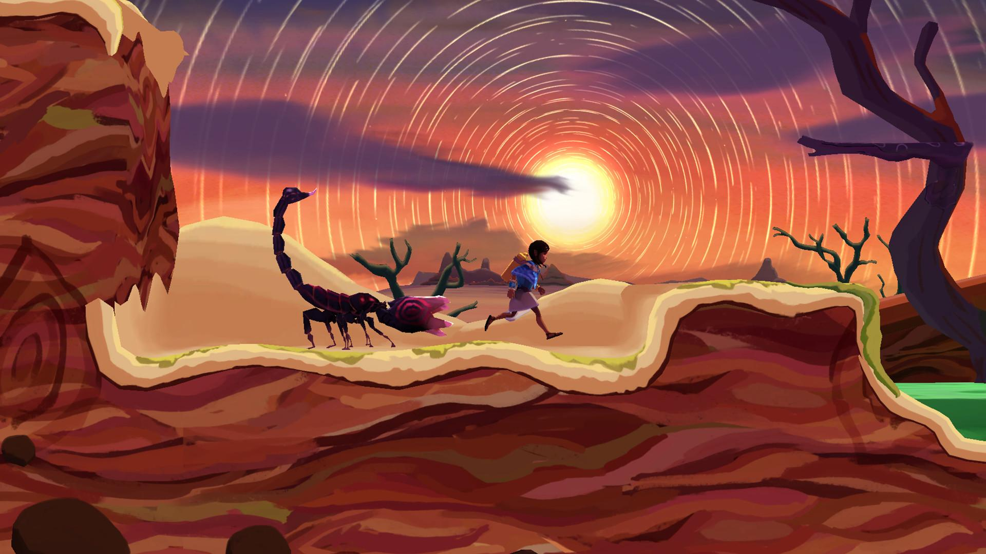
Goals
Consciousness & Change
© 2022, 2024 Jeannie Novak All rights reserved.
Credit: Inkline
Caption: Ayo: A Rain Tale raises awareness of the challenges women and girls face in Sub-Saharan Africa.

Slide 10
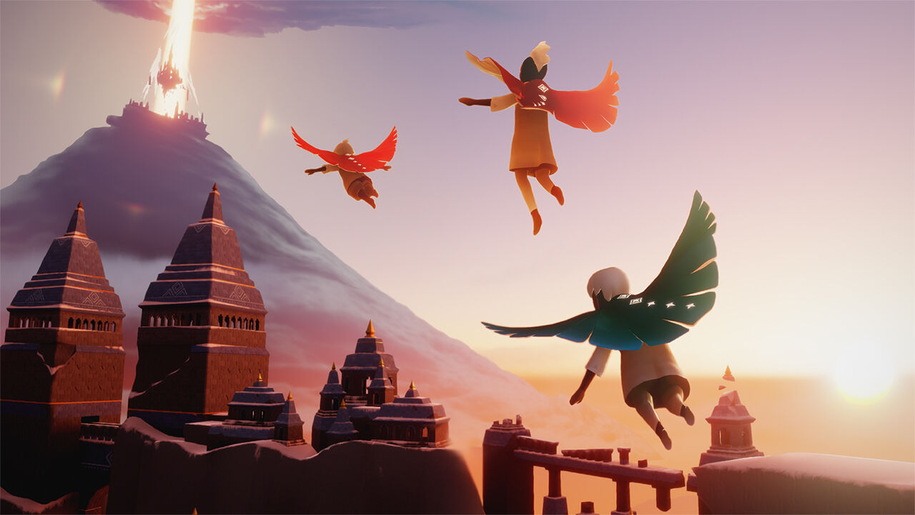
Goals
Aesthetics & Creativity
© 2022, 2024 Jeannie Novak All rights reserved.
Credit: Kam1Kaz3NL77 (MobyGames)
Caption: thatgamecompany’s Sky: Children of the Light was developed with aesthetics and artistic expression in mind.

Slide 11
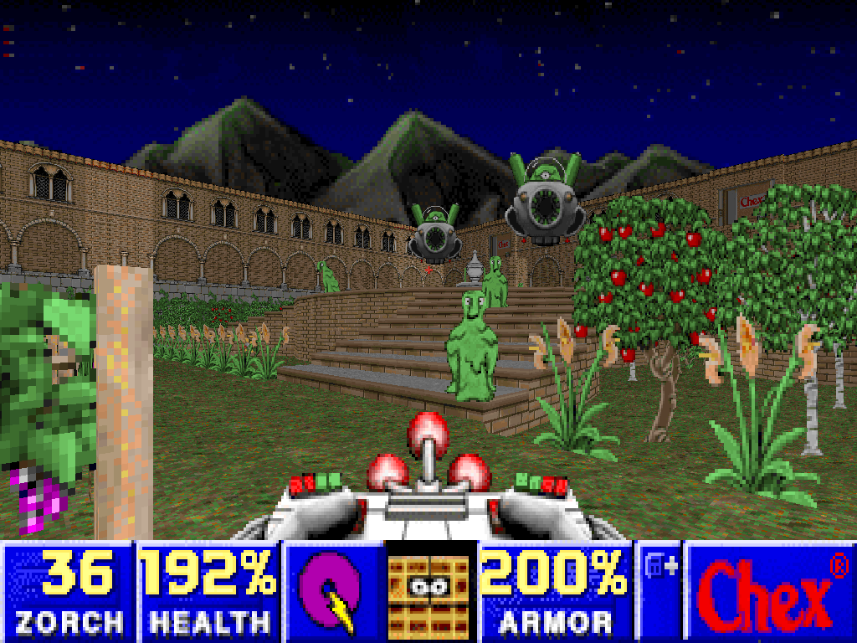
Goals
Marketing & Advertising
© 2022, 2024 Jeannie Novak All rights reserved.
Credit: erc (MobyGames)
Caption: Non-violent Doom adaption Chex Quest was included as a prize in Chex cereal boxes.

Slide 12
Goals
Marketing & Advertising
© 2022, 2024 Jeannie Novak All rights reserved.
Credit: Sega Corporation
Caption: Games such as Alien: Isolation that are based on movie franchises could be considered advergames.

Slide 13
Genres
Action
© 2022, 2024 Jeannie Novak All rights reserved.
Credit: HillsDan (Photobucket)
Credit: brattle (Photobucket)
Credit: DL
Caption: SingStar - left - Rock Band 3 - middle - and Dance Dance Revolution Hottest Party 2 - right - in action.

Slide 14
Genres
Adventure
© 2022, 2024 Jeannie Novak All rights reserved.
Credit: Barbarian_bros (MobyGames)
Caption: Day of the Tentacle helped popularize the adventure genre.

Slide 15
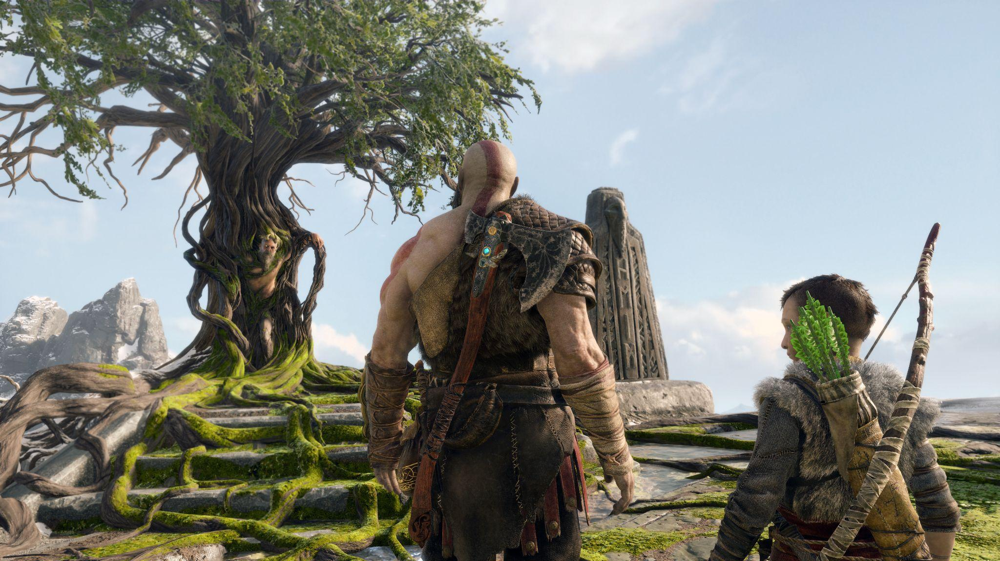
Genres
Action-Adventure
© 2022, 2024 Jeannie Novak All rights reserved.
Credit: Sony Interactive Entertainment
Caption: God of War (2018) - the eighth installment in the popular franchise - has helped push the envelope of the action-adventure genre by incorporating rich story elements.

Slide 16
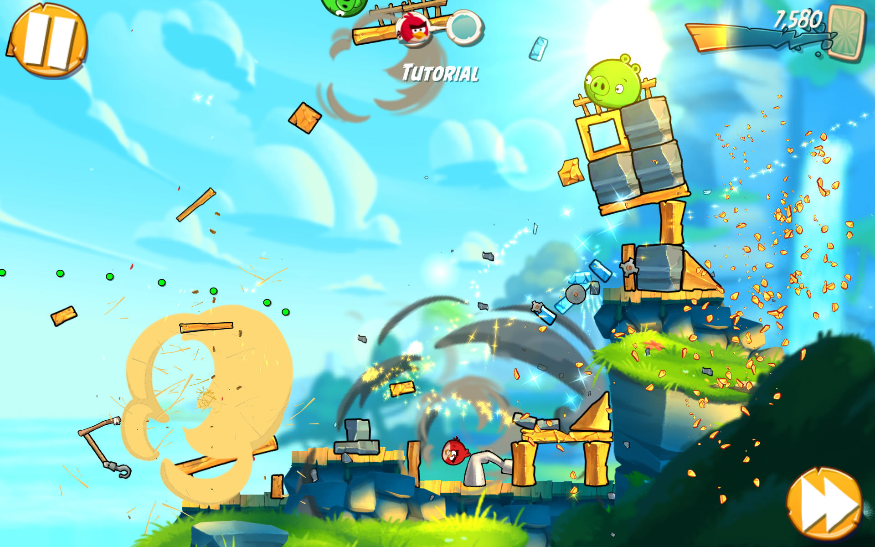
Genres
Puzzle
© 2022, 2024 Jeannie Novak All rights reserved.
Credit: Sciere (MobyGames)
Caption: Angry Birds became so popular that it led to PC and console versions, an animated television series, two feature films, and tons of merchandise (Angry Birds 2, shown).

Slide 17
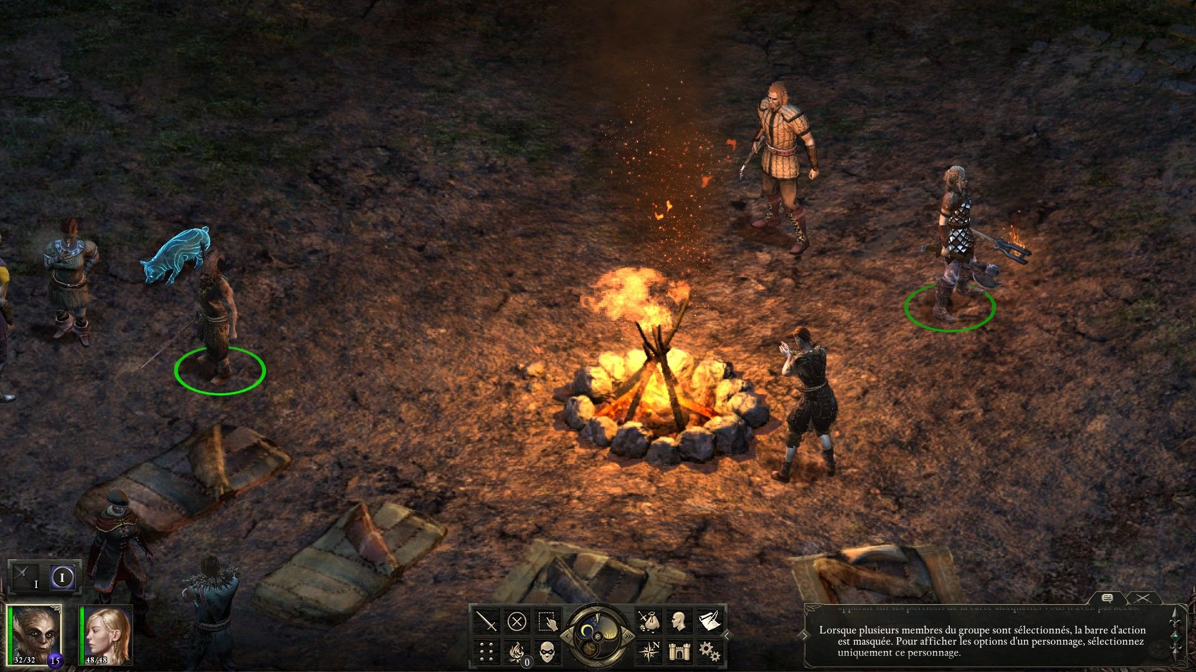
Genres
Role-Playing
© 2022, 2024 Jeannie Novak All rights reserved.
Credit: Barbarian_bros (MobyGames)
Caption: Pillars of Eternity is a role-playing game with a rich environment and in-depth characters.

Slide 18
Genres
Simulation
© 2022, 2024 Jeannie Novak All rights reserved.
Credit: JN
Caption: Microsoft Flight Simulator (2020) is a descendant of the first widely popular vehicle sim.

Slide 19
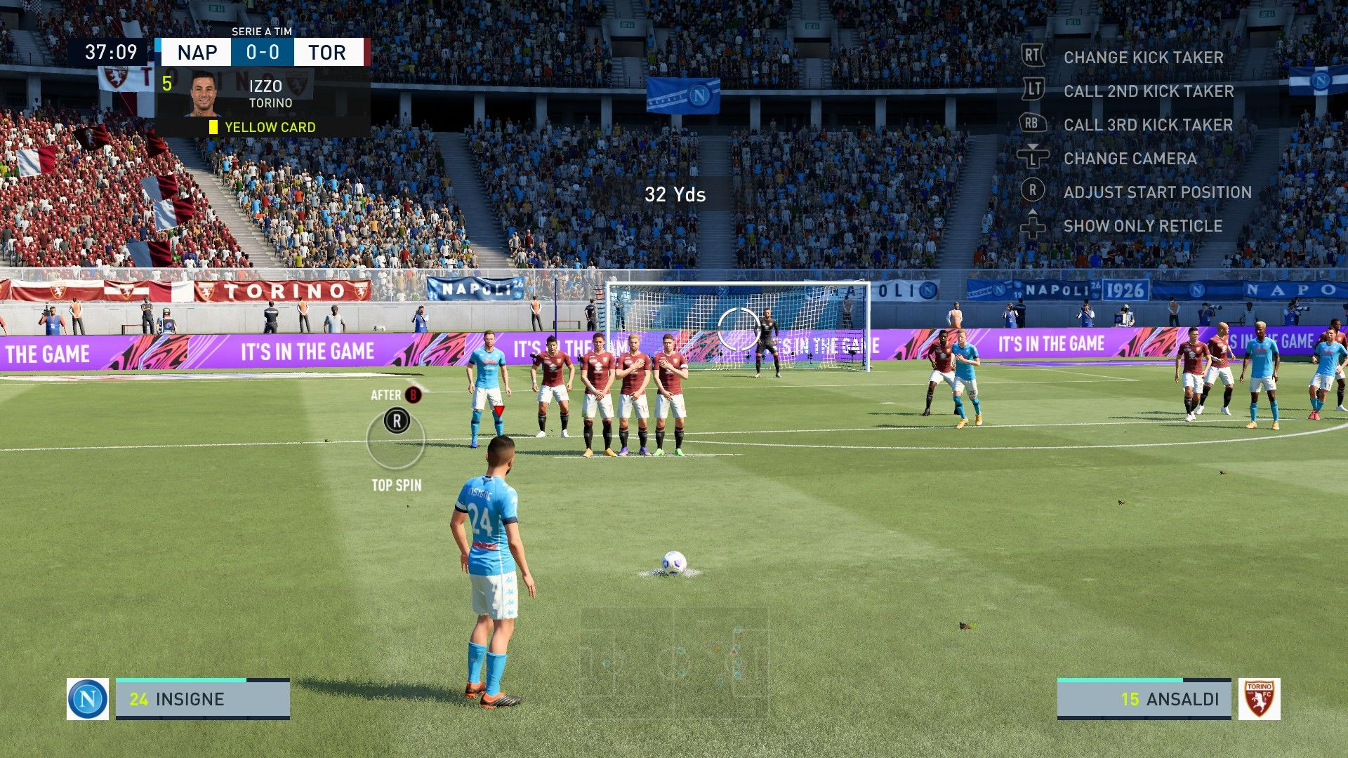
Genres
Simulation
© 2022, 2024 Jeannie Novak All rights reserved.
Credit: Kabushi (MobyGames)
Caption: Sports games like FIFA 21 rely on knowledge of real-world rules to master the game.

Slide 20
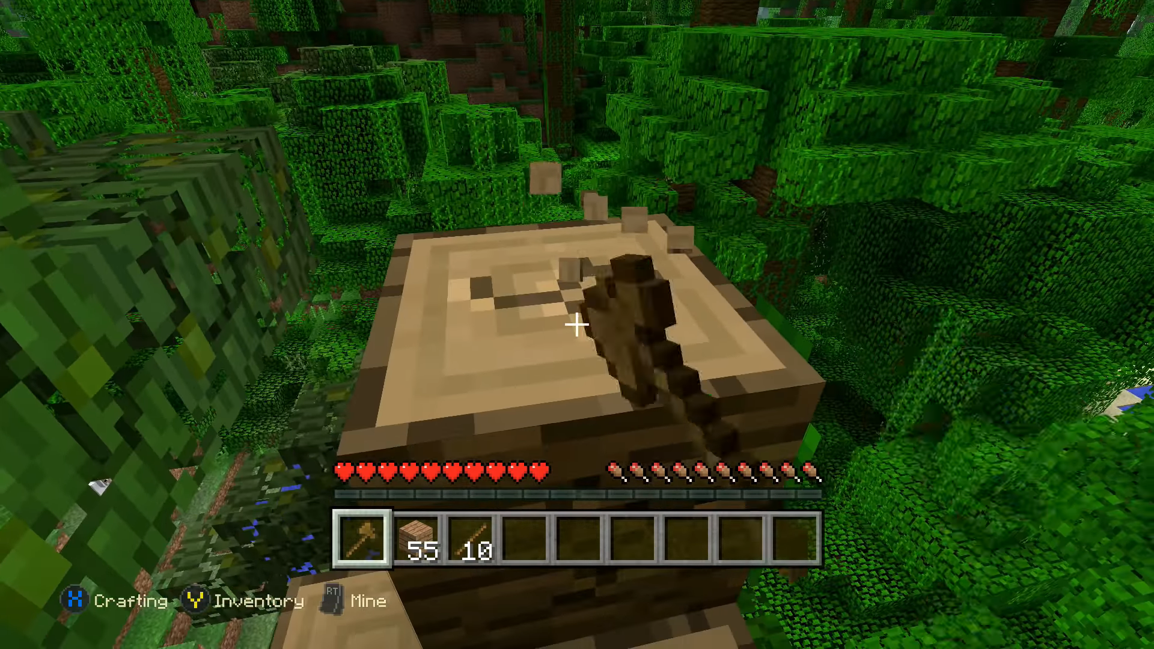
Genres
Sandbox
© 2022, 2024 Jeannie Novak All rights reserved.
Credit: [DELETED] (MobyGames)
Caption: The success of Minecraft—which has provided countless players with creative freedom—has inspired other popular game franchises to incorporate sandbox features.

Slide 21
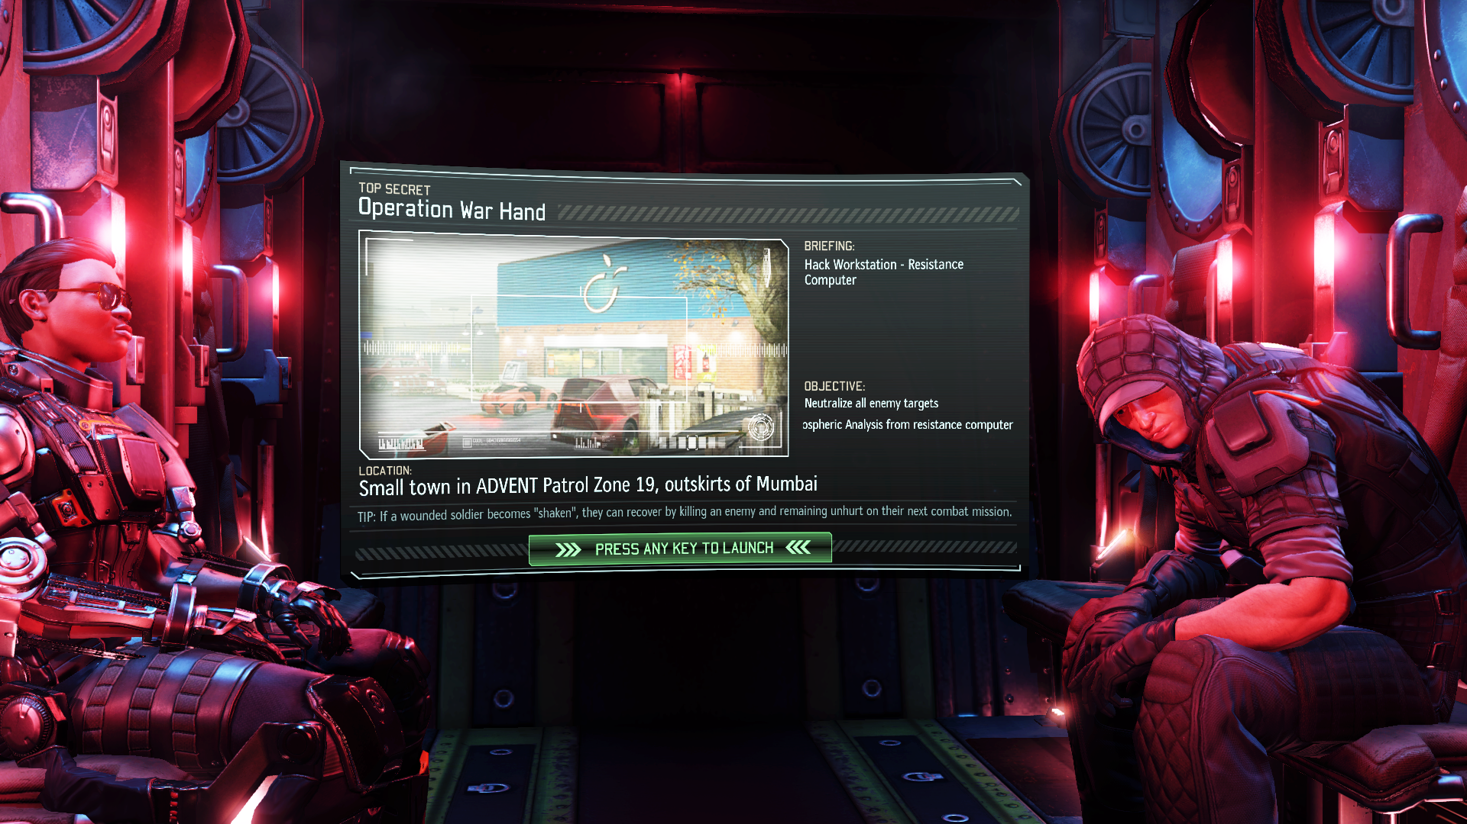
Genres
Strategy
© 2022, 2024 Jeannie Novak All rights reserved.
Credit: 2K Games
Caption: XCOM is an influential turn-based strategy series (XCOM 2, shown).

Slide 22
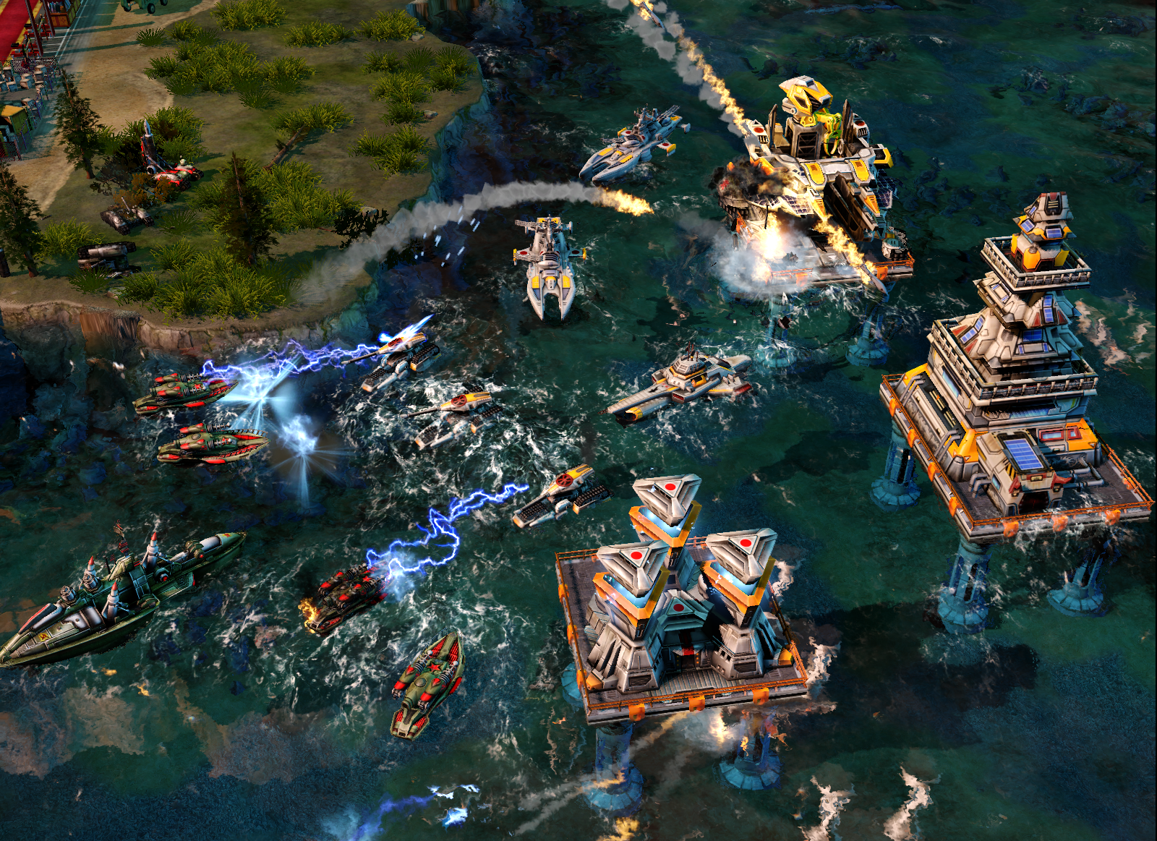
Genres
Strategy
© 2022, 2024 Jeannie Novak All rights reserved.
Credit: Electronic Arts
Caption: Early real-time strategy franchise Command & Conquer has spawned several spin-offs—including Command & Conquer: Red Alert 3 (shown), which utilizes alternate WWII history as a backdrop.

Slide 23
CHAPTER 3
© 2022, 2024 Jeannie Novak All rights reserved.
REVIEW EXERCISES
In this chapter, you learned about several non-entertainment game goals. Choose five genres introduced in this chapter and discuss which particular goal might be a good match for each. Can you think of a goal not mentioned in this chapter that might inspire you to create a game?
1
How do game platforms influence game goals and genres? Web-based Facebook games—accessed initially through the computer platform, but now also through mobile devices—are often considered to be “social games.” Although online multiplayer console games have always had a social component, the console platform did not give rise to the “social game” moniker. Why do you think this is the case? Choose two distinct platforms and discuss which game genres would be particularly relevant for them—as opposed to other platforms.
2

Slide 24
CHAPTER 3
© 2022, 2024 Jeannie Novak All rights reserved.
REVIEW EXERCISES
The ESRB has used a “T” rating on some online multiplayer games. This rating is not necessarily accurate. Why is this? What do you feel motivates people to play MMOs and other online multiplayer games? How does the structure of an online multiplayer game differ from local multiplayer and single-player games?
3
Choose one of your favorite games and change its genre. For example, what would Halo be like if it was a puzzle, simulation or RTS game instead of an FPS? Now, create a brand new game genre that is distinct from those discussed in this chapter. Tie this genre to what you learned about platforms in Chapter 2. What type of platform would be most appropriate for this genre, and why?
4

Slide 25
CHAPTER 3
© 2022, 2024 Jeannie Novak All rights reserved.
REVIEW EXERCISES
5
Combine two genres discussed in this chapter to create a new hybrid genre. What type of game would you create for this new genre? List five unique features of the game.
Adventure games have experienced a general decline in popularity. Why do you think this is the case? What would you change about the content or structure in adventure games to incite new interest in this genre?
6
7
Strategy games often use a military setting. Discuss three settings or scenarios unrelated to combat or warfare that could be incorporated successfully into a strategy game.

Slide 26
CHAPTER 3
© 2022, 2024 Jeannie Novak All rights reserved.
REVIEW EXERCISES
Do you feel that all games are educational by accident? Why or why not? The “edutainment” movement of the 1980s and early 1990s focused on the early childhood market and players in the K-12 grades. What about games created specifically to educate beyond K-12 (post-secondary)? Create an idea for an educational game geared toward adults who are taking a college course. Now choose another type of “serious” (non-entertainment) game goal—such as corporate training, military recruitment, or health. How would you ensure that your game was still fun and engaging while retaining its purpose?
8

