Slide 2
CHAPTER 2
Platforms & player modes what is the framework?
© 2022, 2024 Jeannie Novak All rights reserved.

Slide 3
CHAPTER OBJECTIVES
© 2022, 2024 Jeannie Novak All rights reserved.
After reading this chapter, you should be able to:
Identify the platforms that are available for games, along with the specific elements associated with each platform.
Understand how the choice of hardware affects the way a game is developed and played.
Discuss how modes based on number of players affect the way games are created.
Point out the types of platforms and modes that are most appropriate for cooperative or competitive styles of play.
Define various time interval options and how they change the way a game is played.

Slide 4
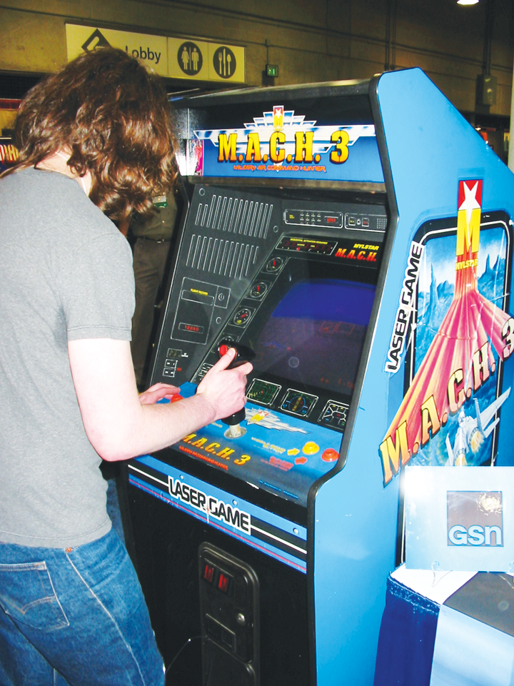
Platform
Arcade
© 2022, 2024 Jeannie Novak All rights reserved.
Credit: JN
Caption: MACH 3 arcade game being played during the Classic Gaming Expo at the Electronic Entertainment Expo (E3).

Slide 5
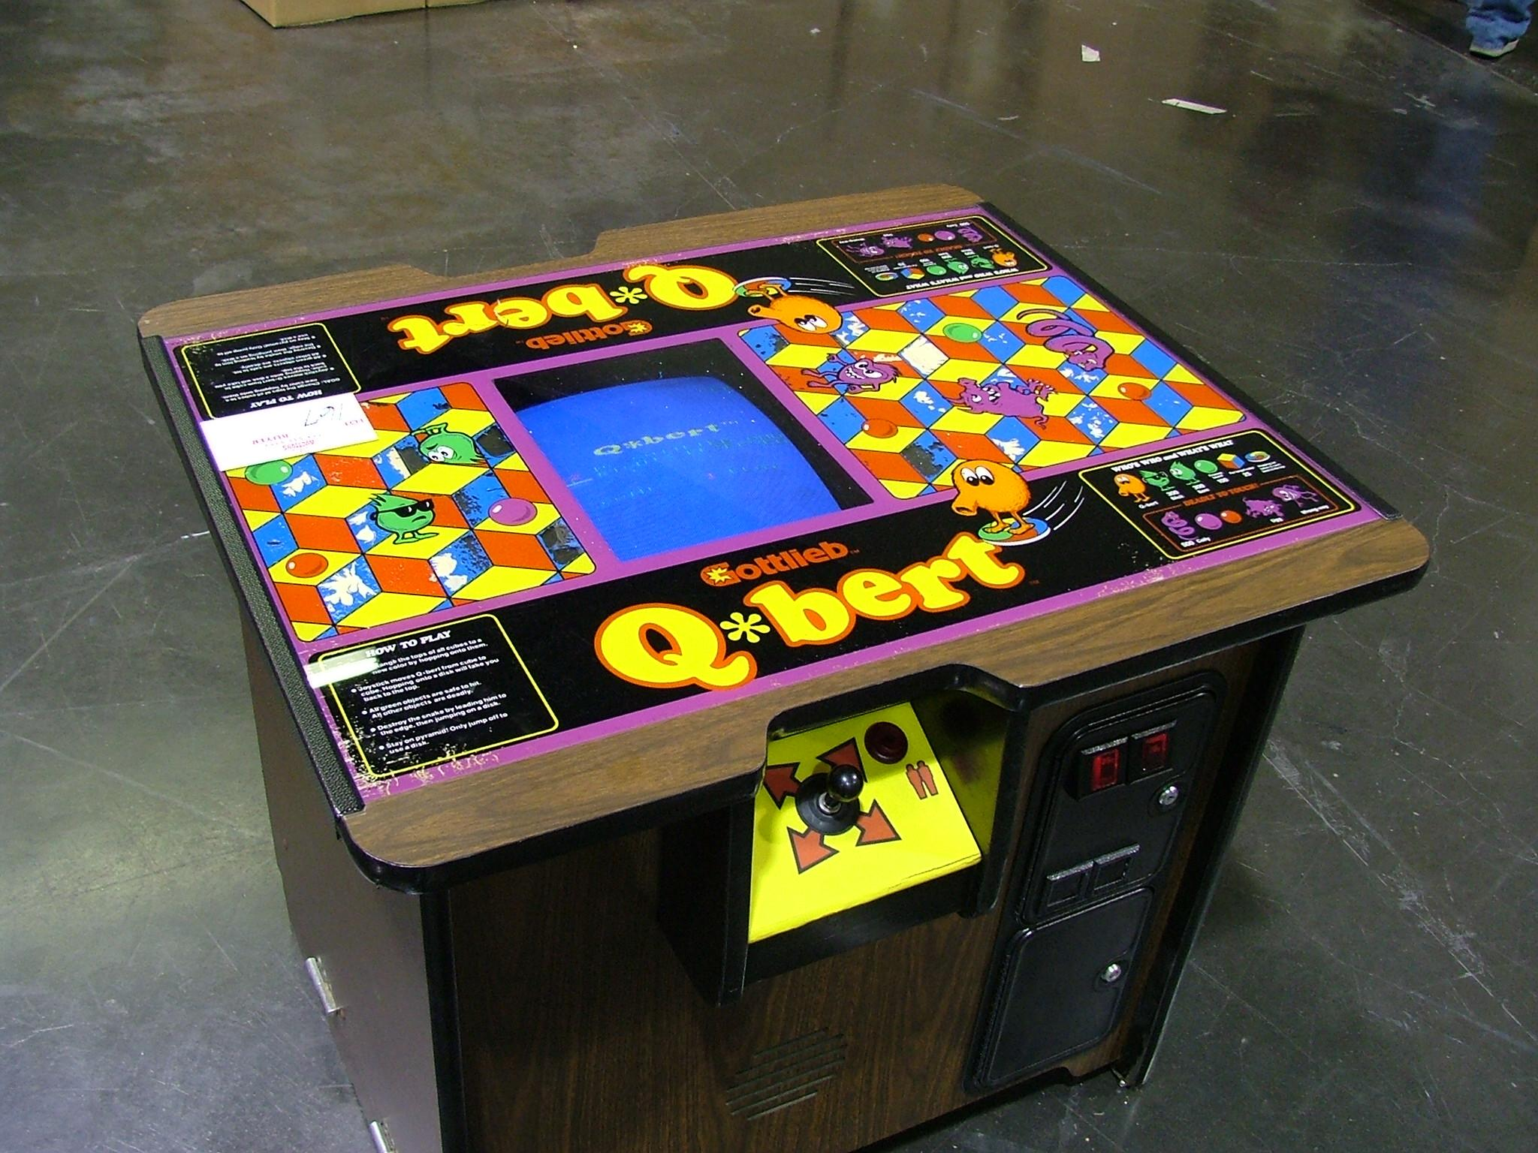
Platform
Arcade
© 2022, 2024 Jeannie Novak All rights reserved.
Credit: Kurt Williams (flickr)
Caption: Q-bert was available as a cocktail arcade cabinet—a format that used to be seen in diners and hotel lobbies.

Slide 6
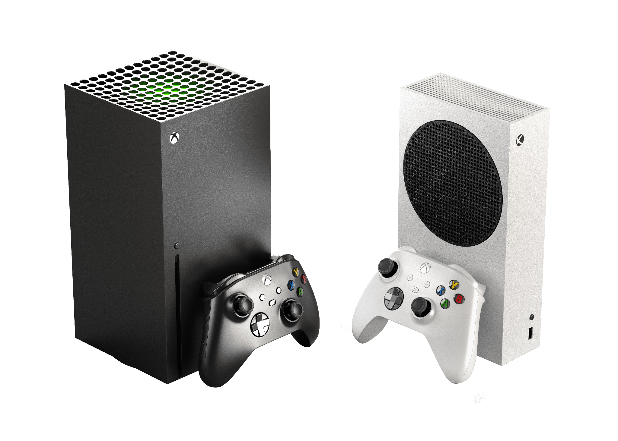
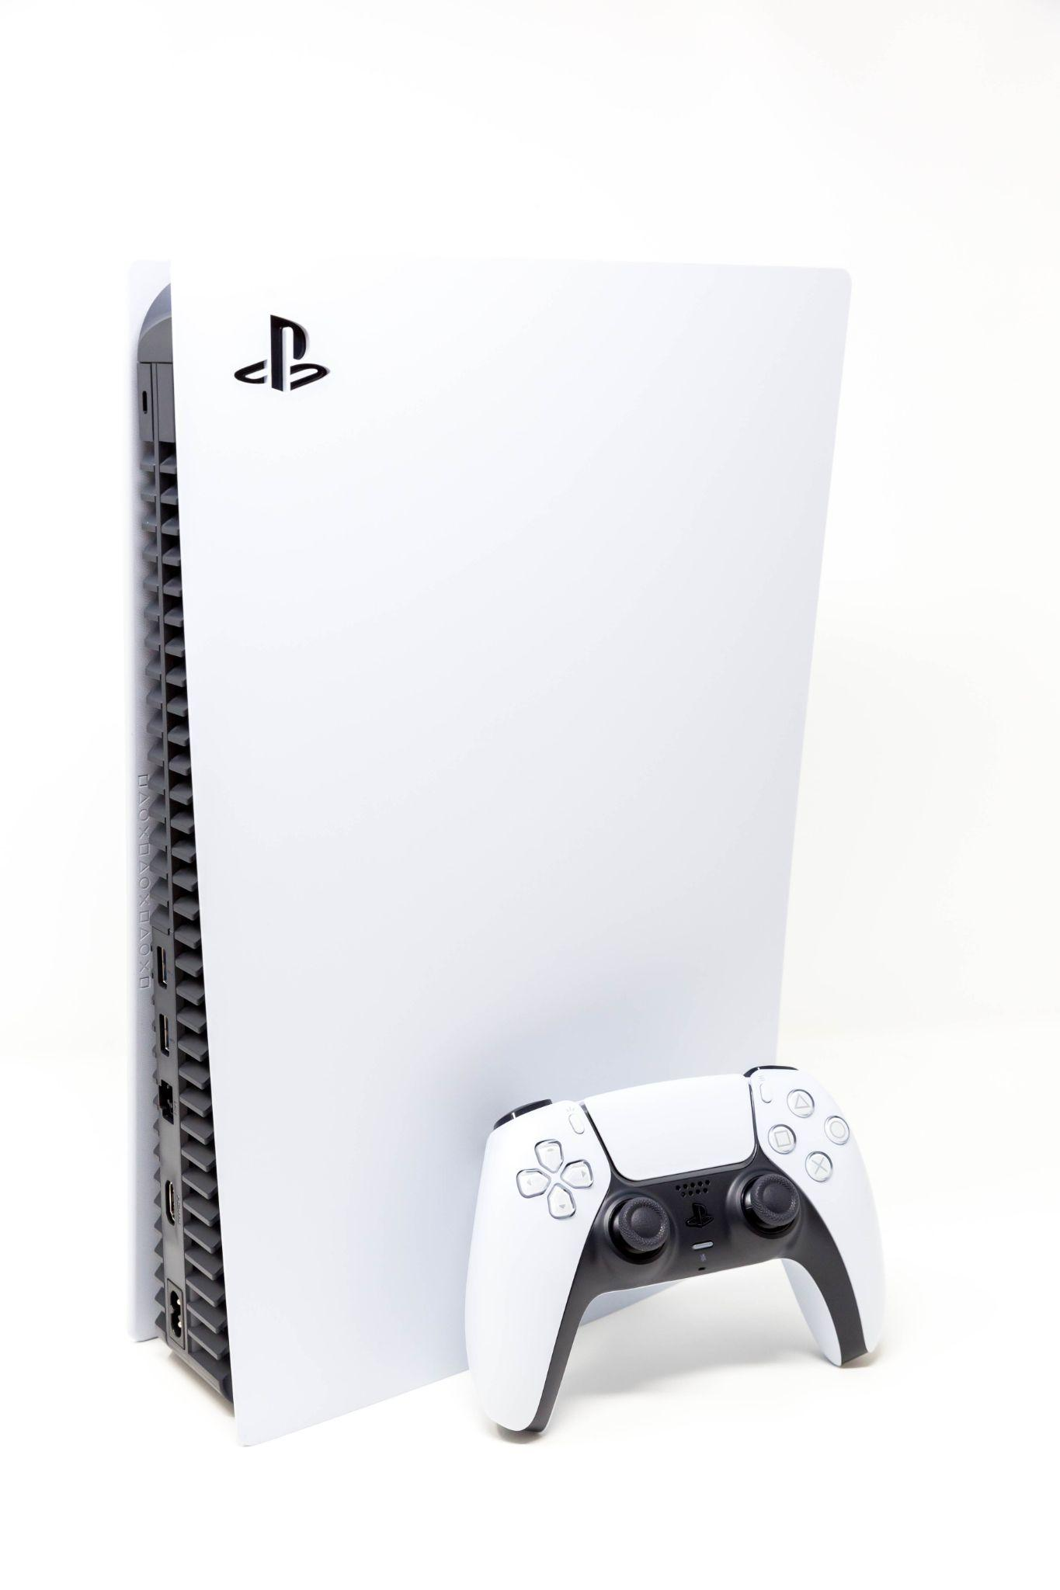
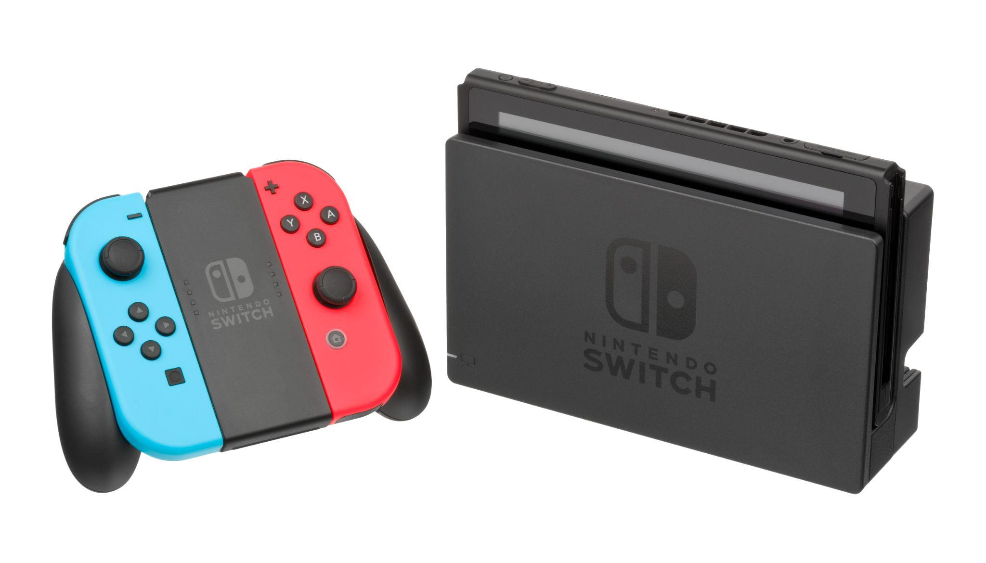
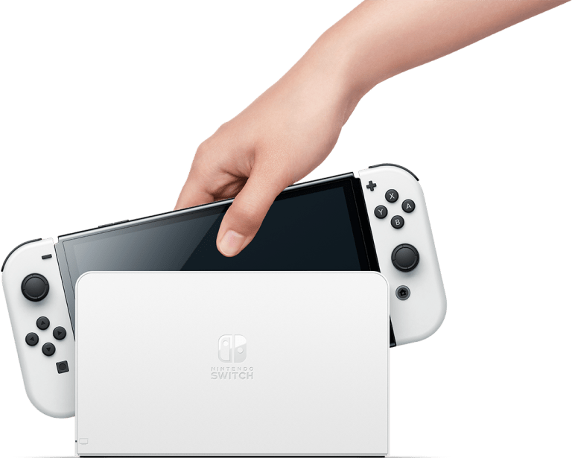
Platform
Console & Handheld
© 2022, 2024 Jeannie Novak All rights reserved.
Credit: Decaale (dreamstime) - modified by Justin Sadur
Credit: Marco Verch (flickr)
Credit: Evan Amos (Wikimedia Commons)
Credit: Pierre Lecourt (flickr)
Caption: The Xbox Series X/S - left - PlayStation 5 - center-left - Nintendo Switch - center-right - and Nintendo Switch - OLED Model - right - are the dominant console systems on the market.

Slide 7
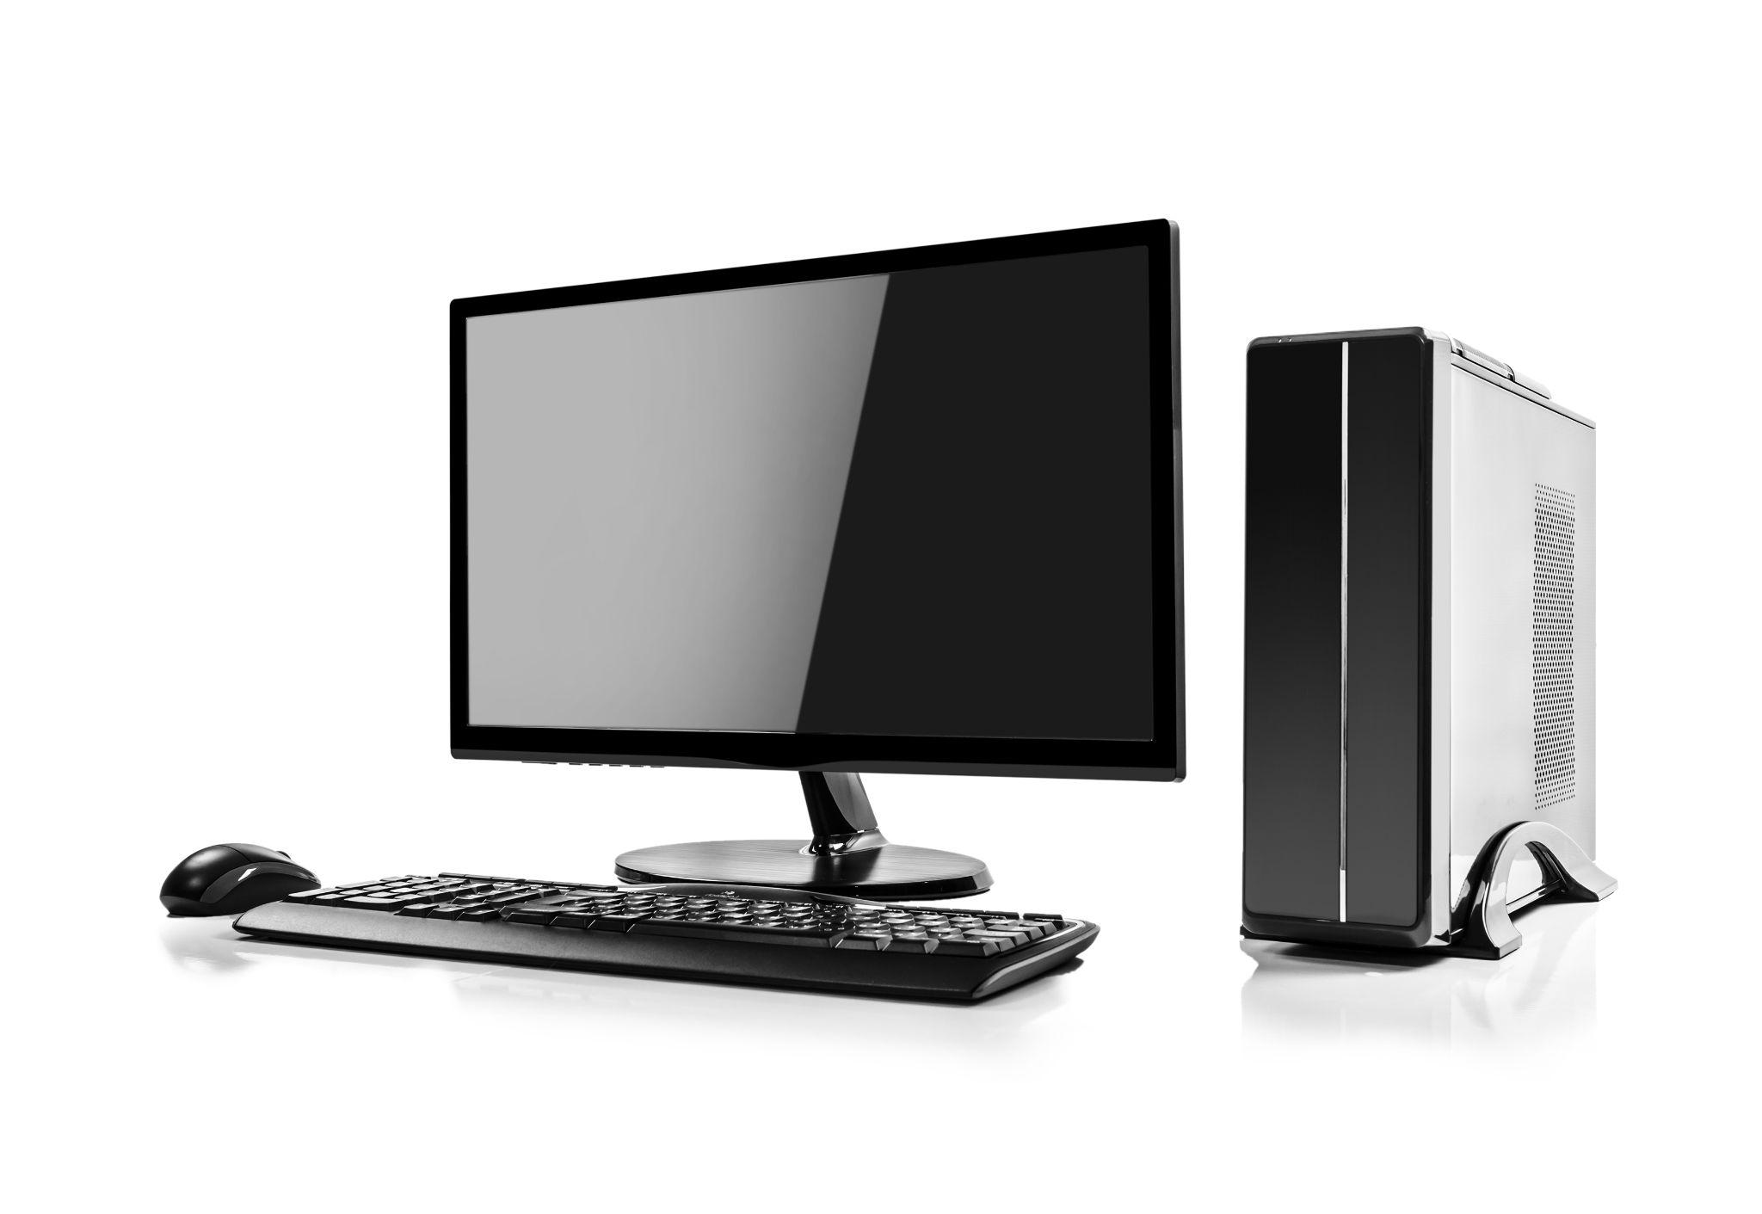
Platform
Computer
© 2022, 2024 Jeannie Novak All rights reserved.
Credit: Den Roxhnovsky (Shutterstock)
Caption: The computer platform (with Windows, Mac, and Linux operating systems) adds complexity to the development process due to non-standard setups and a variety of systems.

Slide 8
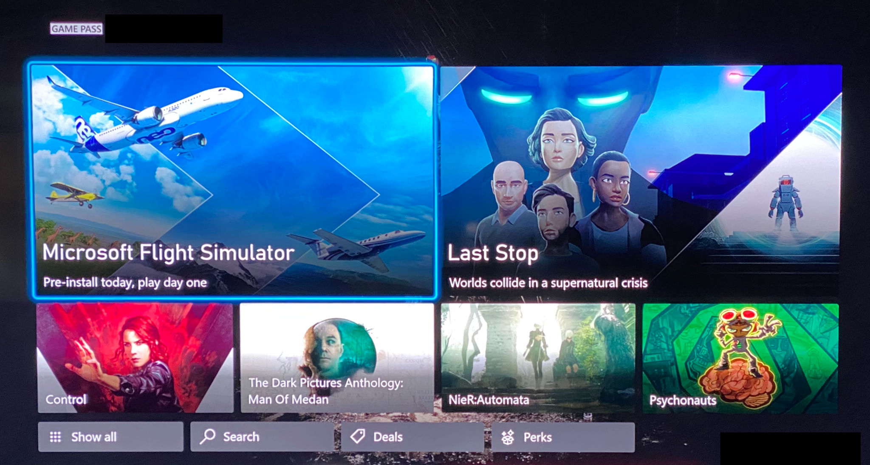
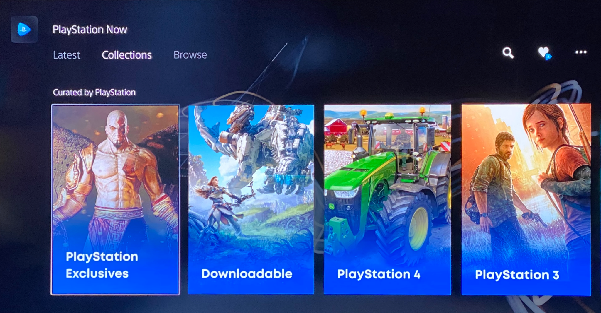
Platform
Online
© 2022, 2024 Jeannie Novak All rights reserved.
Credit: JN
Credit: JN
Caption: Downloadable games have seen a dramatic rise in popularity, with the help of subscription services such as Xbox Game Pass - left - and PlayStation Now - right.

Slide 9
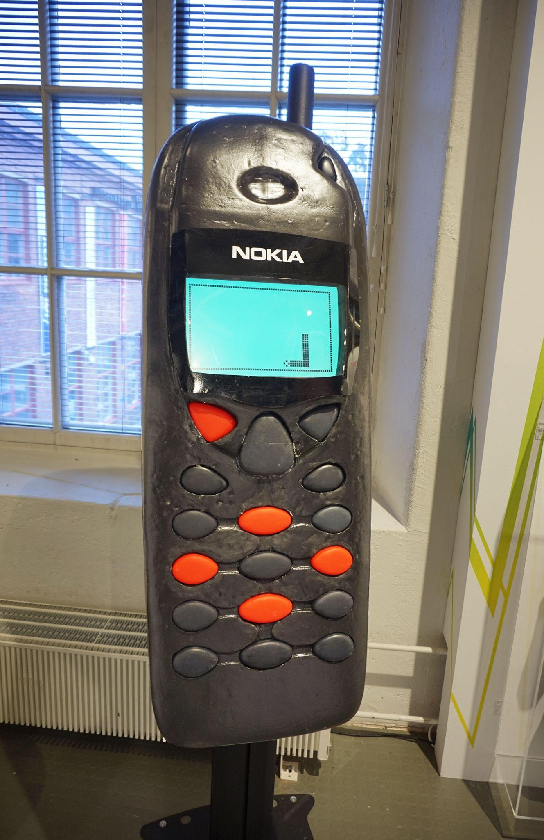
Platform
Mobile
© 2022, 2024 Jeannie Novak All rights reserved.
Credit: Tiia Monto (Wikimedia Commons)
Caption: Snake displayed on a Nokia mobile phone replica at the Finnish Museum of Games.

Slide 10
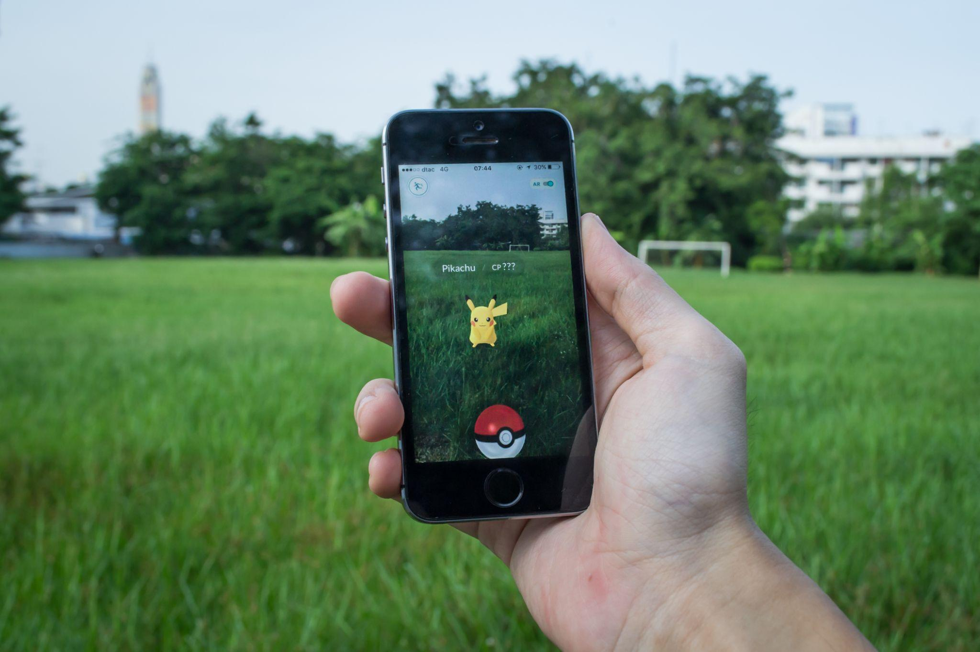
Platform
Immersive
© 2022, 2024 Jeannie Novak All rights reserved.
Credit: Wachiwit (Shutterstock)
Caption: Pokémon GO took full advantage of augmented reality—and introduced the concept to the masses (iPhone 5s, shown).

Slide 11
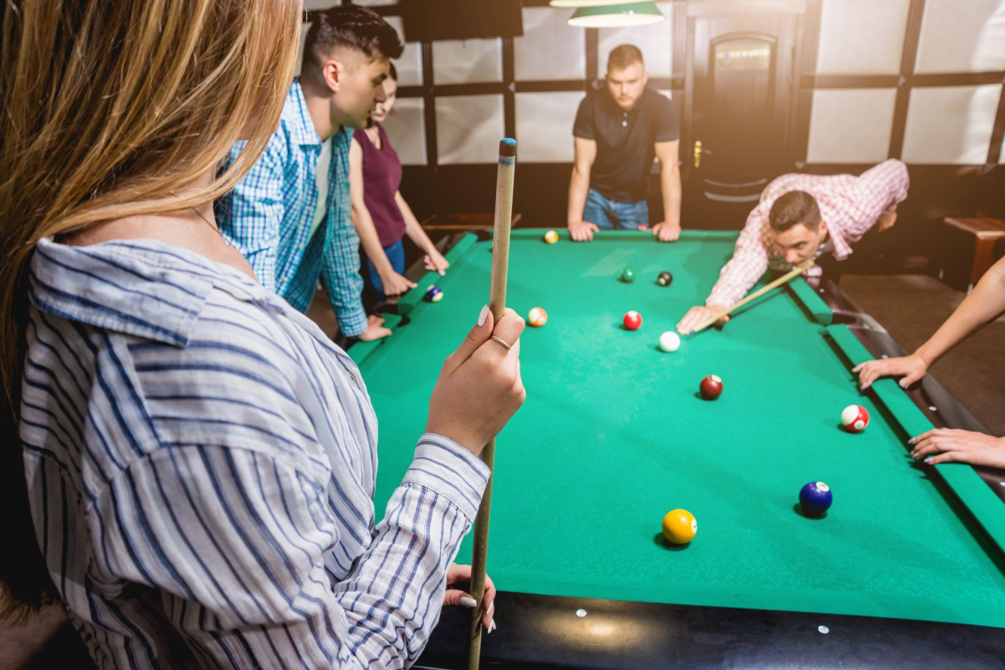
Time Interval Turn-Based & Real Time
© 2022, 2024 Jeannie Novak All rights reserved.
Credit: Roman Ziets (Shutterstock)
Credit: Sergey Nivens (Shutterstock)
Caption: Pool and billiards are classic turn-based games - while soccer is a real-time, team-based sport.

Slide 12
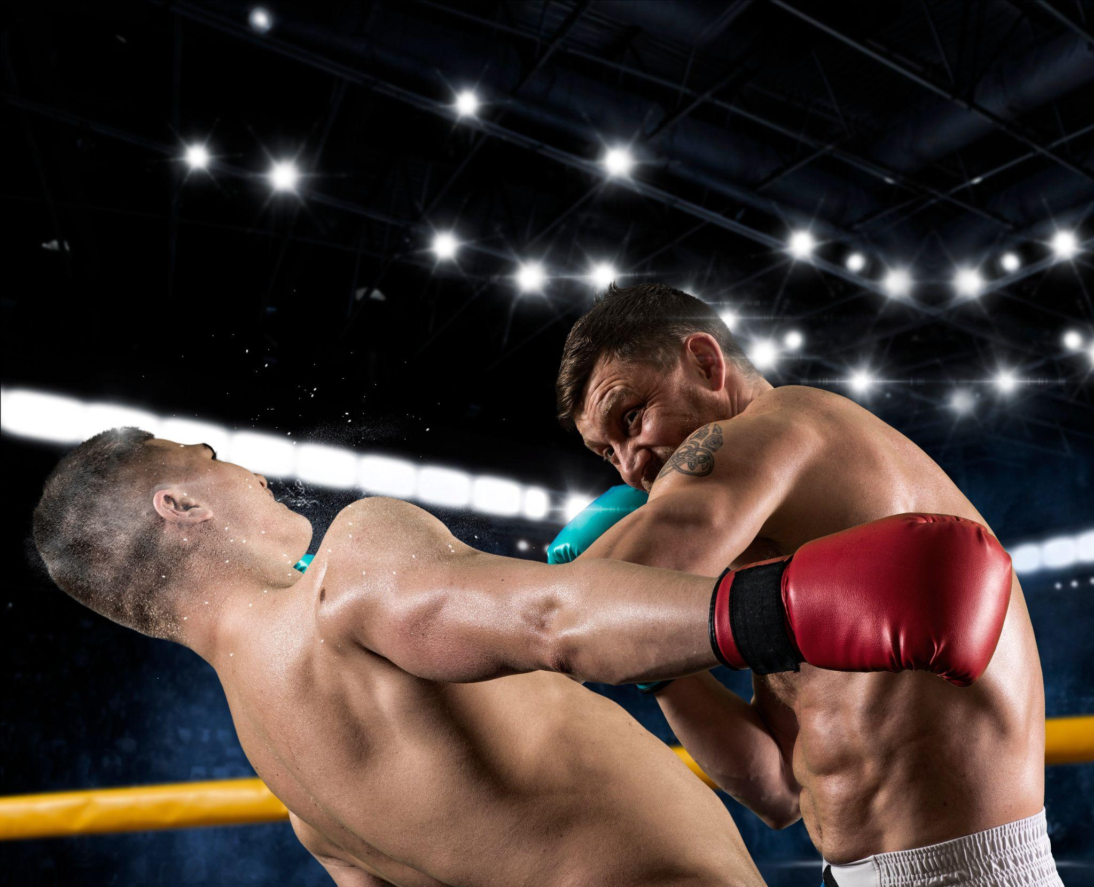
Time Interval
Time-Limited
© 2022, 2024 Jeannie Novak All rights reserved.
Credit: Andrey Burmakin (Shutterstock)
Credit: Wirestock (dreamstime)
Caption: Boxing is a time-limited, real-time sport—while timed chess is a time-limited, turn-based game.

Slide 13
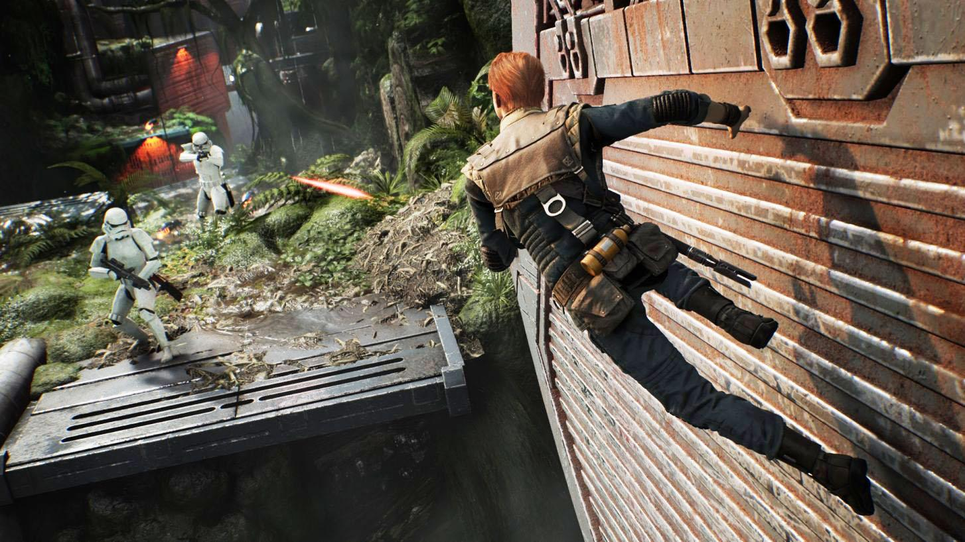
Player Mode
Single-Player
© 2022, 2024 Jeannie Novak All rights reserved.
Credit: Electronic Arts
Caption: Star Wars Jedi: Fallen Order is a modern single-player game.

Slide 14
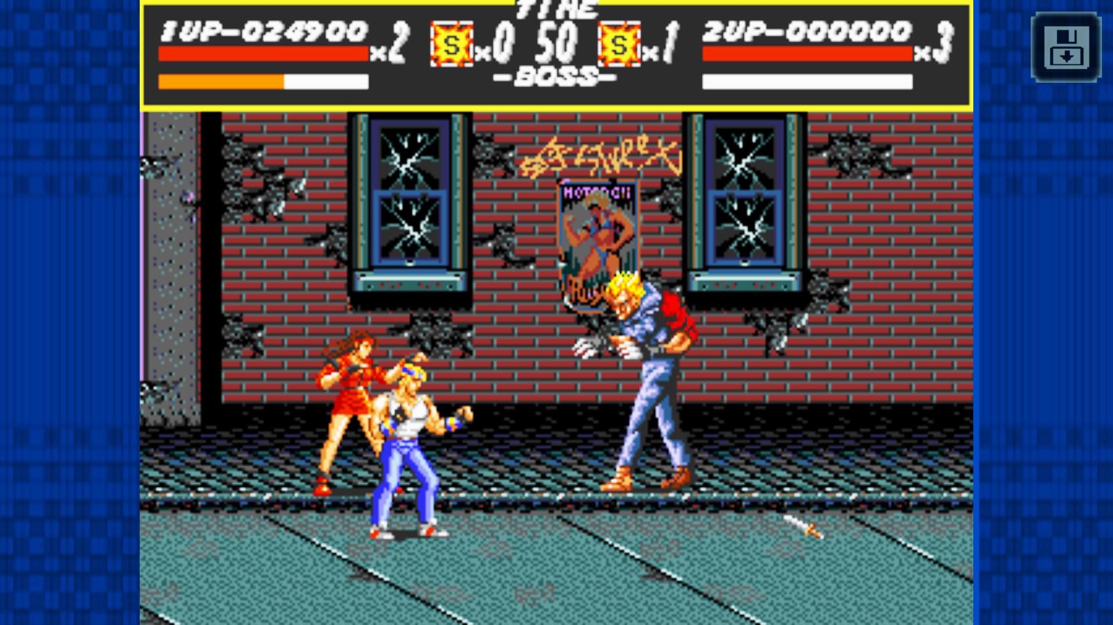
Player Mode
Two-Player
© 2022, 2024 Jeannie Novak All rights reserved.
Credit: Sega Corporation
Caption: In Streets of Rage, two players cooperatively defeat enemies simultaneously.

Slide 15
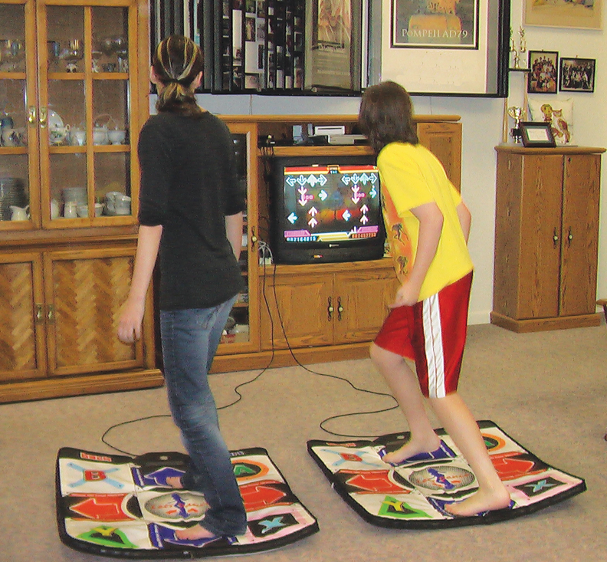
Player Mode
Local Multiplayer
© 2022, 2024 Jeannie Novak All rights reserved.
Credit: DL
Credit: Dragana Gordic (Shutterstock)
Caption: Players sharing the same screen and using separate input devices—such as footpads - left - and controllers - right.

Slide 16
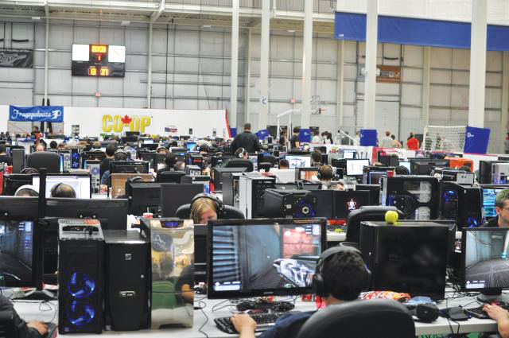
Player Mode
Online Multiplayer
© 2022, 2024 Jeannie Novak All rights reserved.
Credit: Fragapalooza
Caption: Fragapalooza is the longest-running and still one of the largest LAN parties in Canada.

Slide 17
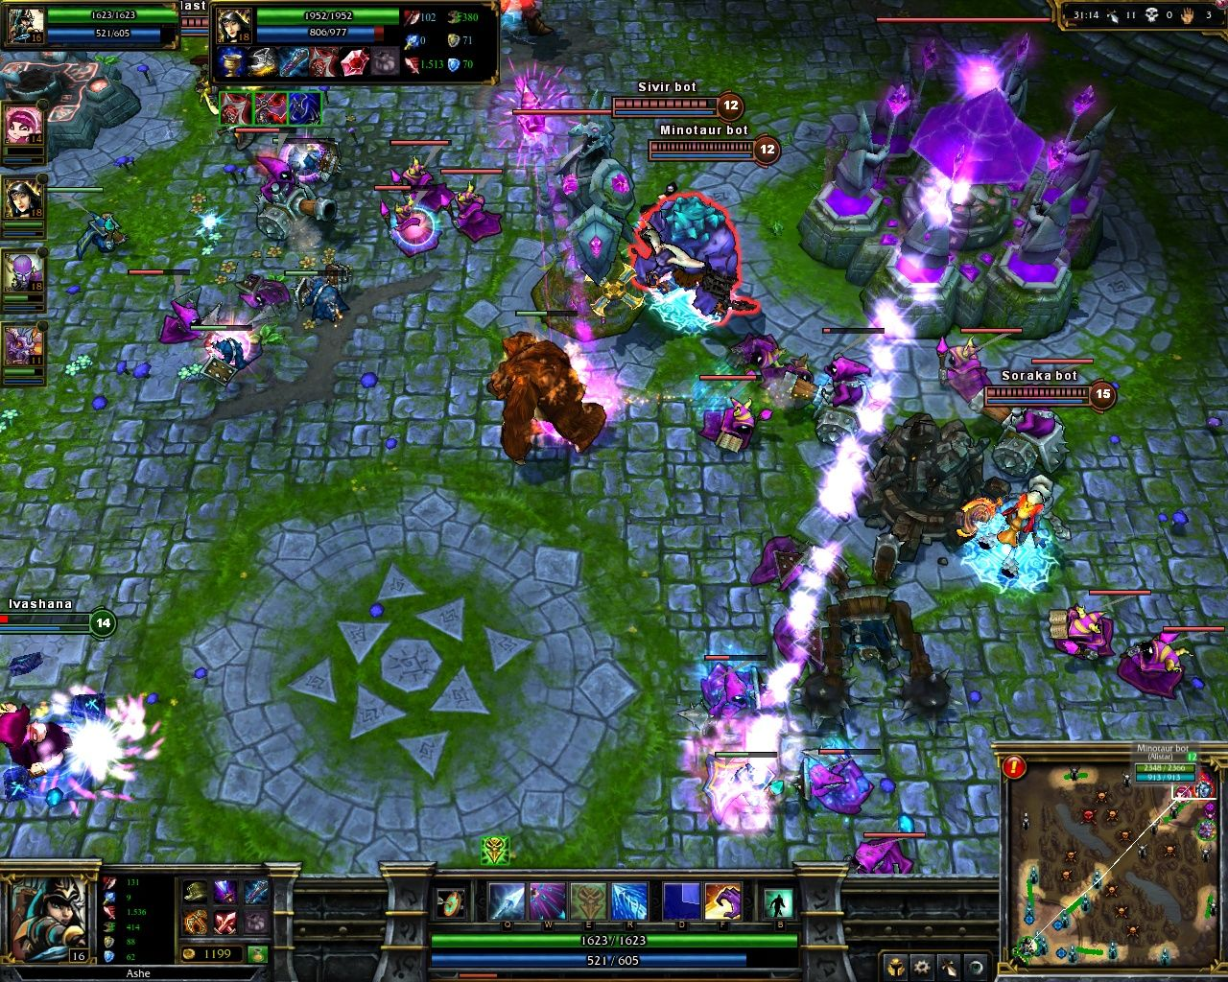
Player Mode
Online Multiplayer
© 2022, 2024 Jeannie Novak All rights reserved.
Credit: Sicarius (MobyGames)
Caption: Thousands of players interact while playing the online multiplayer game League of Legends.

Slide 18
CHAPTER 2
© 2022, 2024 Jeannie Novak All rights reserved.
REVIEW EXERCISES
What is your favorite game platform, and why? Choose a game that you enjoy playing on that platform and discuss how the platform enhances the playing experience. How would that experience change if the game was only available on a completely different platform?
1
Search on Steam and find a computer game that’s currently only available on PC. Choose two other platforms (arcade, console, mobile, immersive) and discuss how you would optimize the game for your chosen platforms.
2

Slide 19
CHAPTER 2
© 2022, 2024 Jeannie Novak All rights reserved.
REVIEW EXERCISES
3
Play a turn-based, asynchronous multiplayer mobile game. Choose another game that might benefit from these features, and discuss why.
Local multiplayer is common on console systems, but it can be awkward on computer systems. You’ve been asked to develop a local multiplayer game for PC. What type of game would you develop for this player mode, and why?
4

Slide 20
CHAPTER 2
© 2022, 2024 Jeannie Novak All rights reserved.
REVIEW EXERCISES
5
Find a game on any platform that’s strictly couch co-op. Create two additional player modes for the game: online multiplayer, and single-player. Discuss what features you would need to alter for each mode, and why.
6
Find a game that utilizes a particular time interval (turn-based, real-time or time-limited)—and discuss how you would change the game so that it utilizes a different time interval.

Slide 21
CHAPTER 2
© 2022, 2024 Jeannie Novak All rights reserved.
REVIEW EXERCISES
Come up with an idea for an online multiplayer game that incorporates competition and cooperation—either separately or together. Discuss which time interval you would use—and whether your game would involve team-based play or not.
7
How do platform, time interval, and player mode affect the playing experience? You learned in this chapter that the chess tabletop game isn’t always merely a turn-based game—but it has a time-limited version. Imagine what chess would be like if it were played in real time. Now change the player mode to multiplayer. How would the experience of playing chess change if it was a real-time, multiplayer game? Come up with a variation of one of your favorite games by tweaking the time interval and player mode.
8

