Slide 2
CHAPTER 1
HISTORICAL ELEMENTS HOW DID WE GET HERE?
© 2022, 2024 Jeannie Novak
All rights reserved.

Slide 3
CHAPTER OBJECTIVES
© 2022, 2024 Jeannie Novak
All rights reserved.
After reading this chapter, you should be able to:
Point out the significant milestones in the history of game development.
Discuss game development pioneers and their contributions to the industry.
Track the game industry’s evolution from coin-operated electromechanical and mainframe computer games of the 1960s to the many segments of today.
Identify the factors that contributed to the video game slump of the early 1980s in the United States.
Understand why certain game companies and titles were more successful than others during game development history.

Slide 4
Before the Arcades
© 2022, 2024 Jeannie Novak
All rights reserved.
Credit: The United States National Archives
Credit: John Phelan (Wikimedia Commons)
Caption: The first electronic games were played at military bases such as the Miramar Naval Air Station - left - and at academic institutions such as the Massachusetts Institute of Technology - right.

Slide 5
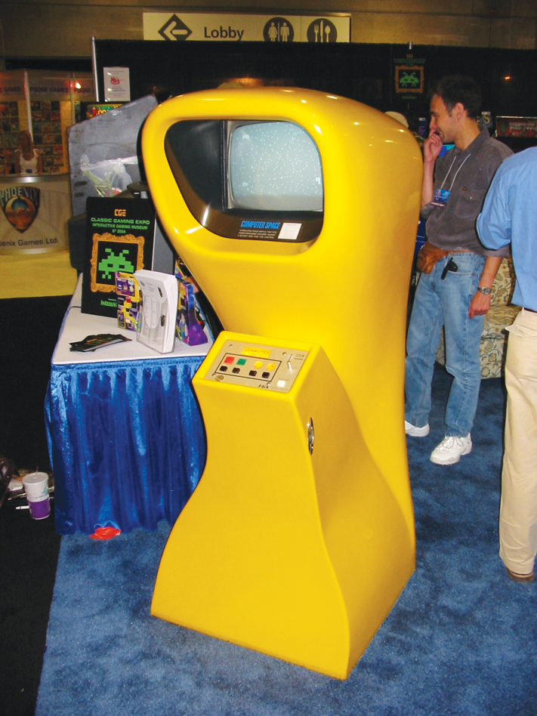
The Arcade Phenomenon
Computer Space
© 2022, 2024 Jeannie Novak
All rights reserved.
Credit: JN

Slide 6
The Arcade Phenomenon
Pong
© 2022, 2024 Jeannie Novak
All rights reserved.
Credit: stabel (MobyGames)
Caption: Pong - the first successful arcade game.

Slide 7
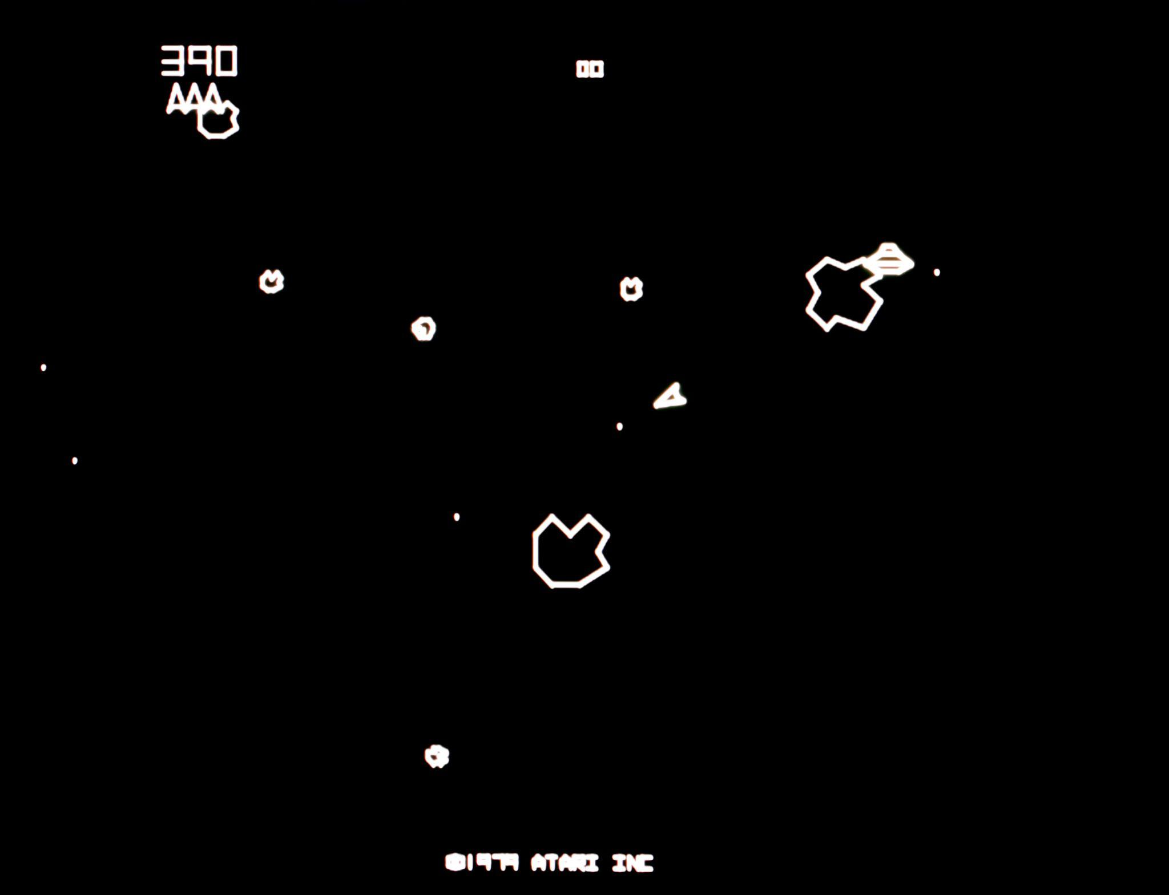
The Arcade Phenomenon
Asteroids
© 2022, 2024 Jeannie Novak
All rights reserved.
Credit: ArcadeImages (Alamy Stock Photo)

Slide 8
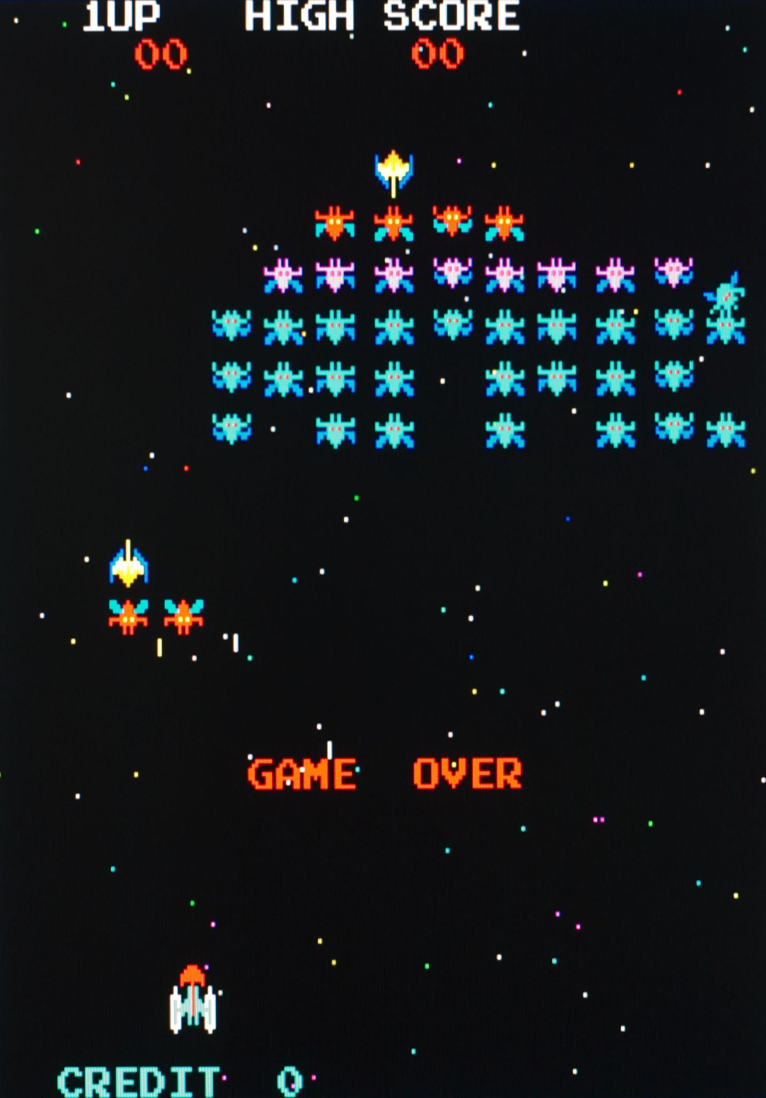
The Arcade Phenomenon
Galaxian
© 2022, 2024 Jeannie Novak
All rights reserved.
Credit: ArcadeImages (Alamy Stock Photo)

Slide 9
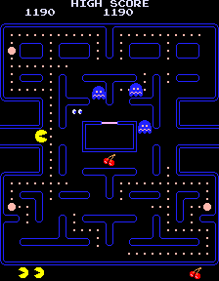
The Arcade Phenomenon
Pac-Man
© 2022, 2024 Jeannie Novak
All rights reserved.
Credit: 666gonzo666 (MobyGames)
Caption: Pac-Man is one of the most popular arcade games of all time.

Slide 10
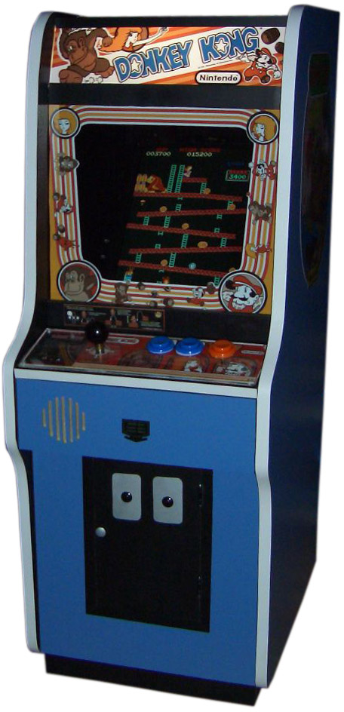
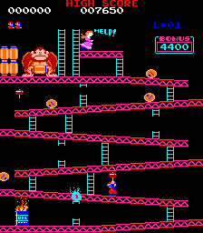
The Arcade Phenomenon
Donkey Kong
© 2022, 2024 Jeannie Novak
All rights reserved.
Credit: Joshua Driggs/ZapWizard photo | bayo & Shooke background (Wikimedia Commons)
Credit: Игги Друге (MobyGames)
Caption: Donkey Kong kicked off a successful franchise that’s still wildly popular to this day (arcade cabinet - left - screenshot - right).

Slide 11
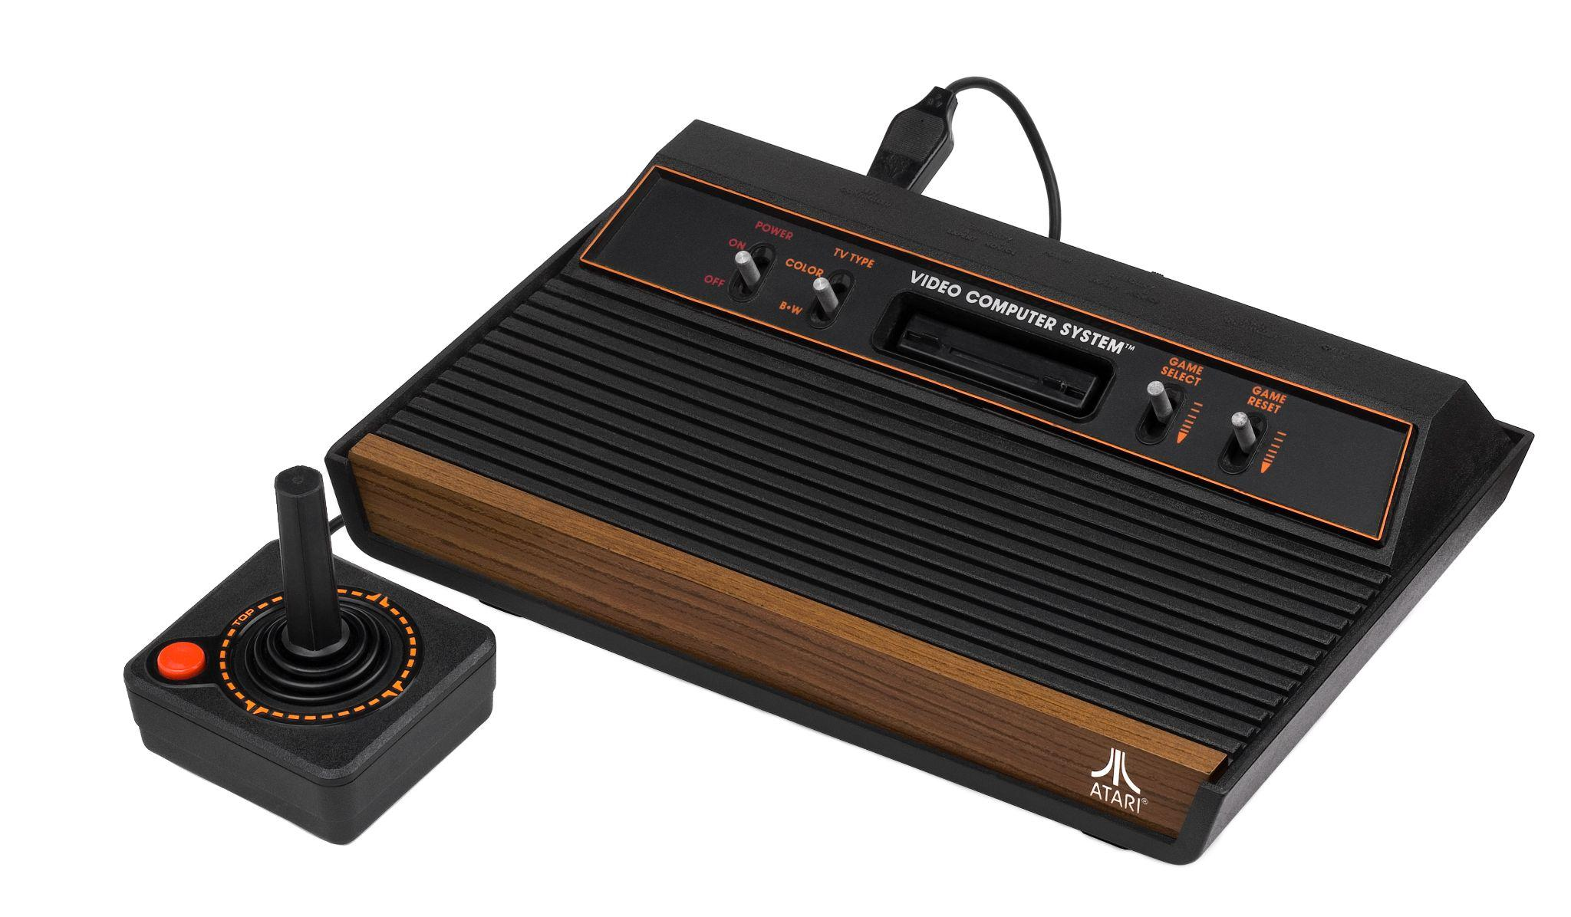
The Birth of Console Games
Atari VCS/2600
© 2022, 2024 Jeannie Novak
All rights reserved.
Credit: Evan Amos (Wikimedia Commons)
Caption: The Atari VCS/2600 successfully launched the home game console industry.

Slide 12
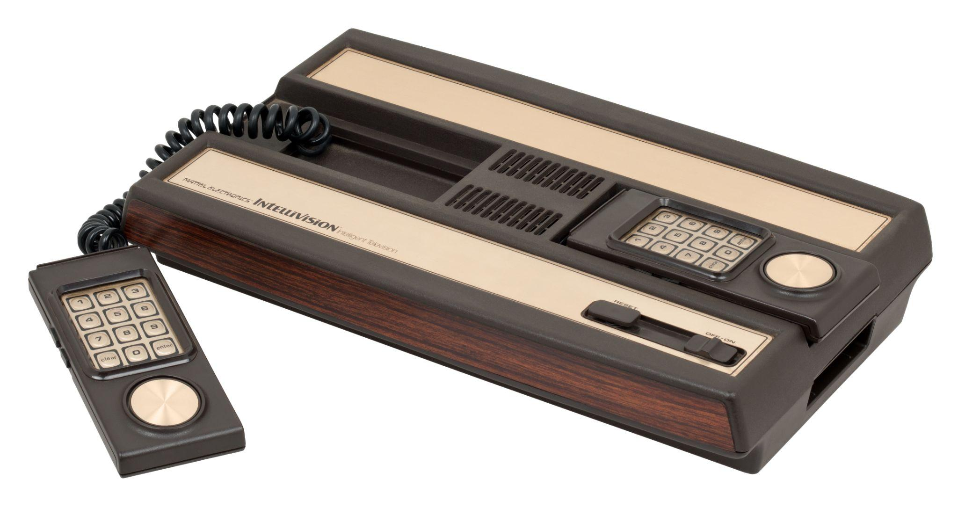
The Birth of Console Games
Mattel Intellivision
© 2022, 2024 Jeannie Novak
All rights reserved.
Credit: Evan Amos (Wikimedia Commons)
Caption: Mattel’s Intellivision game console used a keypad and movement disc instead of a joystick.

Slide 13
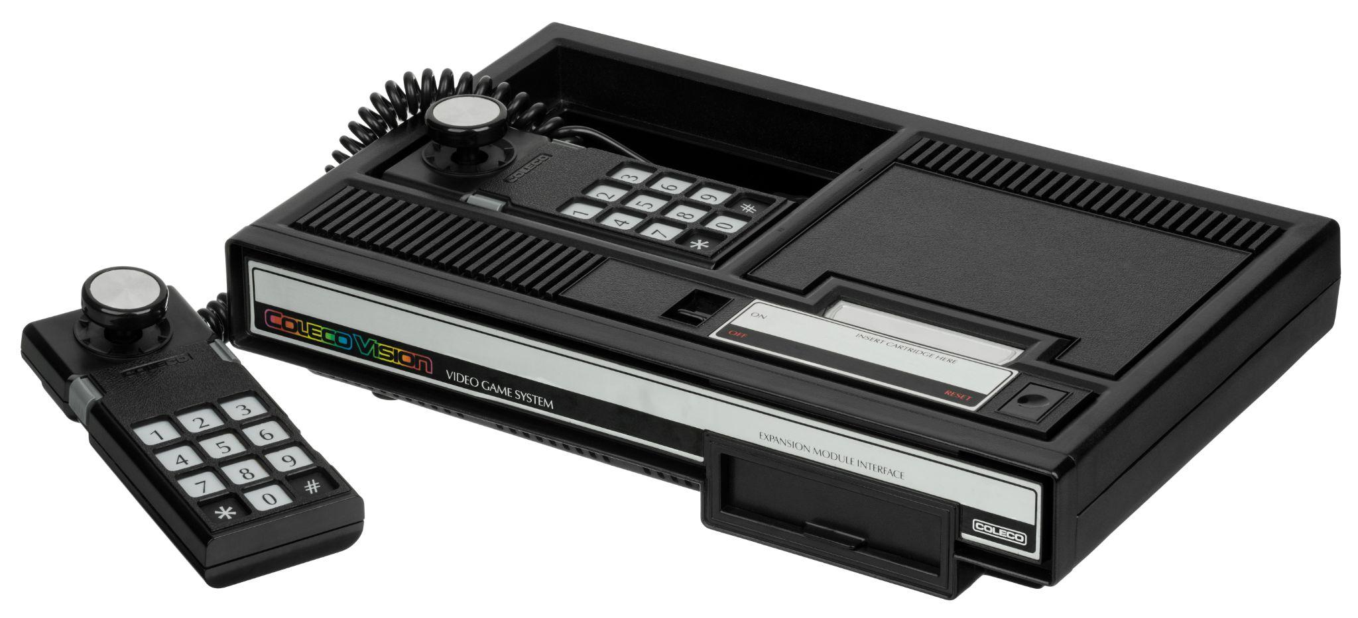
The Birth of Console Games
ColecoVision
© 2022, 2024 Jeannie Novak
All rights reserved.
Credit: Evan Amos (Wikimedia Commons)
Caption: Coleco’s ColecoVision blended the best of the VCS/2600 and Intellivision console systems.

Slide 14
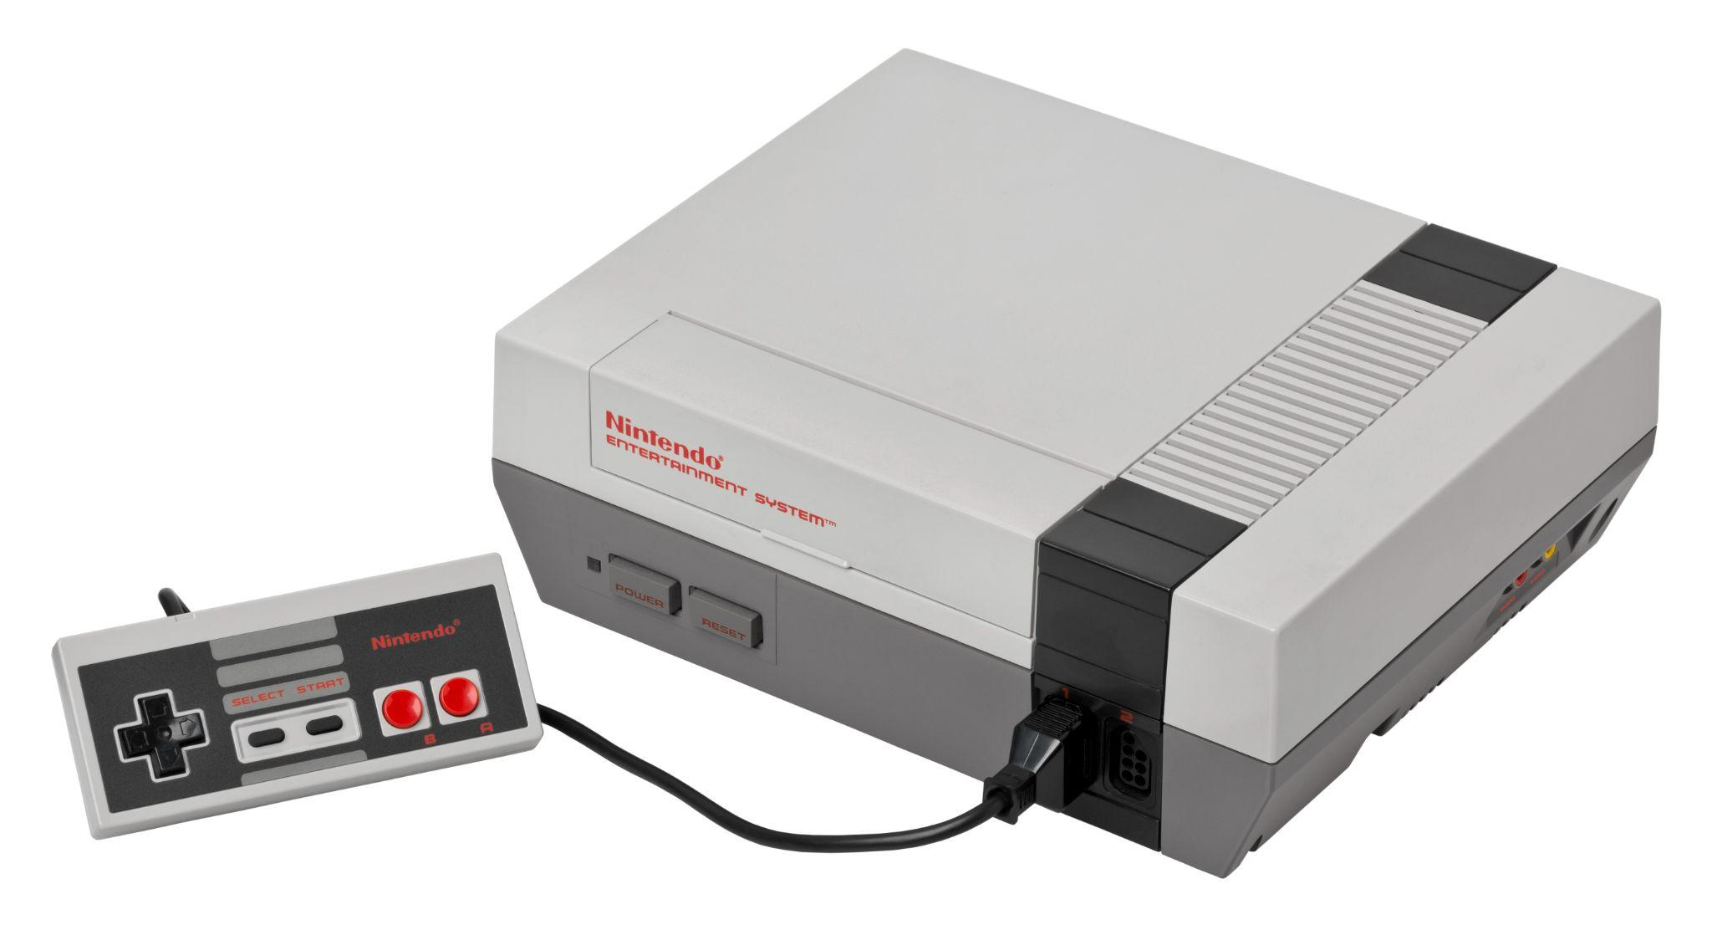
The US Industry Slump & A New Golden Age
Nintendo Changes the Game
© 2022, 2024 Jeannie Novak
All rights reserved.
Credit: Evan Amos (Wikimedia Commons)
Caption: The Nintendo Entertainment System (NES) revolutionized the console industry.

Slide 15
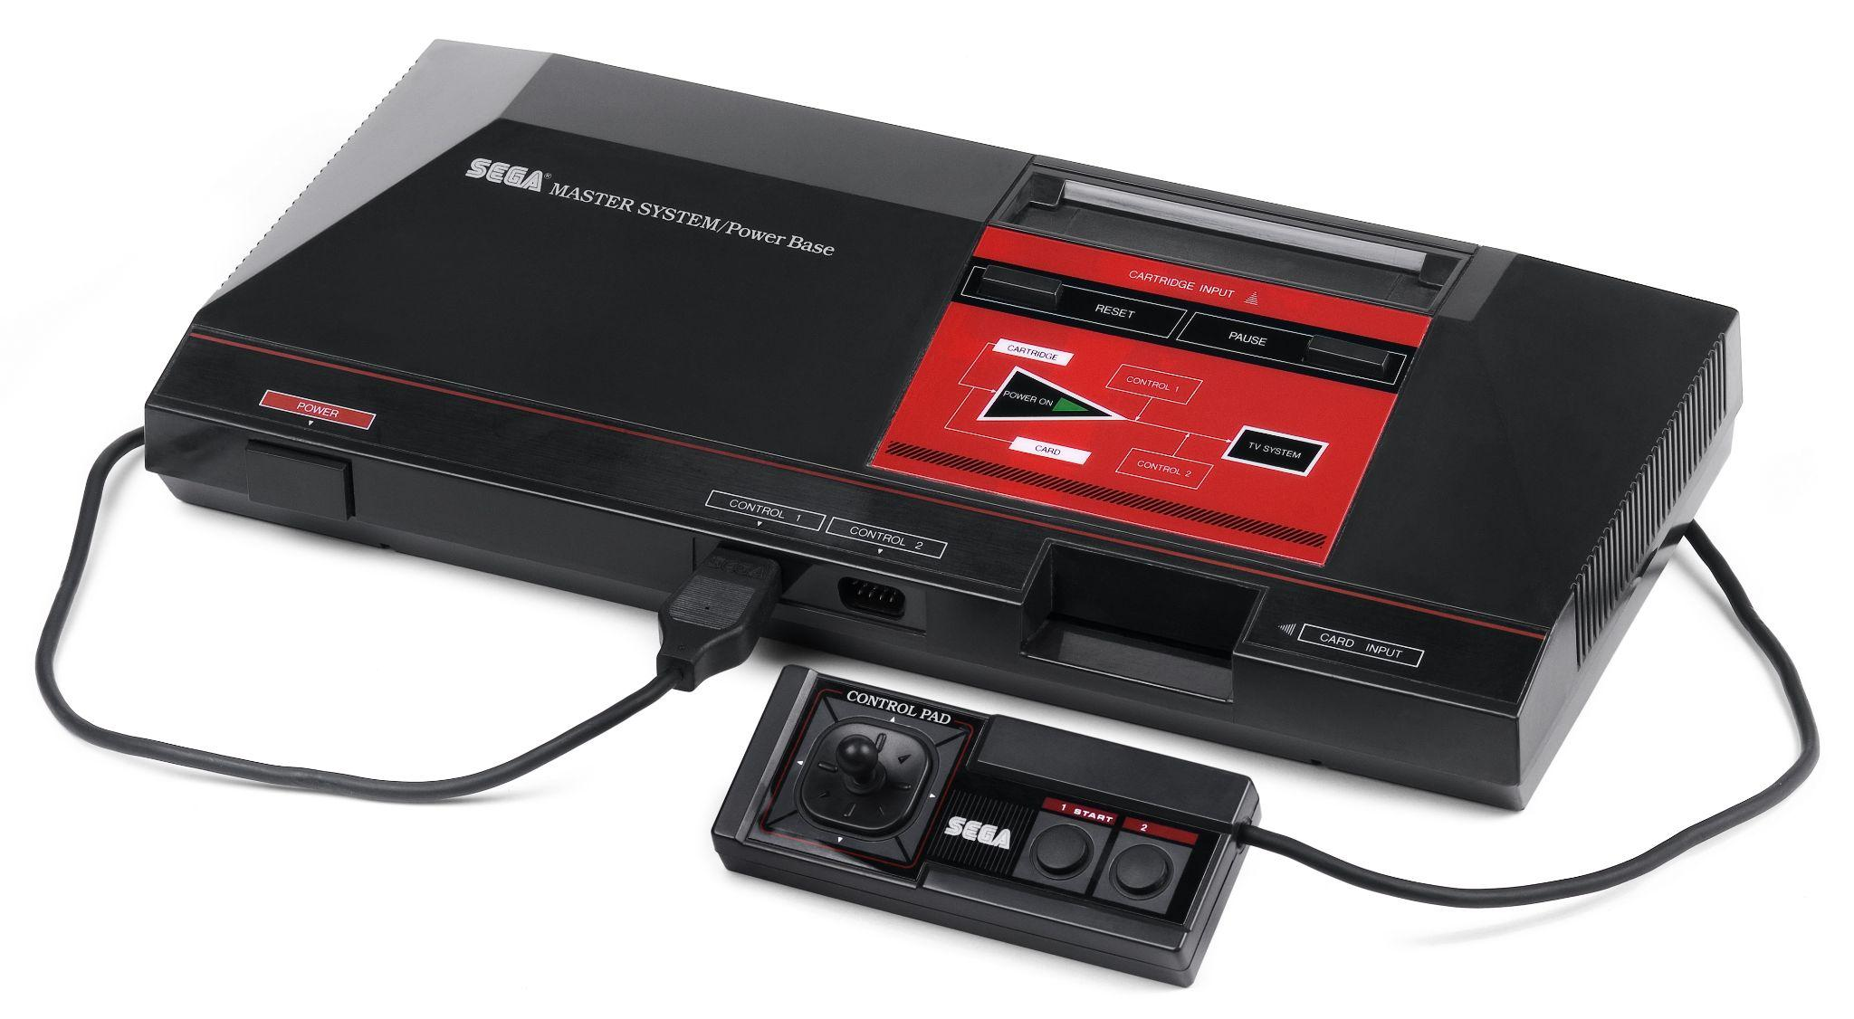
The U.S. Industry “Slump” & A New Golden Age
Sega & Sony Enter the Fray
© 2022, 2024 Jeannie Novak
All rights reserved.
Credit: Evan Amos (Wikimedia Commons)
Caption: The Sega Master System (SMS) was Sega’s first notable entry into the console market.

Slide 16
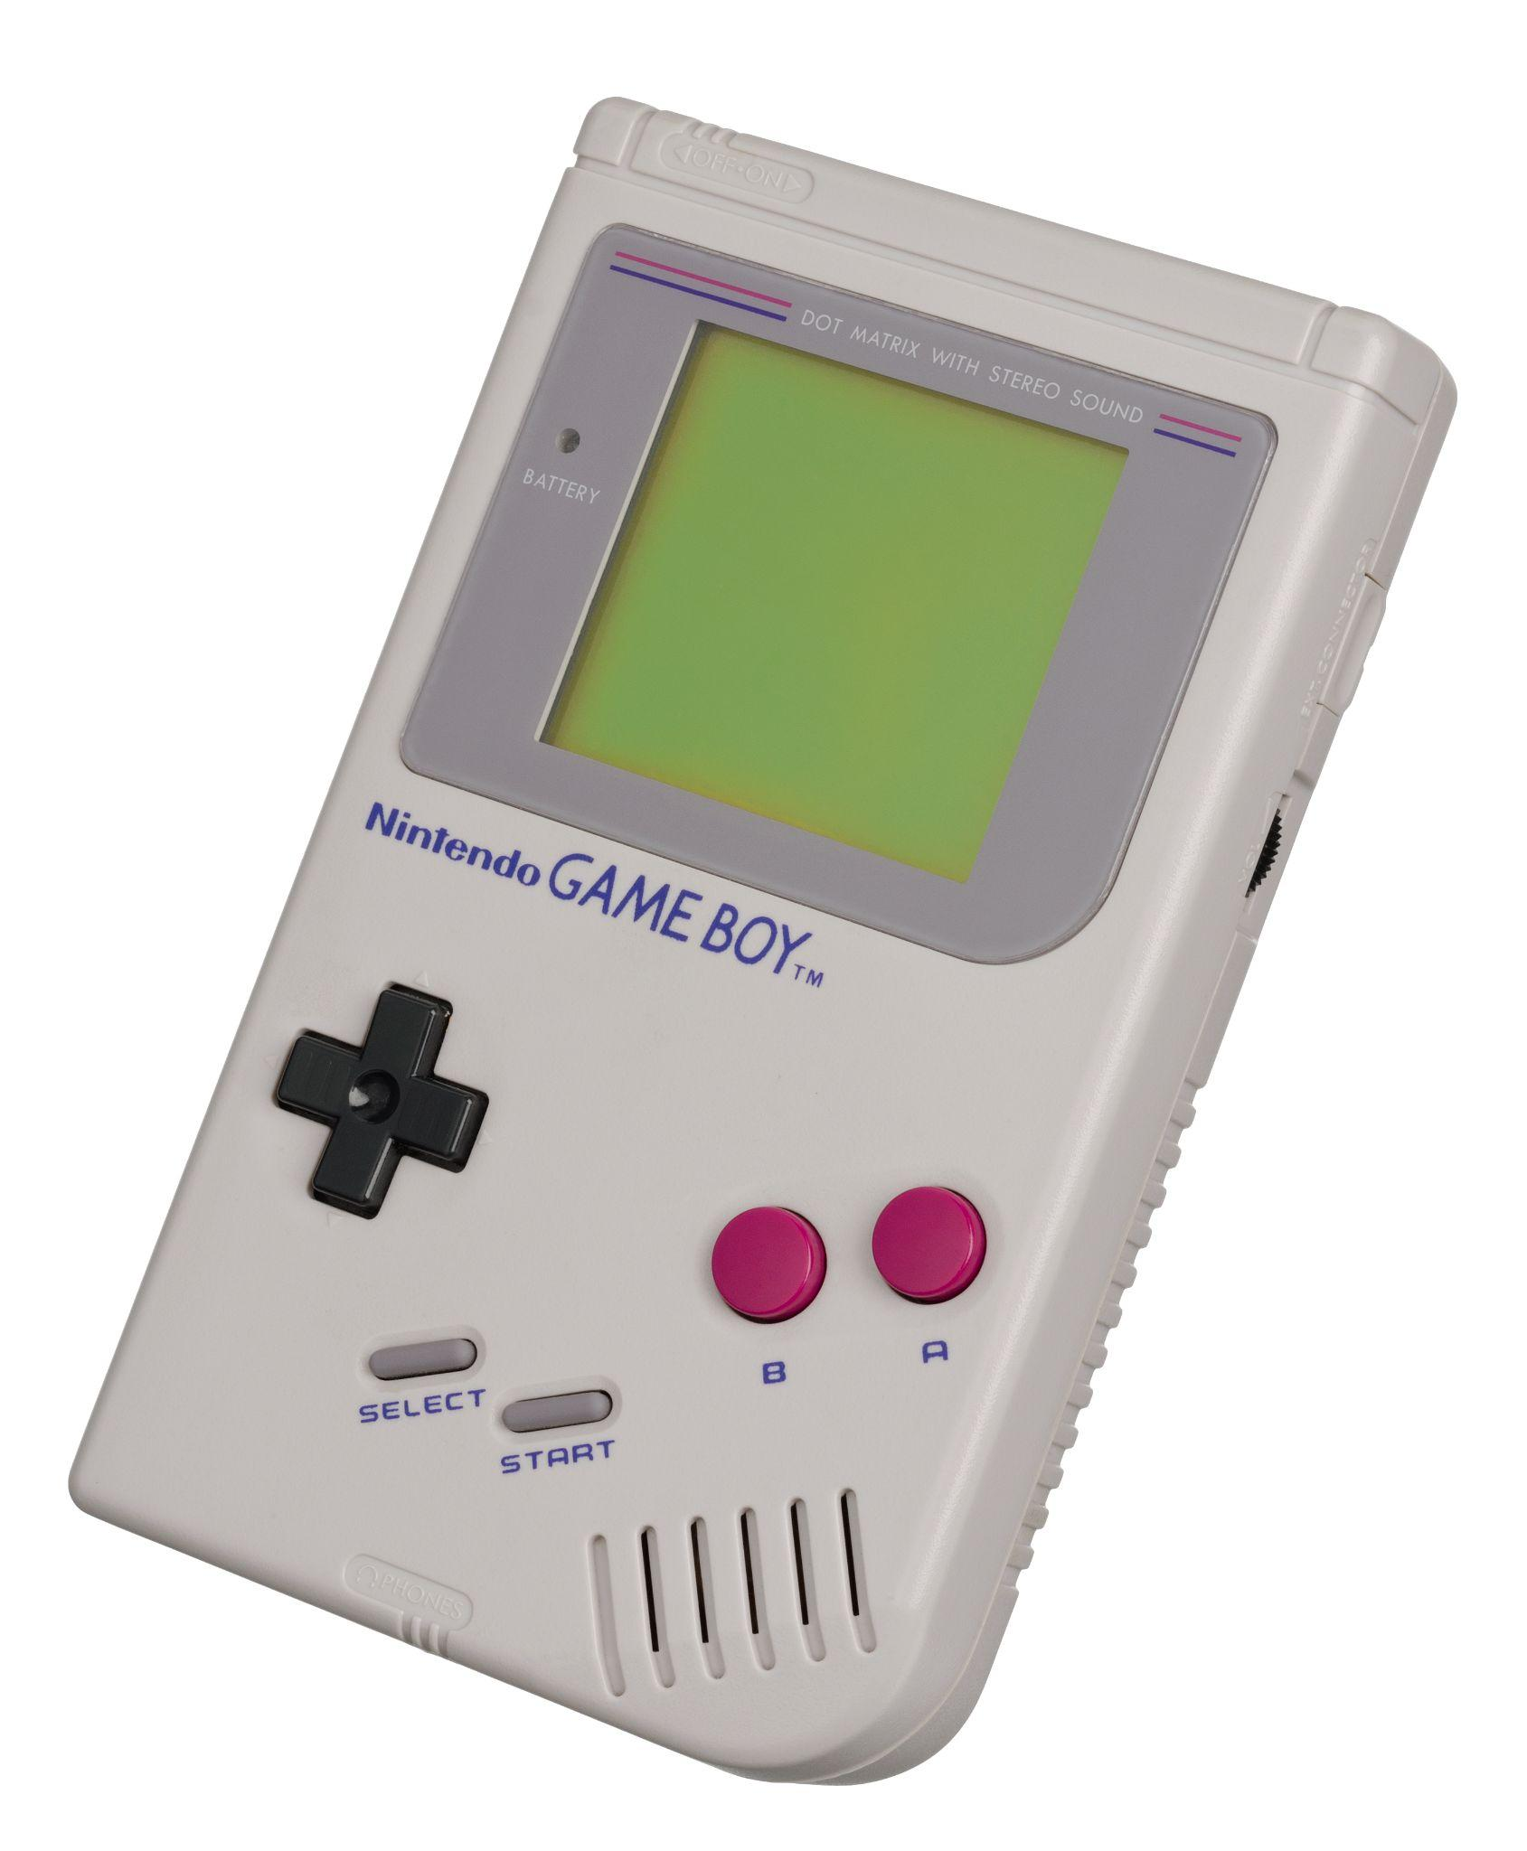
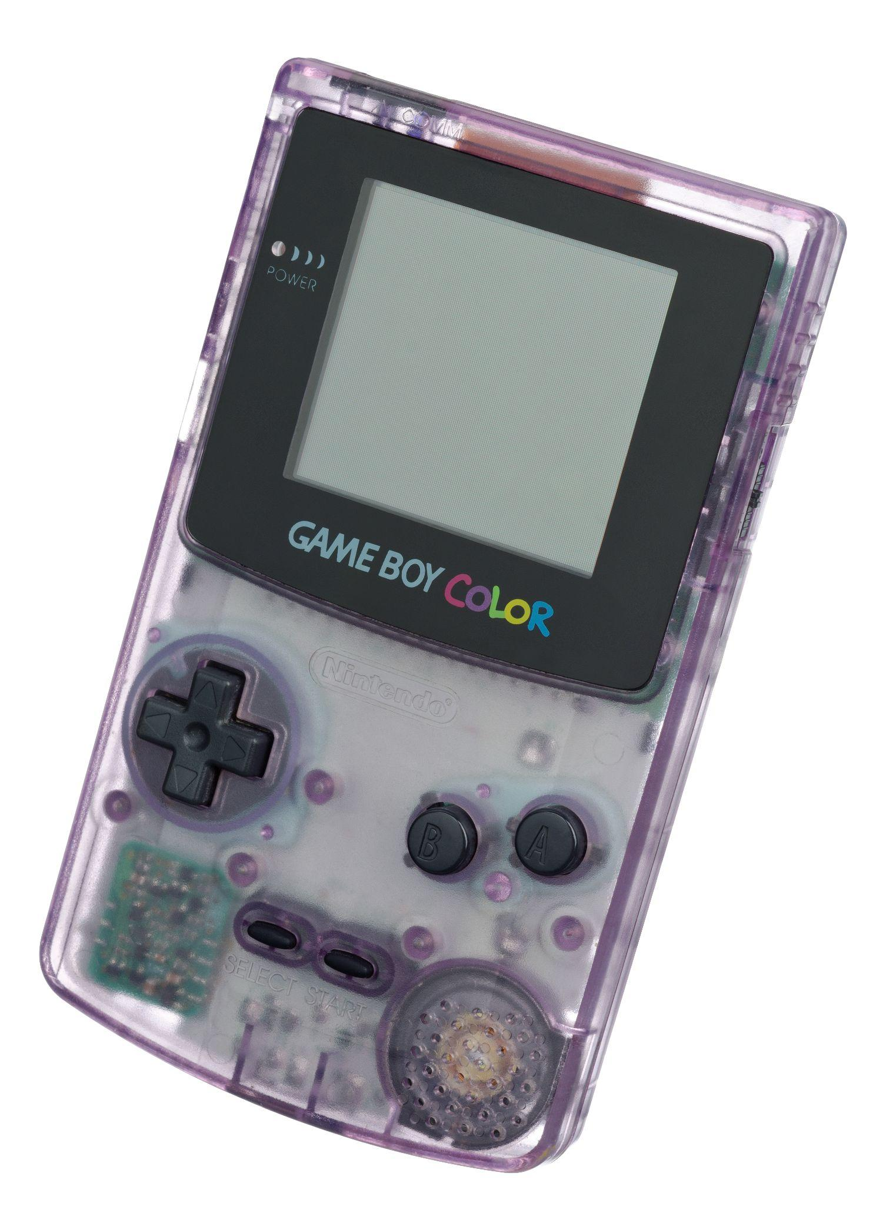
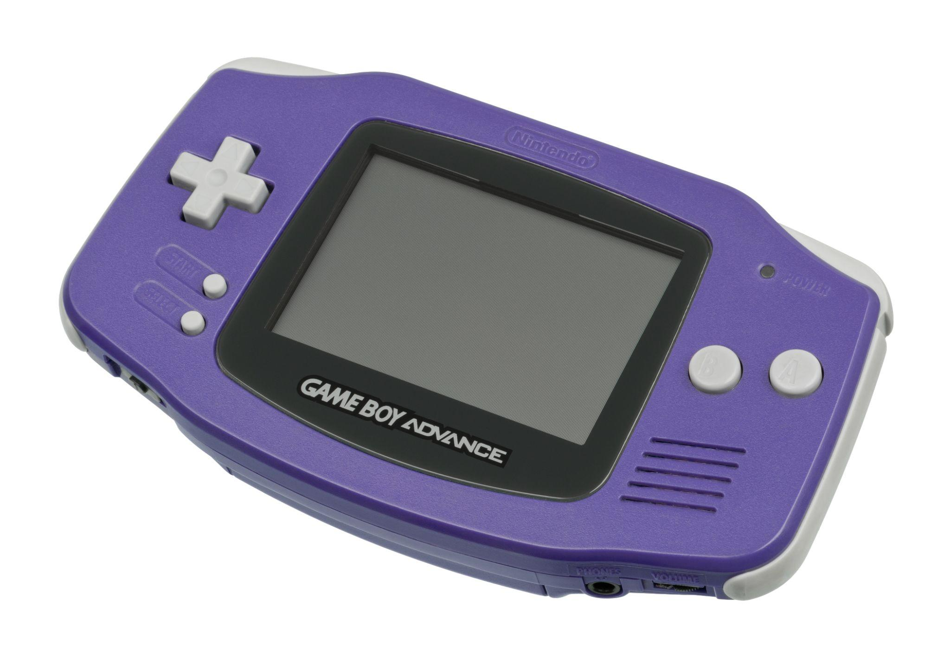
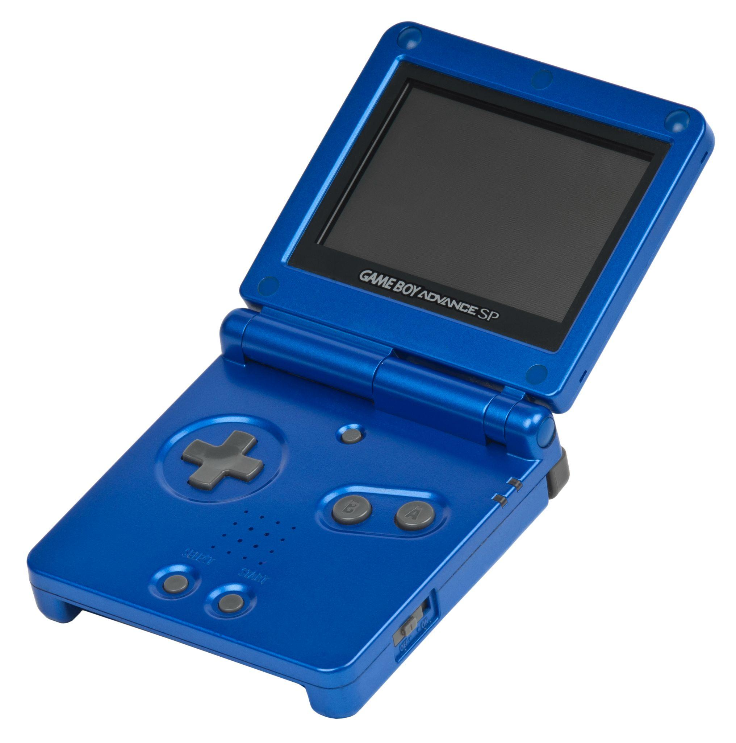
The U.S. Industry “Slump” & A New Golden Age
Handhelds Come of Age
© 2022, 2024 Jeannie Novak
All rights reserved.
Credit: Evan Amos (Wikimedia Commons)
Credit: Evan Amos (Wikimedia Commons)
Credit: Evan Amos (Wikimedia Commons)
Credit: Evan Amos (Wikimedia Commons)
Caption: Nintendo’s Game Boy - left - followed by the Game Boy Color - center-left - Game Boy Advance - center-right - and Game Boy Advance SP - right - kicked off a new era of portable gaming.

Slide 17
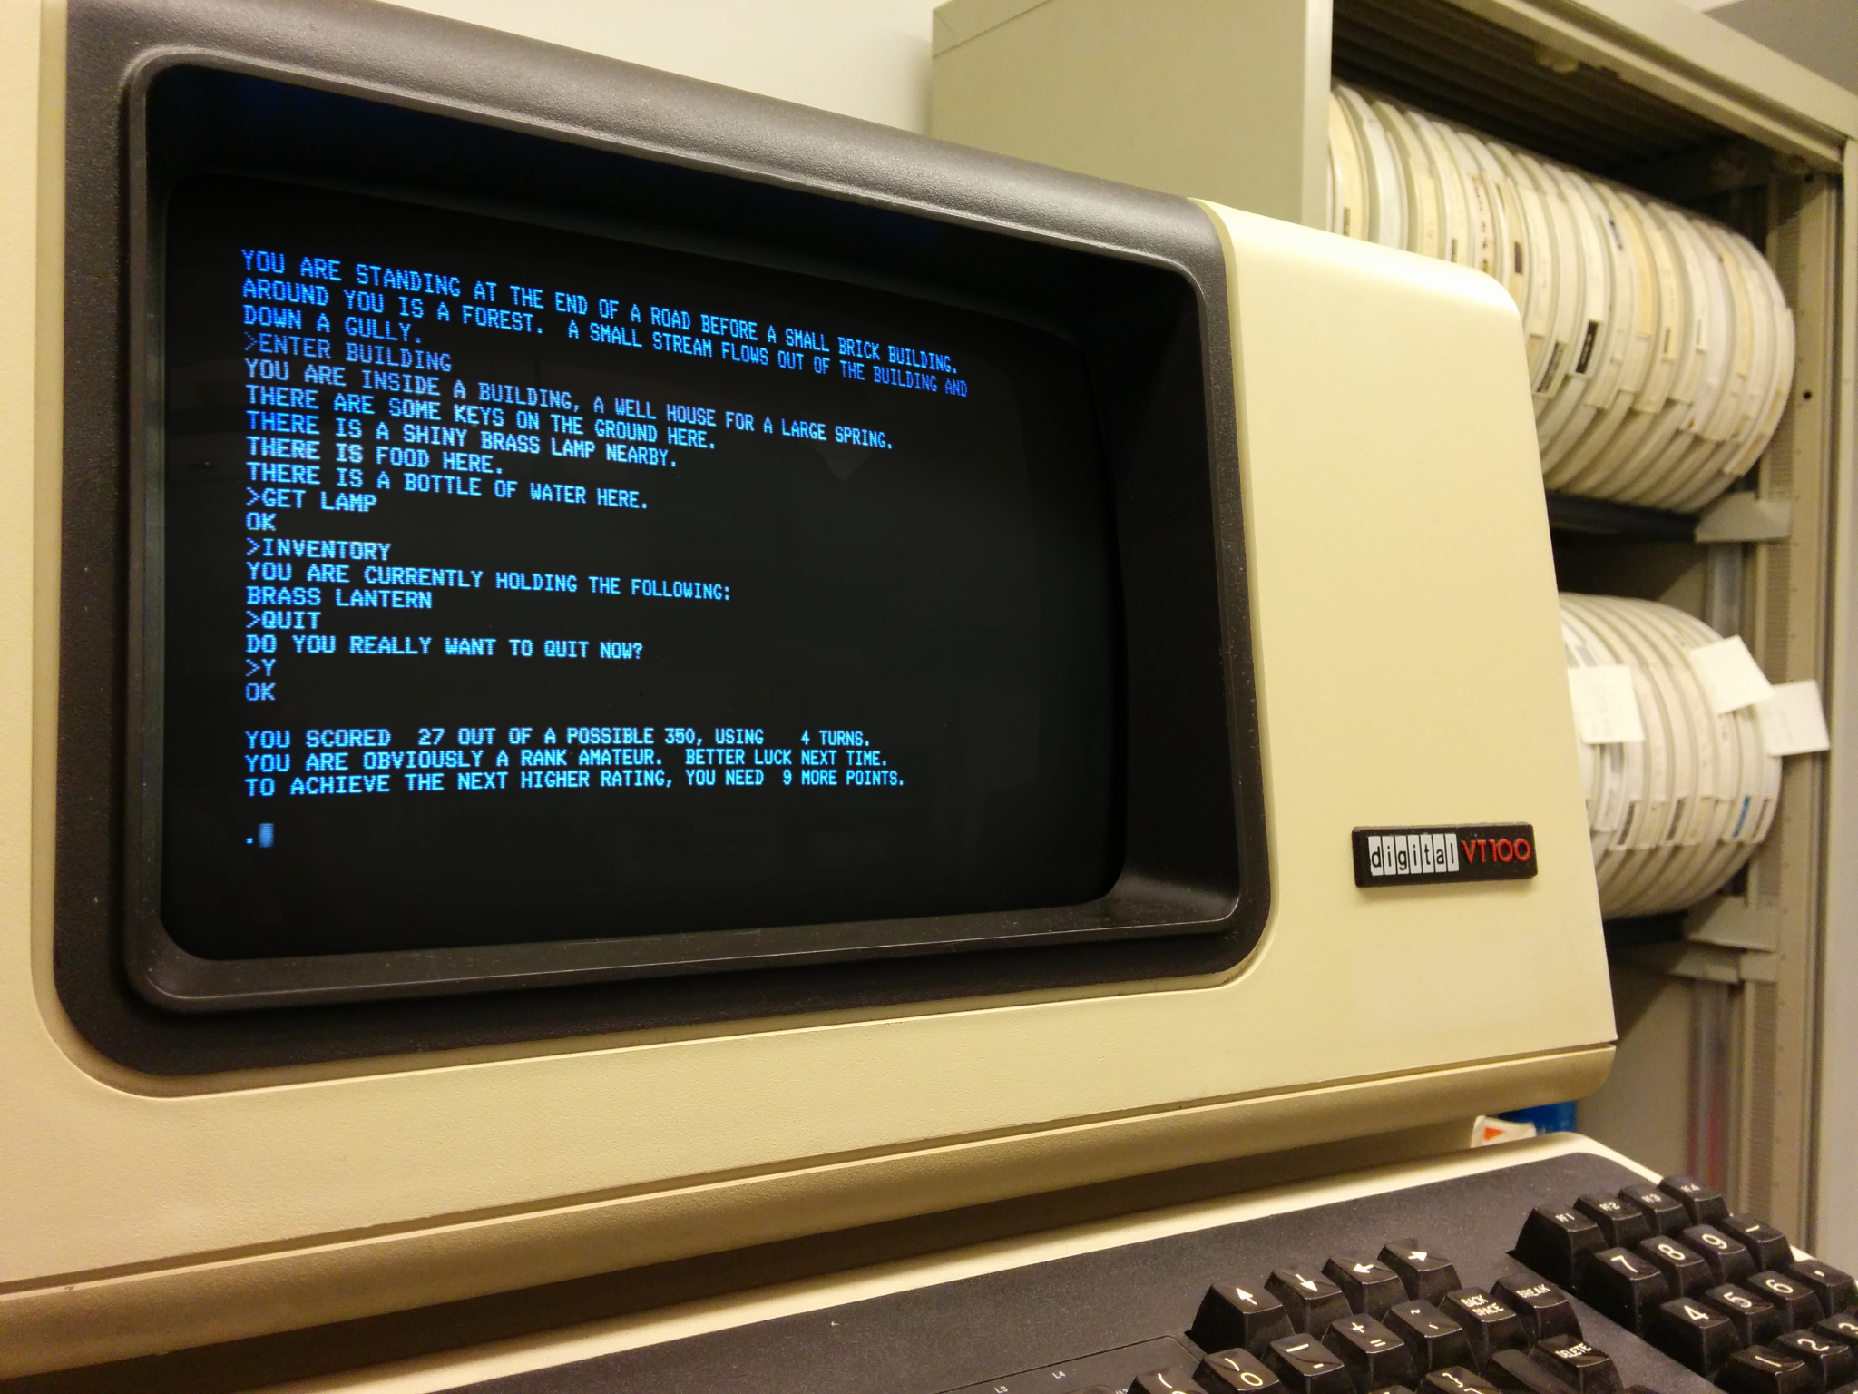
The Personal Computer Revolution
Mainframes & Text Adventures
© 2022, 2024 Jeannie Novak
All rights reserved.
Credit: Autopilot (Wikimedia Commons) - modified by Justin Sadur

Slide 18
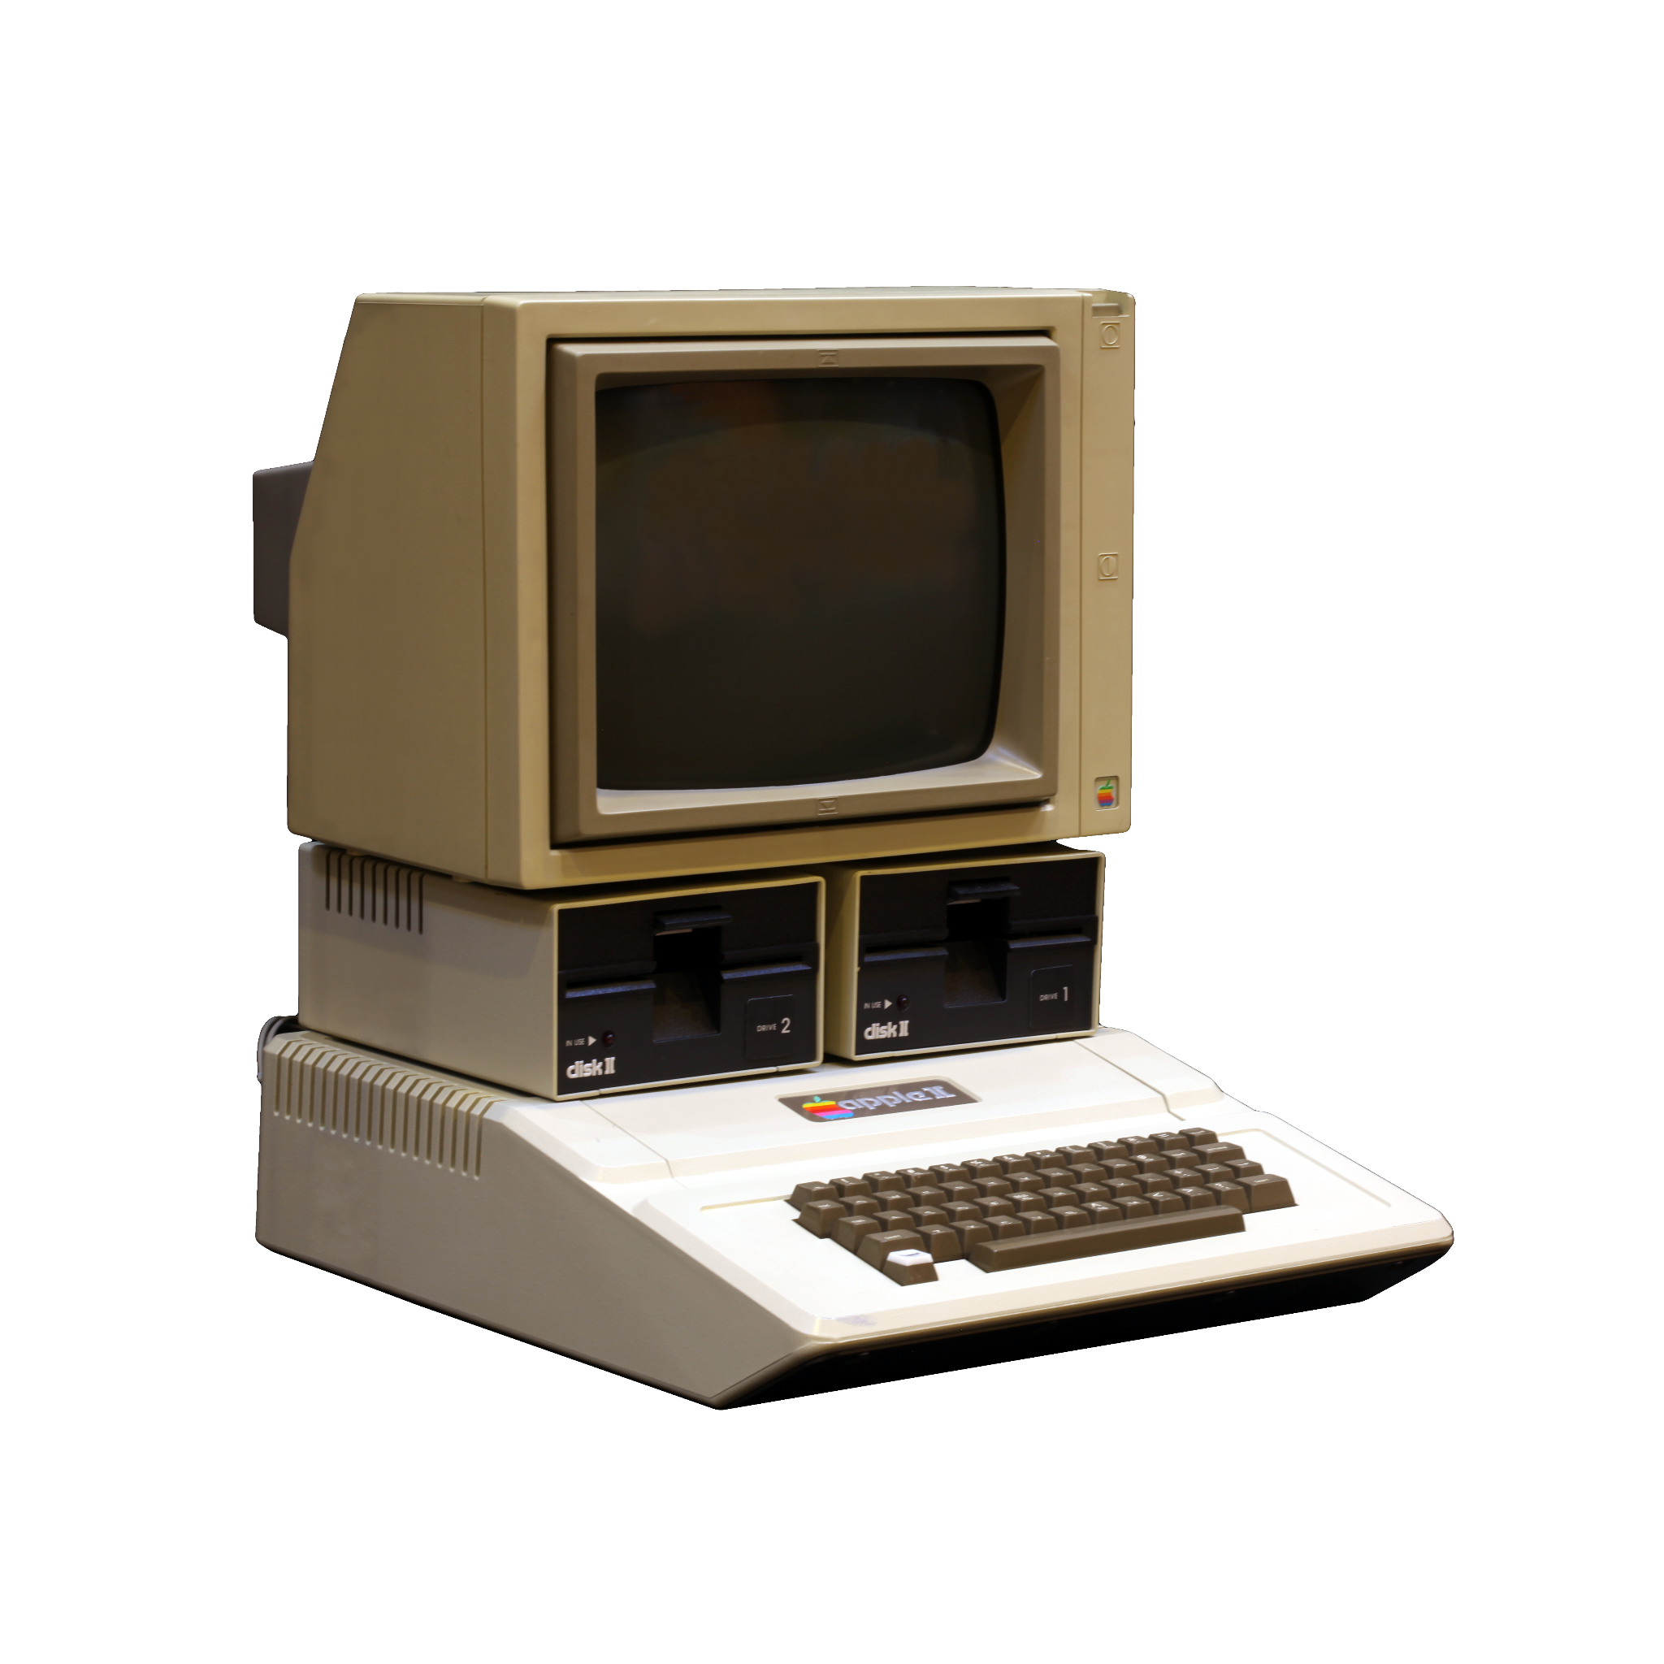
The Personal Computer Revolution
Apple II
© 2022, 2024 Jeannie Novak
All rights reserved.
Credit: Rama (Wikimedia Commons)
Caption: The first home computer games were played on the Apple II.

Slide 19
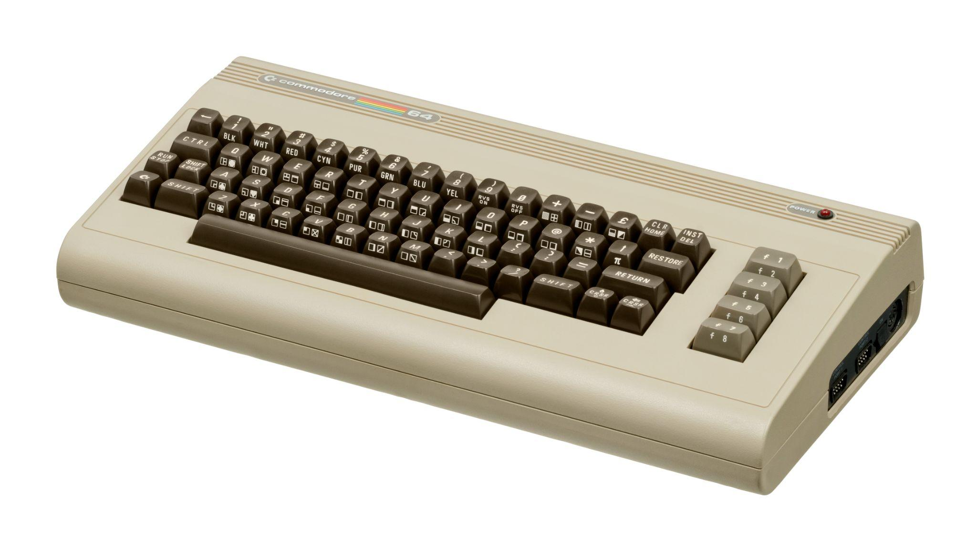
The Personal Computer Revolution
Commodore 64
© 2022, 2024 Jeannie Novak
All rights reserved.
Credit: Evan Amos (Wikimedia Commons)
Caption: The Commodore 64 made personal computing affordable.

Slide 20
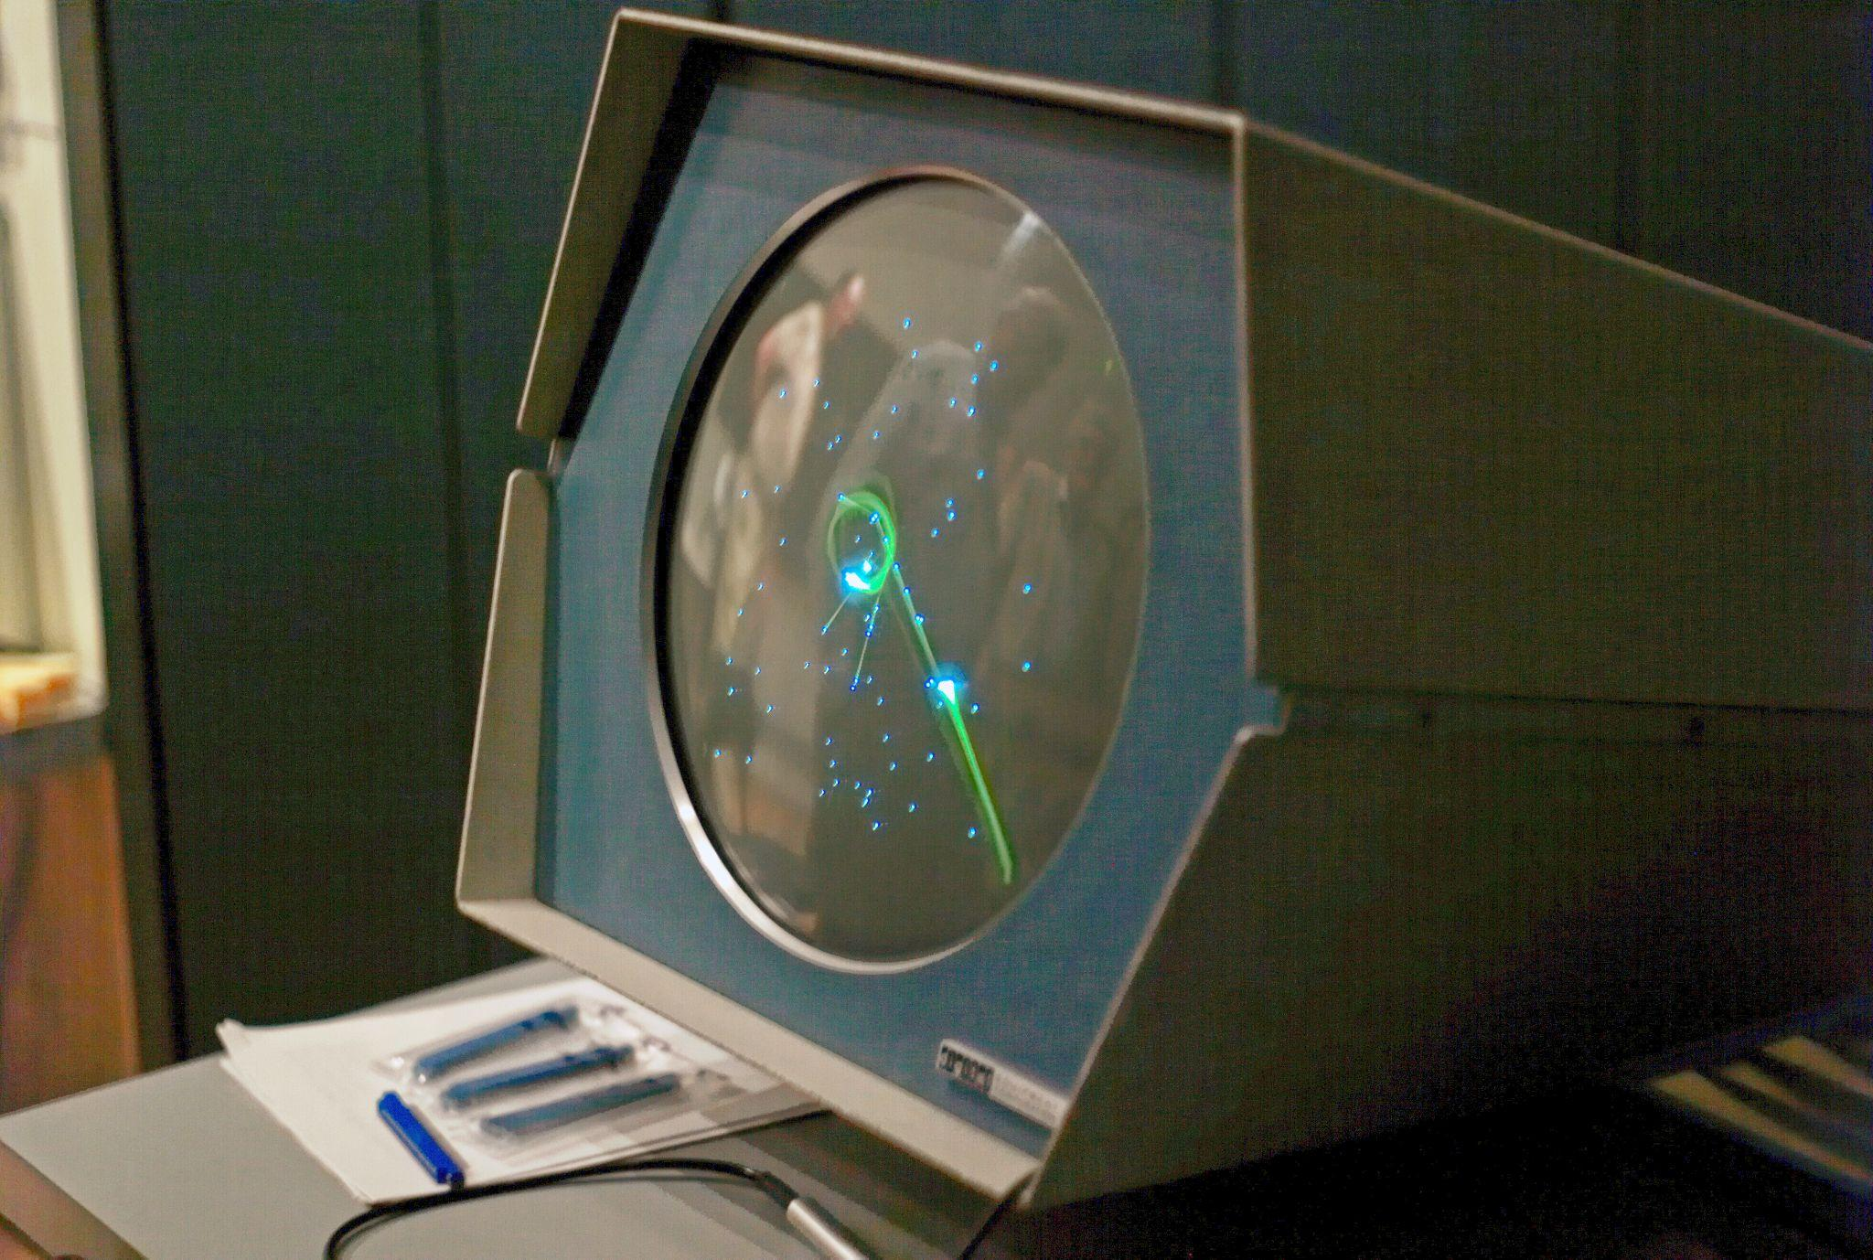
Multiplayer Meets the Online Elite
Plato
© 2022, 2024 Jeannie Novak
All rights reserved.
Credit: Joi Ito (Wikimedia Commons)
Caption: The mainframe game that started it all - Spacewar! (shown running on a DEC PDP-1 minicomputer).

Slide 21
Multiplayer Meets the Online Elite
MUDs
© 2022, 2024 Jeannie Novak
All rights reserved.
Credit: Richard Bartle
Caption: MUD1, considered to be the oldest virtual world in existence, was created by Richard Bartle and Roy Trubshaw in 1978.

Slide 22
Multiplayer Meets the Online Elite
CompuServe
© 2022, 2024 Jeannie Novak
All rights reserved.
Credit: Yahoo

Slide 23
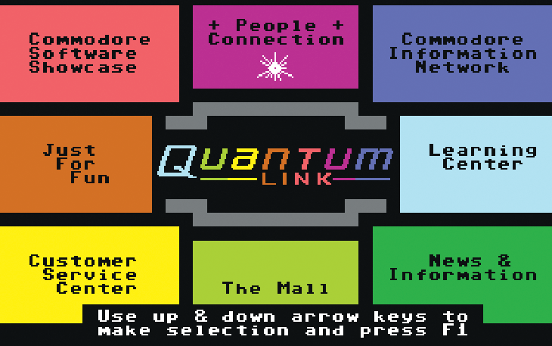
Multiplayer Meets the Online Elite
Quantum Link
© 2022, 2024 Jeannie Novak
All rights reserved.
Credit: Yahoo

Slide 24
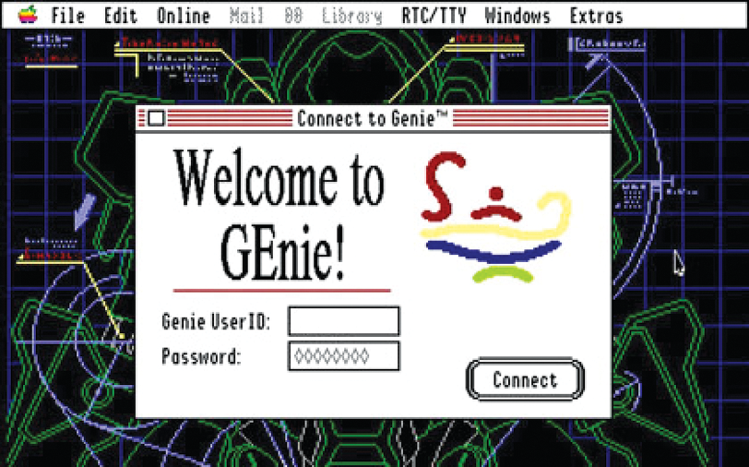
Multiplayer Meets the Online Elite
GEnie
© 2022, 2024 Jeannie Novak
All rights reserved.
Credit: Ken Gagne (Wikimedia Commons)
Caption: GEnie once established itself as the premier online service for multiplayer online games.

Slide 25
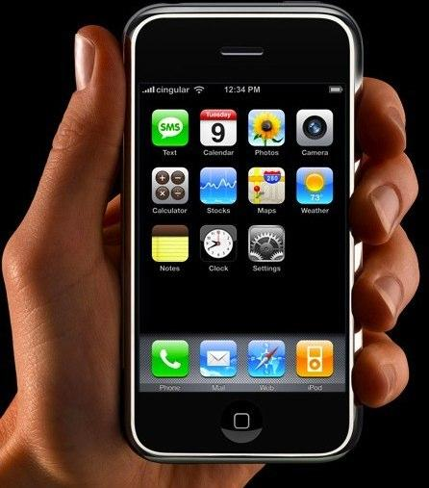
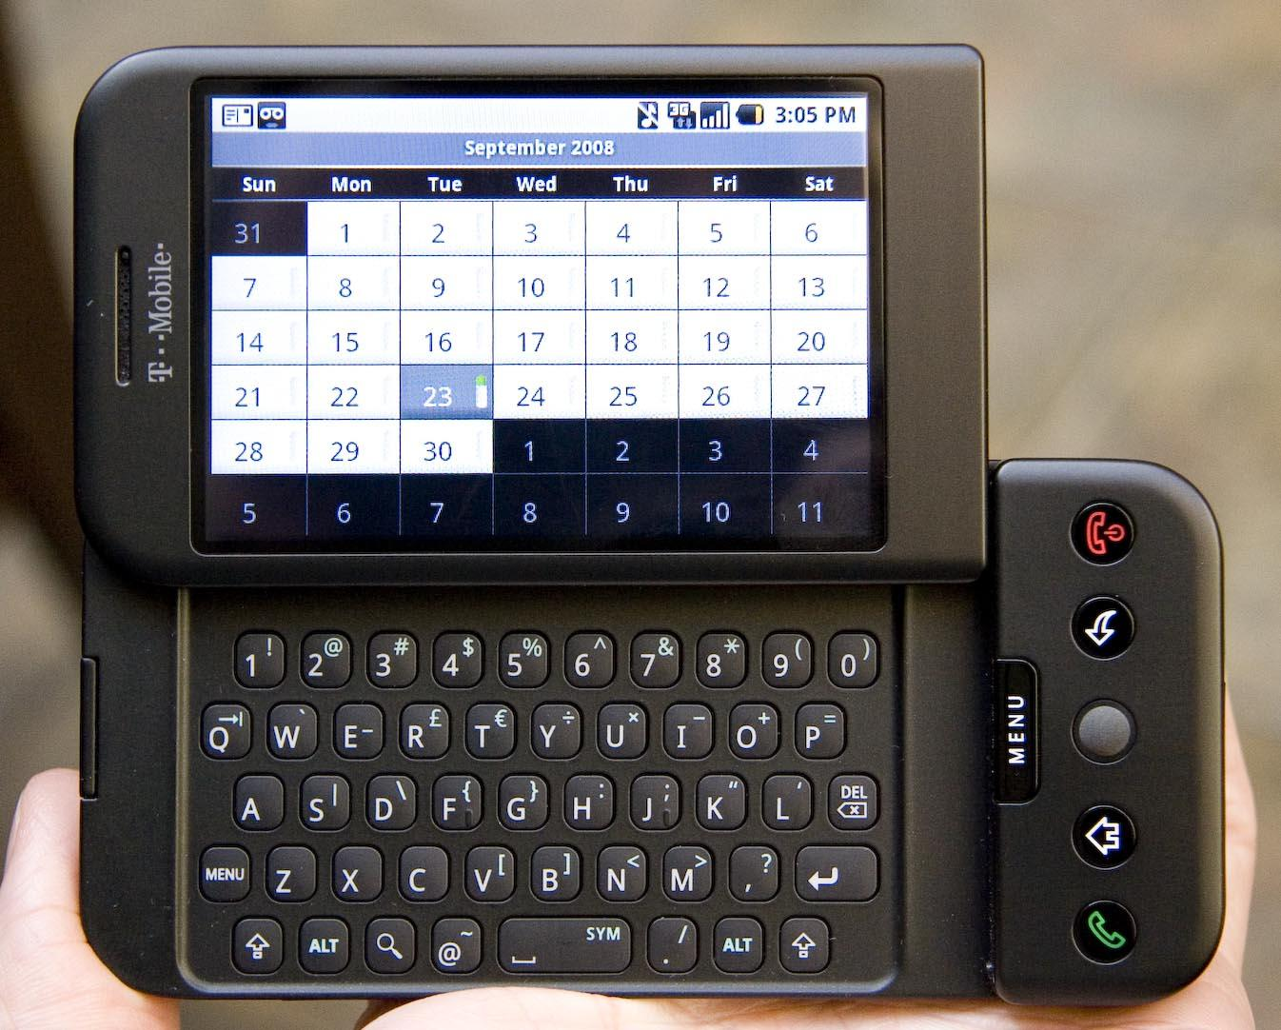
Nomadic Culture
© 2022, 2024 Jeannie Novak
All rights reserved.
Credit: Jason Rhode (Flickr)
Credit: AxelBoldt (Wikimedia Commons)
Caption: Smartphones such as Apple’s iPhone series (first-generation model shown - left) and a variety of Android-based systems (T-Mobile G1 - right) dominate the mobile market.

Slide 26
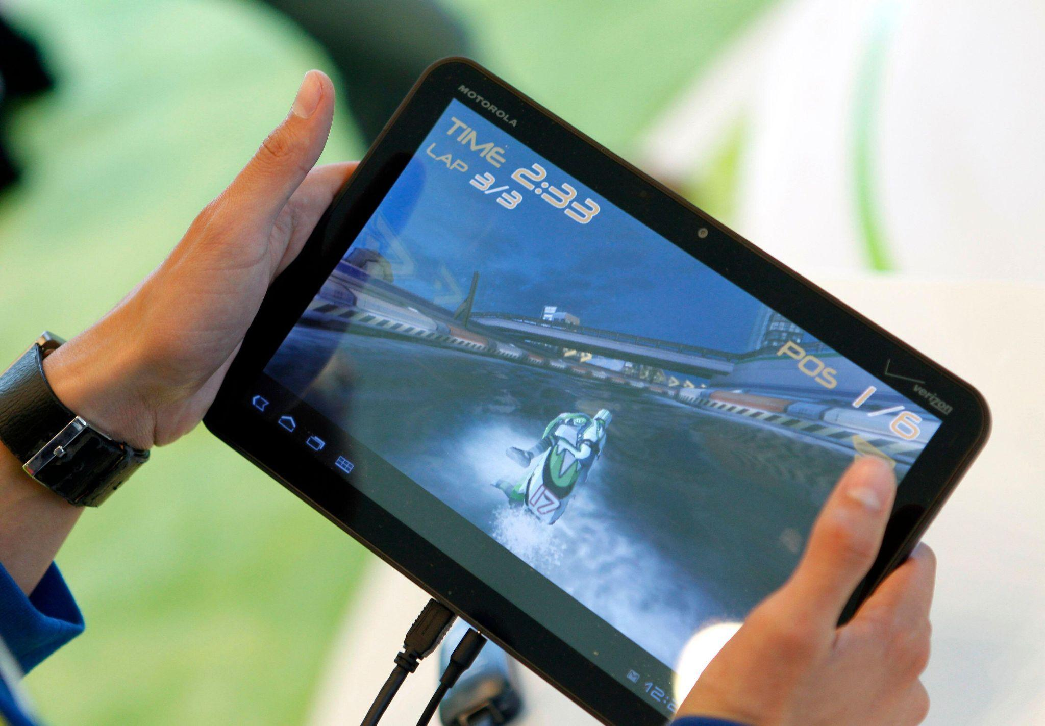
Nomadic Culture
© 2022, 2024 Jeannie Novak
All rights reserved.
Credit: pressureUA (iStock)
Credit: REUTERS/Beck Diefenbach (Alamy Stock Photo)
Caption: Tablet systems such as Apple’s iPad series (iPad 2 - left) and a variety of Android-based tablets (Motorola Xoom - right) are basically larger versions of their smartphone counterparts.

Slide 27
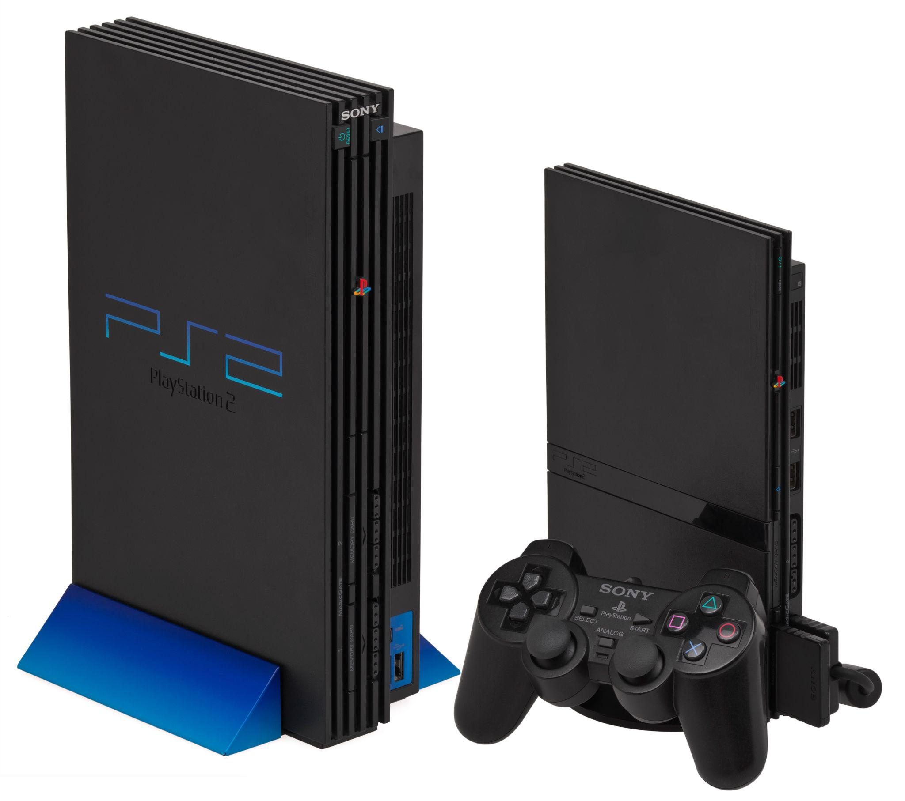
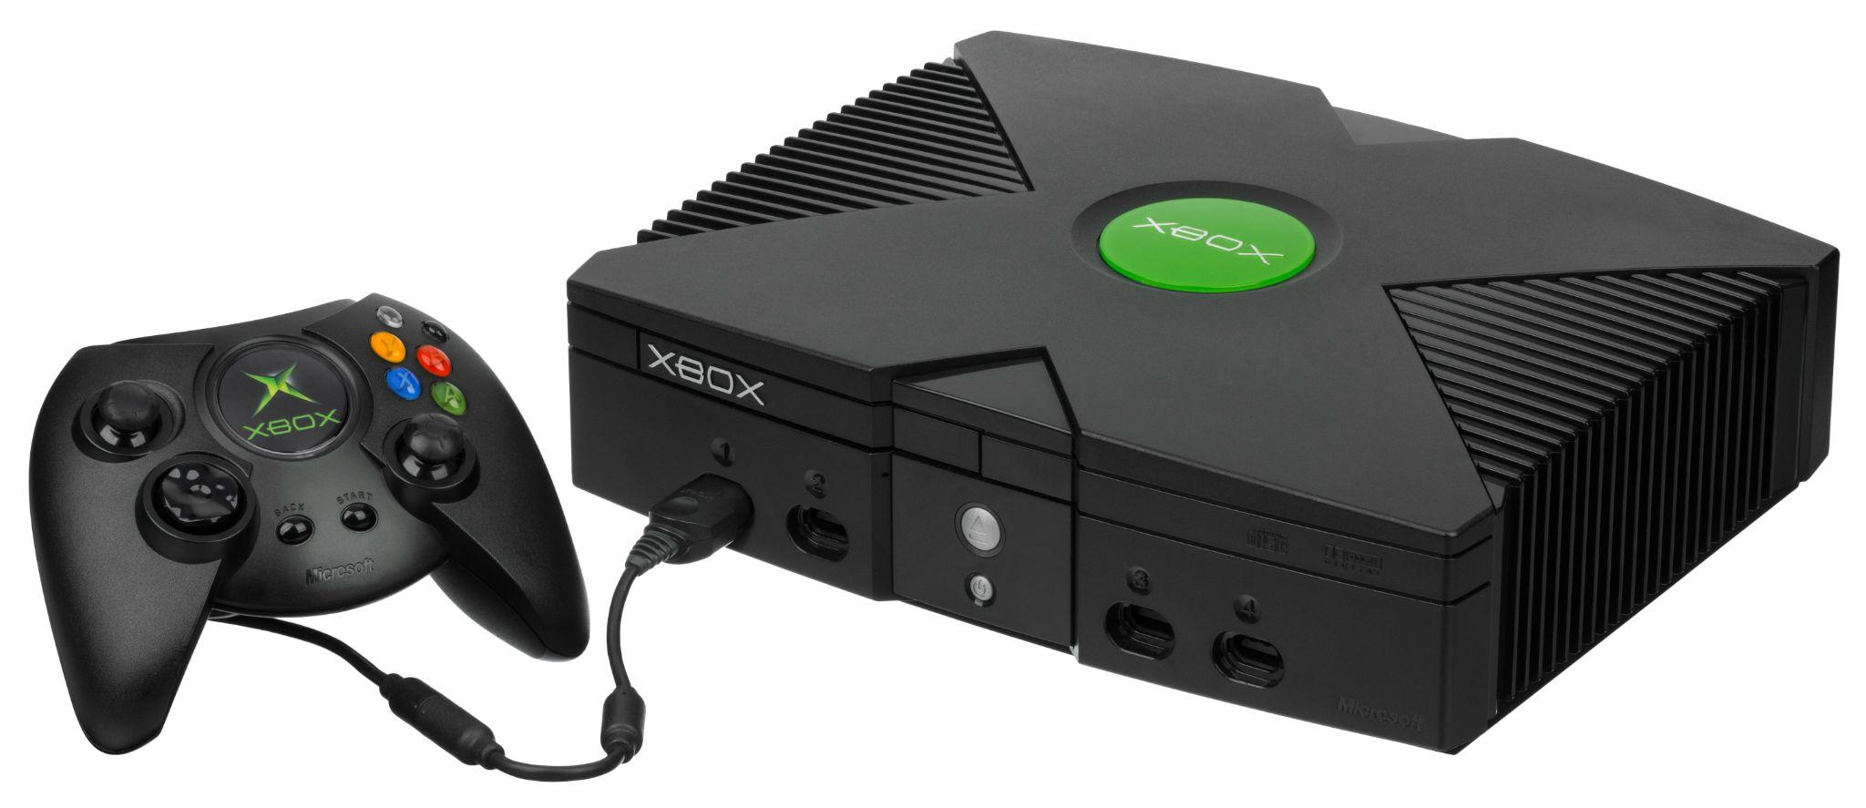
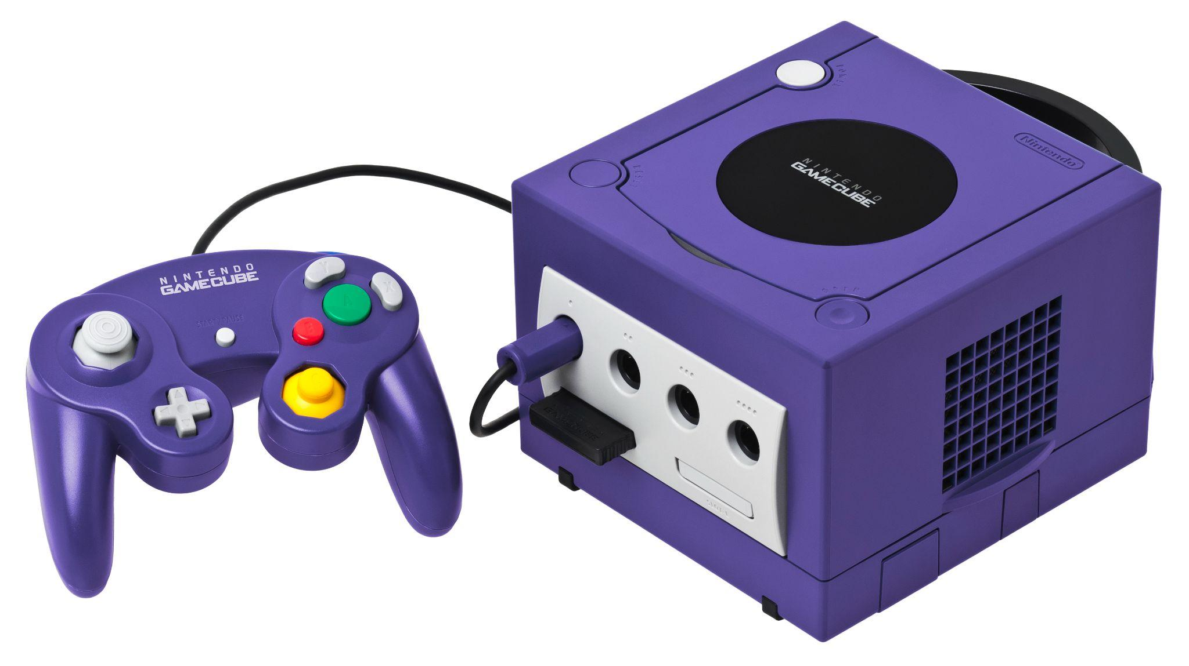
The “Big Three” Console Wars
© 2022, 2024 Jeannie Novak
All rights reserved.
Credit: Evan Amos (Wikimedia Commons)
Credit: Evan Amos (Wikimedia Commons)
Credit: Evan Amos (Wikimedia Commons)
Caption: The PlayStation 2 - left - Xbox - middle - and GameCube - right - consoles were manufactured by Sony, Microsoft, and Nintendo, respectively (the “Big Three”).

Slide 28
CHAPTER 1
© 2022, 2024 Jeannie Novak All rights reserved.
REVIEW EXERCISES
1
What are the key phases and milestones in the history of game development? How has convergence played a role in connecting these phases?
2
Why have some game development companies been more successful than others? How can you apply this knowledge to the current industry?
3
What early games helped attract a larger audience to the industry? Why did they succeed in doing so?

Slide 29
CHAPTER 1
© 2022, 2024 Jeannie Novak All rights reserved.
REVIEW EXERCISES
4
What traditions in early game development are still in existence? How are they appealing and useful to developers and players?
Several theories have been used to explain the decline of the arcade industry and the associated video game slump of the early 1980s in the U.S. Do you agree with any of these theories in particular? Do you have a theory of your own? Is there anything that could have been done to prevent this slump?
5
What was the first video game you ever played? Did it capture your attention? Why? What are some tabletop games that were popular in the past? Do you feel that the thrill of any of these games has been captured in digital form?
6

Slide 30
CHAPTER 1
© 2022, 2024 Jeannie Novak All rights reserved.
REVIEW EXERCISES
7
Choose a time in the history of game development, and pretend you are a developer working in the industry. Knowing the limitations of the time, what type of game would you create?
8
You’ve read about the many eras and phases of the game industry. Are we at the dawn of a new era? Can you predict the primary features of the next phase in game industry history?

